Slide 1
HW2
Dongho Kim
06.27.2024

Slide 2


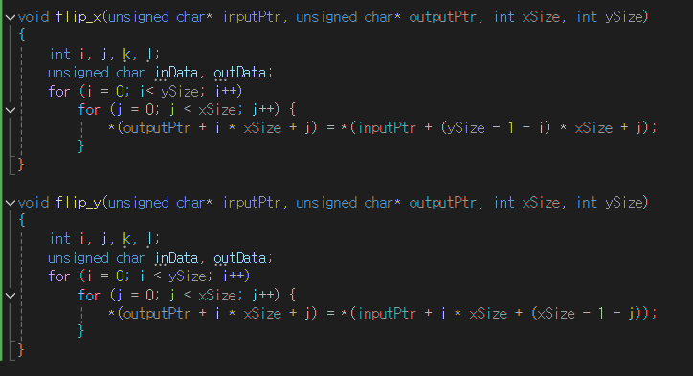


Flip
Flip X
Flip Y

Slide 3
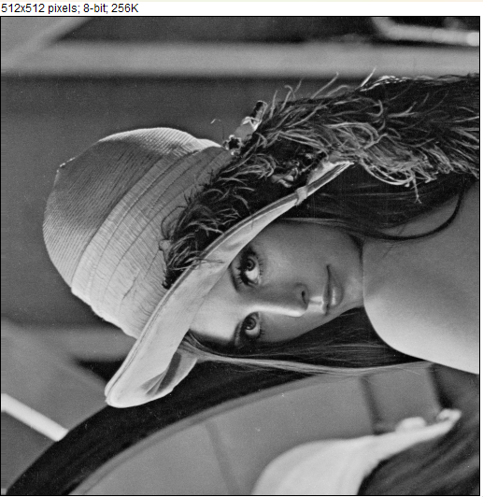
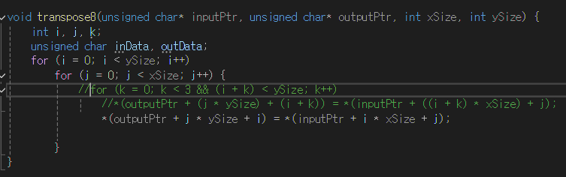


Transpose
One line excuted
20 line excuted

Slide 4
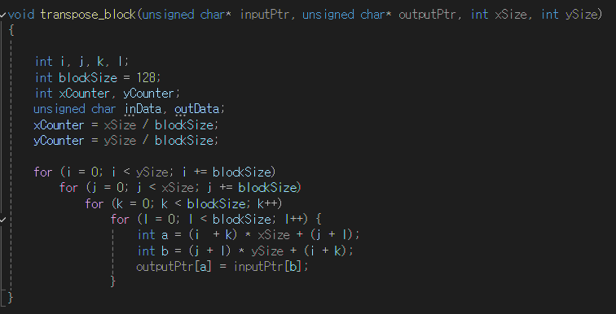



Transpose
Block by Block on 512x512
Transposed Image
Transpose block : 32
Transpose block : 64
Transpose block : 128

Slide 5
Performance reporting
Module Name | Image Size x | Image Size y | Ms Geenric C
Flip8 | 512 | 512 | flipX: 0.347285 / flipY:0.350884
Transpose | 512 | 512 | 0.579003
 | 256 | 256 | 0.112611
 | 128 | 128 | 0.024523
Transpose(blockxblock)
32x32 | 512 | 512 | 0.587459
64x64 | 512 | 512 | 0.548135
128x128 | 512 | 512 | 0.588865
32x32 | 256 | 256 | 0.143009
64x64 | 256 | 256 | 0.136701
128x128 | 256 | 256 | 0.1311180
64x64 | 128 | 128 | 0.033516
32x32 | 128 | 128 | 0.035785

