Slide 1
HW3
Dongho Kim
07.01.2024

Slide 2
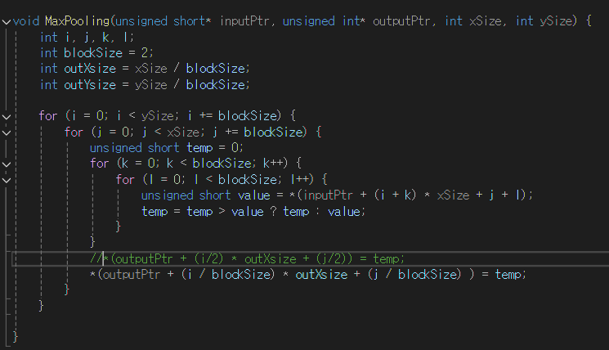
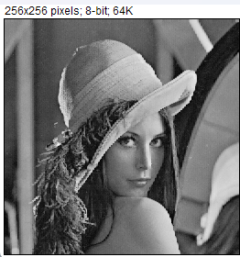

Max Pooling

Slide 3
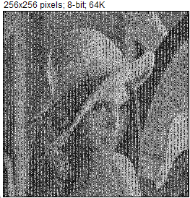
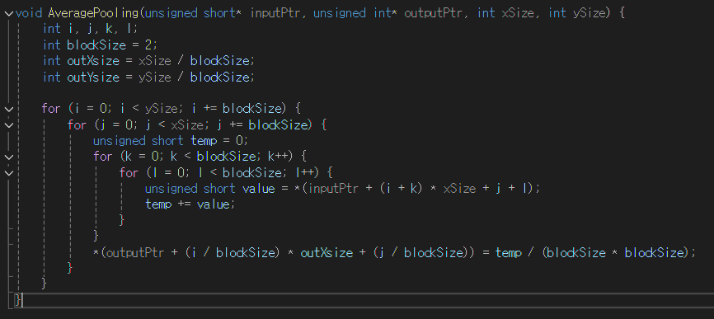

Average Pooling

Slide 4





Matrix multiplication
Size
512 x 512
256 x 256
128 x 128
64 x 64
32 x 32

Slide 5
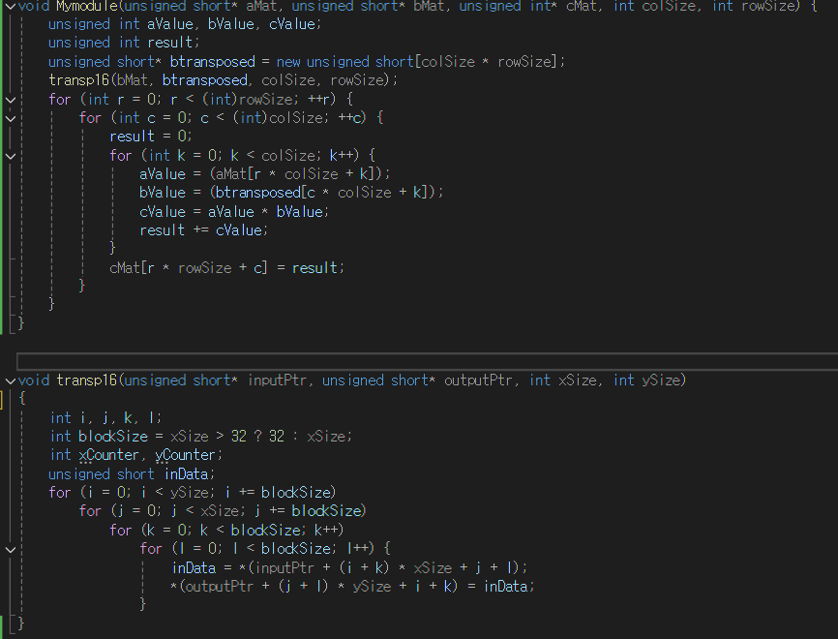
Matrix multiplication using transpose

