Slide 1
HW7
Dongho Kim
2024.07.02

Slide 2
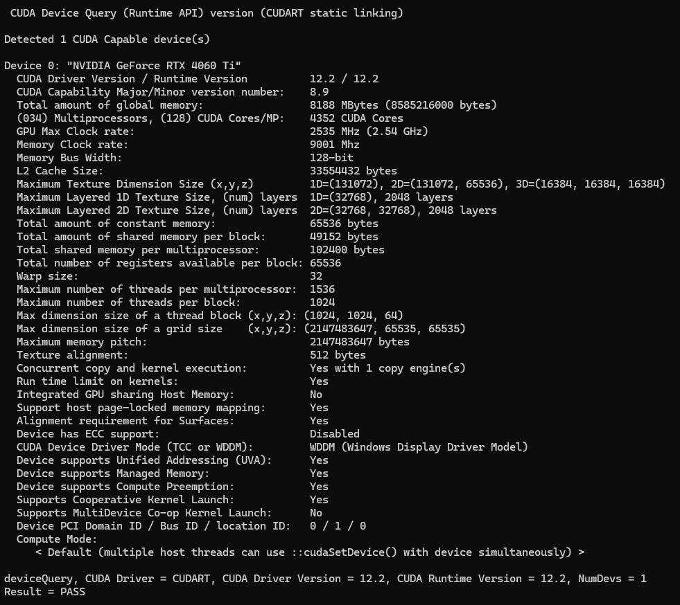
Device Query

Slide 3
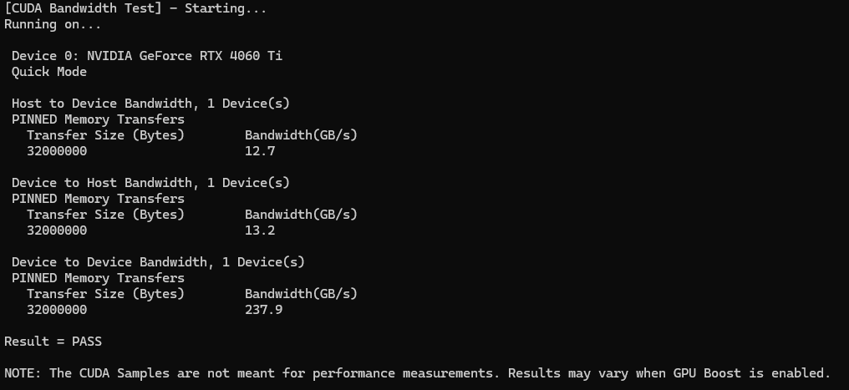
Bandwidth Test

