Slide 1
Detecting Alzheimer's Disease by Applying Convolutional Neural Network to MRI Scans
Team Thinkers
Dongho Lee, Christian Yan, Luke Mostert
with Prof. Barnabas Bede and Yilin Wu

Slide 2
Outline
Overview of CSP200 (dataset, accuracy)
Gained access to ADNI
Converting NiFTI (3D MRI data) into multiple png files (NiBabel)
Linking CSV metadata (age, maybe sex) with the png images to enhance learning
Applying OpenCV to find keypoints in brain scans and compare them to each other
Future plans

Slide 3
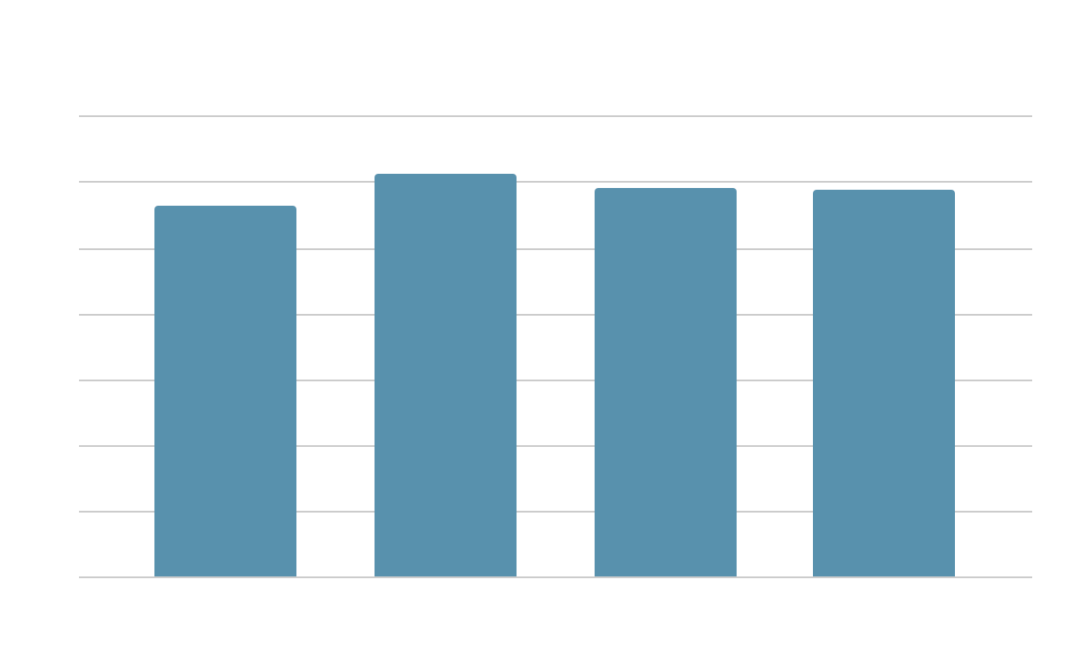
Continuing from CSP200
In CSP200, we have reached an accuracy of ~80% via a pseudo-ensemble (voting by average) of:
(1) VGG19
(2) ResNet50
(3) our own convolutional neural network.
A dataset from Kaggle consisting of 5121 MRIs was used for training.

Slide 4
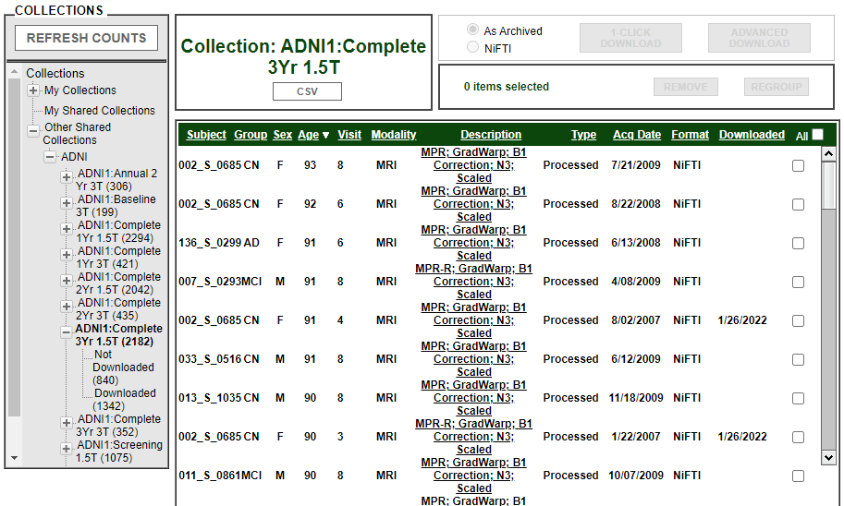
Access to ADNI
(Alzheimer’s Disease Neuroimaging Initiative)
Provides MRI data in NiFTI (3D) or DCM (2D)
Premade archives come in NiFTI format
Notes:
Last semester in CSP200 we had requested access to Alzheimer’s Disease Neuroimaging Initiative, or ADNI. We were able to gain access to thousands of 3D and 2D MRI data.
There is a list of premade archives for us to download, and we first chose to download the one with 2,182 NiFTI files

Slide 5
The NiFTI Data (featuring NiBabel)
Our deep learning algorithm requires 2D image input
NiFTI files (.nii)
NiBabel
NumPy arrays
matplotlib
Regular image files (.png)
VGG19 or OpenCV:
“suitable for training?”
YES
NO
(discard)
Notes:
Since the input for our deep learning algorithm is in a regular 2D image format like png, NiFTI files will need to be converted to png beforehand. We will use a specialized library called NiBabel which allows us to read NiFTI files into NumPy arrays, then feed it into a pre-trained VGG19 algorithm. The VGG19 model will take a look at each horizontal slice of the MRI and decide to save it as a png file or discard it. Each NiFTI file yields 6-8 png files, which roughly give us 15,000 training images.

Slide 6
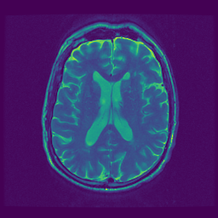
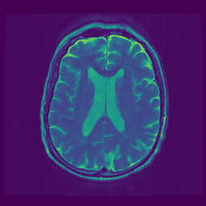
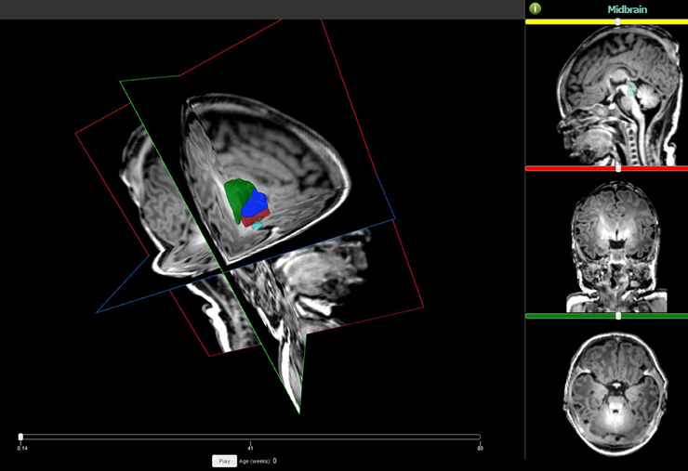
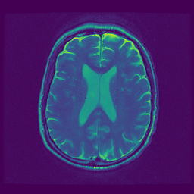
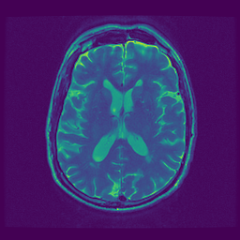
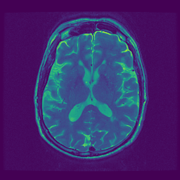
NiFTI to PNG
The core NiFTI to PNG algorithm is complete
The VGG19 transfer learning algorithm is at 97% accuracy
and will be incorporated into the NiFTI-to-PNG conversion
Notes:
And this is what the result looks like he image on the left is a NiFTI file opened with a viewer. On the right are the horizontal slices that were exported in png format.
Right now, the NiFTI to png algorithm is complete, but we still need to figure out how to put the VGG19 model into it to automatically select the right layers for training.

Slide 7
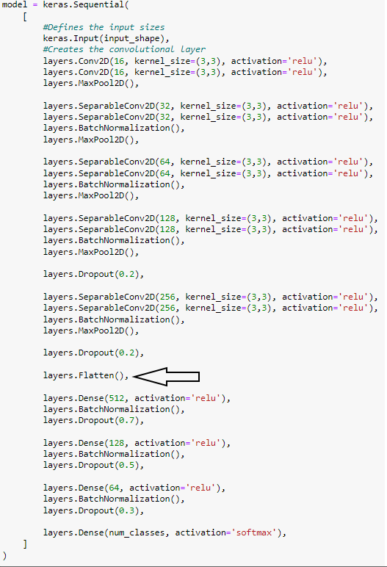
The CSV Metadata
For a new addition to our project we want to try and add new parameters.
We will start with adding age in as parameter.
Alzheimer's tends to happen from ages 65+ but is not restricted to that age group.
Then possible move onto adding more parameters such as sex.
We will be adding the data near the end of our model on a flattened layer.

Slide 8
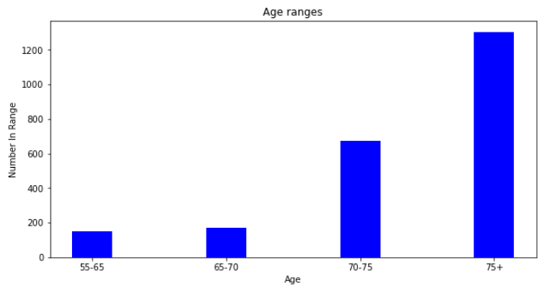
Age range for CSV Dataset

Slide 9
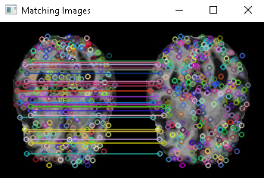
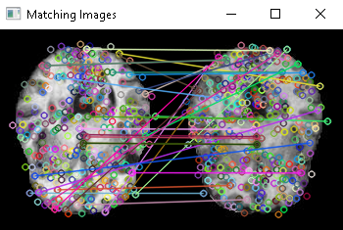
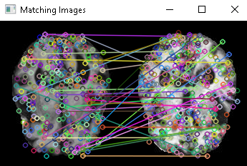
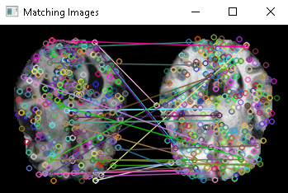
Application of OpenCV
Using OpenCV we are trying to detect features in the brain scans and use them to increase the accuracy.
As of right now using the SIFT (scale-invariant feature transform) algorithm as our first one, we are detecting keypoints in two images and comparing them to each other.
The lines on these images represent the similarities of the two scans, the shorter the line the more accurate the similarity
We will be scoring the images based on average length of the lines in order to try and increase accuracy.
same scan
non-dem vs non-dem
dem vs dem
dem vs non-dem
Notes:
we are using OpenCV (computer vision and machine learning software library) to detect features in the scans. Right now using the SIFT (scale-invariant feature transform) algorithm we are finding the keypoints in the image and comparing them to eachother, as of now we have only done this on 2 different brain scans as you can see below we compared the same brain, a non demented vs a non demented, a demented vs demented, and a demented vs non demented. The circles you see on the images are the keypoints and the lines connecting them are showing similarity. The shorter the line the more similar as you can see with the scan on the left of the same brain all the lines are straight and the shortest they can be meaning very similar in this case identical. We will be scoring these images based on the average length of lines in order to try and increase our accuracy

Slide 10
Future Plans
Week # | Dates | Plans
5 | Jan 31-Feb 6 | Create a PNG dataset from the archive
6 | Feb 7-13 | Link CSV metadata with the PNG dataset
7 | Feb 14-20
8 | Feb 21-27 | Add OpenCV SIFT algorithm to the ensemble
9 | Feb 28-Mar 6 | Research K-means clustering algorithm
10 | Mar 14-20 | Implement K-means algorithm (OpenCV: cv.kmeans())
11 | Mar 21-27
12 | Mar 28-Apr 3 | TBD
13 | Apr 4-10 | TBD
Notes:
As you can see these are our future plans, in the next 2 weeks we will be creating a PNG data set and linking the CSV data with that dataset, we will also be adding the openCV work into the ensemble, we then will be researching and implementing K-means algorithm

Slide 11

THANK YOU
questions?
Notes:
Thank you for listening to our presentation, we will take any questions you may have now

