Slide 1
Team Thinkers: Milestone #2
Detecting Alzheimer's Disease by Applying Neural Network Models to MRI Scans
Dongho Lee, Christian Yan, Luke Mostert
Professors Barnabas Bede and Yilin Wu

Slide 2
OUTLINE
ADNI Dataset
Extra Parameter
01
02
Image scoring and classification
Future Plans
03
04
PNG files extracted from archives
Adding an extra parameter to our models.
Plans for the rest of CSP250
Scoring the similarities and classifying if they are demented or not

Slide 3
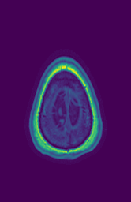
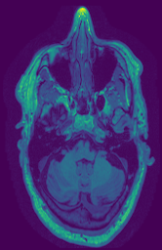
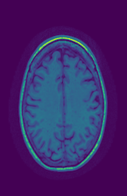
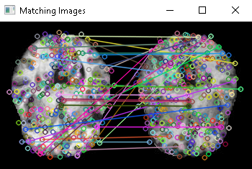
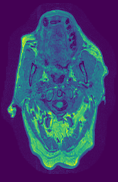
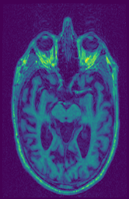
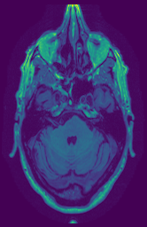
Generating the Dataset Using SIFT
SIFT algorithm
Accuracy < 25%
Notes:
First off, the most important task for me was to generate a proper PNG dataset from the 3D MRI data stored in NiFTI files, since our neural networks require PNG input. Our first approach was to use the SIFT algorithm.
This algorithm tries to look for “keypoints” which are like the defining parts of an image, shown as little circles on this image on the left, then compare images based on where these keypoints occur, as shown by these lines connecting the little circles.
Unfortunately, the algorithm wasn’t exactly good at this with brain MRIs, and was less than 25% accurate. So we needed to take a different approach.

Slide 4
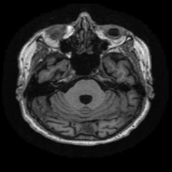
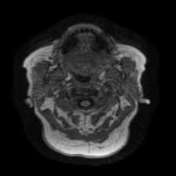
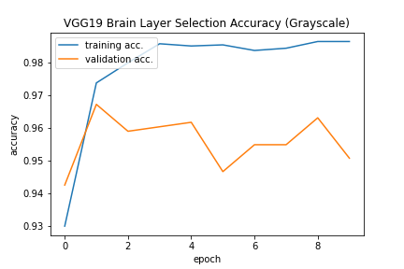
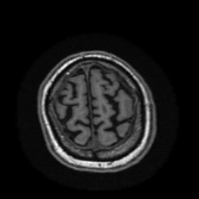
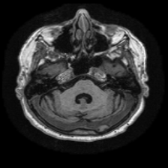
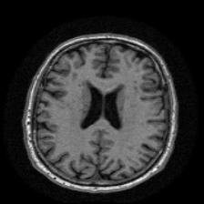
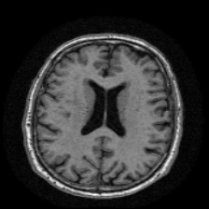
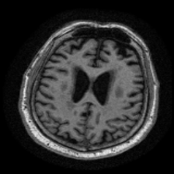
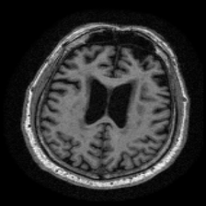
Training VGG19 to Use for Dataset Generation
1936 Not Suitable
1724 Suitable
Notes:
The alternative approach was to use the VGG19 transfer learning, which has been tried and tested last semester. We tried training the VGG19 algorithm using PNG files that were hand-picked based on how they looked. And indeed the accuracy reached 95% in less than 10 epochs of training. So most of the time it could correctly differentiate suitable images from unsuitable images. There still were a few problems, and I will show you how I solved them in the next slide.

Slide 5
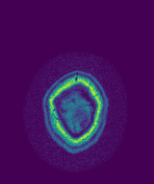
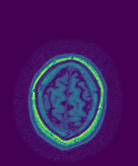
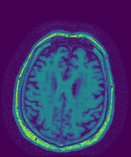
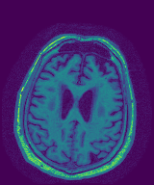
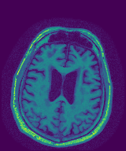
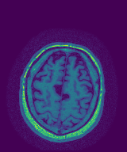
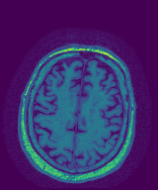
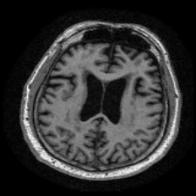
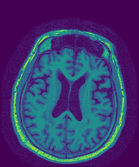
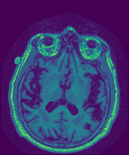
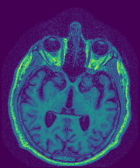
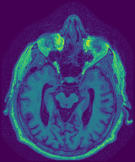
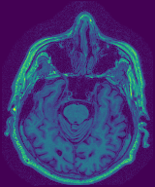
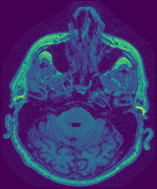
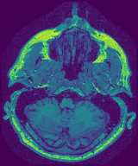
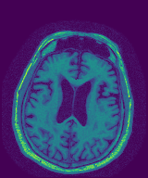
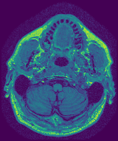
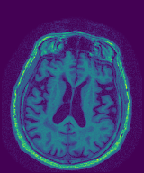
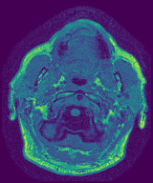
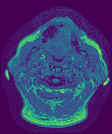
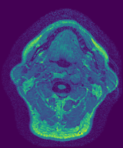
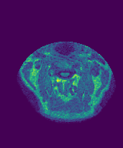
Generating the Dataset Using VGG19
Shape: (width, height) → (None, 224, 224, 3)
2D slice from NiFTI input tensor shape for VGG19
2284 Demented
1011 NonDemented
3 ADNI archives 3295 images
VGG19
Candidate
slices
Take slice at
⅖-median
Notes:
The first problem being that the data shape from NiFTI files and the input shape for the VGG19 were very different…
It took us a few days to figure it out but eventually we got the code to feed NiFTI into the VGG19 algorithm.
The next problem was that the VGG19 algorithm would pick the wrong MRI slice 5% of the time, which is pretty significant considering that our archives had about 3300 MRI files.
The solution was to let the algorithm pick out multiple candidate layers, then choose the ⅖-median. So if the VGG19 algorithm picks 6 candidates, I would multiply (6 by ⅖) and get 2.4.
Convert this to int, ultimately selecting the one at index 2.
So the dataset generation was complete at this point, and now we needed to train our ensemble deep learning model from CSP200.

Slide 6
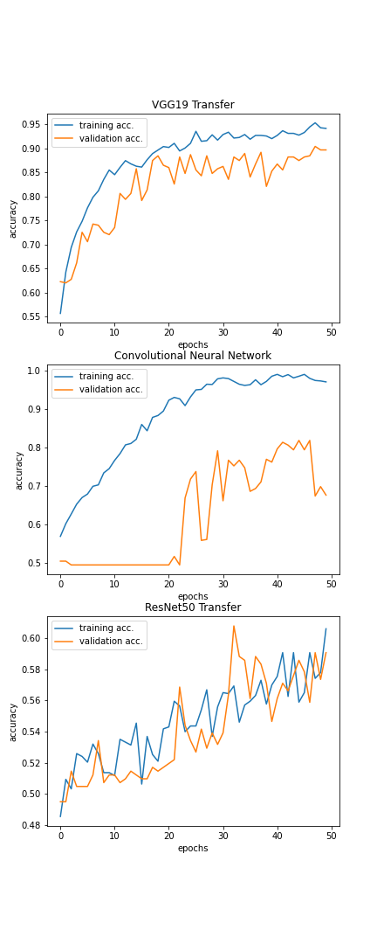
Actual Training with ADNI Dataset
1034 Demented (2284-1250)
1011 NonDemented
3 ADNI archives 2045 images
Ensemble consisting of 3 models:
VGG19 (87%) > CNN (68%) > ResNet50 (59%)
Notes:
Our new dataset was imbalanced, with about 2 demented brains per 1 nondemented. So some demented brain images were excluded from the generated dataset to bring the number of demented vs nondemented brains close to 1:1. Then the training was done for 50 epochs without the age parameter, and the results were mixed between different models.
VGG19 performed best, whereas the convolutional neural network and ResNet50 were struggling a lot. The overall prediction by the ensemble was practically being dictated by the VGG19 network alone,
And it showed a decent accuracy of 85%, compared to the accuracy of 80% from the previous semester.

Slide 7
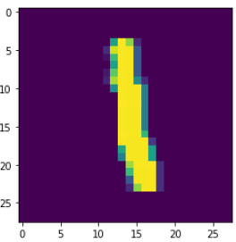
Adding an extra parameter
EXPLORTORY
We are testing using the MNIST dataset
We do this by adding data near the end of the model
Because the accuracy is so high we randomized the extra data instead of properly assigning it.

Slide 8
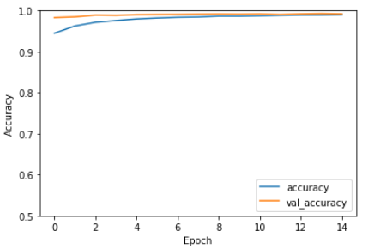
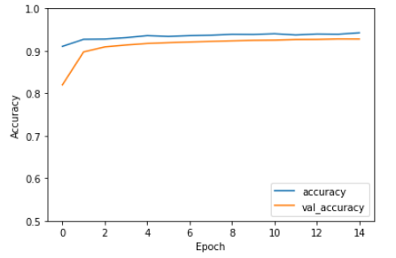
Comparison
Without extra parameter 99.5%
With extra parameter 94.4%
DESCRIPTIVE
CAUSAL
Mars is actually a very cold place
Jupiter is the biggest planet of them all

Slide 9
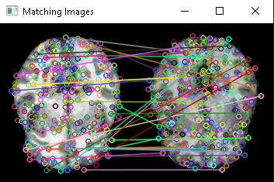

Image Similarity
Similarity scores
DESCRIPTIVE
CAUSAL
Mars is actually a very cold place
From our previous presentation we were working with finding similarities in images as shown by the brain scans on the left.
The image under is a snip from code showing the score we got with the mean of the euclidean distances of each keypoint
These averages are not helpful on their own so we are having to try things in order to make them useful to our project
Jupiter is the biggest planet of them all
Notes:
Since our previous presentation we have been working on scoring the similarities of the brain scans, using euclidean distance we can get the mean of all of the distances of the keypoints which will be the score, the output in the snip above is this mean and that is the number we will be working with, that 732 is just for this one image as each pair has a different similarity score, the smaller the number the more similar the images, ranging from about 700 to about 1200, the problem with this is that the number doesn't do much for us on its own so we have to find ways to make it useful

Slide 10
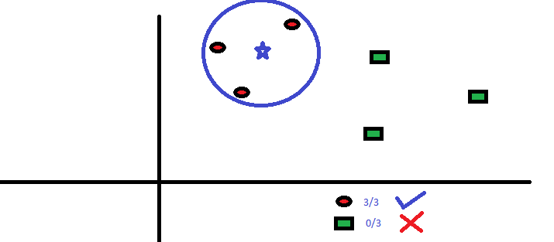
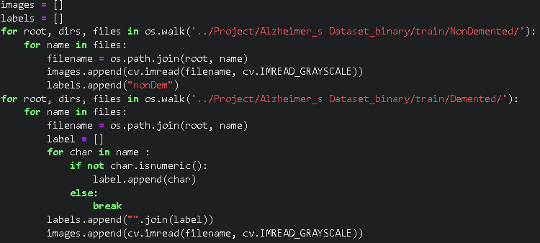
Image Classification
Over the past few weeks we have done some research with K Nearest Neighbor in order to see if it would be helpful in classifying images as demented or non-dememted using the scores
Another thing that we are going to try is, instead of using KNN, just finding the average of all of the demented and all of the non-demented and comparing the scores with just that one number
Notes:
Over the past few weeks we have researched and tested with K Nearest Neighbors which, in theory, will find the K nearest scores and classify if it is demented or non demented with KNN.
Another method we are going to try is just getting the average for all the demented and nondemented images and comparing with just that one number instead of using KNN
The code snip is just going through the files and separating each images with a label of if it is demented or not going forward we will be using this for the classification and scoring each image

Slide 11
Future Plans
Week # | Dates | Plans
9 | Feb 28-Mar 6 | Access to more ADNI archives, tune or reaplce CNN and ResNet50 (VGG19 works well)
10 | Mar 14-20 | Implement K-means algorithm (OpenCV: cv.kmeans()) Add age parameter to the ensemble algorithm
11 | Mar 21-27
12 | Mar 28-Apr 3 | TBD
13 | Apr 4-10 | TBD
Notes:
Here are our future plans, we look to access more ADNI archives, and tune our CNN and ResNet50, we are also looking to implement K-means and add the age parameter to the ensemble

Slide 12
THANK YOU
Thank you for listening!
Are there any questions?

