Slide 1
Team Thinkers: M3
Detecting Alzheimer’s Disease by Applying
Neural Network Models
to MRI Scans
Dongho Lee, Christian Yan, Luke Mostert
With Professor Barnabas Bede

Slide 2
Outline
Expanded Dataset from ADNI
Evaluation: Confusion Matrix and the False Negative Rate
Image Augmentation Using Age
K-Nearest Neighbors
Challenges

Slide 3
Expanded Dataset from ADNI
1034 Demented
1011 NonDemented
3 ADNI archives 2045 images
4643 Demented
2018 NonDemented
6 ADNI archives 6661 images
3 images/NiFTI file
Dataset unbalanced by a ratio of 2.2 : 1 … accuracy will not be a good measure
E.g. a model that always answers “demented” for any input will have an accuracy of 2.2/(2.2+1) = 68.8%
Notes:
Up until our second milestone, we’ve only been using 1.5T MRI scans (where Tesla is a unit of magnetic field strength) But ADNI also provides 3 Tesla MRI scans and they are similar to a 1.5 Tesla scan, so we decided to add 3 more 3 Tesla archives from ADNI to our collection. But there weren’t many 3 Tesla scans and the number of exported images didn’t reach 3000 even when we put all 6 archives together. We wanted to use more images than we had in the last semester (which was 5000 images), so we decided to export a maximum of 3 images per scan.
Since a NiFTI file is represented in 3D, there are many layers that look very similar but different in subtle ways. Not only would this increase the number of images itself, but also increase the robustness of the model, by teaching what differences to ignore (when seeing different layers of the same brain) and what differences to pay attention to (when seeing images of different brains).
But this also meant that now the accuracy metric was not a good measure of the quality of our model, since the dataset was very unbalanced by a ratio of 2.2:1. For example, if our model answered demented for any input, we would get an accuracy of around 70%. To avoid this, we needed to introduce the confusion matrix to evaluate our model.

Slide 4
Evaluation: Confusion Matrix and the False Negative Rate
There are several values that can be derived from the confusion matrix
General measurement:
F1 score = general performance of the model (combines sensitivity and precision)
Specific measurement:
False Negative Rate = the likelihood of a demented patient to go undetected
 | Predicted to be Not Demented | Predicted to be Demented
Not Demented | True Negative | False Positive
Demented | False Negative | True Positive
▷ Reducing the False Negative Rate means we miss as few demented patients as possible
Notes:
Our confusion matrix looks something like this shown on the right. Using the four values in this matrix, we can create many different measurements.
Our general measurement is the F1 score, which is the harmonic mean of sensitivity and precision and it can be a good substitute for accuracy in a scenario with an unbalanced dataset. The F1 score should be close to 1 in a good model.
For our more specific measurement, we chose based on what you would want in a diagnosis procedure for Alzheimer’s disease. If you think about it, the last thing you want is a situation where demented patients go undetected and don’t receive treatment. A positive case getting a negative prediction, is called a false negative, so our decision was to target for a low false negative rate.
Reducing the false negative rate means we miss as few demented patients as possible.

Slide 5
Image Augmentation Using Age
Adding the extra parameter at the start.
Adding pixels to the top of the image based off the age of the patient.
How much it helped depended on the amount of added rows to the image.

Slide 6
Time and Computer Specifications.
Adding the extra data took only about 5 minutes.
Each Epoch took ~21 seconds.
Running the 300 epochs took a little below 2 hours.
Hardware Specifications.
GPU - NVIDIA GeForce RTX 2070.
CPU - AMD Ryzen 7 2700 Eight-Core Processor 3.20GHz.
RAM - 32GB DDR4 2200MHz.

Slide 7
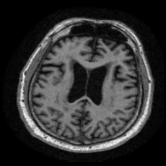
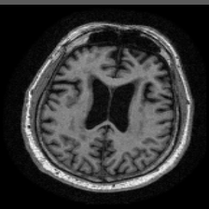
No added data vs. Added data
Demented with no Added Paramter
Demented with Added Parameter

Slide 8
Results of the added data.
Added Rows | 30 Epochs(validation accuracy) | 300 Epochs(validation accuracy)
0 | 88.73% | 90.10%
1 | 93.72% | 88.22%
3 | 93.50% | 88.00%
5 | 94.87% | 96.32%
* using the accuracy+AUC metrics when training (verified by the false negative rate) -
Although theoretically only AUC is the correct choice in a scenario with an unbalanced dataset

Slide 9
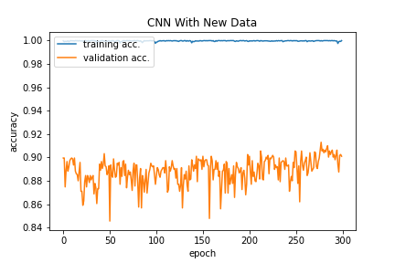
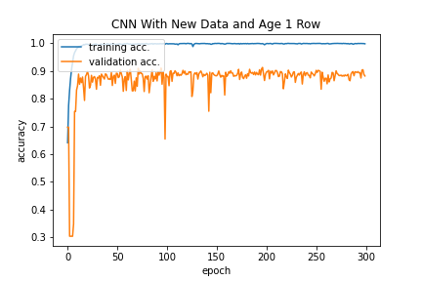
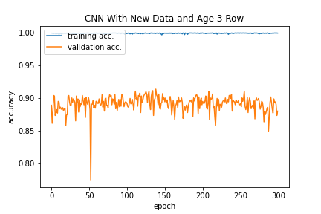
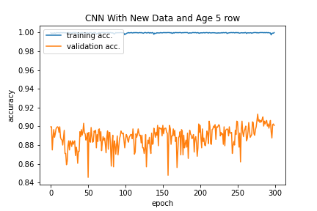
300 Epoch Runs

Slide 10
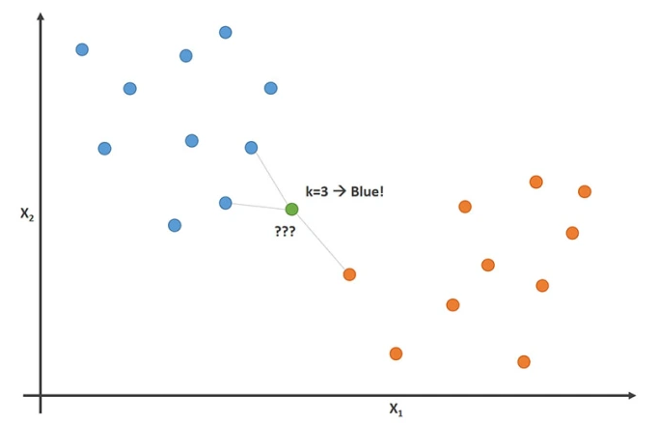
K- Nearest Neighbors (K-NN)
K-Nearest Neighbors or K-NN is a supervised machine learning algorithm where a piece of data is compared to its ‘k’ nearest neighbors in order to classify that data.
The image to the right shows a ‘k’
of 3, meaning it will check against
the 3 closest points.

Slide 11
How we used K-NN
Due to the large dataset sampling was required in order to cut down the time it took to score the images.
After scoring the images and putting that data into a matrix we then used the K-Nearest Neighbors algorithm on this data in order to classify the images as demented or non-demented based on these scores.

Slide 12
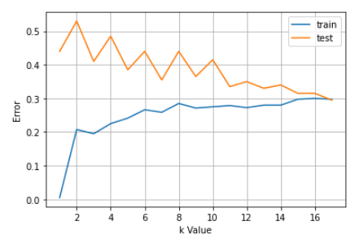
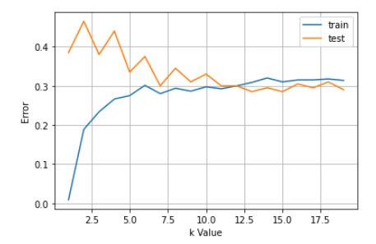
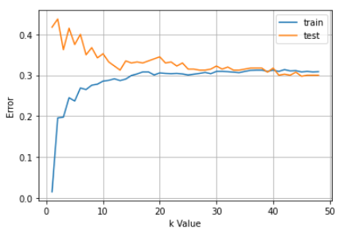
1000x50 ~70% 15 minutes
1000x100 ~71% 40 minutes
1000x150 ~71% 2 hours
2000x1000 ~70% 12 hours
Notes:
Some reasons for this accuracy is that the scores for these images are all too similar to eachohter meaning KNN will take the closest but since those closest are all mixed up it will be inaccurate in classifying demented or non demented

Slide 13
Challenges
Adding in the extra parameter in the middle of the model caused multiple issues. Which is why we swapped to augmenting the data and adding the strips to each image.
Anaconda and the various machine learning libraries were not installed on the Archimedes machine (hopefully we can gain access to this machine in the future to run more epochs more quickly)
The amount of time image comparisons were taking.

Slide 14
Thank You!
Any Questions?

