Slide 1
HCP 3T and 7T for Young Adult Download Tutorial
Dong-Hui Song
Email: donghuipsy@gmail.com
Homepage: https://donghui1119.github.io/donghui/
State Key Laboratory of Cognitive Neuroscience and Learning
Beijing Normal University
Jan.27.2022

Slide 2
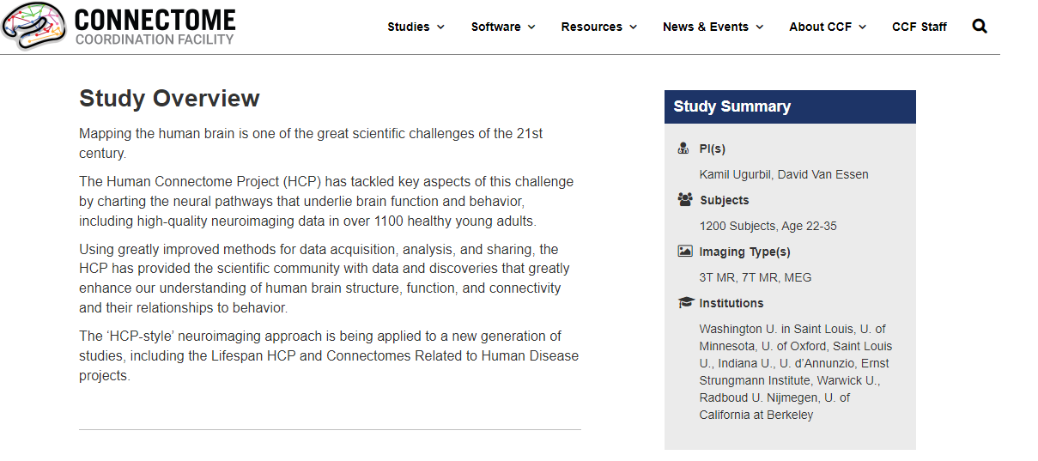
Overview
All About HCP
https://wiki.humanconnectome.org/display/PublicData/HCP+Wiki+-+Public+Data
Healthy Young Adult Studies
https://www.humanconnectome.org/study/hcp-young-adult

Slide 3
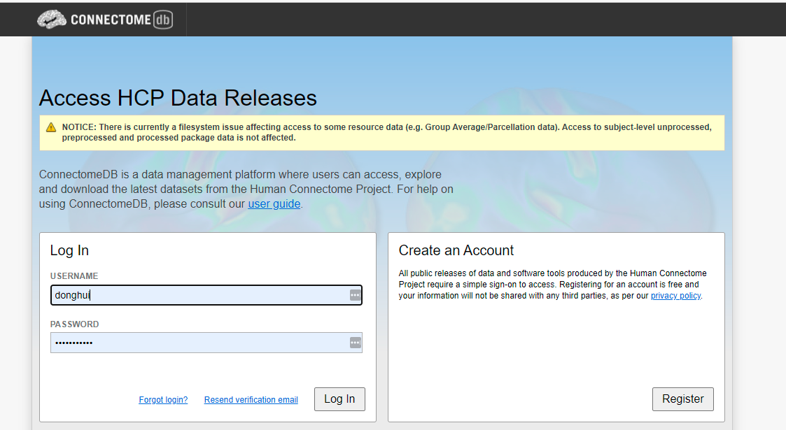
1. Registering ConnectomeDB
https://db.humanconnectome.org/app/template/Login.vm;jsessionid=7B2CE8B12CD52F5C9713DC5551E9B389

Slide 4
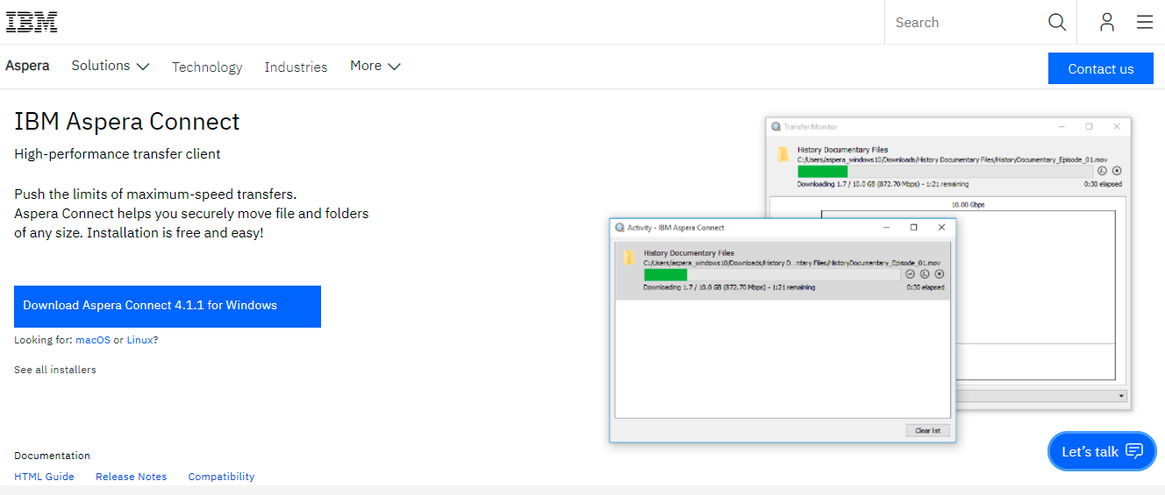
2. Configuring IBM Aspera Connect
2.1 Downloading IBM Aspera Connect
2.1.1 Windows
https://www.ibm.com/aspera/connect/
2.1.2 Linux
https://d3gcli72yxqn2z.cloudfront.net/connect_latest/v4/bin/ibm-aspera-connect_4.1.1.73_linux.tar.gz

Slide 5
2.2 Installing and configuring IBM Aspera Connect
2.2.1 IBM aspera connect on Windows
https://download.asperasoft.com/download/docs/connect/3.7.4/user_win/webhelp/index.html#dita/installation.html
2.2.2 IBM aspera connect on Linux
https://www.ibm.com/docs/en/aspera-connect/4.1?topic=suc-installation

Slide 6
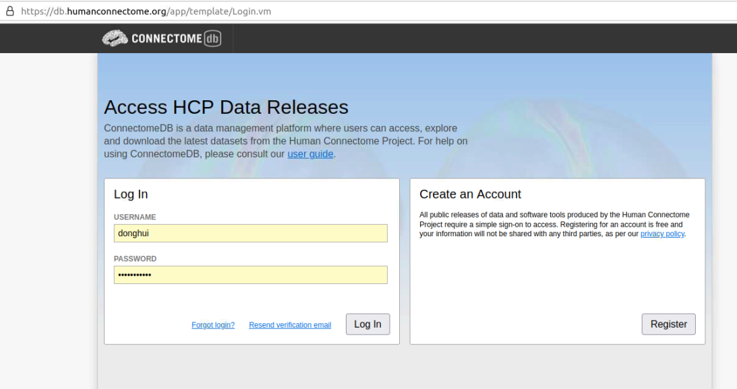
3. Downloading Data
3.1 Log in your account

Slide 7
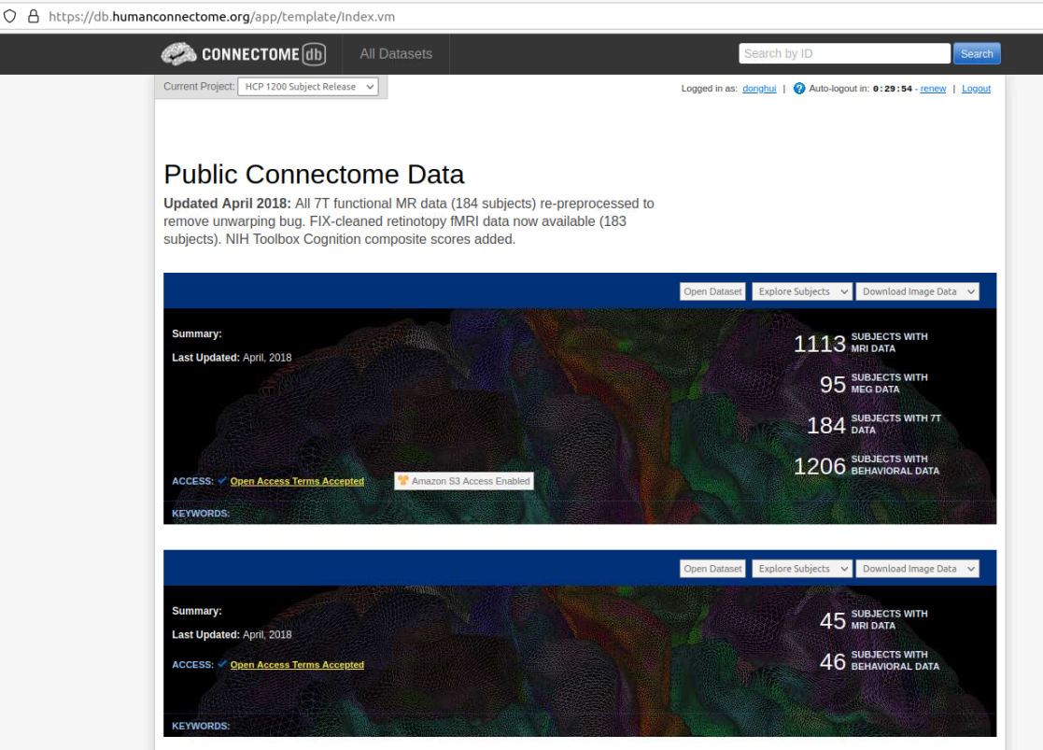
3.2 Finding the data your want to download

Slide 8
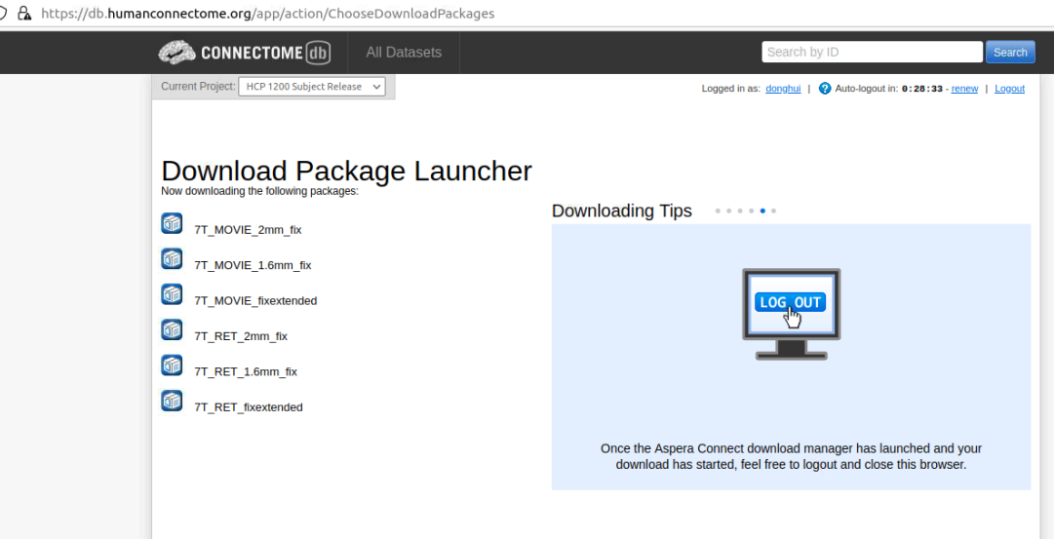
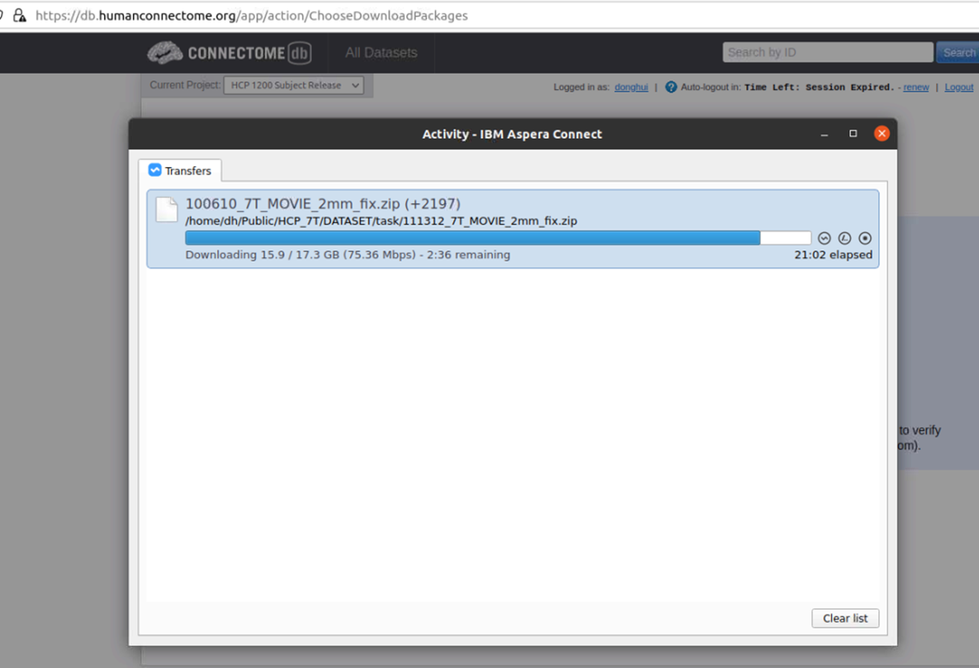
3.3 Download your data

