Slide 1

Introduce Cloud

Slide 2







Introduce Cloud
Cloud Computing
AWS
AWS Servies
Why AWS?

Slide 3
I. Cloud Computing

Slide 4
I. Cloud Computing
What is Cloud Computing?
Cloud computing is the delivery of computing services, including servers, storage, databases, networking, software, analytics, and intelligence over the Internet (“the cloud”) to offer faster innovation, flexible resources, and economies of scale.
Rather than keeping files on a proprietary hard drive or local storage device, cloud-based storage makes it possible to save them to a remote database. As long as an electronic device has access to the web, it has access to the data and the software programs to run it.

Slide 5
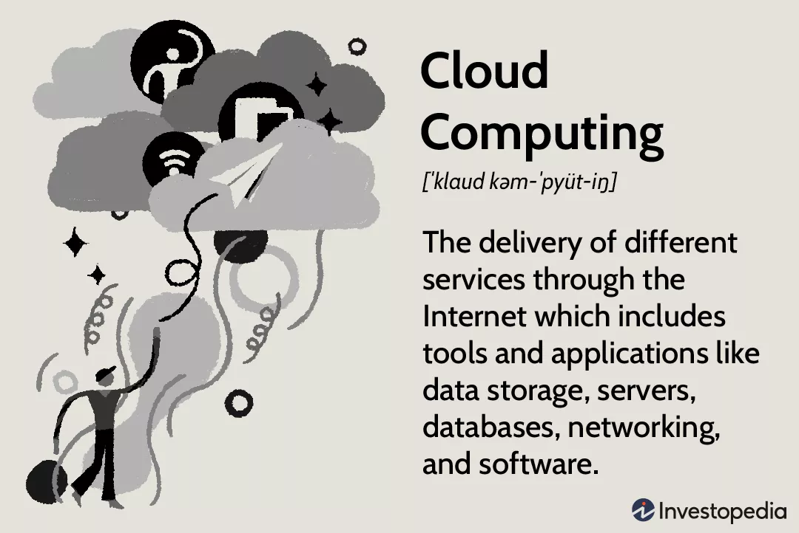
I. Cloud Computing
What is Cloud Computing?

Slide 6
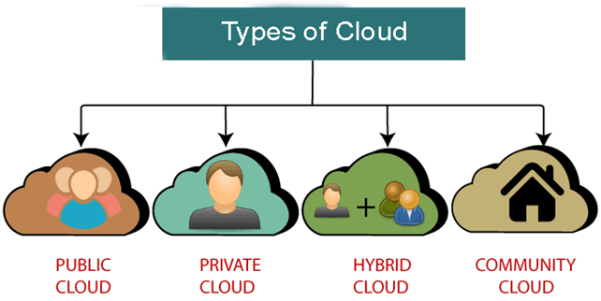
I. Cloud Computing
Types of Cloud

Slide 7
I. Cloud Computing
Types of Cloud
Public clouds provide their services on servers and storage on the Internet. These are operated by third-party companies, who handle and control all the hardware, software, and the general infrastructure. Clients access services through accounts that can be accessed by just about anyone.
Private clouds are reserved for specific clientele, usually one business or organization. The firm's data service center may host the cloud computing service. Many private cloud computing services are provided on a private network.

Slide 8
I. Cloud Computing
Types of Cloud
Hybrid clouds are, as the name implies, a combination of both public and private services. This type of model allows the user more flexibility and helps optimize the user's infrastructure and security.
Community clouds are built for the purpose of sharing infrastructure and data for many different organizations and users. For example, businesses operating in the education industry can share a cloud to exchange data for each other.

Slide 9
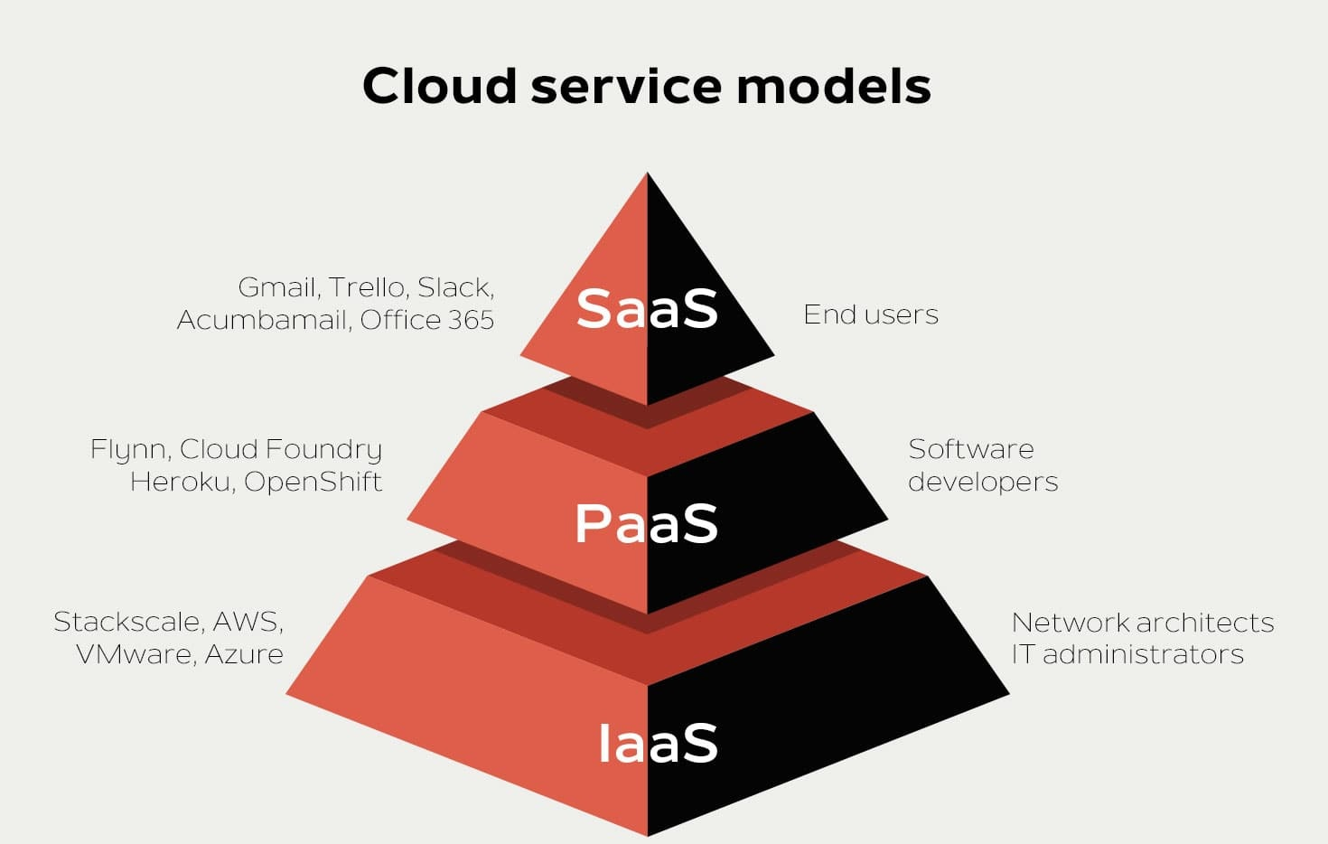
I. Cloud Computing
Cloud service models

Slide 10
I. Cloud Computing
Cloud service models
Software-as-a-service (SaaS) involves the licensure of a software application to customers. Licenses are typically provided through a pay-as-you-go model or on-demand. This type of system can be found in Microsoft Office's 365.

Slide 11
I. Cloud Computing
Cloud service models
Platform-as-a-service (PaaS) is considered the most complex of the three layers of cloud-based computing. PaaS shares some similarities with SaaS, the primary difference being that instead of delivering software online, it is actually a platform for creating software that is delivered via the Internet. This model includes platforms like Salesforce.com and Heroku.

Slide 12
I. Cloud Computing
Cloud service models
Infrastructure-as-a-service (IaaS) involves a method for delivering everything from operating systems to servers and storage through IP-based connectivity as part of an on-demand service. Clients can avoid the need to purchase software or servers, and instead procure these resources in an outsourced, on-demand service. Popular examples of the IaaS system include IBM Cloud and Microsoft Azure.

Slide 13
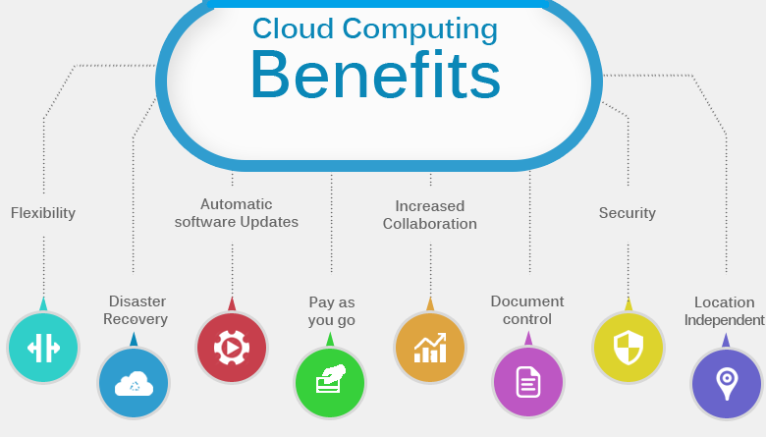
I. Cloud Computing
Cloud Computing Benefits

Slide 14
I. Cloud Computing
Cloud Computing Benefits
Cost savings: Helps minimize costs. You will not spend money on the original infrastructure. For example: Buy hardware, software, system installation, ...
Convenience: Users can quickly access and use resources via the Internet without complicated installation
Safe and continuous: All data is synchronized in the cloud. Help ensure higher safety, avoid data loss due to hard drive damage. In addition, the supplier will back up and have security methods to better protect data.
Deploy quickly anywhere: With just a few simple steps to deploy them everywhere. This means that users will get a better experience with lower latency.

Slide 15
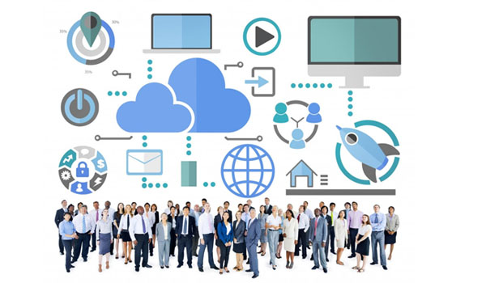
I. Cloud Computing
Who needs to use Cloud Computing?
Cloud computing can be used for anyone:
Companies, businesses, organizations wishing to store and share data.
Website developers, applications, software.
End users (individual users).

Slide 16
I. Cloud Computing
Cloud Service providers
Google Cloud
Amazon Web Services (AWS)
Microsoft Azure
IBM Cloud
Alibaba Cloud

Slide 17
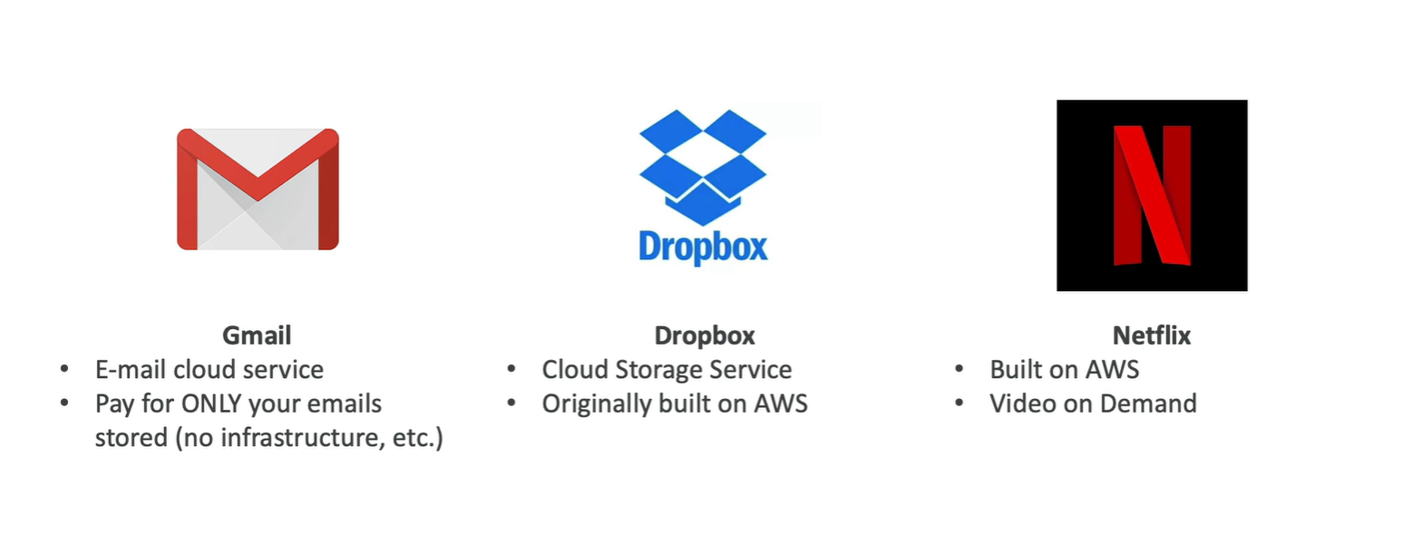
I. Cloud Computing
Example of Cloud Computing
Today, there are several examples of cloud computing applications used by both businesses and individuals. One type of cloud service would be streaming platforms for audio or video, where the actual media files are stored remotely. Another would be data storage platforms like Google Drive, Dropbox, OneDrive, or Box.

Slide 18
II. AWS

Slide 19
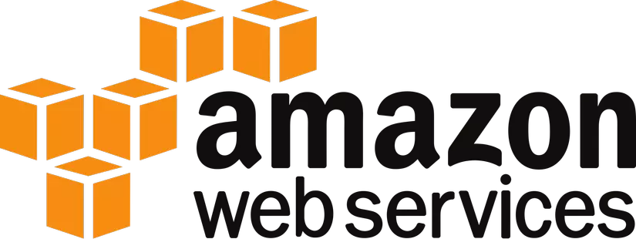
II. AWS
What is AWS?
AWS
AWS Meaning: The Amazon Web Services (AWS) platform provides more than 200 fully featured services from data centers located all over the world, and is the world's most comprehensive cloud platform.
Amazon web service is an online platform that provides scalable and cost-effective cloud computing solutions.
AWS is a broadly adopted cloud platform that offers several on-demand operations like compute power, database storage, content delivery, etc., to help corporates scale and grow.

Slide 20
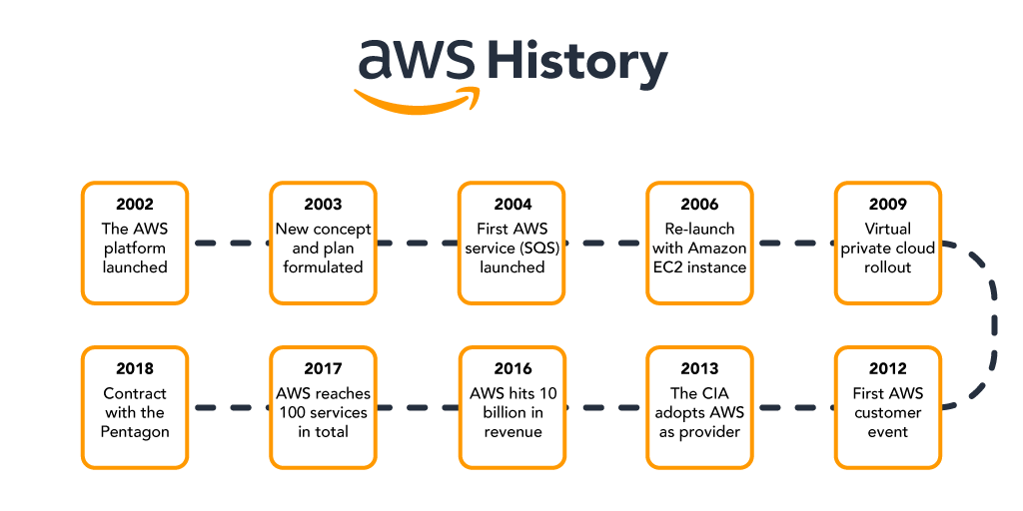
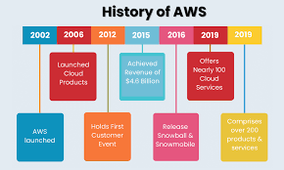
II. AWS
AWS
History of AWS

Slide 21
II. AWS
History of AWS
AWS
2002 - The platform was launched
2003 - Concept was reformulated with standardized plans
2004 - The first service (Simple Queue Service) launched for public usage
2006 - Official re-launch with Amazon EC2
2009 - Virtual Private Cloud launches
2012 - Holds first customer event
2013 - CIA adoption
2016 - Reaches 10 billion in revenue target
2017 - 100 services in total
2018 - Signs 10 billion dollar contract with the Pentagon

Slide 22
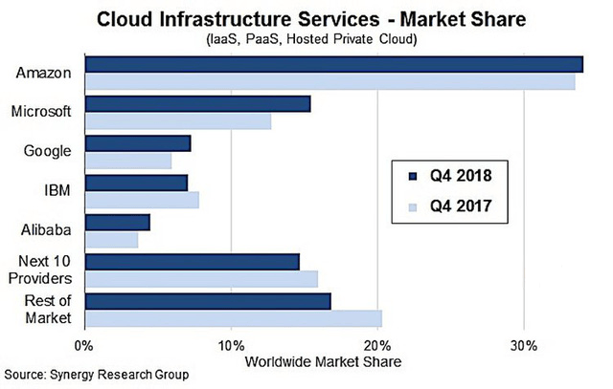
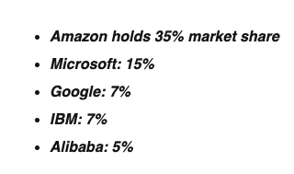
II. AWS
In 2018, the cloud compuIn 2018, the cloud computing service market thrived when businesses spent up to 70 billion USD on cloud services.ting service market thrived when businesses spent up to 70 billion USD on cloud services.
Cloud Infrastructure Services
In 2018, the cloud computing service market thrived when businesses spent up to 70 billion USD on cloud services.

Slide 23
II. AWS
AWS
Advantages of AWS
AWS provides a user-friendly programming model, architecture, database as well as operating system that has been already known to employers.
AWS is a very cost-effective service. There is no such thing as long-term commitments for anything you would like to purchase.
It offers billing and management for the centralized sector, hybrid computing, and fast installation or removal of your application in any location with few clicks.
There is no need to pay extra money on running data servers by AWS.
AWS offers a total ownership cost at very reasonable rates in comparison to other private cloud servers.

Slide 24
II. AWS
AWS
Disadvantages of AWS
AWS has supportive paid packages for intensive or immediate response. Thus, users might need to pay extra money for that.
There might be some cloud computing problems in AWS especially when you move to a cloud Server such as backup protection, downtime, and some limited control.
From region to region, AWS sets some default limitations on resources such as volumes, images, or snapshots.
If there is a sudden change in your hardware system, the application on the cloud might not offer great performance.

Slide 25
II. AWS
AWS
Applications of AWS
Application Hosting/SaaS Hosting
Sharing Media (Image/ Video)
Hosting Website
Content Delivery and Media Distribution
Social Networking
Storage, Backup, and Disaster Recovery
Development & Testing Environments
Social Networking
Academic Computing
Search Engines
Mobile and Social Applications

Slide 26
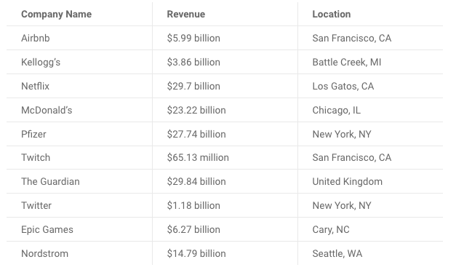
II. AWS
AWS
Most successful companies that use AWS

Slide 27
III. AWS Services

