Slide 1
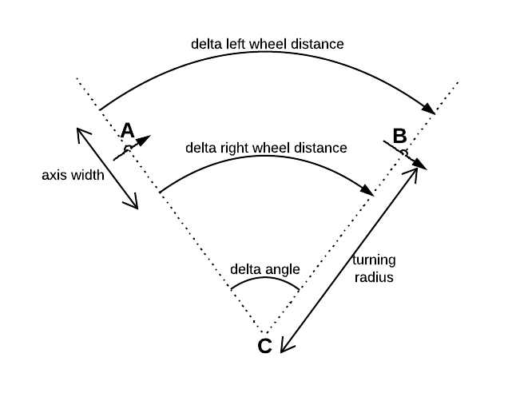
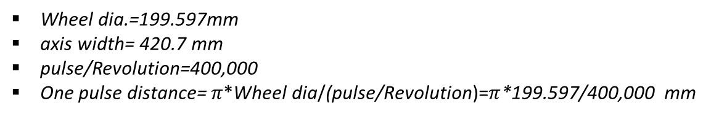
Dead reckoning with Encoder only
Wheel dia.=199.597mm
axis width= 420.7 mm
pulse/Revolution=400,000
One pulse distance=$π\text{∗}\text{Wheel} \text{dia}\text{/}\text{(}\text{pulse}\text{/}\text{Revolution}\text{)=}π$*199.597/400,000 mm
Δx =Δd*cos(ϴk-1+Δϴ)
Δy =Δd*sin(ϴ k-1+Δϴ)
Δϴ= (dist_wR - dist_wL)/ axis width
Δd= (ΔdL+ ΔdR)/2
ΔdL= ΔL_encoder *(distance/count#)
ΔdR= ΔR_encoder *(distance/count#)

Slide 2
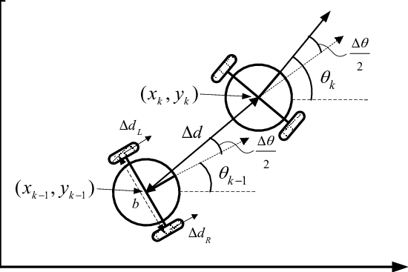
Dead reckoning with Encoder+Gyro (1)
Δx =Δd*cos(ϴk-1+Δϴ/2)
Δy =Δd*sin(ϴ k-1+Δϴ/2)
Δϴ/2= ϴgyro(k)-ϴgyro(k-1)
Δd= (ΔdL+ ΔdR)/2
ΔdL= ΔL_encoder *(distance/count#)
ΔdR= ΔR_encoder *(distance/count#)

Slide 3
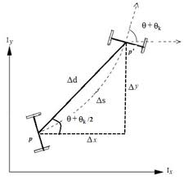
Dead reckoning with Encoder+Gyro (2)
ϴgyro(k)
Δx =Δd*cos(ϴ+Δϴ)
Δy =Δd*sin(ϴ+Δϴ)
Δϴ= ϴgyro(k)-ϴgro(k-1)
ϴgyro(k-1)
Δd= (ΔR_encoder+ ΔL_encoder)
*(distance/conter)*(1/2)

