Slide 1
Review of ABB Drives

Slide 2
Direct torque control explains what DTC is; why and how it has evolved; the basic theory behind its success; and the features and benefits of this new technology.
2. EU Council Directives and adjustable speed electrical power drive systems is to give a straightforward explanation of how the various EU Council Directives relate to power drive systems.
3. EMC compliant installation and configuration for a power drive system assists design and installation personnel when trying to ensure compliance with the requirements of the EMC Directive in the user’s systems and installations when using AC drives.
4. Guide to variable speed drives describes basics of different variable speed drives (VSD) and how they are used in industrial processes.
5. Bearing currents in modern AC drive systems explains how to avoid damages.

Slide 3
6. Guide to harmonics with AC drives describes harmonic distortion, its sources and effect, and also distortion calculation and evaluation with special attention to the methods for reducing harmonics with AC drives.
7. Dimensioning of a drive system. Making dimensioning correctly is the fastest way of saving money. Biggest savings can be achieved by avoiding very basic mistakes. These dimensioning basics and beyond can be found in this guide.
8. Electrical braking describes the practical solutions available in reducing stored energy and transferring stored energy back into electrical energy.
9. Guide to motion control drives gives an overview of high performance drives and motion control.
10. Functional safety guide introduces the Machinery Directive and the standards that must be taken into account when designing a machine, in order to ensure operational safely.

Slide 4
Overview of ABB Book
Chapter 1 - Introduction ............................................................................7
General ..............................................................................................7
This manual’s purpose ........................................................................7
Using this guide .................................................................................7
What is a variable speed drive? ...........................................................8
Summary ...........................................................................................8
Chapter 2 - Evolution of direct torque control ...........................................8
DC motor drives .................................................................................9
Features ........................................................................................9
Advantages ...................................................................................9
Drawbacks ..................................................................................10
AC drives - Introduction ....................................................................10
AC drives - Frequency control using PWM .........................................11
Features ......................................................................................11
Advantages .................................................................................12
Drawbacks ..................................................................................12
AC drives - Flux vector control using PWM ........................................12

Slide 5
Features ......................................................................................12
Advantages .................................................................................13
Drawbacks ..................................................................................13
AC drives - Direct torque control .......................................................14
Controlling variables .....................................................................14
Comparison of variable speed drives .................................................15
Chapter 3 - Questions and answers ........................................................17
General ............................................................................................17
Performance ....................................................................................18
Operation .........................................................................................24
Chapter 4 - Basic control theory .............................................................28
How DTC works ...............................................................................28
Torque control loop...........................................................................29
Step 1 Voltage and current measurements ....................................29
Step 2 Adaptive motor model .......................................................29
Step 3 Torque comparator and flux comparator .............................30
Step 4 Optimum pulse selector ....................................................30
Speed control ..................................................................................31
Step 5 Torque reference controller .................................................31
Step 6 Speed controller ...............................................................31
Step 7 Flux reference controller ....................................................31
Chapter 5 - Index .....................................................................................32

Slide 7
The efficiency of the drive system
The total efficiency of the drive system depends on the losses in the motor and its control. Both drive and motor losses are thermal, so they appear as heat. Input power to the drive system is
electrical in form, while output power is mechanical. That is why calculating the coefficient of efficiency (η) requires knowledge of both electrical and mechanical engineering.
Electrical input power Pin depends on voltage (U), current (I) and the power factor (cosϕ). The power factor tells us what proportion of the total electric power is active power and how much is
so called reactive power. To produce the required mechanical power, active power is required. Reactive power is needed to produce magnetization in the motor.
Mechanical output power Pout depends on the required torque (T) and rotating speed (n). The greater the speed or torque required, the greater the power required. This has a direct effect
on how much power the drive system draws from the electrical supply. As mentioned earlier, the frequency converter regulates the voltage, which is fed to the motor, and in this way directly
controls the power used in the motor as well as in the process being controlled.
Electrical switching with transistors is very efficient, so the efficiency of the frequency converter is very high, from 0.97 to 0.99. Motor efficiency is typically between 0.82 and 0.97 depending
on the motor size and its rated speed. So it can be said that the total efficiency of the drive system is always above 0.8 when controlled by a frequency converter.

Slide 8
The load, friction and inertia resist rotation
The motor must produce the required torque to overcome the load torque. Load torque consists of friction, inertia of the moving parts and the load itself, which depends on the application. In
the example in the diagram, the motor torque has to be greater than the load torque, which is dependent on the mass of the box, if the box is to rise.
Load factors change according to the application. For example, in a crusher, the load torque is dependent not only on friction and inertia, but also on the hardness of the crushed material. In
fans and blowers, air pressure changes affect the load torque, and so on.

Slide 9
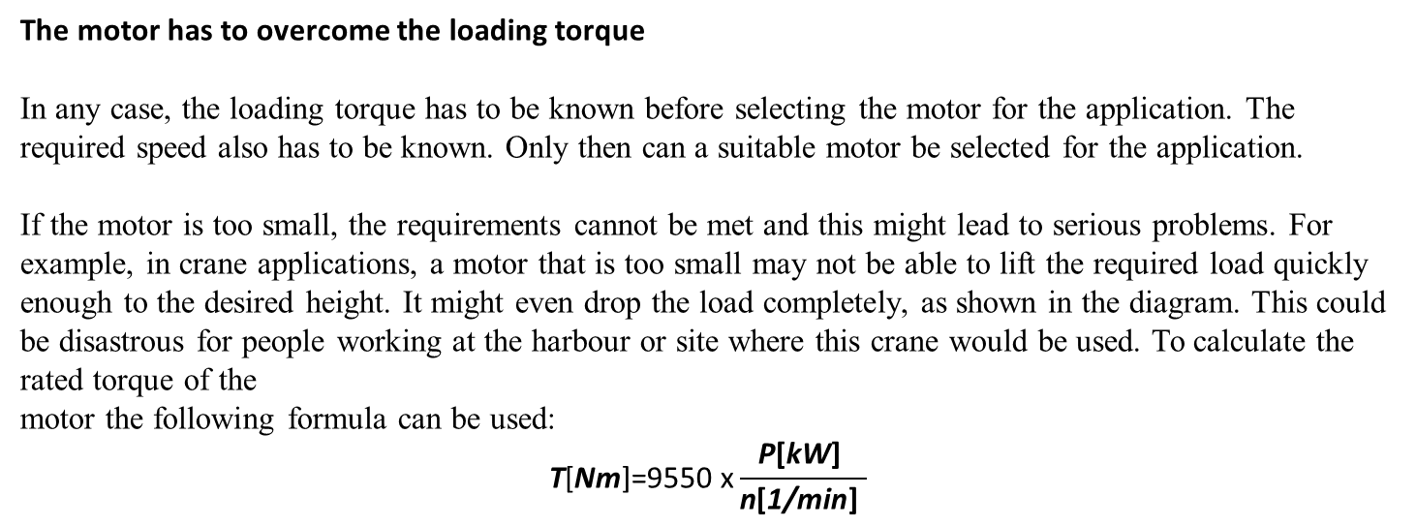
The motor has to overcome the loading torque
In any case, the loading torque has to be known before selecting the motor for the application. The required speed also has to be known. Only then can a suitable motor be selected for the application.
If the motor is too small, the requirements cannot be met and this might lead to serious problems. For example, in crane applications, a motor that is too small may not be able to lift the required load quickly enough to the desired height. It might even drop the load completely, as shown in the diagram. This could be disastrous for people working at the harbour or site where this crane would be used. To calculate the rated torque of the
motor the following formula can be used:
$$\text{T}\text{[}\text{Nm}\text{]=9550 }\text{x}\frac{\text{P}\text{[}\text{kW}\text{] }}{\text{n}\text{[}\text{1/}\text{min}\text{]} }$$

Slide 10
The drive torque and load torque are equal at nominal speed
A motor’s torque/speed curve is unique and has to be calculated for every motor type separately. A typical torque/speed curve is shown in the graph as Tm. As can be seen, the maximum load
torque is reached just below nominal speed.
Load torque Tl usually increases with speed. Depending on the application it can be linear or quadratic. The motor will automatically accelerate until the load torque and motor torque are
equal. This point is shown on the graph as the intersection of Tm and Tl. Actual torque (Tact) is shown on the y-axis and actual speed (nact) on the x-axis.
These are the principles that govern how an ordinary squirrel cage motor works. With a frequency converter, optimal control performance can be obtained from the motor and the whole drive system.

Slide 12
Mechanical, hydraulic and electrical VSDs
Above are the four most common VSDs in the industrial sector. Mechanical variable speed control usually uses belt drives, and is controlled by moving conical pulleys manually or with positioning motors.
Hydraulic coupling
In hydraulic coupling, the turbine principle is used. By changing the volume of oil in the coupling, the speed difference between the driving and driven shafts changes. The oil amount is controlled with pumps and valves.
DC drive
In the DC drive, a DC converter changes the motor supply voltage fed to the DC motor. In the motor, a mechanical inverter, a commutator, changes direct current to alternating current.
AC drive
In the frequency converter or AC drive, a standard squirrel cage motor is used, so no mechanical inverters are required. The speed of the motor is regulated by a frequency converter that changes the frequency of the motor voltage, as presented earlier in this guide. The frequency converter itself is controlled with electrical signals. The diagram shows the location of the control equipment for each type of VSD. In mechanical and hydraulic VSDs, the control equipment is located between the motor and the working machine, which makes maintenance very difficult. In electrical VSDs, all control systems are situated in an electrical equipment room and only the driving motor is in the process area. This is just one benefit of electrical VSDs.

Slide 14
Electrical VSDs dominate the market
Here are the four most important arguments for using electrical VSDs, presented along with estimated VSD market shares in Europe in 2000. The four main benefits of using electrical VSDs
are highlighted at the turning points of the speed curve.
Maintenance costs
Direct on-line starting stresses the motor and also the electrical equipment. With electrical VSDs, smooth starting is possible and this has a direct effect on maintenance costs.
Productivity
Process equipment is usually designed to cater for future productivity increases. Changing constant-speed equipment to provide higher production volumes requires money and time.
With the AC drive, speed increases of 5 to 20 percent are not a problem, and the production increase can be achieved without any extra investment.
Energy saving
In many processes, production volumes change. Changing production volumes by mechanical means is usually very inefficient. With electrical VSDs, changing the production volume
can be achieved by changing the motor speed. This saves a lot of energy particularly in pump and fan applications, because the shaft power is proportional to the flow rate to the power of three.
Higher quality
The accurate speed control obtainable with electrical VSDs results in process optimization. The optimal process control leads to the best quality end product, which means the best profit for
the customer.

Slide 15
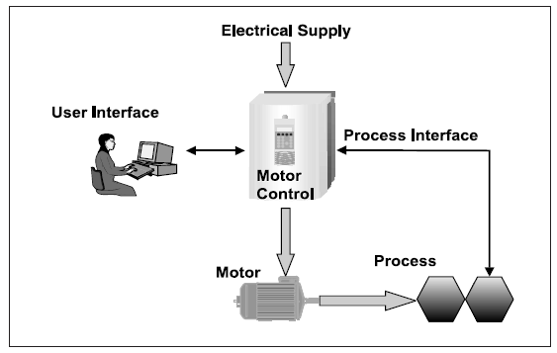
The basic functions of an AC drive
In this diagram, the basic functions of an AC drive are presented. There are four different components in AC drive motor control. These components are the user interface, the motor, the electrical supply and the process interface.
An electrical supply feeds the required electricity to the drive; one selection criteria for the drive is the supply voltage and its frequency. The AC drive converts the frequency and voltage and feeds the motor. This conversion process is controlled by signals from the process or user via the process and user interfaces.
The user interface provides the ability to observe the AC drive and obtain different process information via the drive. This makes the drive easy to integrate with other process control equipment and overriding process control systems.

Slide 16
A motor’s load capacity curves with an AC drive
If the motor is driven without a frequency converter, its load capacity curves cannot be modified. It will produce a specified torque at certain speed and maximum torque cannot be
exceeded.
With a frequency converter drive, there are different loading options. The standard curve, Curve 1 in the diagram, can be used continuously. Other curves can only be used for certain periods
of time, because the motor’s cooling system is not designed for this kind of heavy use.
These higher load capacity levels might be needed, for example, during startup. In certain applications, as much as twice the amount of torque is required when starting. With a frequency converter this is possible, meaning that a motor can be dimensioned according to its normal use. This reduces the investment cost.
To be able to use these features it is very important that the load, the AC drive and the motor are compatible. Otherwise the motor or the converter will overheat and be damaged.

Slide 17
Reversing
Reversing the motor rotation is simple to accomplish with an AC drive. With ABB’s frequency converters it can be achieved simply by pressing one button. Furthermore, it is possible to set different acceleration and deceleration ramp times. The ramp form can also be modified according to the user’s wishes. In the diagram (above, left) an S-ramp has been presented. Another possibility could be a linear ramp.
Torque control
Torque control is relatively simple with an AC drive. Torque boosting, which was presented earlier, is necessary if a very high starting torque is required. Variable torque U/f settings
mean that maximum torque can be achieved at a lower speed of rotation than normal.
Eliminating mechanical vibrations
Mechanical vibrations can be eliminated by by-passing critical
speeds. This means that when a motor is accelerated close to its critical speed, the drive will not allow the actual speed of the motor to follow the reference speed. When the critical point
has been passed, the motor will return to the regular curve very quickly and pass the critical speed.

Slide 18
Power loss ride-through
The power loss ride-through function is used if the incoming supply voltage is cut off. In such a situation, the AC drive will continue to operate using the kinetic energy of the rotating motor. The drive will be fully operational as long as the motor rotates and generates energy for the drive.
Stall function
With an AC drive, the motor can be protected in a stall situation with the stall function. It is possible to adjust supervision limits and choose how the drive reacts to the motor stall condition. Protection is activated if three conditions are met at the same time.
1. The drive frequency has to be below the preset stall frequency.
2. The motor torque has to rise to a certain limit, calculated by the drive software.
3. The final condition is that the motor has been in the stall limit for longer than the time period set by the user.

Slide 19
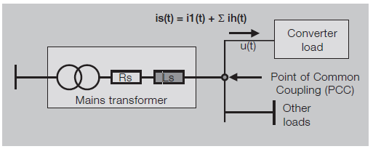
Some new drive installations can have their bearings fail only a few months after startup. Failure can be caused by high frequency currents, which flow through the motor bearings.
Harmonic currents are created by non-linear loads connected to the power distribution system. Harmonic distortion is a form of pollution in the electric plant that can cause problems if the voltage distribution caused by harmonic currents increases above certain limits.
All power electronic converters used in different types of electronic systems can increase harmonic disturbances by injecting harmonic currents directly into the grid. Figure 2.1 shows how the current harmonics (ih) in the input current (is) of a power electronic converter affect the supply voltage (ut), when passing through the transformer short circuit impedance.

Slide 20
Chapter 1 - Introduction ............................................................................7
General ..............................................................................................7
Chapter 2 - Drive system ...........................................................................8
Chapter 3 - General description of a dimensioning procedure ..................9
Chapter 4 - Induction (AC) motor.............................................................11
4.1 Fundamentals .............................................................................11
4.2 Motor current .............................................................................13
4.2.1 Constant flux range .............................................................14
4.2.2 Field weakening range .........................................................15
4.3 Motor power ..............................................................................16
Chapter 5 - Basic mechanical laws .........................................................17
5.1 Rotational motion .......................................................................17
5.2 Gears and moment of inertia .......................................................20
Chapter 6 - Load types ............................................................................22
Chapter 7 - Motor loadability ...................................................................25
Chapter 8 - Selecting the frequency converter and motor ......................26
8.1 Pump and fan application (Example) ............................................27
8.2 Constant torque application (Example) ........................................29
8.3 Constant power application (Example) ........................................31
Chapter 9 - Input transformer and rectifier ..............................................35
9.1 Rectifiers ....................................................................................35
9.2 Transformer ................................................................................36
Chapter 10 - Index ...................................................................................38

Slide 21
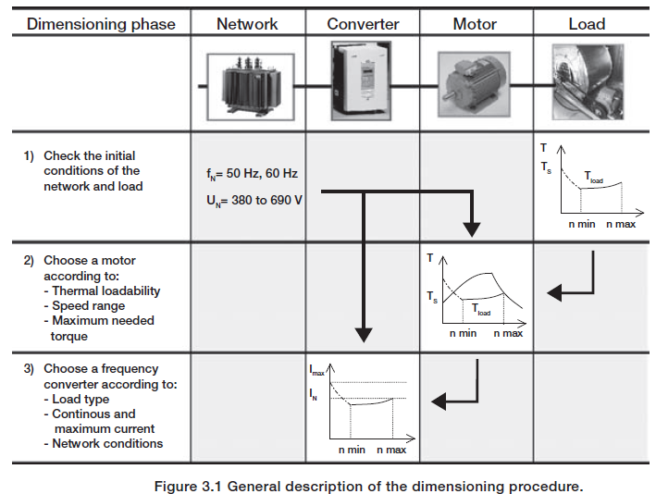

Slide 22
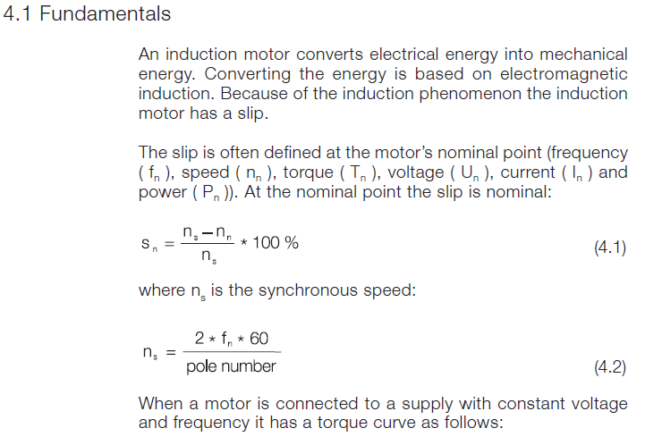

Slide 23
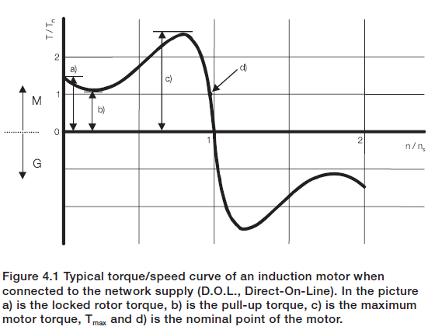

Slide 24
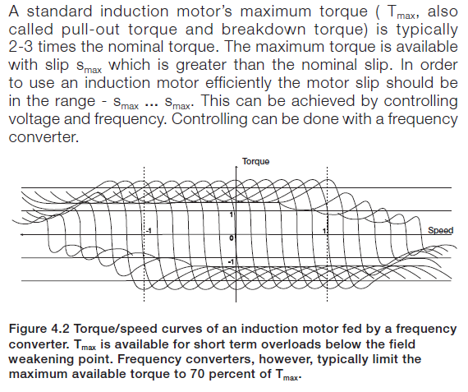

Slide 25
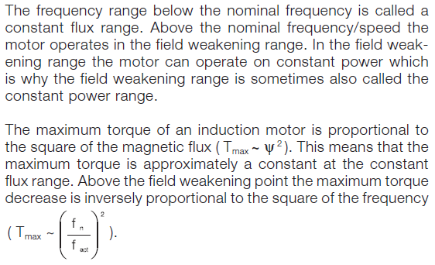

Slide 26
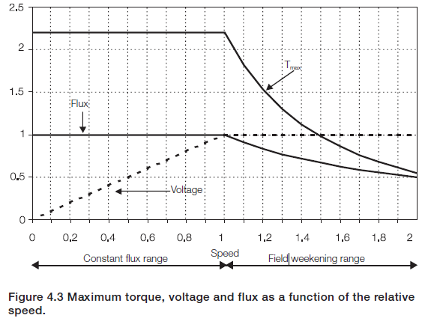

Slide 27
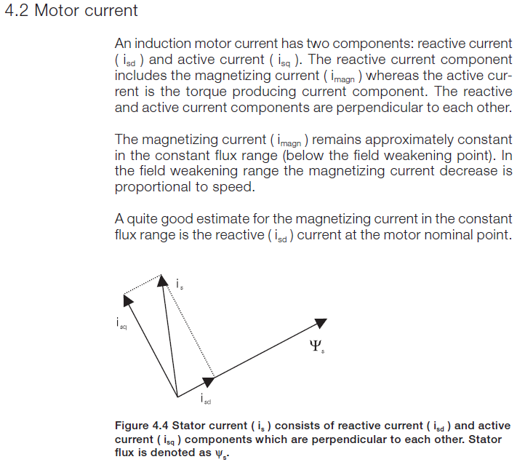

Slide 28
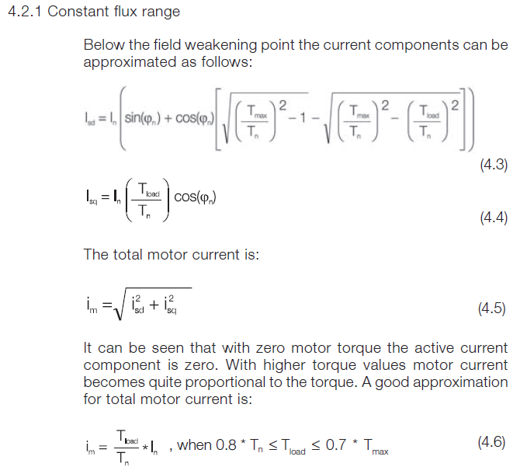

Slide 29
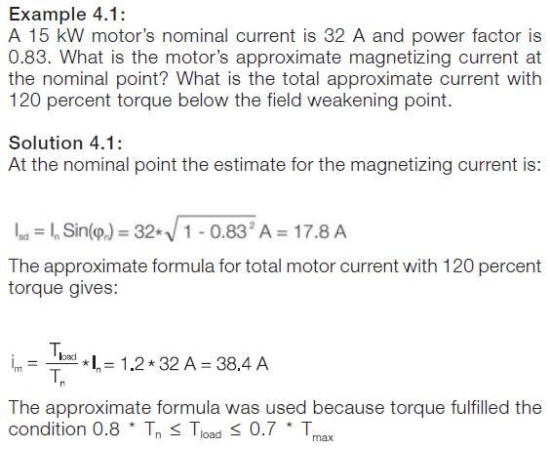

Slide 30
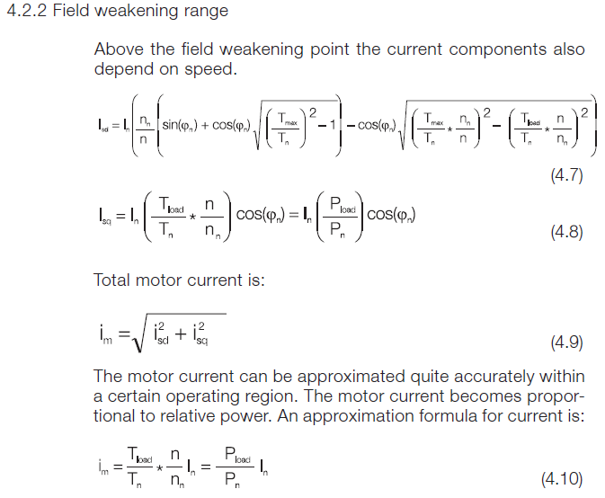

Slide 31
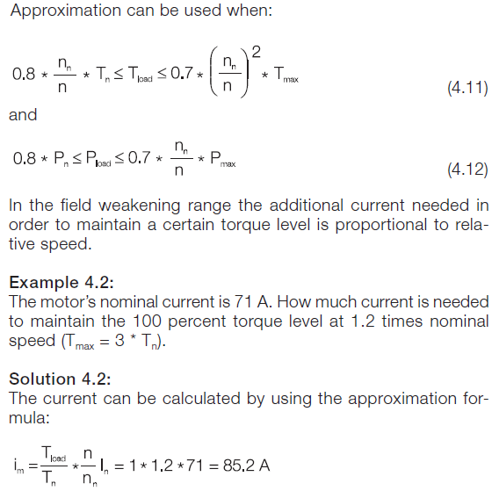

Slide 32
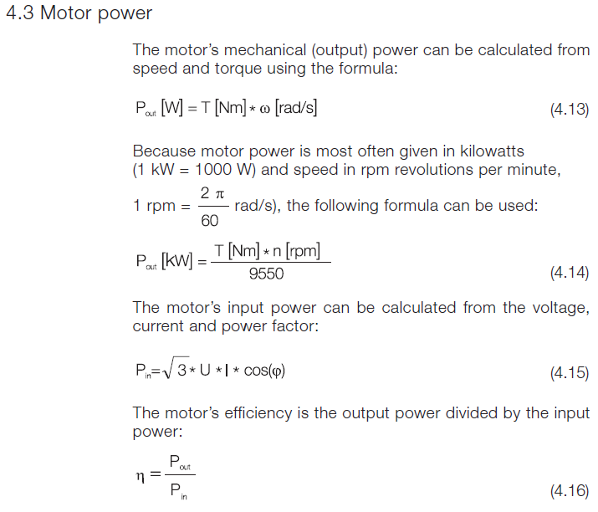

Slide 33
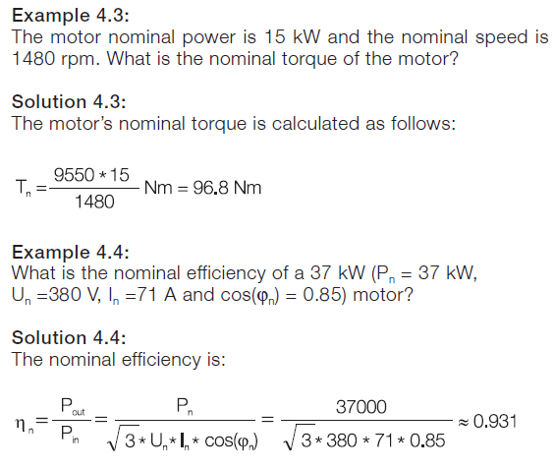

Slide 34
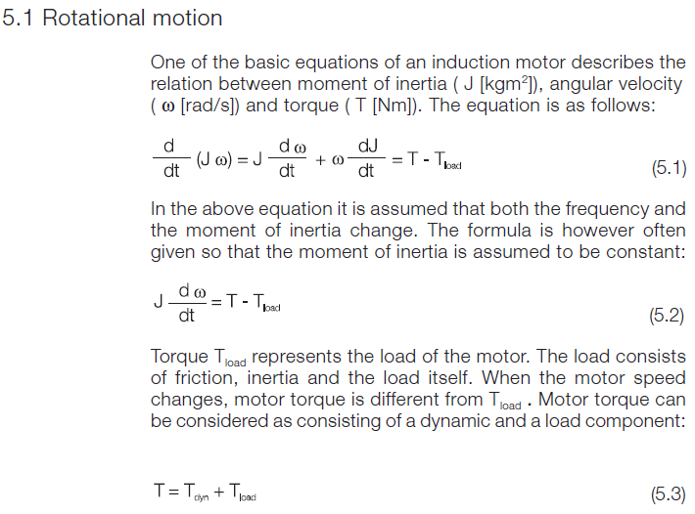

Slide 35
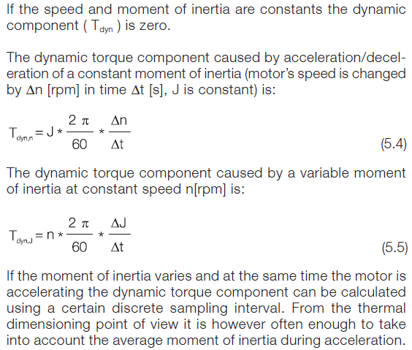

Slide 36
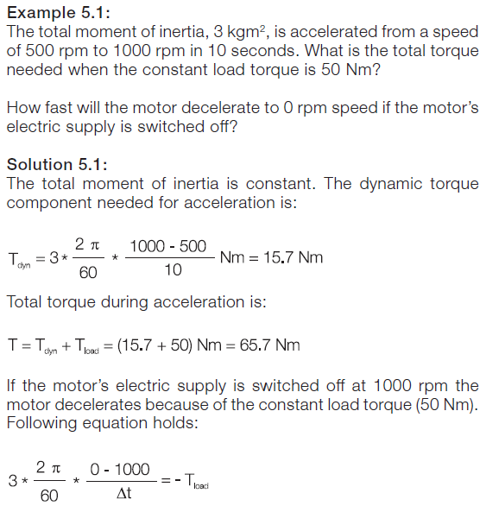

Slide 37
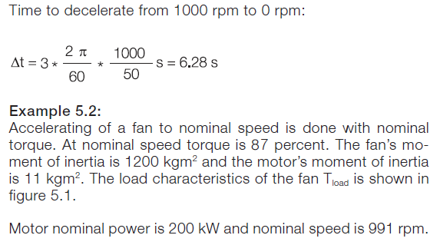

Slide 38
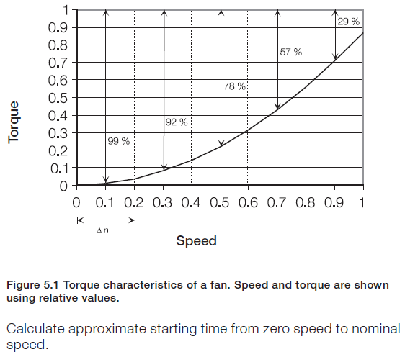

Slide 39
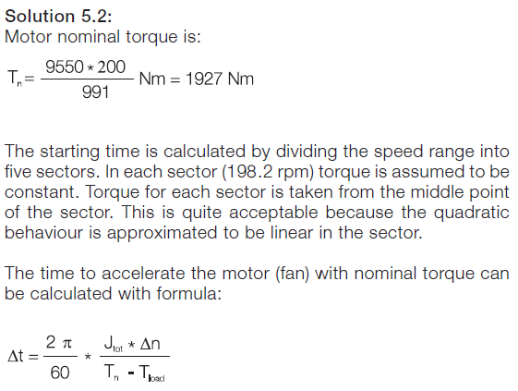

Slide 40
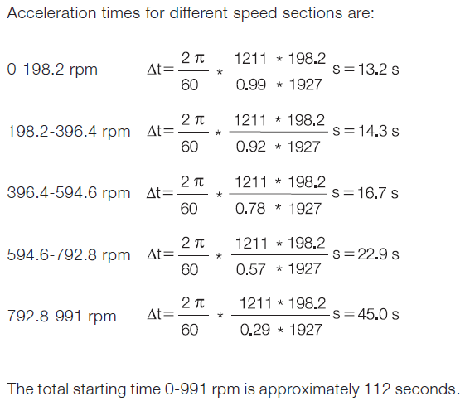

Slide 41
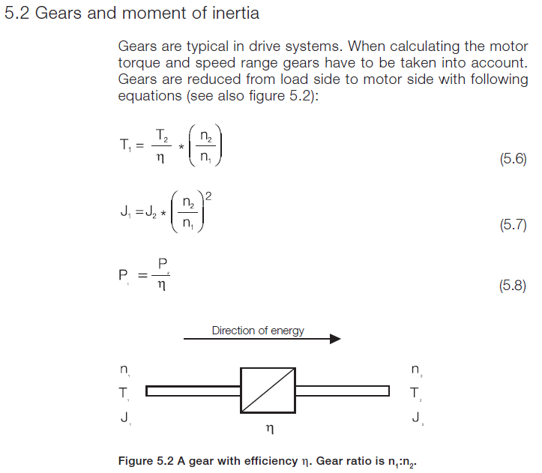

Slide 42
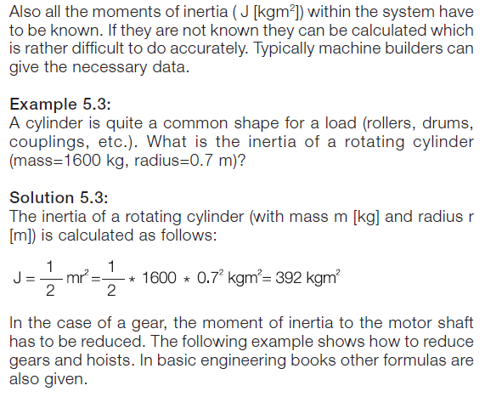

Slide 43
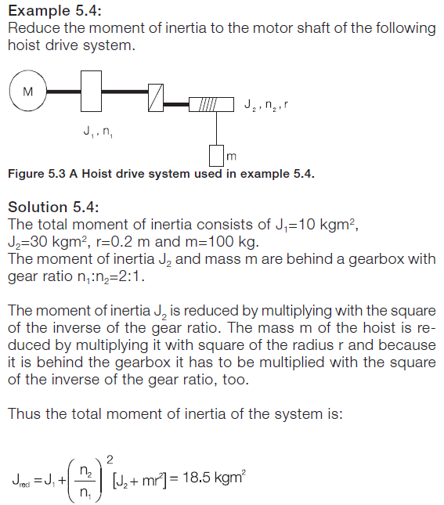

Slide 44
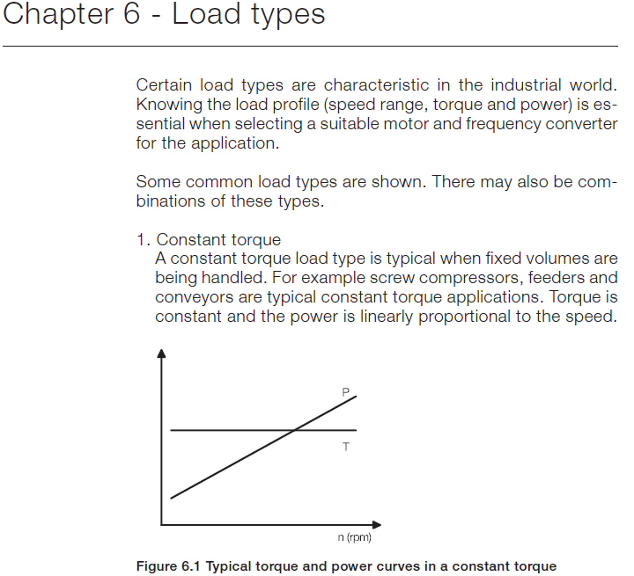

Slide 45
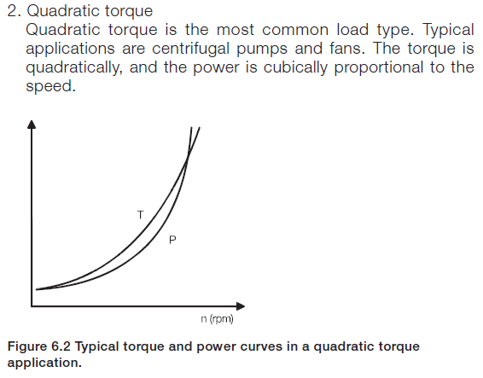

Slide 46
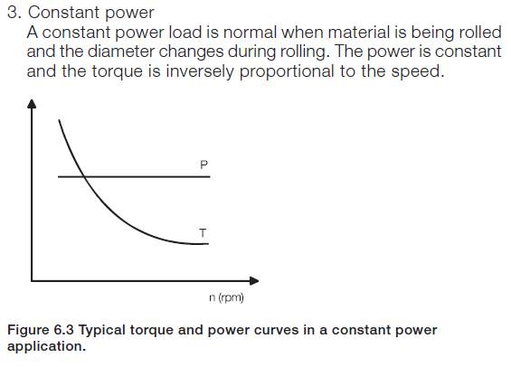

Slide 47
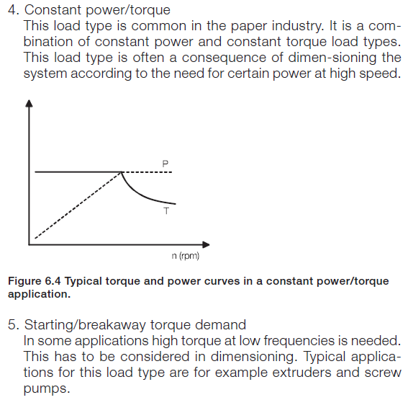

Slide 48
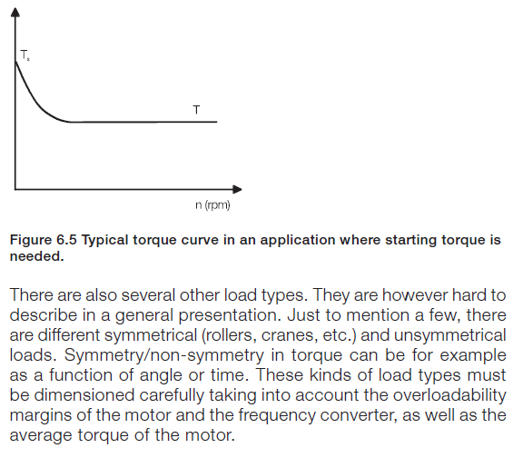

Slide 49
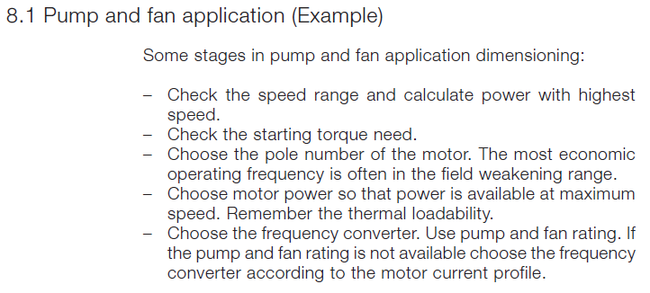

Slide 50
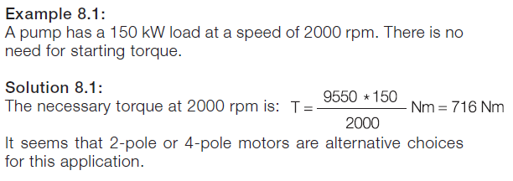

Slide 51
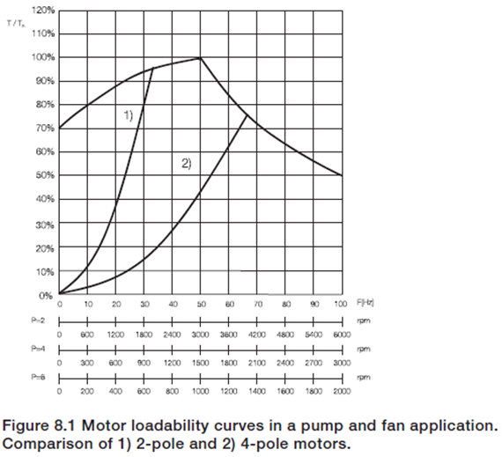

Slide 52
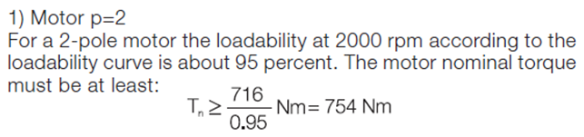
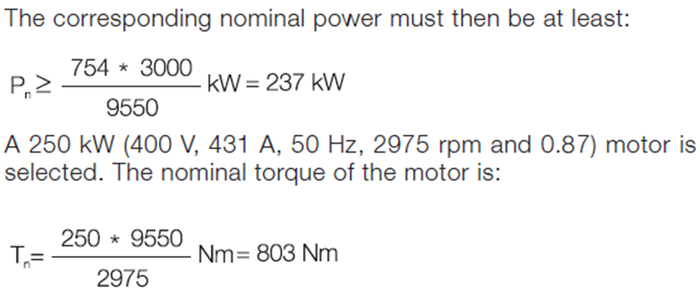

Slide 53
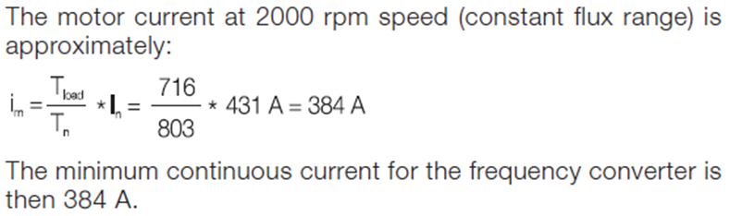
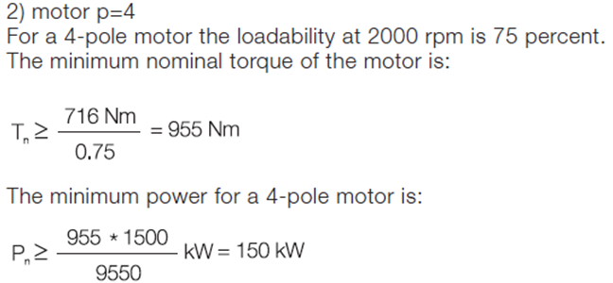

Slide 54
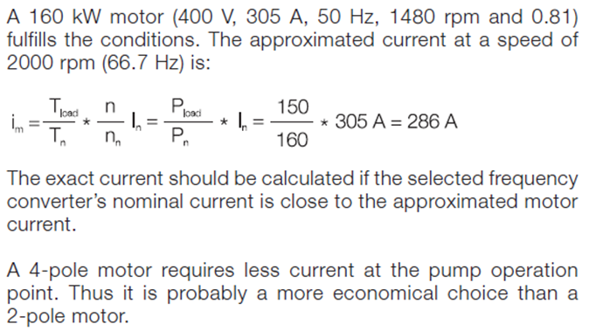

Slide 55
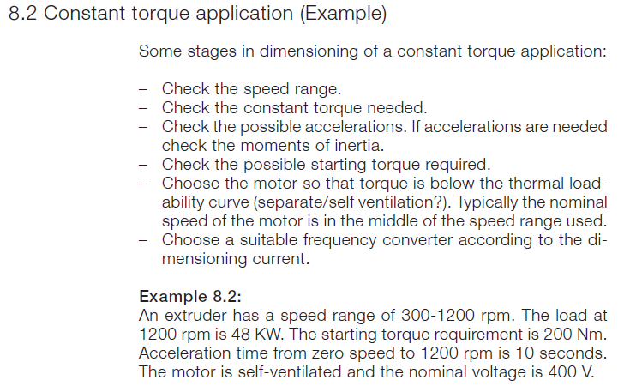

Slide 56
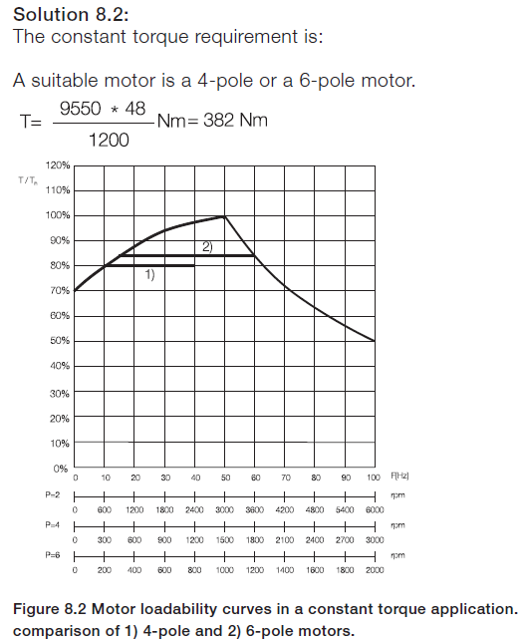

Slide 57
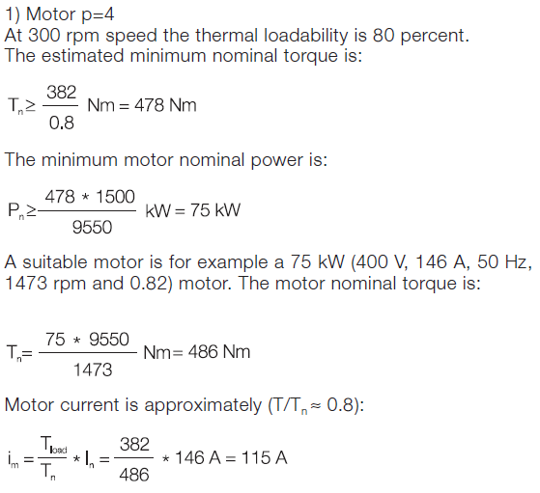

Slide 58
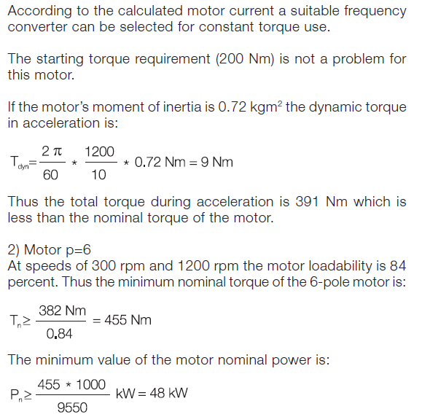

Slide 59
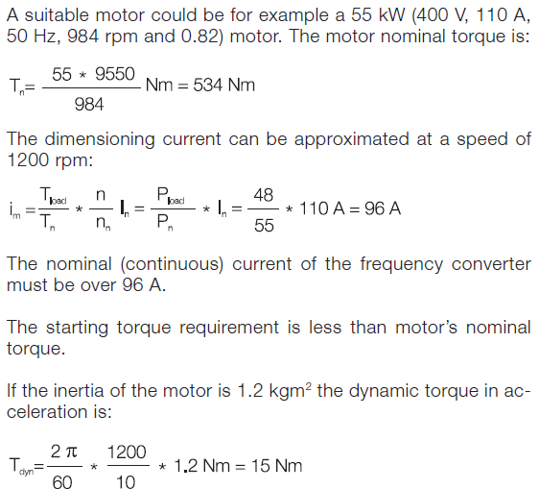

Slide 60
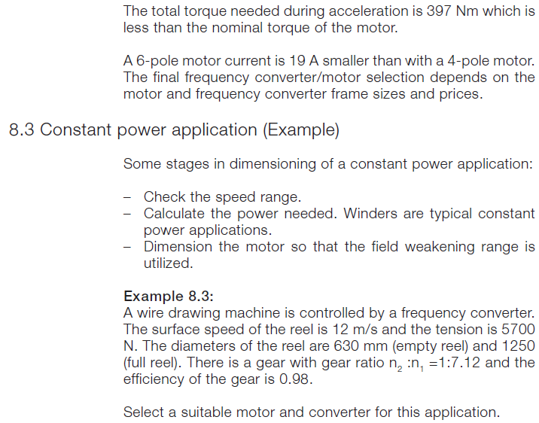

Slide 61
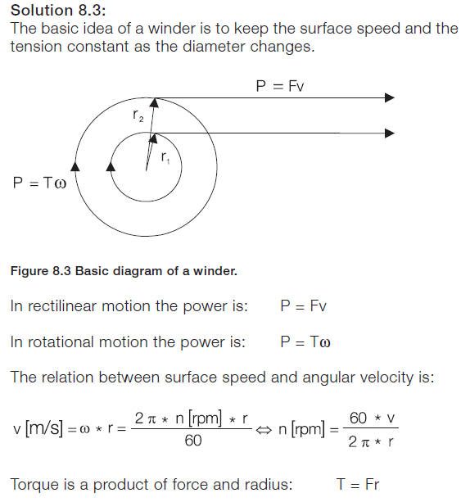

Slide 62
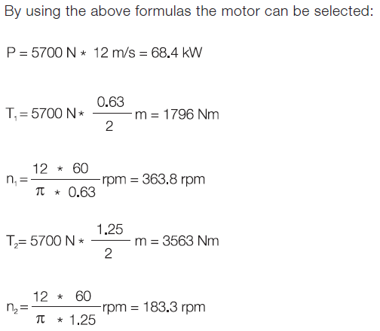

Slide 63
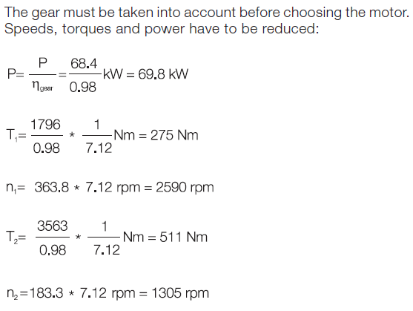

Slide 64
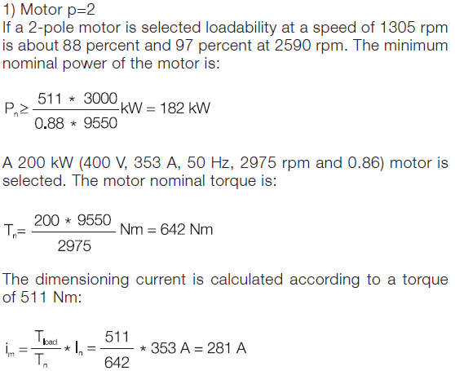

Slide 65
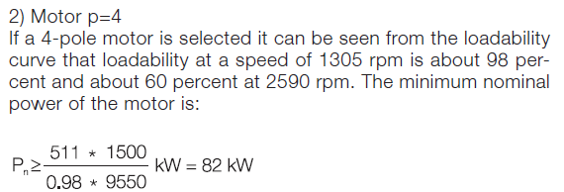


Slide 66


Slide 67


Slide 68
PUMP SYSTEM ANALYSIS AND SIZING

