Slide 1
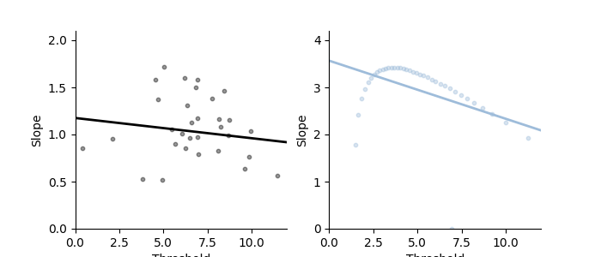
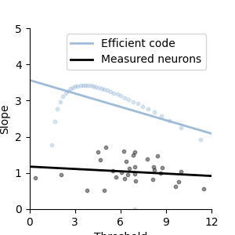
Slope
Threshold
Threshold
Threshold versus slope in variable rewards task.
We found a negative correlation between the slope and threshold (rho = -0.61, p = 0.00004, pearson), which were calculated from an approximate sigmoid function estimated from the measured neurons. This was also true for the efficient code (cyan; rho=-0,53, p=0.0005 )

Slide 2
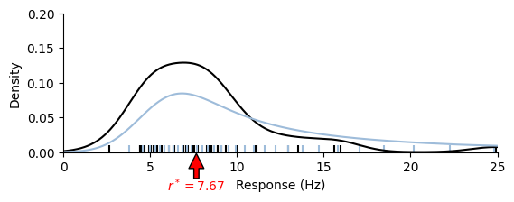
?

Slide 3
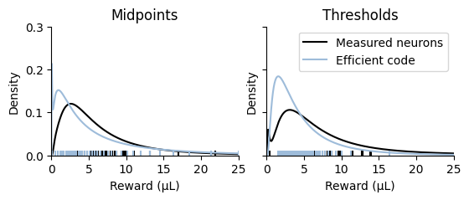
(supplementary section)
Difference between density of thresholds and density of midpoints
Since we are using two metrics for the positions of neurons (i.e. threshold and midpoint), here we demonstrate how they are different from each other.
First, note that in our formalism, 'density’ refers to the position of a neuron with sigmoid response function, the midpoint. On the other hand, threshold is the reward when a neuron fires at spontaneous activity, and this is the point at which the neuron codes zero prediction error in reinforcement learning.
Since the two metrics are different, their densities should be different. As explained earlier, in our formalism, neurons located at high gain pass through the convex point of the response function when they show spontaneous activity, i.e., when they receive a stimulus corresponding to their threshold, while at low gain they pass through the opposite, convex point of the response function. This means that the threshold of a neuron at higher gain is located at a relatively lower value than the midpoint, and conversely, the threshold of a neuron at low gain is located at a relatively higher value than the midpoint.
This tendency is obvious at lower gains because the variable magnitude task has a log normal-like distribution. As shown in Figure xx, the midpoints have a log normal distribution that is skewed to the left relative to the thresholds.
(caption)
Figure xx. Log-normal kernel density estimation of midpoints and thresholds. Measured neurons (black) and efficient code (Cyan) are overlayed.

Slide 4
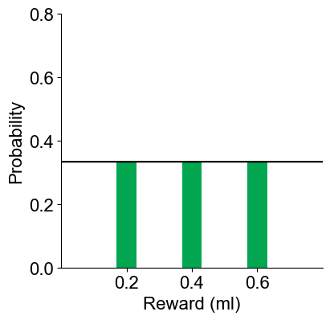
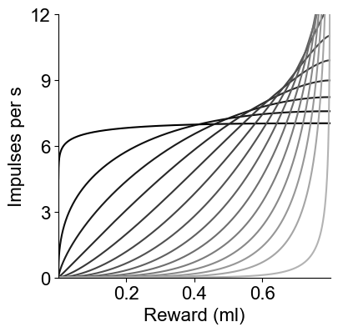
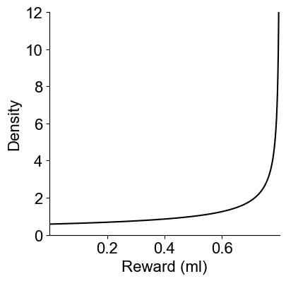
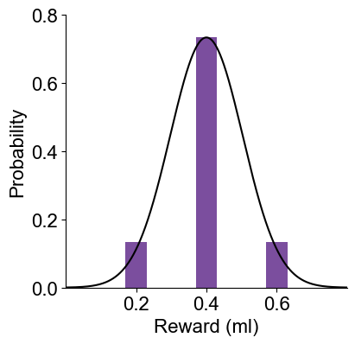
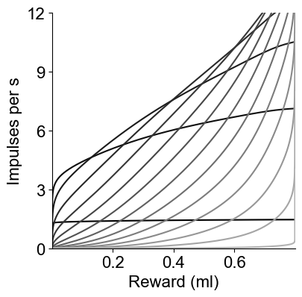
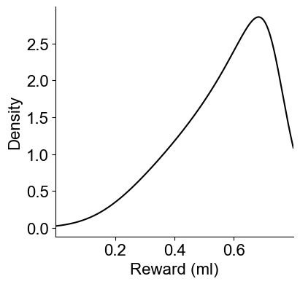
Reward distribution
Predicted tuning curves
Predicted density
Uniform
Normal

Slide 5
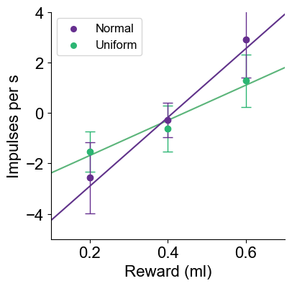
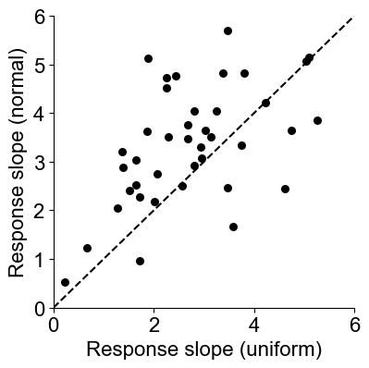

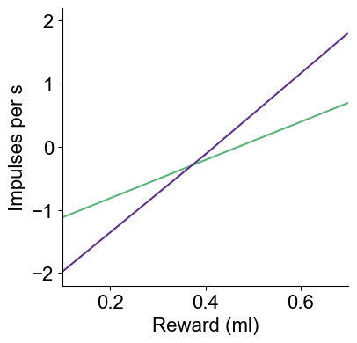
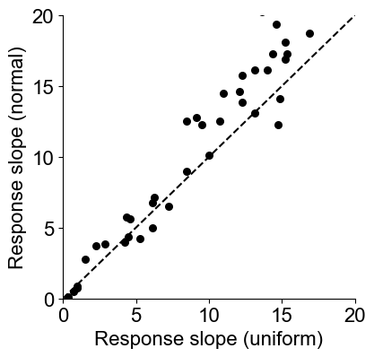

Higher reward slopes for the narrower distribution
Data from Rothenhoefer 2021
Efficient coding model

