Slide 1
Moirai-MoE Empowering Time Series Foundation Models with Sparse Mixture of Experts
DongJae Seo

Slide 2
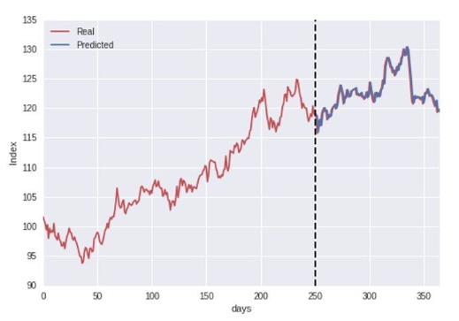
Introduction Moirai-MoE
Time Series Forecasting:
A task that predicts future values based on past time-series data
Time Series Data Heterogeneity in forecasting:
Frequency (ex: 15min, 1hr, daily)
Domain (Energy, Electricity)
Context/Prediction length
Dimensionality (Number of forecasting variables)
Time Series Forecasting Foundation Model
-> A pretrained model that can forecast diverse time-series
regardless of frequency, domain, or dimensionality
Notes:
시계열 예측 -> 시계열데이터의 heterogeneity -> 시계열 예측 Foundation model

Slide 3
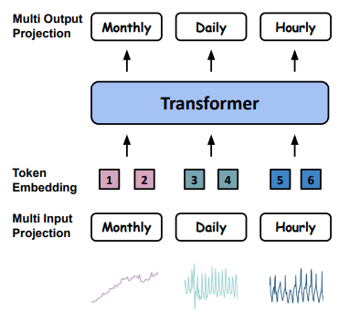
Related Work Moirai-MoE
Time Series Forecasting Foundation Model
Language prompts – TEMPO, UniTime
Frequency specialized models – Moirai, TimesFM
No specialization – Chronos, Lag-LLaMA, Moment, Timer
Moirai: Frequency based data grouping, embedding done in each frequency band
Notes:
기존 연구: language prompt 를 사용 frequency 를 기반하여 데이터를 나누는 따로 specialization 이 없는 논문에서는 moirai 와 비교 frequency 기반 패치 길이를 다르게 하여 같은 frequency 데이터의 표현을 학습하는 경향

Slide 4
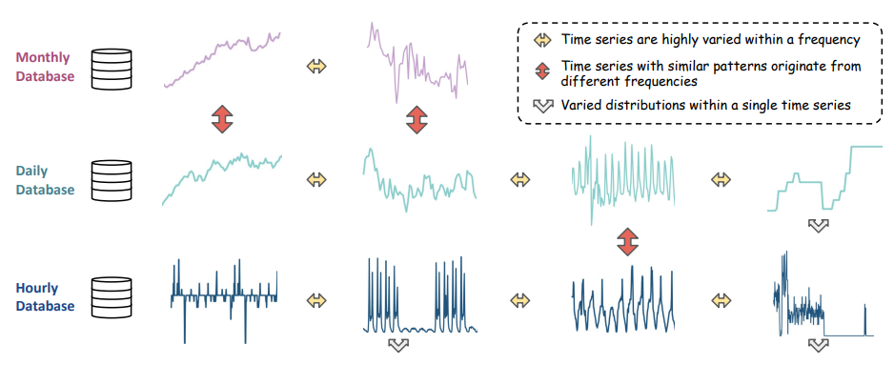
Related Work Moirai-MoE
Problem:
Frequency cannot be used as a reliable indicator since it does not always carry meaningful information about time series patterns
Same frequency -> varying pattern
Different frequency -> similar pattern
Different distribution within single time series
Notes:
Frequency 를 임의적으로 나누는 방식은 그림은 같은 frequency ~~~

Slide 5
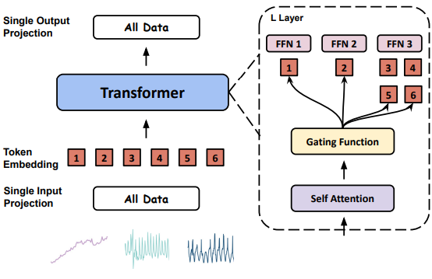
Related Work Moirai-MoE
Problem:
Frequency cannot be used as a reliable indicator since it does not always carry meaningful information about time series patterns
Moirai-MoE splits time series into token units,
Mixture of Experts learns token-level representations instead of frequency-based features
Same frequency -> varying pattern
Different frequency -> similar pattern
Different distribution within single time series
Notes:
-> 기존 frequency 를 통해 diverse 한 time series data 를 나눈걸 experts 가 transformer 내부에서 학습할 수 있도록 한다

Slide 6
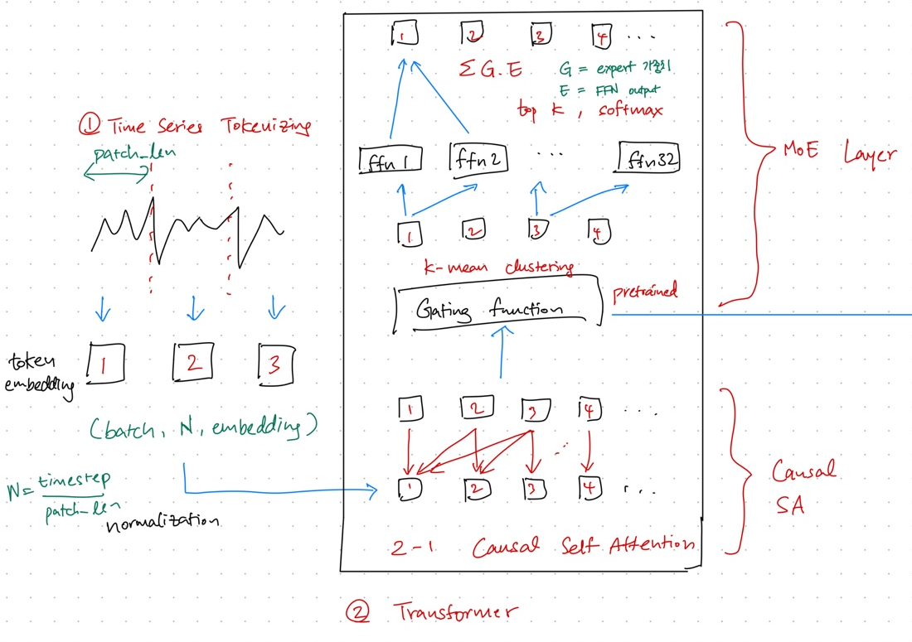
Methodology Moirai-MoE
Notes:
같은 구조를 gating function 하고 mixture of experts 가 어떻게 작동하는지

Slide 7
Methodology Moirai-MoE
Time Series Tokenizing
Splits the time series into patches and embeds them
(batch, N, embedding)
N = Series Length / patch_length
2. Token-wise normalization
(distribution property)

Slide 8
Methodology Moirai-MoE
Transformer
Causal Self Attention
Output tokens only attend to past or same-timestamp input tokens

Slide 9
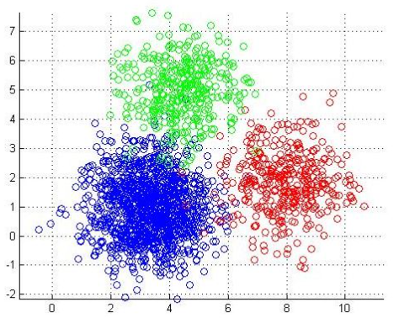
Methodology Moirai-MoE
Transformer
K = 32 (experts)
Gating Function (K mean cluster)
Uses representations obtained from the original Moirai FM during pretraining
Each patch embedding is assigned to k experts
K-mean cluster
K = 3, 2 dimension
Notes:
Gating function 은 각각의 패치 임베딩이 어느 expert 를 고를지 정해준다 여기서 gating function 은 k mean cluster 인데 기존 moirai 모델을 사용하여 얻은 임베딩으로 32 개의 cluster 를 생성 각 패치 임베딩에서 제일 가까운 두개의 클러스터가 사용될 2개의 expert 가 된다

Slide 10
Methodology Moirai-MoE
Transformer
The gating network selects the top-k experts (k = 2)
Expert weights are computed based on the Euclidean distance between patch and centroid
(patch – centroid Euclidean distance based)
The output of the MoE layer is:
ΣG.E
Notes:
각각의 클러스터에 대한 가중치와 클러스터에서 ffn 레이어를 거친 임베딩을 곱한후 더해준다

Slide 11
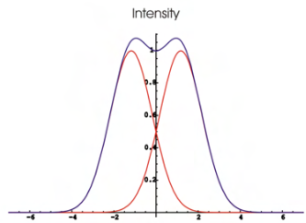
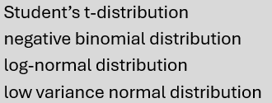

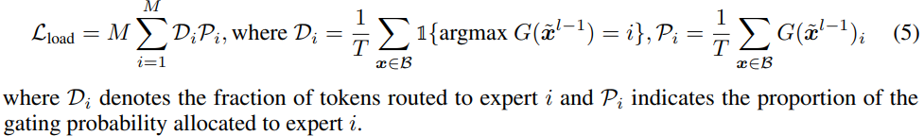
Methodology Moirai-MoE
Loss
A probability distribution over each timestamp in the prediction patch:
ϕ = {w1, ϕ1, . . . , w4, ϕ4}
w1 = weight of ϕ1
Φ1 = mean & variance of a distribution
The model is trained to maximize the probability of the ground truth within the predicted distribution
+ Includes a load-balancing loss so that tokens are evenly assigned across experts
Notes:
4 개 분포 확인

Slide 12
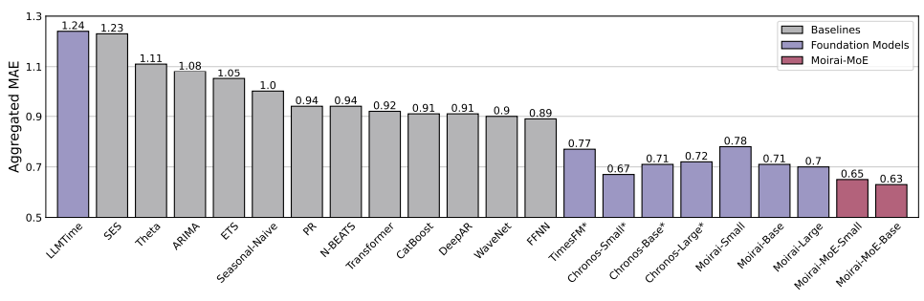
Experiment & Result Moirai-MoE
In-distribution forecasting Results (Monash Benchmark)
Moirai-MoE has SOTA performance
Compared to other foundation models such as Chronos, it uses 65× fewer active parameters

Slide 13
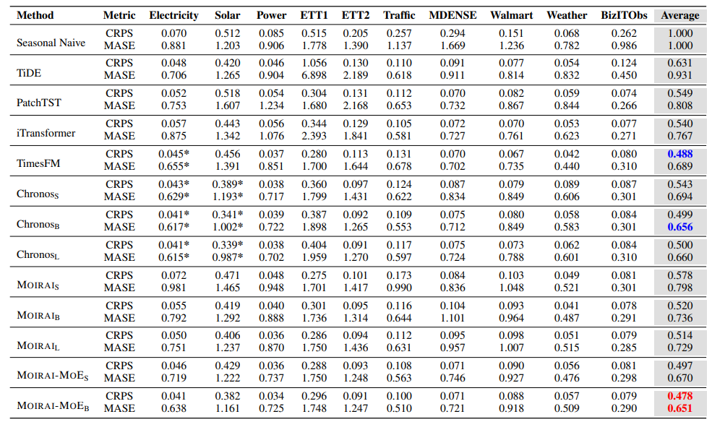
Experiment & Result Moirai-MoE
Zero shot forecasting Results Probability & Point forecasting
(CRPS)Continuous Ranked Probability Score, (MASE)Mean Absolute Scaled Error
Moirai-MoE-B shows higher performance than TimesFM & Chronos, despite being pretrained on less data
Second best
Best

Slide 14

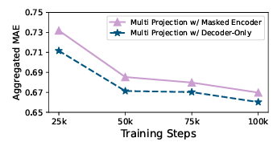
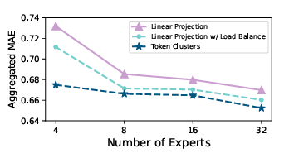
Ablation Studies Moirai-MoE
Model Structure:
Replacing the original Moirai masked-encoder architecture with Moirai-MoE
consistently improved performance
2. Expert number:
more the Expert number, better the performance

Slide 15
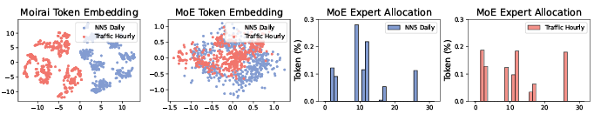
Model Analyses Moirai-MoE
NN5 Daily
Traffic Hourly
Two datasets have similar patterns but different frequencies.
Frequency-based Moirai embeddings show large separation even for similar-pattern data
Moirai-MoE embeddings blend these similar-pattern datasets more appropriately
x: expert index / y: token
Datasets with similar characteristics are assigned to similar experts

Slide 16
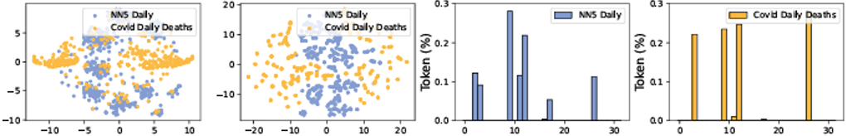
Model Analyses Moirai-MoE
NN5 Daily
Covid Daily Deaths
Two datasets have different patterns but the same frequency.
Because they share frequency, Moirai representations mix together,
In Moirai-MoE representations, they remain clearly separated
x: expert index / y: token
Since the datasets have different characteristics,
the experts assigned in Moirai-MoE behave differently
->
Able to produce frequency-invariant representations that capture time-series patterns

Slide 17
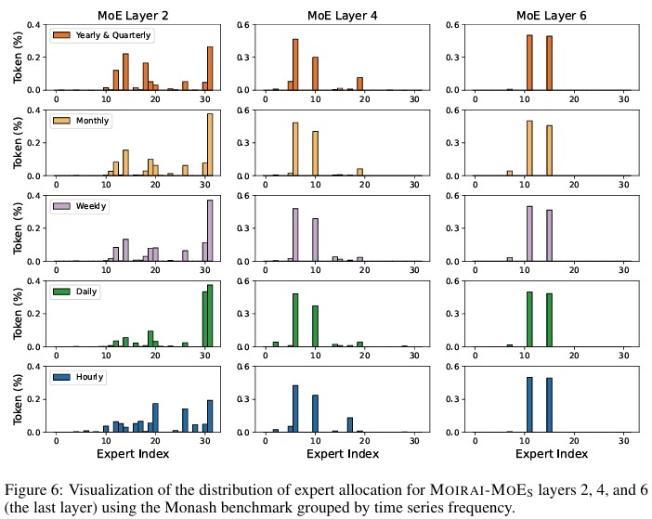
Model Analyses Moirai-MoE
Observations:
Frequency-invariant
Shallow layers tend to reference multiple experts, while deeper layers assign experts that are more dataset-specific
From these observations:
1. The model gains high-level representation capability for dataset-specific patterns
2. The model denoises heterogeneity within time-series data during training
Expert index usage frequency at MoE Layers 2, 4, and 6

Slide 18
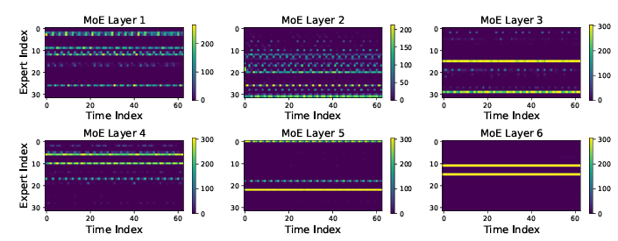

Model Analyses & Conclusion Moirai-MoE
Observation:
When applied to Traffic data,
expert allocation corresponds to periodic patterns within the dataset.
-> The model can capture time-series periodicity effectively
The first foundation model in time-series forecasting to apply Mixture of Experts
Can represent diverse time-series patterns in a frequency-invariant manner
Achieves high performance with fewer active parameters compared to Moirai and other foundation models

