Slide 1
KTH Edge AI
Robotics Challenge
Kick-off meeting
2026.10.07

Slide 2
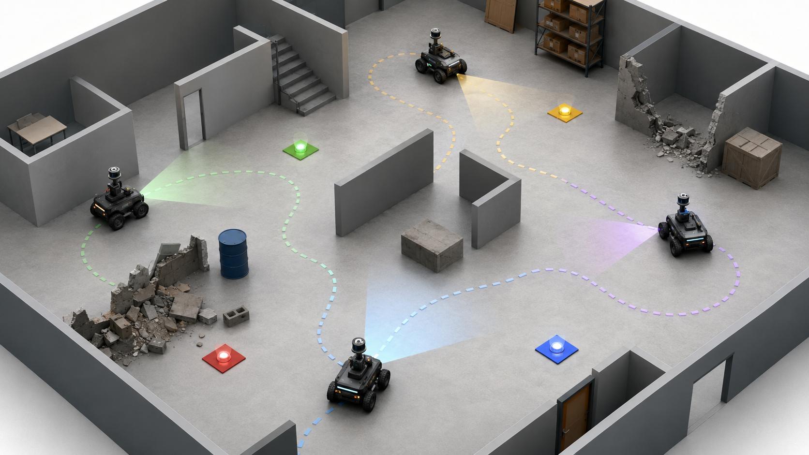
Challenge overview
Each team will control a group of approximately four wheeled mobile robots operating in an unknown indoor environment. During the mission, the robots may need to:
Explore an initially unknown environment
Detect, identify, and localize different targets
Share information between robots and edge node
Allocate tasks among robots
Form robot groups to complete specific rescue tasks
Adapt their behavior according to mission updates
Manage computation, communication, or energy consumption
Core theme: AI + Robotics + Edge Computing + Communication + Control
02

Slide 3
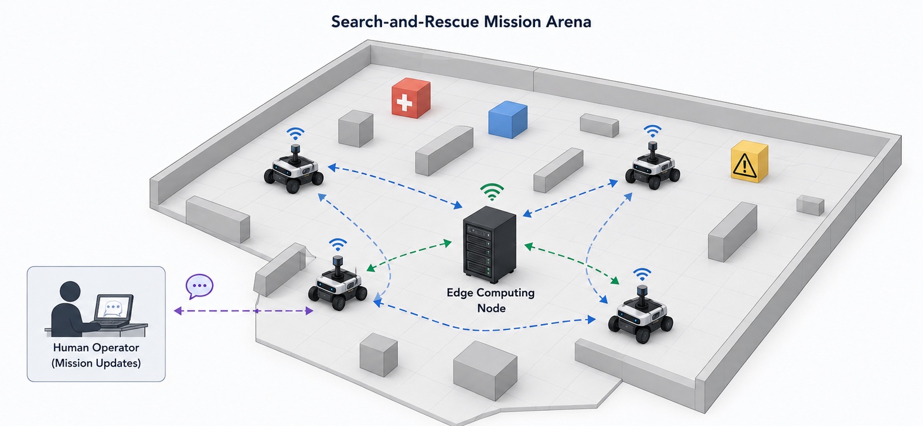
System architecture - overview
1. Mobile robot team
Robots perform sensing, local computation, motion control, and exploration.
Robots can communicate and share local information with each other.
2. Edge computing node
A single local computing server is available to each team.
Teams decide which tasks are executed onboard and which are offloaded to the edge.
Typical edge functions may include: multi-robot coordination; perception/object detection; map fusion; task allocation; LLM inference.
3. Human operator + LLM
The human operator provides natural-language mission updates.
The LLM interprets the instructions and converts them into executable tasks.
03

Slide 4
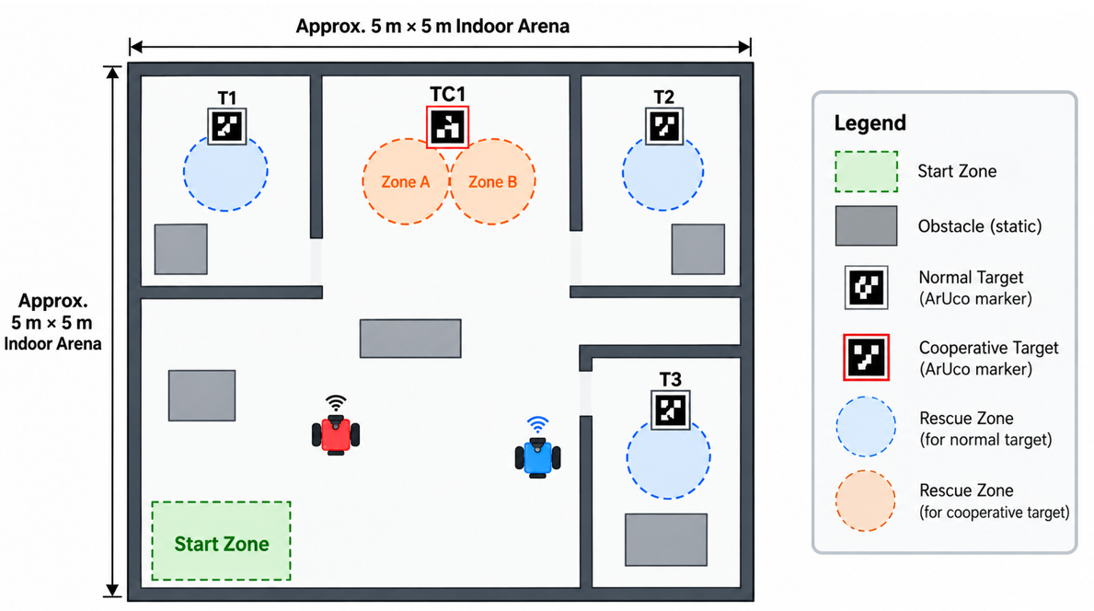
Competition environment
In-door, flat-floor environment of approximately 5m × 5m (final dimensions are TBD), containing rooms, walls, and static obstacles.
Rescue targets are represented by ArUco visual markers and divided into two types: Normal Targets and Cooperative Targets.
Rescue zone is used for rescue-completion verification. Each ArUco marker corresponds to one or more predefined Rescue Zones.
A rescue is completed when the robot enters the corresponding Rescue Zone and remains there continuously for the required duration.
Illustrative arena
05

Slide 5
Overall competition flow
Two main tasks
Task 1
Handover
Task 2A
Safe Mode
Task 2B
Explore, map
and detect
Save unified
outputs
Autonomous
rescue
Verify results and reposition
LLM-guided
mission
05

Slide 6
Task 1 Autonomous exploration, mapping, and detection
Teams may use up to two robots starting from a designated start area to autonomously explore an unknown environment and build a unified 2D occupancy grid map within limited time:
The robot system shall operate autonomously based on the current map and sensor information, performing path planning, obstacle avoidance, and motion execution toward the selected target;
Existing ROS 2 SLAM, navigation, and other open-source software packages are allowed.
06

Slide 7
Task 1 Autonomous exploration, mapping, and detection
Teams may use up to two robots starting from a designated start area to autonomously explore an unknown environment and build a unified 2D occupancy grid map within limited time:
The robot system shall operate autonomously based on the current map and sensor information, performing path planning, obstacle avoidance, and motion execution toward the selected target;
Existing ROS 2 SLAM, navigation, and other open-source software packages are allowed.
Target detection and localization
The system shall perform the following pipeline:
01
02
03
04
05
ArUco observation
Identify target ID and type
Estimate relative position
Pose in
map frame
Update
target list
Required output: A 2D occupancy map and a target list
06

Slide 8


Task 2A Multi-robot rescue
Task 2 uses the unified map and target list generated in Task 1. Multiple robots cooperate to complete rescue tasks. Teams may use up to four robots and use the organizer-provided edge node for global state aggregation, task planning, and multi-robot coordination.
Edge Node
Multiple Robots
Task 1 Outputs
Task planning – What should be done next?
Robot allocation – Which robot(s) should do it?
Coordination – How should robots cooperate?
Global state – Track progress and update plans
ID Type
T1 Normal
TC1 Coop.
State / progress
Unified Map
Target List
Task assignments
Autonomous Navigation & Rescue Execution (path planning, motion control, obstacle avoidance)
Map + target information from Task 1
Teams develop
Implement multi-robot coordination
Integrate task assignments with autonomous navigation and rescue execution
Design the robot–edge communication interface
Build global robot and target state management
Develop task planning and robot allocation
08

Slide 9
Normal and cooperative rescue
Normal Target
Cooperative Target
Rescue Zone
Zone A
Zone B
1 robot
Continuous dwell
2 different robots
Simultaneous continuous dwell
Rescue zone position is determined from the marker pose using unified and publicly specified geometric rules (TBD)
Task 2A is also time-limited and ends when one of the following conditions occurs: (1) The competition time limit is reached; (2) All valid rescue targets have been successfully completed; (3) The referee terminates the run due to safety, equipment failure, or another necessary reason.
After Task 2A results have been verified, the organizers will reposition the robots to predefined Task 2B starting positions. The map, target list, and other environment information obtained previously are retained.
09

Slide 10
Task 2B LLM-guided mission: Task flow
In this task, the LLM acts as a high-level mission interpreter and planner. Its primary role is to understand the natural-language mission instruction and convert mission objectives and high-level constraints into a structured mission plan.
Operator
Edge Node
Multiple Robots
Natural-language
mission input
LLM Mission Interpreter
Interpret instruction，Extract objectives & constraints，
Generate a structured mission plan
State / progress
Structured mission plan
Retained
information
Multi-Robot Coordinator
Task assignments
Autonomous Navigation & Rescue Execution
Execution planning ，Robot allocation，Coordination，
Global state management
Teams develop
Natural-language mission input interface
LLM prompting and mission interpretation
Structured mission-plan representation
Integrate the LLM mission layer with the existing Task 2A coordination framework
11

Slide 11
Task 2B LLM-guided mission: Task flow
In this task, the LLM acts as a high-level mission interpreter and planner. Its primary role is to understand the natural-language mission instruction and convert mission objectives and high-level constraints into a structured mission plan.
Operator
Edge Node
Multiple Robots
Natural-language
mission input
LLM Mission Interpreter
Interpret instruction，Extract objectives & constraints，
Generate a structured mission plan
State / progress
Structured mission plan
Retained
information
Multi-Robot Coordinator
Task assignments
Autonomous Navigation & Rescue Execution
Execution planning ，Robot allocation，Coordination，
Global state management
Simple Example
Natural-language mission
LLM → Structured mission plan
Coordinator / Robots
“Rescue T2 first. Then T1 and T3.
Complete TC1 last.”
T2 → {T1, T3} → TC1
Robot assignment, navigation,
coordination and rescue execution
11

Slide 12
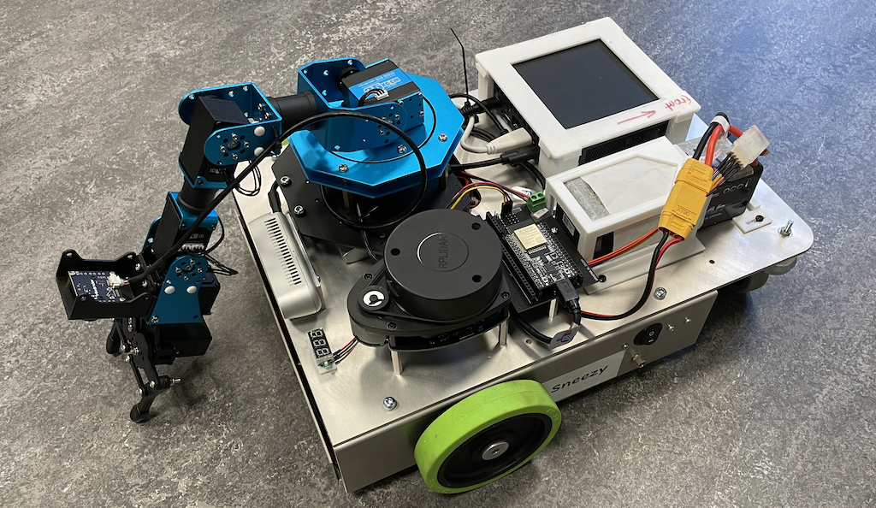
Robot platform and development environment
The competition uses differential-drive wheeled mobile robots:
Mobile Base
Onboard Computing
Differential-drive platform
Wheel encoders
Intel NUC11TNKi5
NVIDIA GT 1030
ROS 2 onboard software
Perception
State Estimation
RPLIDAR — mapping & obstacle sensing.
RealSense D435i — RGB-D perception & ArUco detection
Wheel encoders
IMU
Odometry/localization support
More information about the robot can be found at: https://canvas.kth.se/courses/59505/pages/robot-setup?module_item_id=1339720
Edge node information to be announced later…
04

Slide 13
Robot platform and development environment
Environments used to develop, test, integrate, and deploy the challenge system:
1. Robot & Edge computing
2. Simulation environment
Provides the common runtime and development environment for robot-side and edge-node applications.
Enables autonomy and multi-robot behaviors to be developed and tested before physical deployment.
• Ubuntu Linux
• ROS 2
• Python / C++
• ROS 2 workspace & package system
• Gazebo
• Simulated robot model
• Simulated indoor competition arena
• Simulated LiDAR/RGB-D sensors
3. Communication environment
4. Development & Debugging
Supports communication between robots, the edge node, and the operator, including task dispatching, state sharing, feedback, and coordination.
Supports visualization, debugging, data recording, software integration, and team collaboration.
• Local Wi-Fi/LAN
• ROS 2 DDS communication
• Topics / services / actions
• Robot IDs and namespaces
• RViz
• ROS 2 CLI & colcon
• rosbag
• Git / VS Code / terminal tools…
04
Task 2B add-on: LLM inference runtime and model on the edge node — exact backend/model to be specified later.

Slide 14
What we provide vs. What teams develop
Organizer Provides
Teams Develop
Status:
Available
Partial
To do
• Autonomous exploration and navigation integration
Available
Robot platform & onboard hardware
• Target detection and localization
Available
ROS 2 / Gazebo development environment
• Robot–edge communication and information sharing
Available
Basic robot model for Gazebo simulation
• Global robot / target / task-state management
Available
Simulated sensor / Single-robot SLAM baseline
• Task planning and robot allocation
Partial
Basic setup/ simulation tutorial
• Multi-robot coordination and cooperative rescue
Partial
Competition task/ arena / target specification
• Feedback, failure handling, and replanning
To do
Real-robot ROS 2 I/O interface
To do
Robot-edge basic network connectivity
• LLM mission interpretation and integration for Task 2B
To do
Edge-node base runtime / LLM environment
• Overall system integration and testing

Slide 15
Milestone and development timeline
End-to-end autonomous rescue baseline (simulation demo is sufficient)
Autonomous exploration, ArUco detection and localization
Autonomous map-based navigation
At least two robots should connect, with their states available to the system
Basic robot–edge communication demonstrated
Basic task planning and robot allocation
At least one Normal Rescue and one Cooperative Rescue
Week 0
Week 4
Week 8
Kick-off
Mid-term milestone
Final
Early Development Phase
Integration and real-robot validation
• Focus primarily on Gazebo simulation
• Develop and test exploration, SLAM, navigation, multi-robot coordination…
• Use simulation for rapid iteration and debugging
• Physical robots are used mainly for validation and system integration
• Teams that need real-robot testing should book a time slot in advance
13

Slide 16
Resources and next steps
Resources
Rulebook v0
Robot Setup and Technical Tutorial
ROS 2 workspace and Gazebo resources
Questions and discussion
After this meeting
1 Set up and run the simulation
2 Check interfaces and SLAM
3 Implement autonomous exploration
4 Assign team responsibilities
14

