Slide 1

Version Control
Based on the materials by
Mike Jackson, Katy Huff, Paul Ivanov, Rachel Slaybaugh, Anthony Scopatz, and Greg Wilson
Copyright © Software Carpentry 2013
This work is licensed under the Creative Commons Attribution License
See http://software-carpentry.org/license.html for more information.

Slide 2
With version control we can…
Keep track of changes like a lab notebook for code and documents
Roll back changes to any point in the history of changes to our files
Back up our entire history of changes in various locations
Work on our files from multiple locations
Identify and resolve conflicts when the same file is edited within two repositories without losing any work
Collaboratively work on code or documents or any other files

Slide 3
Different version control systems
Centralized version control, for example SVN
Distributed version control, for example Mercurial or Git
Remote repositories hosting services, for example GitHub and BitBucket
Ask about a repository at your research institution!

Slide 4
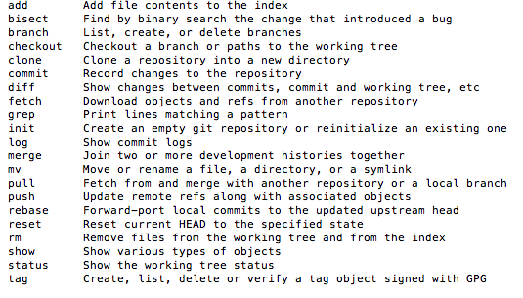
Git
Distributed version control
Very powerful
Widely used
May seem a steep learning curve but it’s well worth it!

Slide 5
Distributed version control
_x0013_Local Remote_x0016_
Working
copy
commit
push
add
checkout
pull
Staging area (git add….)

Slide 6
Commits
i87hks
hni686ad
abjgd687
khd76enak
commit
commit
commit
HEAD

Slide 7
Commits - checkouts
i87hks
hni686ad
abjgd687
khd76enak
commit
commit
commit
git checkout hni686ad
HEAD

Slide 8
Branching
MASTER
i87hks
hni686ad
abjgd687
khd76enak
commit
commit
commit
branch (git checkout –b feature1)
commit
FEATURE1

Slide 9
Merging a branch
MASTER
hni686ad
abjgd687
khd76enak
i87hks
commit
commit
commit
git merge feature1
branch (git checkout –b feature1)
commit
FEATURE1

Slide 10
Working with remote repository
_x0013_Local Remote_x0016_
Working
copy
push
commit
checkout
pull
My laptop
GitHub

Slide 11
Working with remote repository
Remote_x0016_
pull
push
pull
push
Working
copy
Working
copy
commit
commit
checkout
checkout
Aleksandra
John

Slide 12
Workflows and best practices
Thinking about joining and contributing to project that uses a version control?
Check their workflow and recommended practice (for example, each new feature in a new branch).
If in doubt, ask questions!

