Slide 1

Make Sensitive Media Ecosystem
w/ Reader Reports
GiveUsSushiForLunch

Slide 2
Problem Statement
Minorities are excluded from the news.

Slide 3
Target Audience
Minorities are excluded from the news.

Slide 4
Target Audience
Minorities
are excluded from the news.
Women, Disabled, LGBT, Foreigners, etc.

Slide 5
Our Solution
Sensitive Media Ecosystem w/ Reader Reports
Reader Reports
Sensible CMS
Feedback emails

Slide 6
Reader Reports
Readers can report hate speech of articles.
Database of hate speech can be constructed.

Slide 7

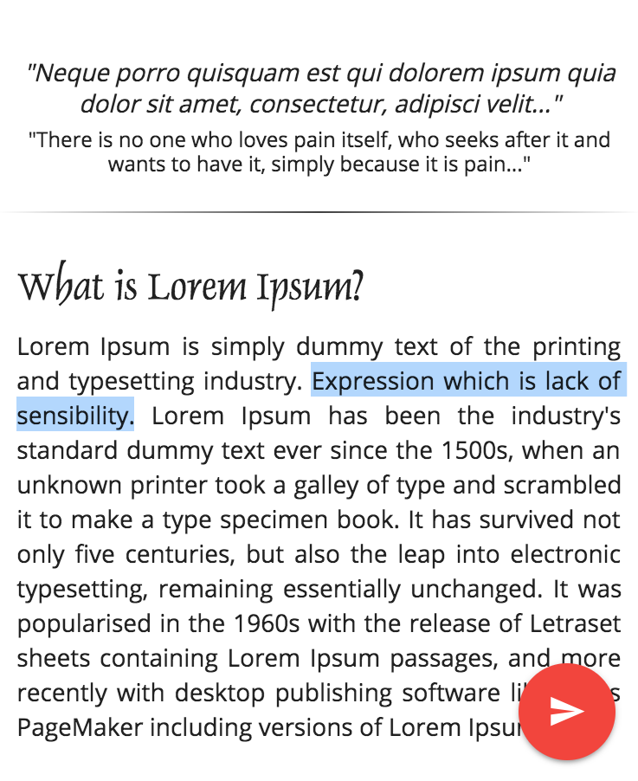
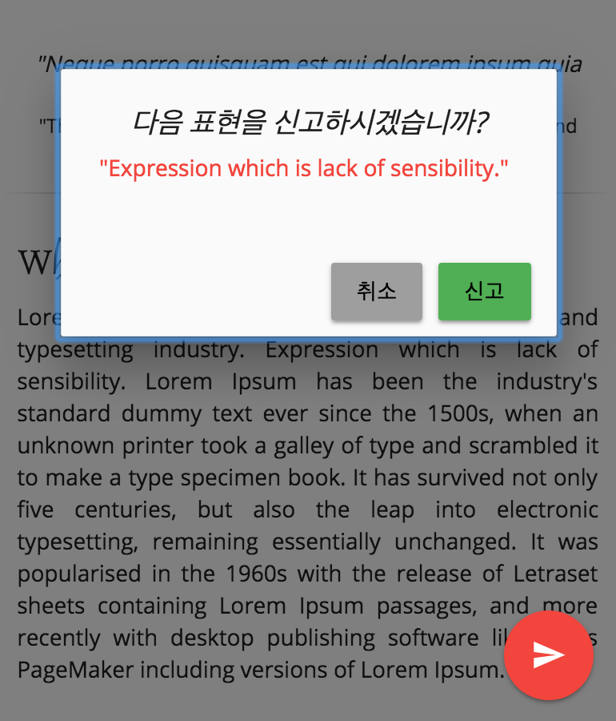
Reader Reports

Slide 8
Sensible CMS
With machine learning, we can build a CMS which can check hate speech automatically.
Writers can self-check their own articles, even can check its ‘Diversity Index’.

Slide 9
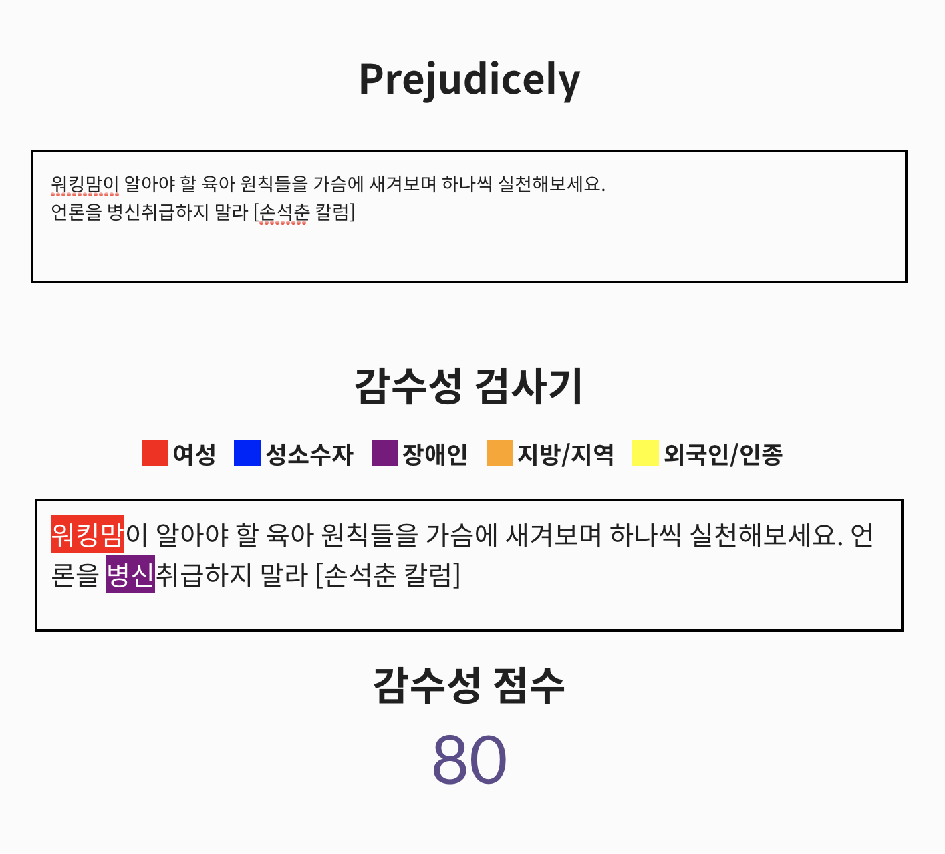
Sensible CMS

Slide 10
Feedback emails
We can send feedback emails to the readers who sent reports.
This will engage more and more.
In this email, we can also put ’No-hate-speech stories’

Slide 11
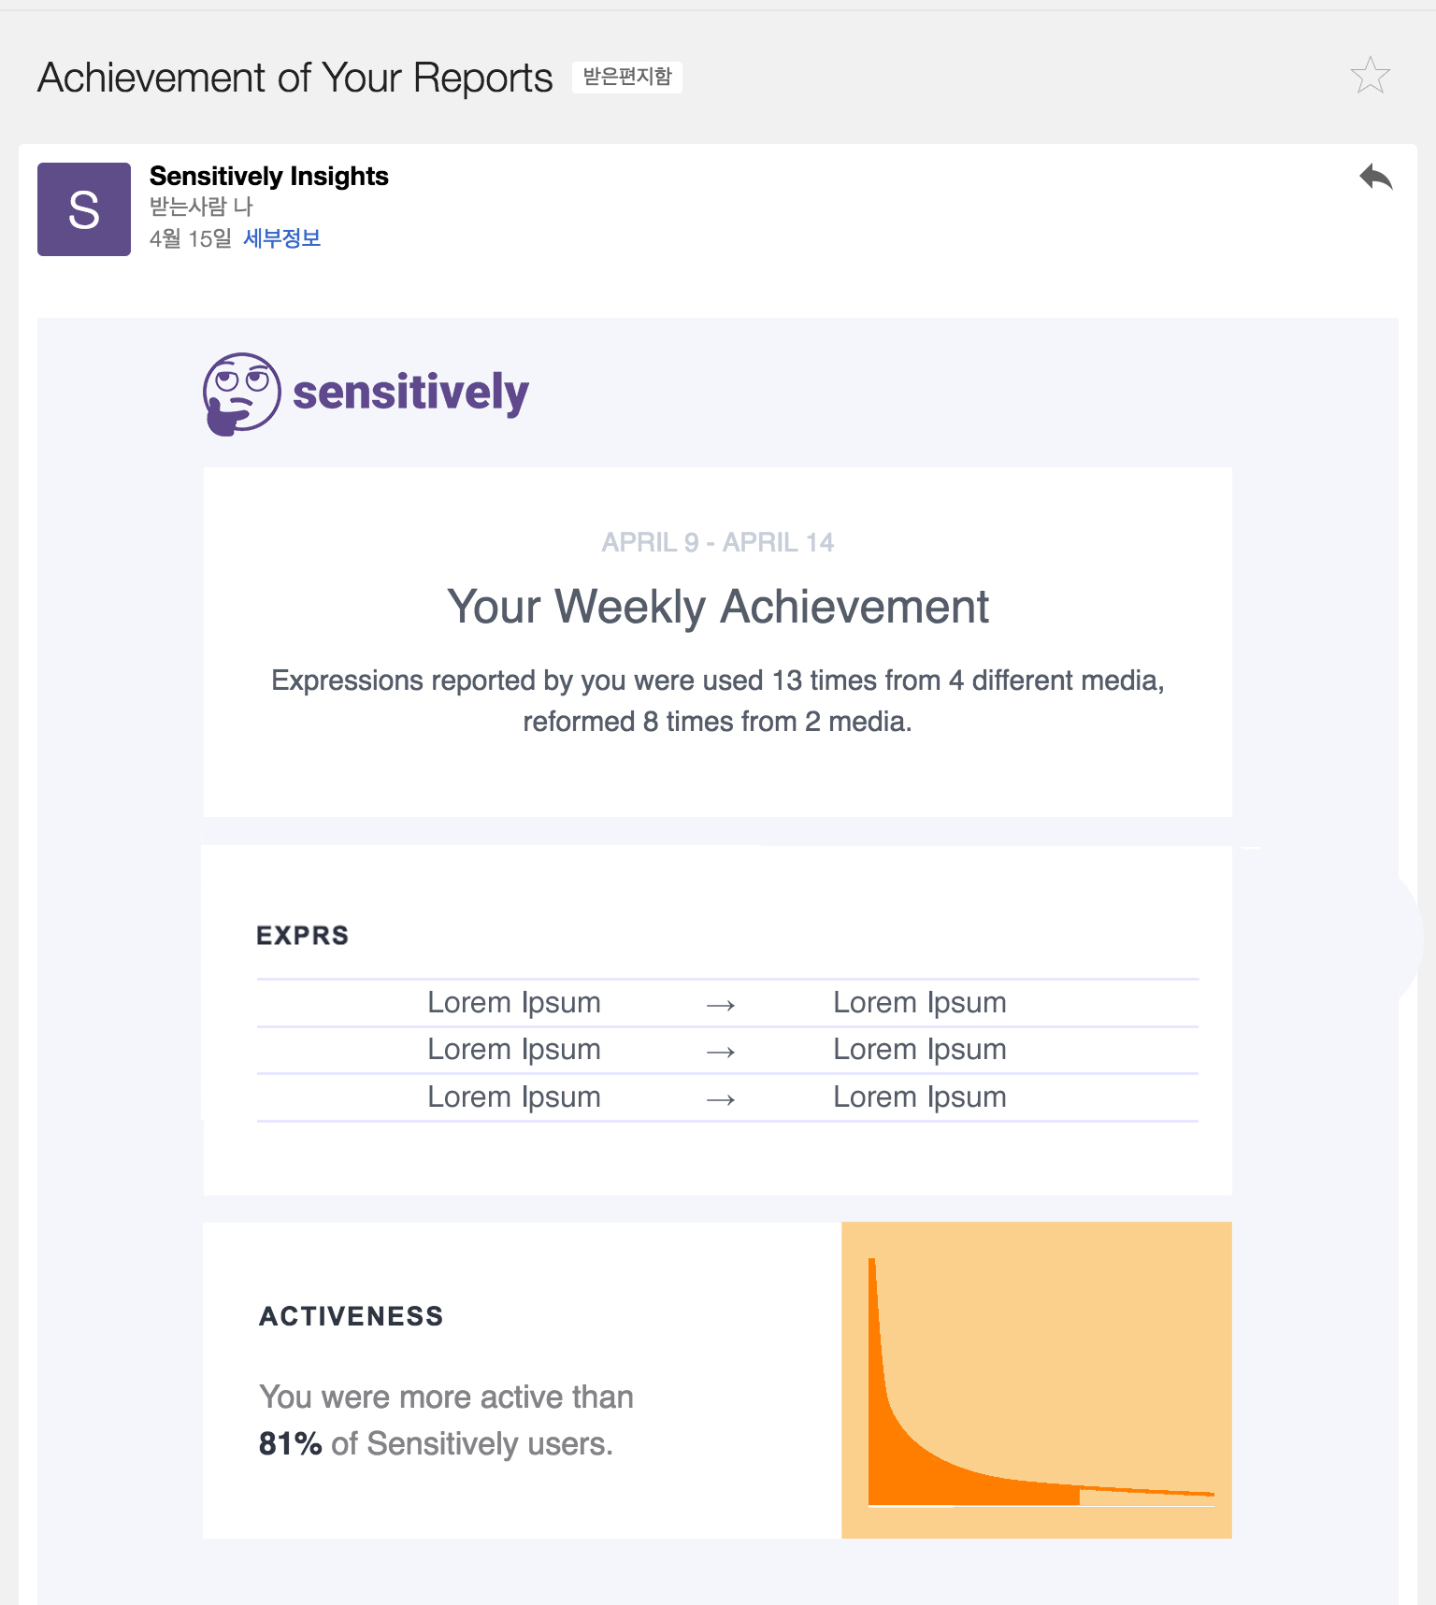
Feedback emails

Slide 12
Further Directions
Media can treat stories whose diversity index is high more important.
Not only for minorities but also whole readers.
We can build the news community which does not exclude minorities.

