Slide 2
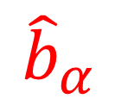
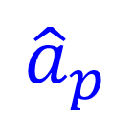


$${\hat{a}}_{p}$$
$${\hat{b}}_{α }$$
$$l$$
$$L$$

Slide 3

$${\hat{a}}_{p}$$
$${\hat{b}}_{α }$$
$$l$$
$$β$$
$$L$$

Slide 4
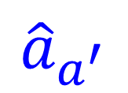
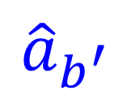

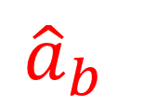

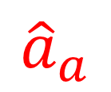
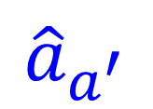

(a)
$${\hat{a}}_{a}$$
$${\hat{a}}_{b }$$
Homodyne
detection
$${\hat{a}}_{a^{′}}$$
$${\hat{a}}_{b^{′}}$$
(b)
$${\hat{a}}_{a}$$
$${\hat{a}}_{b }$$
Homodyne
detection
$${\hat{a}}_{a^{′}}$$
$${\hat{a}}_{b^{′}}$$
SLM

Slide 5
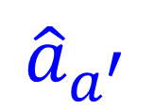

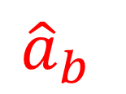
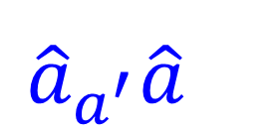

(a)
(b)
$${\hat{a}}_{a}$$
$${\hat{a}}_{b }$$
$${\hat{a}}_{a}$$
$${\hat{a}}_{b }$$
Homodyne
detection
Homodyne
detection
$${\hat{a}}_{a^{′}}{\hat{a}}_{}^{}$$
$${\hat{a}}_{b^{′}}$$
$${\hat{a}}_{a^{′}}$$
$${\hat{a}}_{b^{′}}$$
SLM

Slide 6

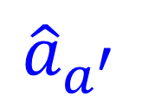
(a)
(b)
$${\hat{a}}_{a}$$
$${\hat{a}}_{b }$$
$${\hat{a}}_{a}$$
$${\hat{a}}_{b }$$
Homodyne
detection
Homodyne
detection
in
in
in
in
$${\hat{a}}_{a^{′}}$$
$${\hat{a}}_{b^{′}}$$
$${\hat{a}}_{a^{′}}$$
$${\hat{a}}_{b^{′}}$$
SLM

Slide 7




$${\hat{a}}_{a}$$
$${\hat{a}}_{b }$$
Homodyne
detection
$${\hat{a}}_{a^{′}}$$
SLM
$${\hat{a}}_{b^{′}}$$

Slide 8
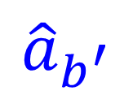



$${\hat{a}}_{a}$$
$${\hat{a}}_{b }$$
Homodyne
detection
$${\hat{a}}_{a^{′}}$$
$${\hat{a}}_{b^{′}}$$
SLM

Slide 9


(a)
BS
(b)
$$φ_{1}$$
$$φ_{2}$$
BS

Slide 10


(a)
(b)
$$φ_{1}$$
BS
$$φ_{2}$$
BS

Slide 11
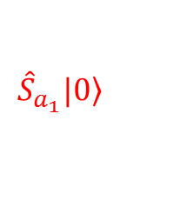

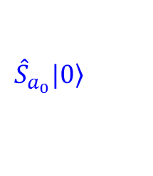

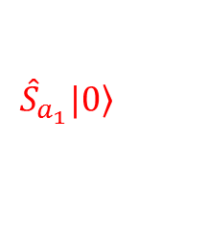

(a)
(b)
$$φ_{1}$$
$${\hat{S}}_{a_{0}}\left.|0\right\rangle$$
$${\hat{S}}_{a_{0}}\left.|0\right\rangle$$
$${\hat{S}}_{a_{1}}\left.|0\right\rangle$$
$${\hat{S}}_{a_{1}}\left.|0\right\rangle$$
BS
$$φ_{2}$$

Slide 12


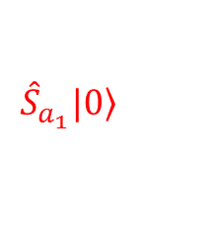

(a)
$${\hat{S}}_{a_{0}}\left.|0\right\rangle$$
$${\hat{S}}_{a_{1}}\left.|0\right\rangle$$
BS
(b)
$$φ_{1}$$
$${\hat{S}}_{a_{0}}\left.|0\right\rangle$$
$${\hat{S}}_{a_{1}}\left.|0\right\rangle$$
$$φ_{2}$$

Slide 13












$$P$$
$$+$$
$$=$$
$$X$$
$$+$$
$$=$$
$$P$$
$$+$$
$$=$$
$$X$$
$$+$$
$$=$$

Slide 14








(a)
$$P$$
$$+$$
$$=$$
$$X$$
(b)
$$+$$
$$=$$
(c)
$$+…+$$
$$=$$

Slide 15












(a)
$$P$$
$$+$$
$$=$$
$$X$$
(b)
$$+$$
$$=$$
(c)
$$+$$
$$+…+$$
$$=$$
(d)
$$+$$
$$+…+$$
$$=$$

Slide 16



$$\hat{S}|0〉$$
$$|0〉$$
$$\hat{S}|0〉$$
$$|0〉$$
$$\hat{S}|0〉$$
$$\hat{S}|0〉$$
(a)
$$P$$
$$+$$
$$=$$
$$X$$
(b)
$$+$$
$$=$$
(c)
$$+$$
$$+…+$$
$$=$$
(d)
$$+$$
$$+…+$$
$$=$$

Slide 17











$$\hat{S}|0〉$$
$$|0〉$$
$$\hat{S}|0〉$$
$$|0〉$$
$$\hat{S}|0〉$$
$$\hat{S}|0〉$$
$$P$$
(a)
$$+$$
$$=$$
$$X$$
(b)
$$+$$
$$=$$
(c)
$$+$$
$$+…+$$
$$=$$
(d)
$$+$$
$$+…+$$
$$=$$

