Slide 1
6.853: Topics in Algorithmic Game Theory
Lecture 9
Fall 2011
Constantinos Daskalakis

Slide 2
Last Time…

Slide 3
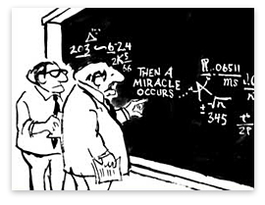
Non-constructive step in the proof of Sperner?

Slide 4
Remember this figure?
{0,1}^{n}
0^{n}
...
= solution

Slide 5
The Non-Constructive Step
an easy parity lemma:
a directed graph with an unbalanced node (a node with indegree ≠ outdegree) must have another.
but, why is this non-constructive?
given a directed graph and an unbalanced node, isn’t it trivial to find another unbalanced node?
the graph can be exponentially large, but has succinct description…

Slide 6



The PPAD Class [Papadimitriou ’94]
Suppose that an exponentially large graph with vertex set {0,1}^{n} is defined by two circuits:
possible previous
node id
P
node id
node id
N
node id
possible next
END OF THE LINE:
Given P and N: If 0^{n} is an unbalanced node, find another unbalanced node. Otherwise say “yes”.
PPAD =
{ Search problems in FNP reducible to END OF THE LINE}

Slide 7
Inclusions
(i)
(ii)
PROOF:
Sufficient to define appropriate circuits P and N as follows:
- Every simplex in the SPERNER instance is identified with an element of {0,1]}^{n} . for some n=n(d, m) that depends on d, the dimension of the SPERNER instance, and m, the discretization accuracy in every dimension.
- Starting Simplex
0^{n}
- Define: P(0^{n}) = 0^{n}; make N(0^{n}) output the simplex S sharing the colorful facet with the starting simplex; also set P(S)=0^{n} (this makes sure that 0^{n} is a source vertex pointing to vertex S)
- Now, if a simplex S is neither colorful nor panchromatic, then set P(S)=S and N(S)=0^{n} (this makes sure that S is an isolated vertex)
important here that the directions are efficiently computable locally, and consistent
- if a simplex S has a colorful facet f shared with another simplex S’, then if the sign of f in S is then set N(S)=S’; otherwise set P(S)=S’.

Slide 9
Other arguments of existence, and resulting complexity classes
“If a graph has a node of odd degree, then it must have another.”
PPA
“Every directed acyclic graph must have a sink.”
PLS
“If a function maps n elements to n-1 elements, then there is a collision.”
PPP
Formally?

Slide 10
The Class PPA [Papadimitriou ’94]
“If a graph has a node of odd degree, then it must have another.”
Suppose that an exponentially large graph with vertex set {0,1}^{n} is defined by one circuit:
possible neighbors
node id
C
{ node id₁ , node id₂}
ODD DEGREE NODE:
Given C: If 0^{n} has odd degree, find another node with odd degree. Otherwise say “yes”.
PPA =
{ Search problems in FNP reducible to ODD DEGREE NODE}

Slide 11
The Undirected Graph
{0,1}^{n}
0^{n}
...
= solution

Slide 12
The Class PLS [JPY ’89]
“Every DAG has a sink.”
Suppose that a DAG with vertex set {0,1}^{n} is defined by two circuits:
node id
C
{node id₁, …, node id_{k}}
node id
F
FIND SINK:
Given C, F: Find x s.t. F(x) ≥ F(y), for all y ∈ C(x).
PLS =
{ Search problems in FNP reducible to FIND SINK}

Slide 13
The DAG
{0,1}^{n}
= solution

Slide 14
The Class PPP [Papadimitriou ’94]
“If a function maps n elements to n-1 elements, then there is a collision.”
Suppose that an exponentially large graph with vertex set {0,1}^{n} is defined by one circuit:
node id
C
node id
COLLISION:
Given C: Find x s.t. C( x )= 0^{n}; or find x ≠ y s.t. C(x)=C(y).
PPP =
{ Search problems in FNP reducible to COLLISION }

Slide 15
Notes:
Exercise: Show that PPAD is a subset of PPP.

Slide 16
Hardness Results

Slide 17
Inclusions we have already established:
Our next goal:

Slide 18
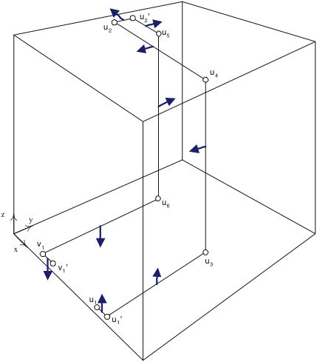
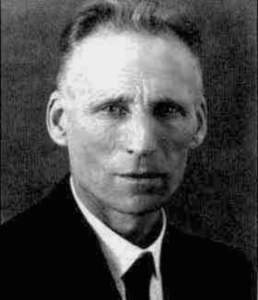
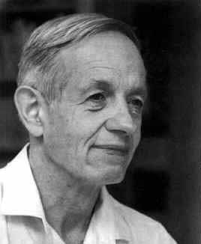
The PLAN
DGP = Daskalakis, Goldberg, Papadimitriou
CD = Chen, Deng
[Pap ’94]
[DGP ’05]
0^{n}
Embed PPAD graph in [0,1]³
...
Generic PPAD
[DGP ’05]
4-player
NASH
[DGP ’05]
[DP ’05]
3-player
NASH
[DGP ’05]
[DGP ’05]
[CD’05]
[CD’06]
2-player
NASH
p.w. linear
BROUWER
multi-player
NASH
3D-SPERNER

Slide 19
This Lecture
DGP = Daskalakis, Goldberg, Papadimitriou
CD = Chen, Deng
[Pap ’94]
[DGP ’05]
0^{n}
Embed PPAD graph in [0,1]³
...
Generic PPAD
[DGP ’05]
4-player
NASH
[DGP ’05]
[DP ’05]
3-player
NASH
[DGP ’05]
[DGP ’05]
[CD’05]
[CD’06]
2-player
NASH
p.w. linear
BROUWER
multi-player
NASH
3D-SPERNER

Slide 20
First Step
Embed PPAD graph in [0,1]³
0^{n}
...
Generic PPAD
our goal is to identify a piecewise linear, single dimensional subset of the cube, corresponding to the PPAD graph; we call this subset L

Slide 21
Non-Isolated Nodes map to pairs of segments
0^{n}
...
Generic PPAD
Non-Isolated Node
pair of segments
main segment
auxiliary segment

Slide 22
Non-Isolated Nodes map to pairs of segments
0^{n}
...
Generic PPAD
Non-Isolated Node
pair of segments
also, add an orthonormal path connecting the end of main segment and beginning of auxiliary segment
breakpoints used:

Slide 23
Edges map to orthonormal paths
0^{n}
...
Generic PPAD
Edge between and
orthonormal path connecting the end of the auxiliary segment of u with beginning of main segment of v
breakpoints used:

Slide 24
Exceptionally 0^{n} is closer to the boundary…
0^{n}
...
Generic PPAD
Modifications of main segment and first breakpoint for 0^{n}:
This is not necessary for the embedding of the PPAD graph to the cube, but will be crucial later in the definition of the Sperner instance…

Slide 25
Finishing the Embedding
0^{n}
...
Generic PPAD
Call L the orthonormal line defined by the above construction.
Claim 1:
Two points p, p’ of L are closer than 3⋅2^{-m} in Euclidean distance only if they are connected by a part of L that has length 8⋅2^{-m} or less.
Claim 2:
Given the circuits P, N of the END OF THE LINE instance, and a point x in the cube, we can decide in polynomial time if x belongs to L.
Claim 3:

Slide 26
Reducing to 3-d Sperner
For convenience we reduce to dual-SPERNER
Differences between dual-SPERNER and SPERNER:
a) Instead of coloring vertices of the subdivision (the points of the cube whose coordinates are integer multiples of 2^{-m}), color the centers of the cubelets; i.e. work with simplicization of the dual graph.
For convenience define:

Slide 27
Reducing to 3-d Sperner
For convenience we reduce to dual-SPERNER
Differences between dual-SPERNER and SPERNER:
b) Solution to dual-SPERNER: a vertex of the subdivision such that all colors are present among the centers of the cubelets using this vertex as a corner. Such vertex is called panchromatic.
Lemma: If the canonical simplicization of the dual graph has a panchromatic simplex, then this simplex contains a vertex of the subdivision that is panchromatic.
Notes:
Proof of Lemma: Just take the edge of the panchromatic simplex connecting its least-significant corner to its most significant corner.

Slide 28
Reducing to 3-d Sperner
0
1
3
2
For convenience we reduce to dual-SPERNER
Differences between dual-SPERNER and SPERNER:
c) Canonical boundary coloring is (for convenience) slightly different than before, as per the following coloring algorithm (see also figure):
Lemma: Modified boundary coloring still guarantees existence of panchromatic simplex.
, unless already colored
, unless already colored
, unless already colored

Slide 29
The REDUCTION
dual-SPERNER
Coloring INSIDE:
All cubelets get color 0, unless they touch line L.
The cubelets surrounding line L at any given point are colored with colors 1, 2, 3 in a way that “protects” the line from touching color 0.

Slide 30
Coloring around L
2
1
⋅
3
3
colors 1, 2, 3 are placed in a clockwise arrangement for an observer who is walking on L
two out of four cubelets are colored 3, one is colored 1 and the other is colored 2

Slide 31
The Beginning of L at 0^{n}
notice that given the coloring of the cubelets around the beginning of L (on the left), there is no point of the subdivision in the proximity of these cubelets surrounded by all four colors…

Slide 32
Coloring at the Turns..
Out of the four cubelets around L which two are colored with color 3 ?
- in the figure on the left, the arrow points to the direction in which the two cubelets colored 3 lie;
- observe also the way the turns of L affect the location of these cubelets with respect to L; our choice makes sure that no panchromatic vertices arise at the turns.
IMPORTANT directionality issue:
The picture on the left shows the evolution of the location of the pair of colored 3 cubelets along the subset of L corresponding to an edge (u, v) of the PPAD graph…
At the main segment corresponding to u the pair of colored 3 cubelets lies above L, while at the main segment corresponding to v they lie below L.

Slide 33
Coloring at the Turns..
the flip in the directions makes it impossible to efficiently decide locally where the colored 3 cubelets should lie!
Claim1: This is W.L.O.G.
to resolve this we assume that all edges (u,v) of the PPAD graph join an odd u (as a binary number) with an even v (as a binary number) or vice versa
for even u’s we place the pair of 3-colored cubelets below the main segment of u, while for odd u’s we place it above the main segment
convention agrees with coloring around main segment of 0^{n}

Slide 34
Proof of Claim of Previous Slide
- Duplicate the vertices of the PPAD graph
- If node u is non-isolated include an edge from the 0 to the 1 copy
non-isolated
- Edges connect the 1-copy of a node to the 0-copy of its out-neighbor

Slide 35
Finishing the Reduction
Claim 1: A point in the cube is panchromatic in the constructed coloring iff it is:
- an endpoint u₂’ of a sink vertex u of the PPAD graph, or
- an endpoint u₁ of a source vertex u ≠0^{n} of the PPAD graph.
Claim 2: Given the description P, N of the PPAD graph, there is a polynomial-size circuit computing the coloring of every cubelet .

