Slide 1
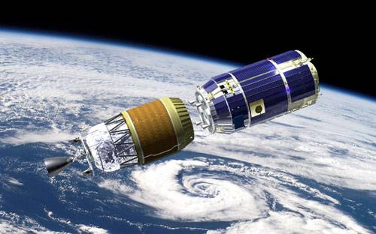
Power of Design Patterns
-- An Online Billing and Paying System On-top-of SSH Frameworks
Team 2: Xiaoming Sun, Dong Liu

Slide 2
Content
1
Project Info & Architecture
Classes with Design Patterns
Summary & Future Development

Slide 3
BPS Project and Background
*
Project Title:
Billing and Payment System (BPS) for Rental Services Provider
*
Project Intent:
To provide a comprehensive and reusable billing and payment system for those SME (Small and Medium Enterprises) who provide some rental services (rent cars, rent books, rent servers, rent tools, etc).
Support personal payment in the future.
*
Application Considerations:
How to develop an enhanced “PayPal” ?
Easy to use → GUI based operation interface → Plain GUI
Onlinetransaction → Web based, available for all kind of terminals, cost effective → JSP, Tomcat server
Large concurrent request, permanent data archive→ Database → MySQL
Flexibility and Extensibility→ Interface based coding → Design Patterns & Frameworks

Slide 4






BPS Business Knowledge
Rate Plan
Products
SME(JSP)
Customer
Tailed
Solution
Authentication
&
Authorizing
FlatFee
OneTime
Coupon
…
BPS
Invoice
Mobile APP
InvoiceDate
Payment
Product Items
(eg. RentCar)
GPS
CarSeat
Coverage
…
Order
Bill
Start Date
End Date
RunBillEngine
Stage 3
Stage 2
Stage 1
Project Develop and Implement Tools:
Apache Tomcat (7.0.55)
Eclipse for JavaEE (JDK 7.0)
MySQL (5.5)
Struts2 (2.3.16)
Spring (4.0.3)
Hibernate (3.6.3)

Slide 5
BPS Architecture Overview (See Detail Later)
Struts2
Spring
Struts:
action map/invoke
Abstract
Factory
Hibernate
XxEntity
struts.xml
table_column
hibernate.
cfg.xml
BillRun
Engine
setters()
getters()
ORM
JSP
Spring:
Core Container
IOC
Abstract
Manager
Abstract
DAO
MySQL
customer
addEntity()
deleteEntity()
setEntity()
getEntity()
customer
product
bean.xml
product
order
orderplan
invoice
RWDAO
billrun
payment
add()
delete()
set()
get()
invoice
……
XxAction
……
Actions defined in JSP
Manager
Base
…
…
@override
setters()
getters()
xxMgr
Impl
xxDAO
Impl
yyMgr
Impl
yyDAO
Impl

Slide 6
Demo

Slide 7
Content
2
Project Info & Architecture
Classes with Design Patterns
Summary & Future Development

Slide 8
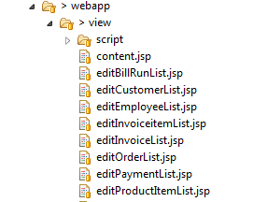
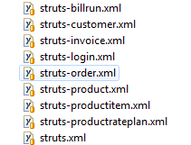
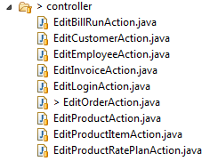
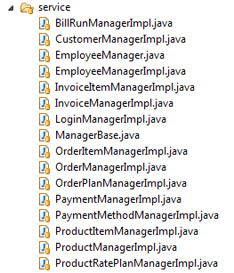


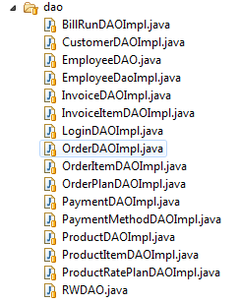
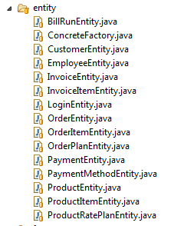
BPS Architecture Insight
index.jsp
…
bill.jsp
product
.jsp
JSP Engine
Struts2
Control Layer
OGNL
struts
.xml
Action
EL
ActionSupport
Spring
Service Logic Layer
IOC
Abstract
Manager
bean
.xml
Transaction
Manager
Impl
Hibernate
Persistence Layer
Abstract
DAO
Entity
hibernate.cfg.xml
DAO
Impl
Connection Pool
MySQL

Slide 9
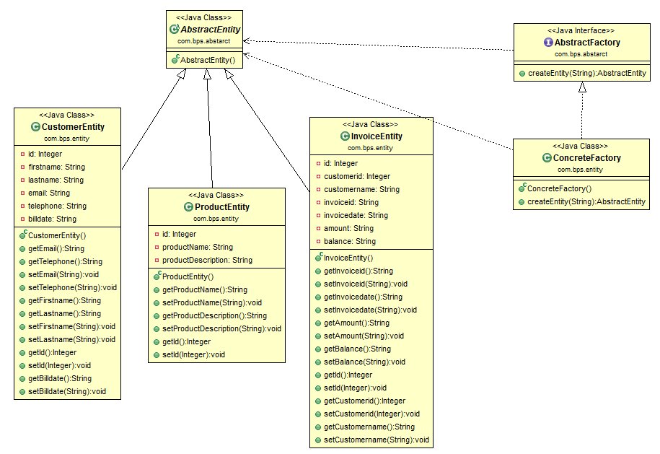
Design Patterns: Factory Method
Factory Method:
factory
Factory Method:
product
Factory Method:
concreteProduct
…
Factory Method:
concreteFactory

Slide 10
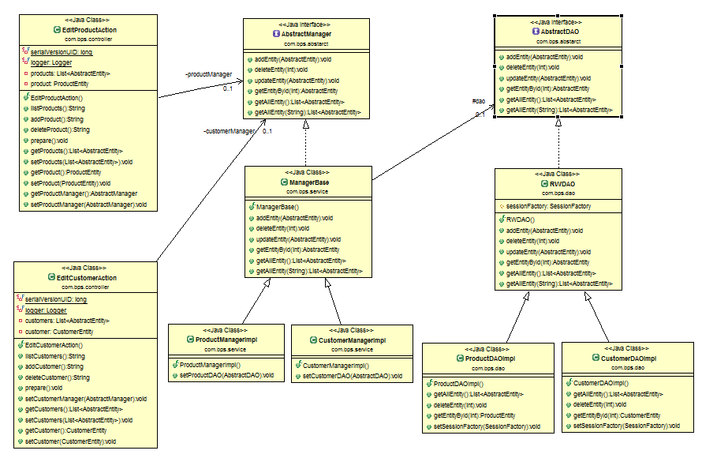
Design Patterns: Bridge
Bridge:
abstraction
Bridge:
implementer
Bridge:
client
Bridge:
Concrete
Implementer
Bridge:
refinedAbstraction

Slide 11
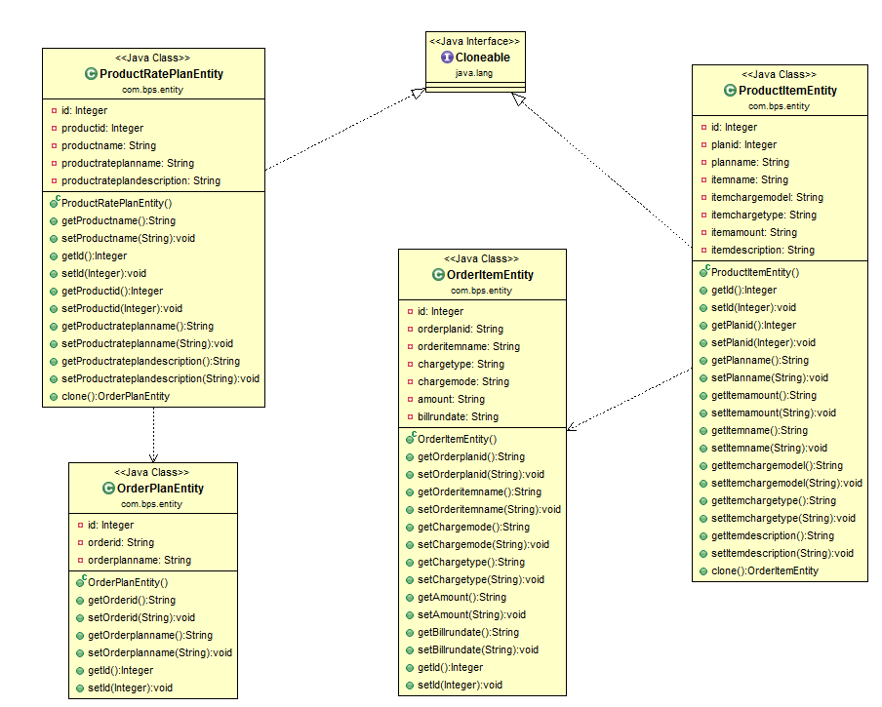
Design Patterns: Prototype
Prototype:
prototype
Prototype:
concretePrototype
Prototype:
Prototype
Manager

Slide 12
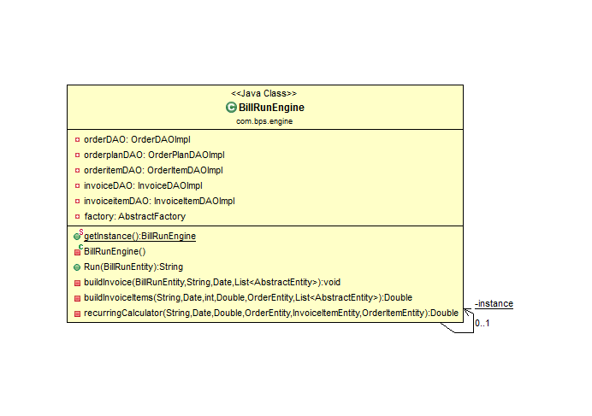
Design Patterns: Singleton
Singleton: singleton

Slide 13
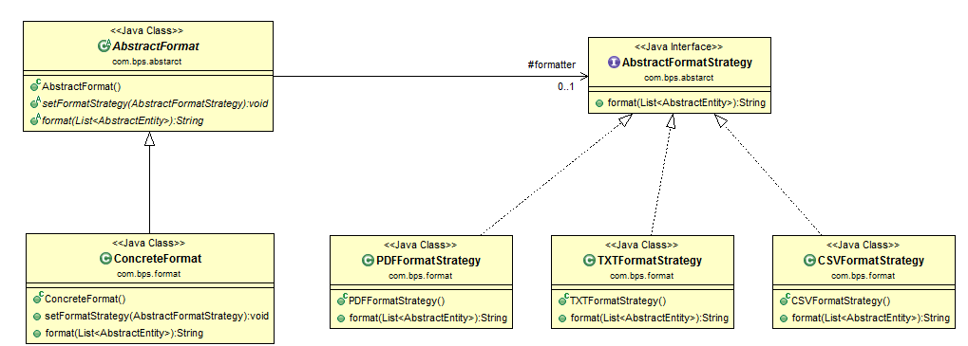
Design Patterns: Strategy
Strategy:
strategy
Strategy:
context
Strategy:
concreteStrategy

Slide 14
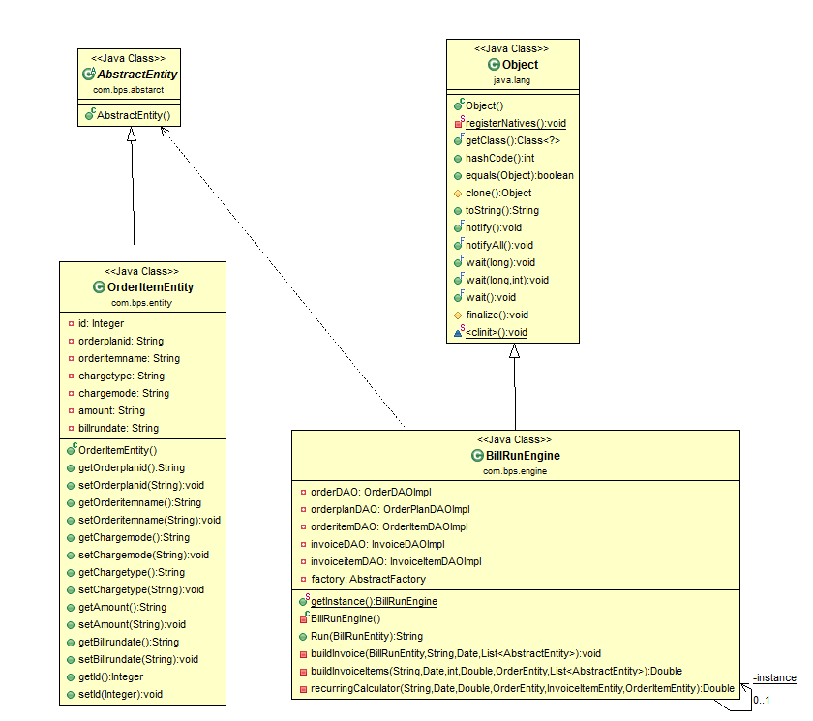
Design Patterns: Iterator
Iterator:
aggregate
Iterator:
iterator
Iterator:
concreteIterator
Iterator:
concreteAggregate

Slide 15
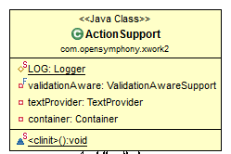
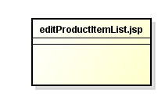
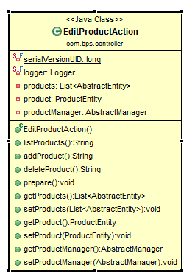
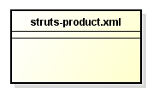
Design Patterns: Observer
Observer:
concreteSubject
Observer:
concreteObserver

Slide 16
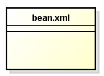
Design Patterns: IoC (Inverse of Control)
IoC:
Controler
IoC:
Requester
IoC:
Schedular

Slide 17
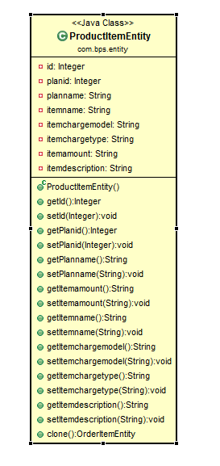
Design Patterns: MVC
MVC:
Modual
MVC:
Controler
MVC:
View

Slide 18
Content
3
Project Info & Architecture
Classes with Design Patterns
Summary & Future Development

Slide 19
Pattern Implementing Experiences
*
Design pattern is hard to grasp and to implement, but it really worthy.
*
If you cannot implement any design patterns at the first time, try to go through your codes and business knowledge as many times to find the necessity to implement.
*
Values of design patterns:
Extensibility: Factory method patterns
Flexibility: Bridge pattern in xxx; Strategy pattern in xxx
Efficiency: MVC pattern in xxx, divide a complicated process into several itomic part, implement and maintain independently.
Consistence: Singleton patter.

Slide 20
Technical Challenges and Future Development
*
Technical Challenges:
Tune the whole Struts2 + Spring + Hibernate frameworks to work well;
Read in two parameters in JSP page for RunBillEngine;
Abstract and define the interfaces;
Choose and implement design patterns during refactor;
Implement BillRunEngine.
*
Future Development
Authorization and authentication;
Payment related functions;
Tailed functions for some big customers;
Mobile App for end users.

Slide 21
Any Questions?

