Slide 1
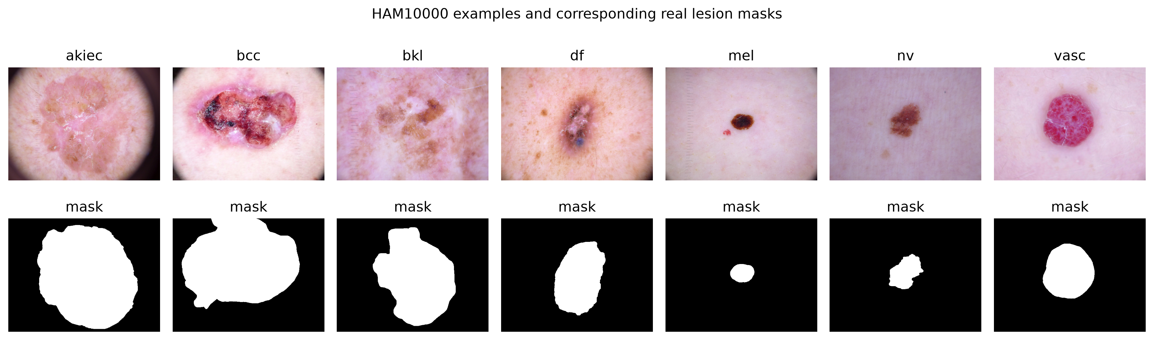
HAM10000 Skin Lesion Classification and Segmentation
Final Project
Six classification checkpoints • lesion segmentation • Apple MPS
All figures and metrics come from saved experiments

Slide 2
Motivation
Early and consistent lesion assessment is clinically valuable
Dermoscopic classes have overlapping appearance
Class imbalance can hide minority-class failures
Segmentation adds spatial lesion localization

Slide 3
Background
Transfer learning reuses ImageNet feature representations
Residual, dense, VGG and compound-scaled CNNs capture features differently
U-Net combines encoder context with decoder localization
Accuracy is reported together with macro and weighted F1

Slide 4
Dataset
HAM10000: 10,015 dermoscopic RGB images
Seven diagnoses; nv is the majority class
10,015 genuine lesion segmentation masks
Official source: Harvard Dataverse (doi:10.7910/DVN/DBW86T)

Slide 5
Data Split and Preprocessing
Canonical lesion-level split with seed 42
7,967 training / 2,048 validation images
Classification: 224×224 and ImageNet normalization
Segmentation: paired 128×128 image/mask transforms
No independent external test set

Slide 6
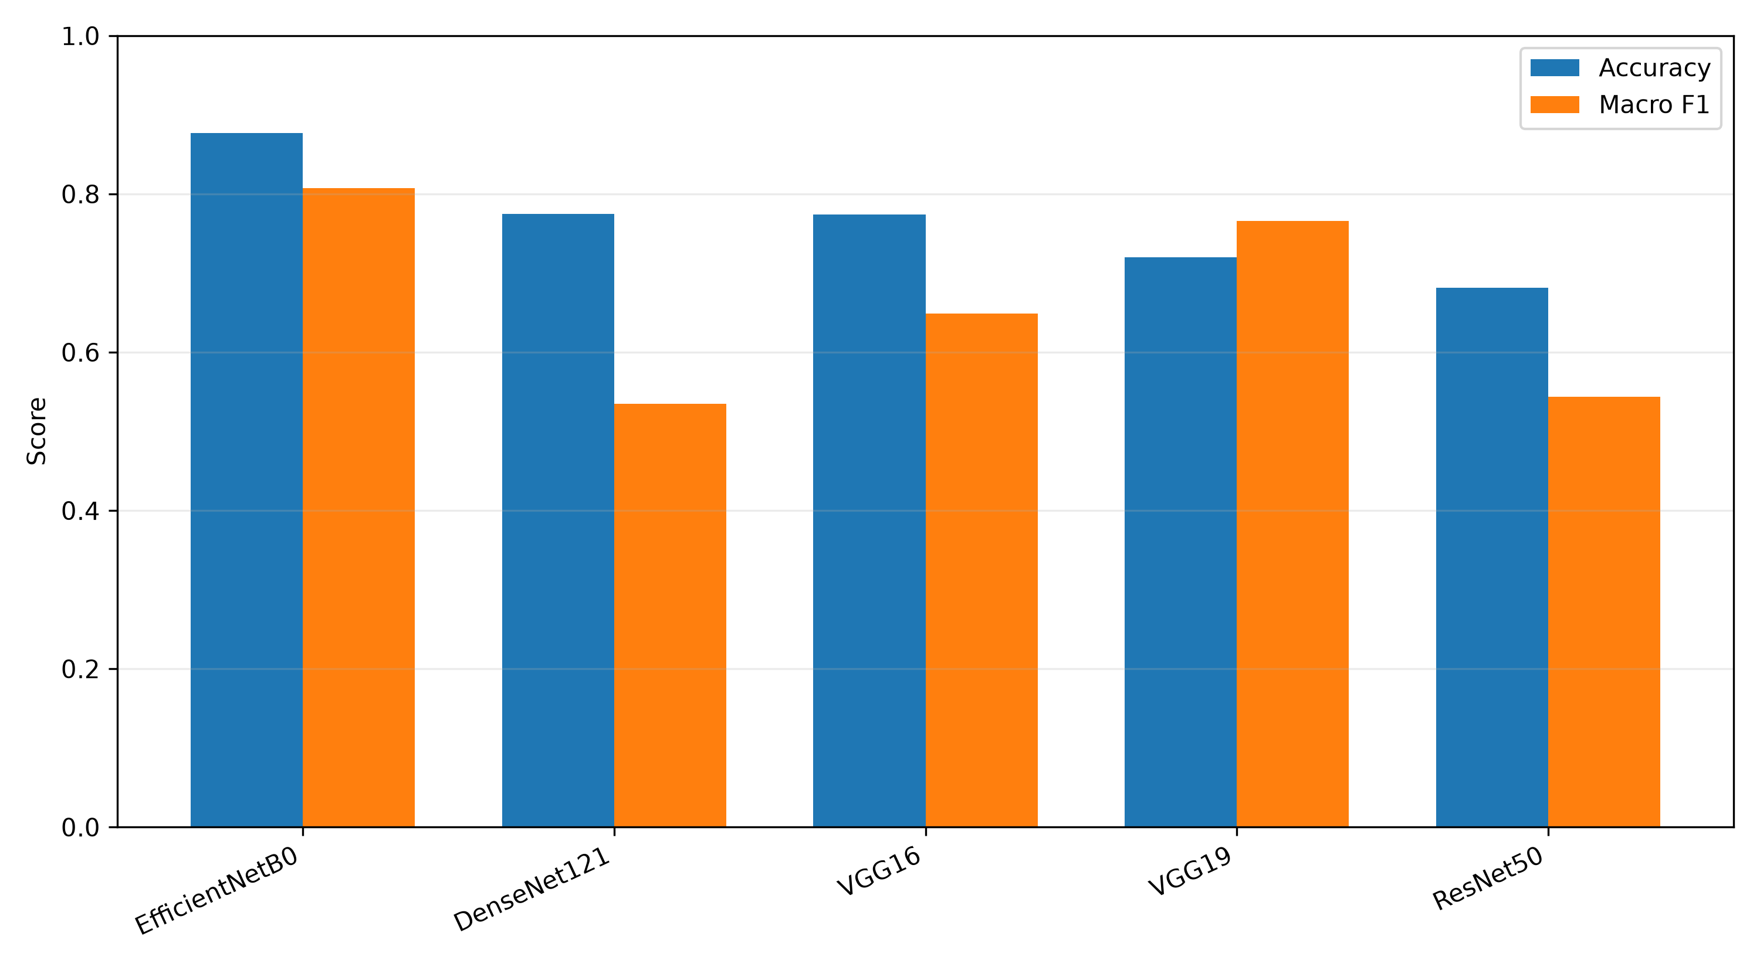
Classification Models
ResNet50: residual connections
VGG16/VGG19: deep sequential convolution blocks
DenseNet121: dense feature reuse
EfficientNet-B0: compound depth/width/resolution scaling
All existing checkpoints evaluated without retraining

Slide 7
Custom CNN
Four convolutional blocks with batch normalization
Adaptive pooling and a compact classification head
423,175 parameters — smallest classifier
Canonical accuracy 48.29%; macro F1 0.3376
No epoch history was fabricated

Slide 8
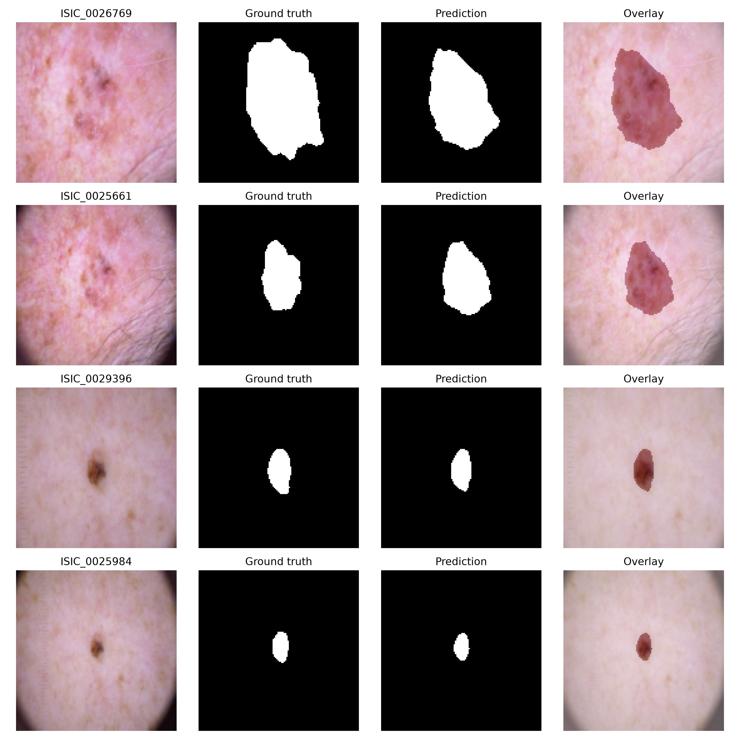
Segmentation Method
Compact U-Net with four encoder/decoder levels
Skip connections preserve spatial information
BCE + soft Dice objective
Adam, batch size 32, five epochs, MPS
Ground truth comes from real HAM10000 masks

Slide 9
Experimental Setup
macOS / Apple Silicon / Python 3.13
PyTorch 2.13.0 and torchvision 0.28.0
All final classification inference device: mps
Same 2,048 image IDs for every classifier
Metrics: accuracy, precision, recall, F1 and confusion matrices

Slide 10
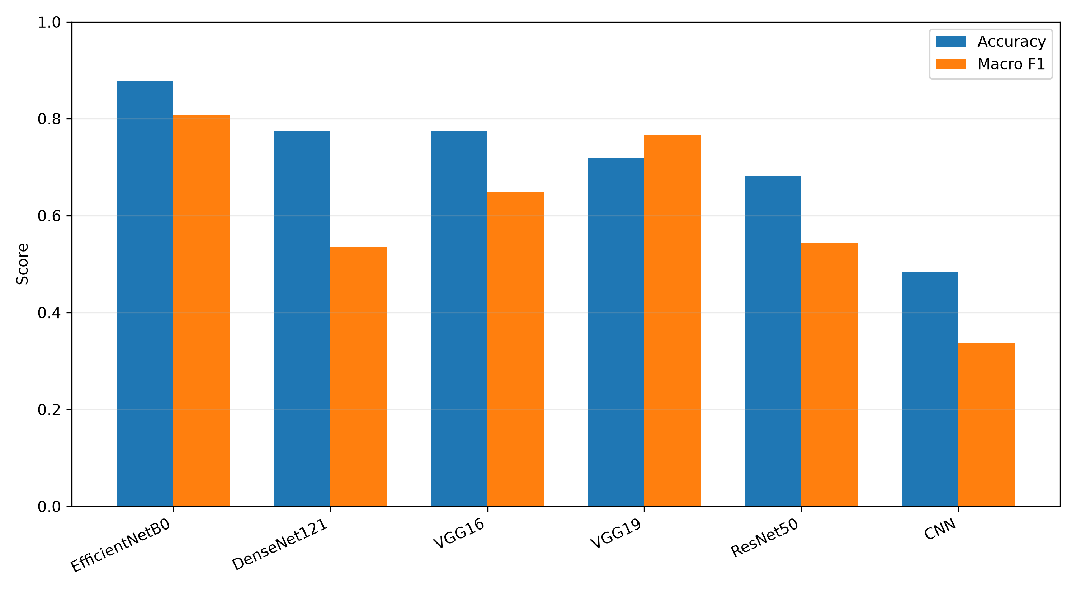
Classification Results
Best: EfficientNetB0 — 87.70% accuracy
Macro F1 0.8075; weighted F1 0.8741
Accuracy–macro F1 gaps reveal class imbalance

Slide 11
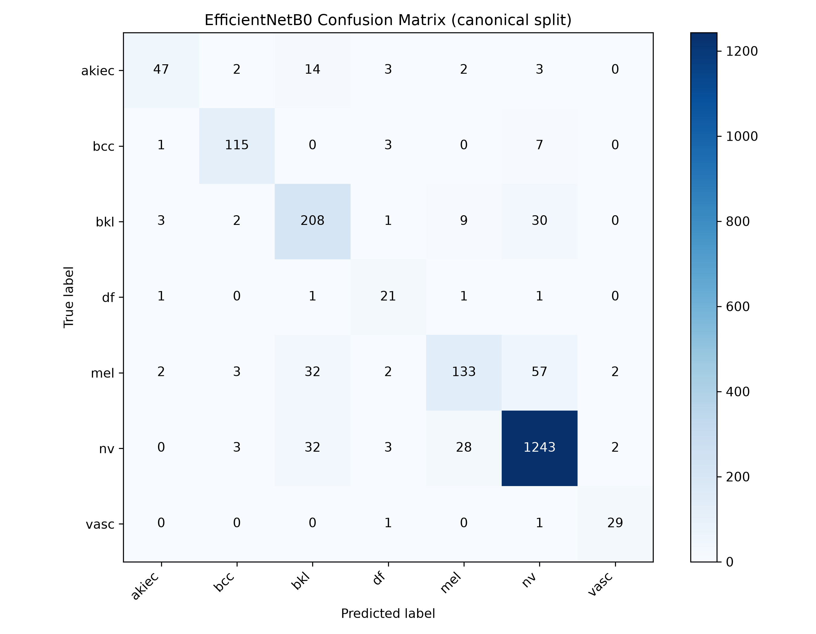
Best Model Confusion Matrix
EfficientNet-B0 performs strongly on nv
Melanoma remains a difficult minority class
Major confusion includes mel → nv
Per-class analysis is required for safe interpretation

Slide 12
Segmentation Results
Dice: 0.9176
IoU: 0.8613
Precision: 0.9582
Recall: 0.8983
Strong overlap on the internal lesion-level validation set

Slide 13
Discussion and Limitations
EfficientNet-B0 offers the best accuracy/parameter balance
VGG models are substantially larger
Historical training protocols were not identical
Canonical inference aligns samples but not training exposure
No external test cohort or clinical validation

Slide 14
Conclusion and Future Work
EfficientNet-B0: 87.70% canonical accuracy
U-Net: Dice 0.9176
Use one fixed split before future training
Improve imbalance handling and calibration
Evaluate externally and explore joint multi-task learning

Slide 15
References
[1] Tschandl et al., HAM10000, Scientific Data, 2018
[2] Paszke et al., PyTorch, NeurIPS, 2019
[3] Tan and Le, EfficientNet, ICML, 2019
[4] He et al., ResNet, CVPR, 2016
[5] Huang et al., DenseNet, CVPR, 2017
[6] Simonyan and Zisserman, VGG, ICLR, 2015
[7] Ronneberger et al., U-Net, MICCAI, 2015
[8] Abou El Houda et al., IEEE TNSE, 2023

