Slide 1
AtomVAE: Towards Zero-Shot Text-to-Motion Synthesis Demo

Slide 2
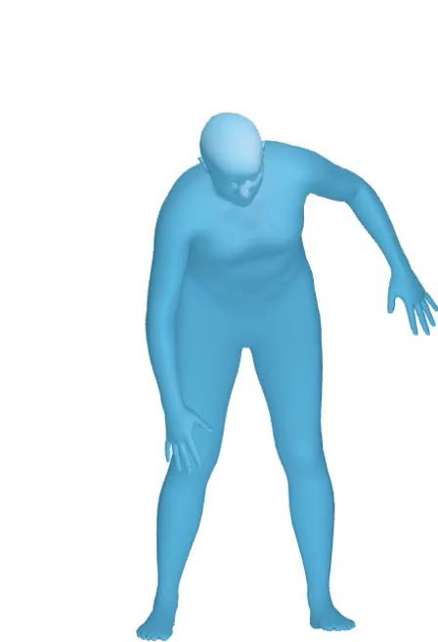
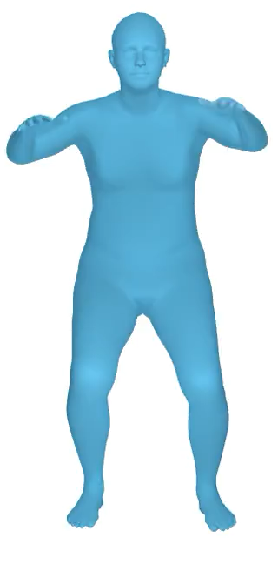
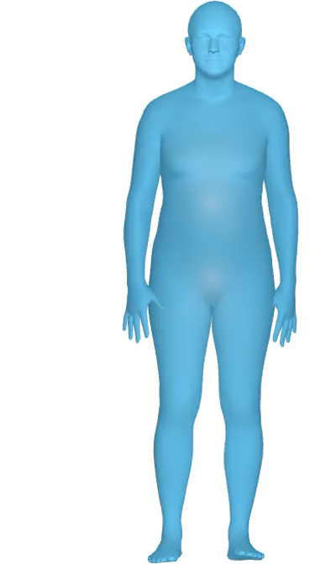
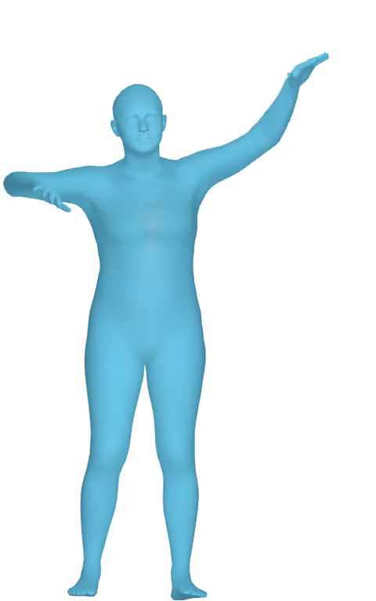
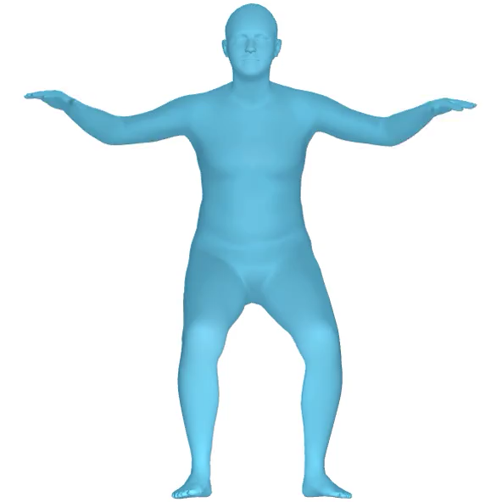
Experiments – Fitness Motion
Our model can generate reasonable motion video like what we always seen at Gym through simply text input.

Slide 3
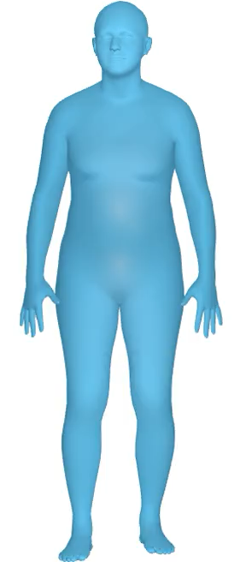
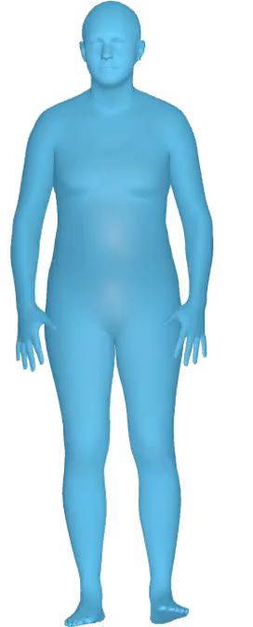
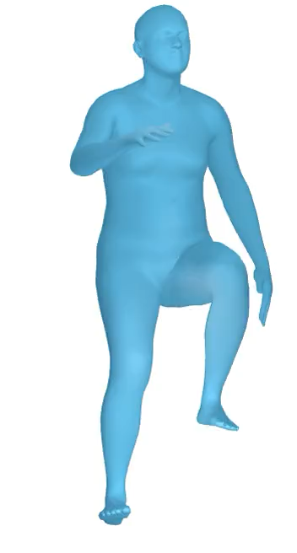
Experiments – Zero-Shot Synthesis
Our model is semantic speed awareness, and this can also reflect on corresponding generation.

Slide 4
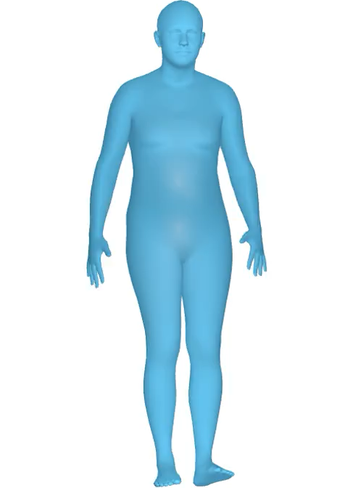
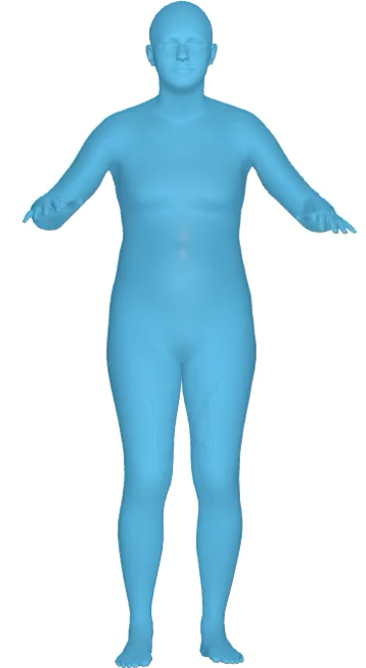
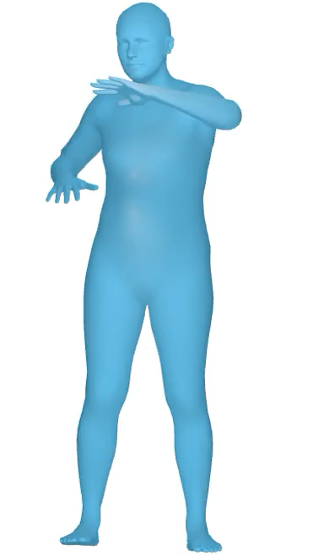
Experiments – Zero-Shot Synthesis
Our model is direction awareness and amplitude perception

Slide 5
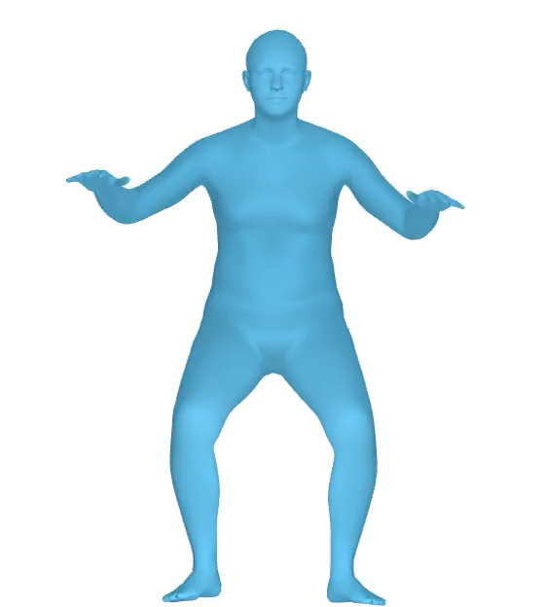
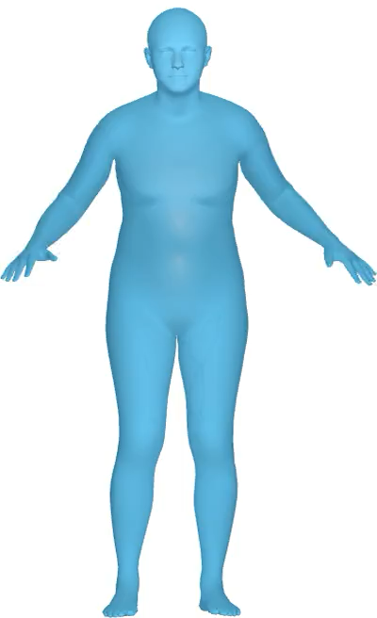
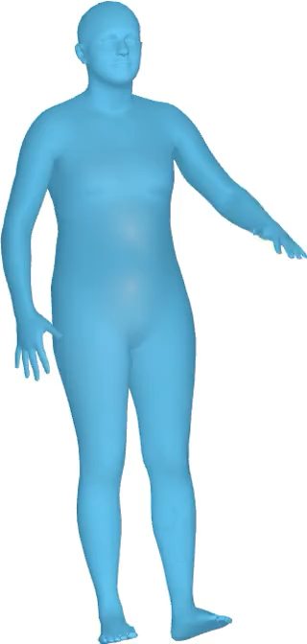
Experiments – Zero-Shot Synthesis
Diversity Awareness : swimming
If we input a broad vocabulary, “swimming”, our model will generate diversity style of swimming, like breaststroke, butterfly, freestyle, etc. For convenience, we show the perspective directly above
Input: Swimming

Slide 6

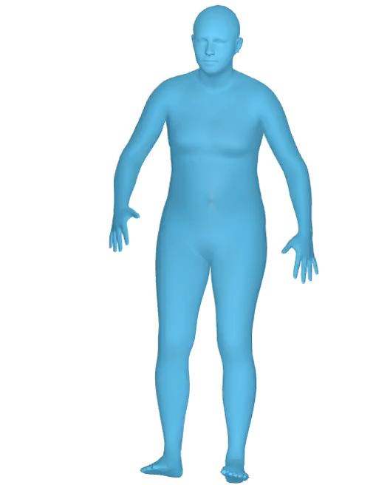
Experiments –Zero-Shot Synthesis
Sequential and Temporal awareness
Our model can understand like human to perform continuous specified actions.
Input:
Grabbing object and place it
Squatting and jumping

