Slide 1



Exploring the General Melodic Characteristics of XinTianYou Folk Songs
12th Sound and Music Computing Conference
Lu Dong

Slide 2
Overview
Data Source
Database
Pre-Processing
Pattern Mining
Melody Clustering
Authoritative books from libraries and museums
Use a MIDI keyboard to build a music database
Segmentation based on Music Theory
Propose to use N-Apriori
Algorithm
Multi-Layer:
Direction-based
Similarity-based

Slide 3
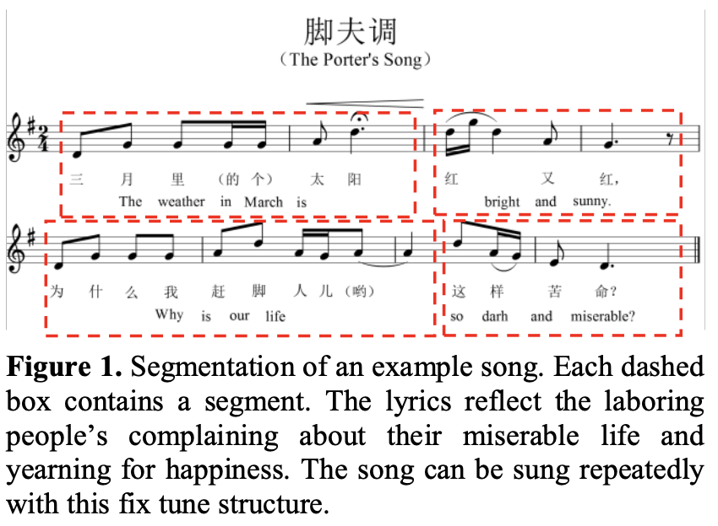
Music Data Processing

Slide 4
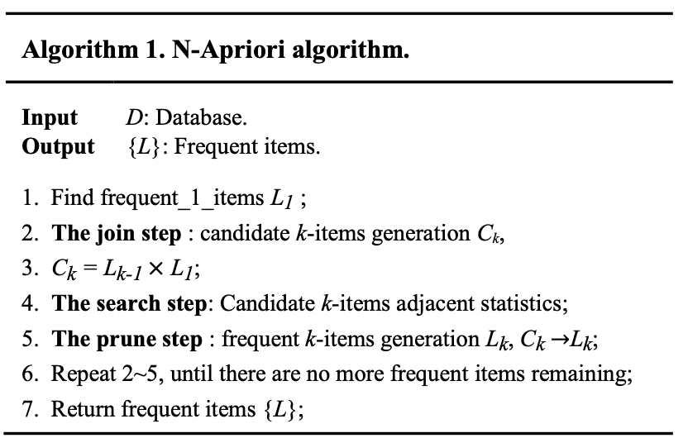
Our Proposed Pattern Mining Algorithm

Slide 5
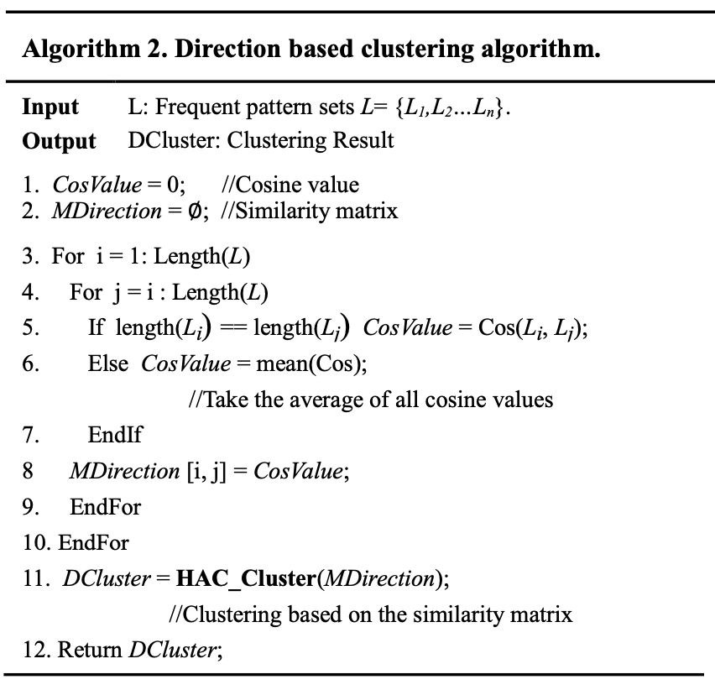
Our Proposed Multi-Layer Melody Clustering

Slide 6
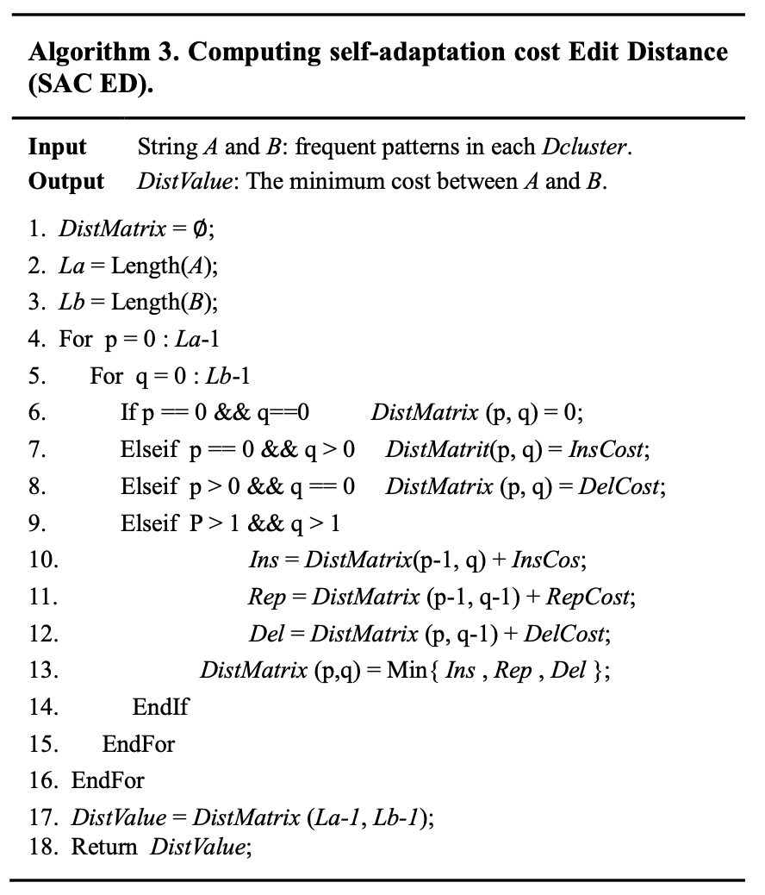
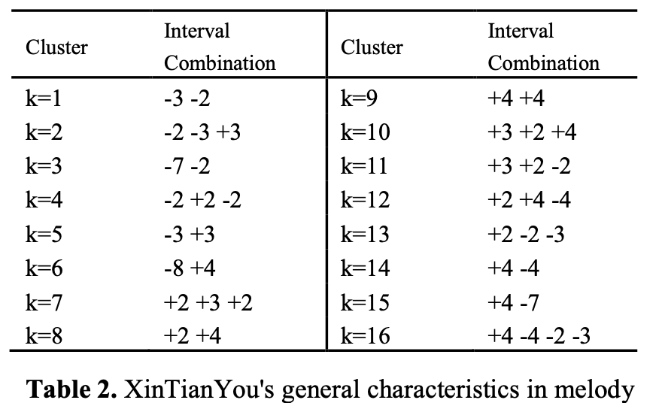
Our Proposed Multi-Layer Melody Clustering

Slide 7
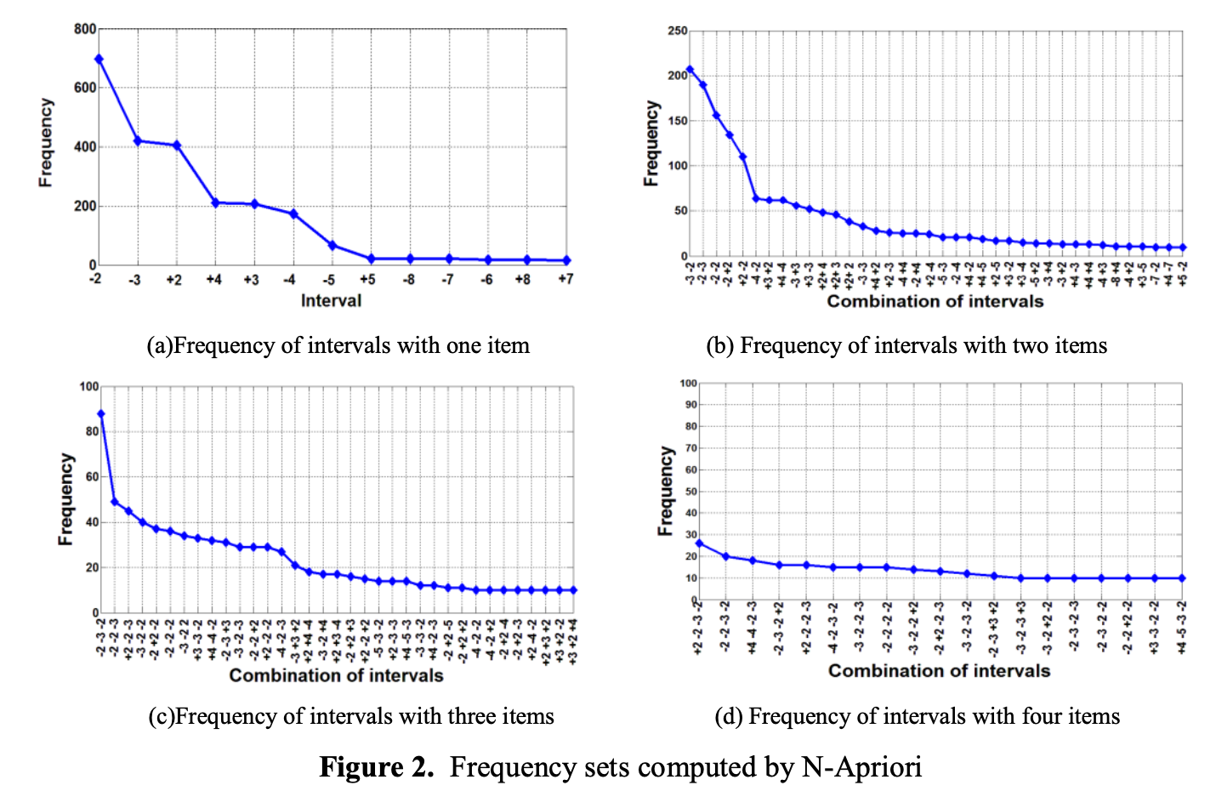
Experiments

Slide 8
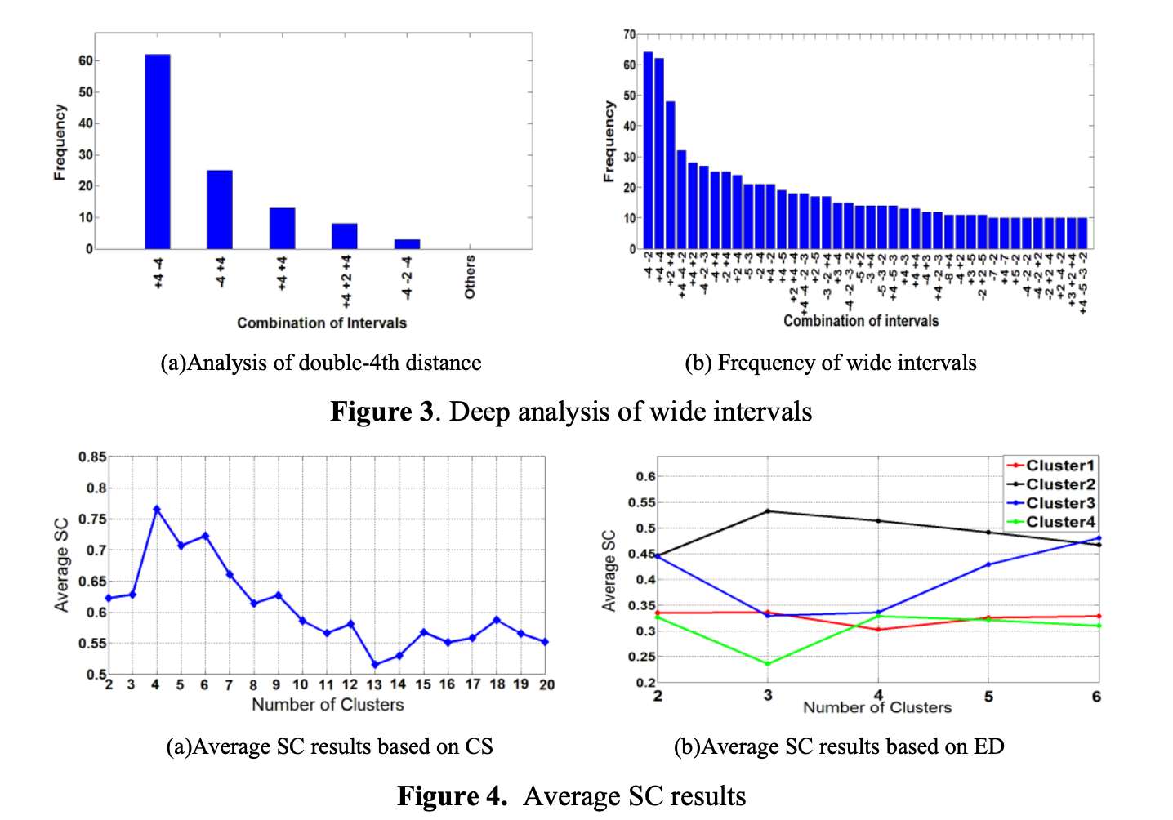
Experiments
We compute the aver- age Silhouette Coefficient (SC) value of all objects in the cluster. The range of average SC values is [-1, 1]. The larger the average SC is, the higher the clustering quality will be.

Slide 9
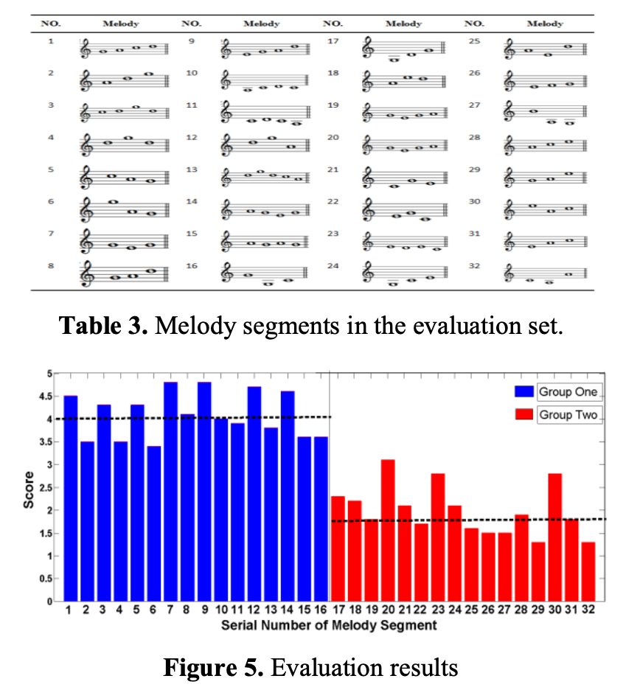
Experiments

Slide 10
Conclusions
XinTianYou, as an important style of folk song, has a profound impact on the musical history of China. The exploration of XinTianYou's general characteristics is important for both automated musical analysis research and obtaining greater insights into Chinese folk music.
We built a XinTianYou MIDI database to facilitate future study and contribute to the community.
We provide a new method for analyzing melody combined with music theory which examines the music data through its interval combinations, the small melody segments.
We propose to employ N-Apriori and Multi-Layer Melody Clustering Algorithm to analyze the data, taking the advantage of redundancy-aware top-k patterns to refine and gather information.
Based on the similarity measure and the support, we finally find the most dominant patterns as the general melodic characteristics, and recognized by the music expert.

Slide 11

Thank you for watching !

