Slide 1
Portfolio for Projects
Shi, Dongmei
17.04.2023

Slide 2
Outline of projects
Projects | Objectives | Tolls
Video game popularity data analysis | Analyzing data to inform the development of new games for a game company ‘GameCo’ | Excell
Preparing for the influenza season | Determine when to send staff, and how many to each state in USA | Excell, Tableau
Rockbuster Stealth | use data to help with the launch strategy for the new online video service | SQL, Tableau
Instacart Grocery | To uncover more information about the sales patterns | Python, Tableau

Slide 3
Project: Video Game Popularity
Objective:
Analyzing data to inform the development of new games for a game company ‘GameCo’
Data sets:
‘video_game_sales’ data set that was drawn from VGChartz
Tools:
Excel – Grouping, Summarizing and Descriptive analysis
The project report link:
Project-video-game-/Project- video game popularity.pdf at main · dongmei-s/Project-video-game- (github.com)

Slide 4
Analysis stages
Stages | Contents | Purpose
Verify the quality and integrity of data | Collect data, clean data, verify the completeness, accuracy and validity of data | To ensure the accuracy of the following analysis
Data analysis | Sales vs. time for each region, Sales distribution for regions, Sales distribution for genres. | To understand game sales vs. time regions and etc.
Modeling | Visualization by line chart and bar chart | To have a better understanding and make predictions
Conclusion and recommendations | Get conclusion and give recommendations | To answer the key questions the stakeholders care

Slide 5
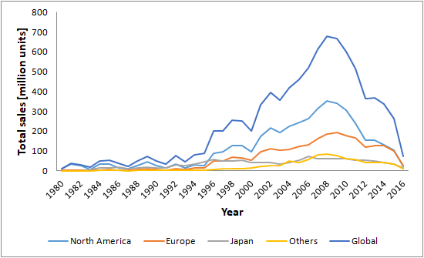
Key visualizations - 1 - Sale‘s change over time
The sales in each region changes over time, which challenges the present assumption that
the sales keep constant over time.

Slide 6
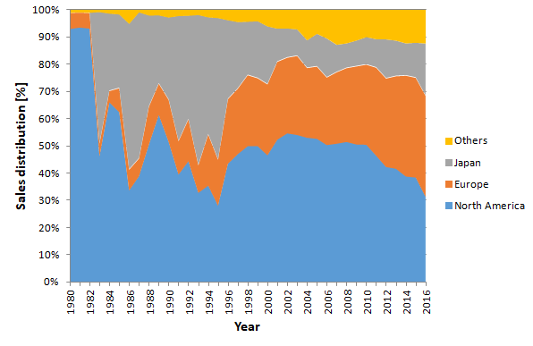
Key visulization – 2 - Sales distribution for different regions
North America: the sales in most cases are dominant large over all the time
Europe: the sale’s proportion keeps constantly around 1/3 in the last 10 years
Japan: the sale’s proportion generally keeps around 12%, but in 2016 is around 19%.
Other regions: the proportion generally keeps around 13% in the last 10 years

Slide 7
Project: Preparing for influenza season
Objective
Determine when to send staff, and how many to each state in USA
Data sets:
‘influenza deaths by geography’ and ‘Population data by geography’
Tools:
Excel and Tableau
The project report link and video link:
https://public.tableau.com/app/profile/winter4019/viz/Projectpresentation-2-10/story-myproject
https://youtu.be/FMSQtpNndq8, https://youtu.be/WzAXaGDAxKc

Slide 8
Analysis stages
Stages | Contents | Purpose
Verify the quality and integrity of data | Collect data, clean data, verify the completeness, accuracy and validity of data | To ensure the accuracy of the following analysis
Data analysis | Influenza deaths distribution in regions; Influenza deaths of vulnerable populations; influenza season length in different regions | To understand the features of influenza season, and its effects on the people
Modeling | Regression, Clustering and Forecasting | To have a better understanding and make predictions
Conclusion and recommendations | Get conclusion and give recommendations | To answer the key questions the stakeholders care

Slide 9
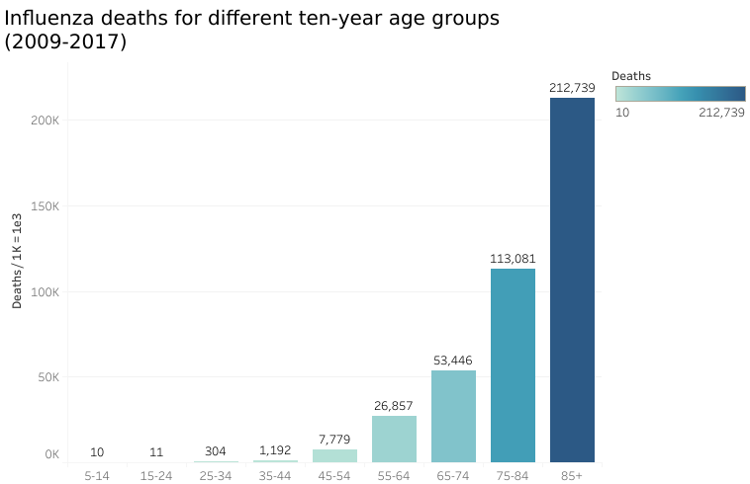
Key visualizations - 1 - Influenza deaths vs. age
Influenza deaths increases as the age increases; deaths of vulnerable population (age >=65)
makes up the biggest proportion of the total influenza deaths.

Slide 10
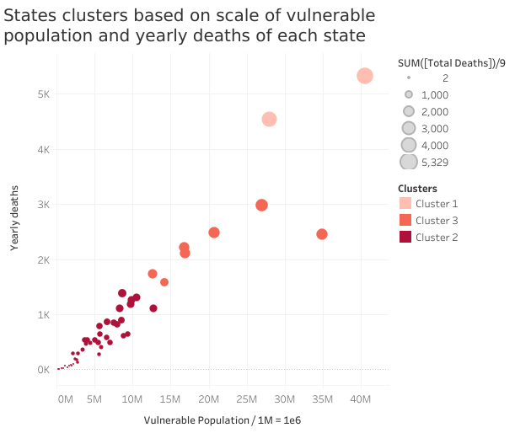
Key visulization – 2 - Population Clustering
Cluster 1 – two states that have the most yearly deaths and a large scale of vulnerable populations.
Cluster 3 – seven states that have a middle scale of yearly deaths and a middle scale of vulnerable populations.
Cluster 2 – other states that have a relatively small scale for both yearly deaths and vulnerable population.

Slide 11
Project: Rockbuster Stealth Video Rental
Objectives:
use data to help with the launch strategy for the new online video service.
Data sets:
‘Rockbuster_data_set’ that includes 15 different tables.
Tools:
SQL and Tableau
The project report link:
https://public.tableau.com/app/profile/winter4019/viz/ProjectRockbuster/Story1

Slide 12
Analysis stages
Stages | Contents | Purpose
Verify the quality and integrity of data | Collect data, clean data, verify the completeness, accuracy and validity of data | To ensure the accuracy of the following analysis
Data analysis | Descriptive statistics; Features of rating and category in rental sale; Customer distribution | To understand the features of rentals and differences in customers behaviors
Modeling | Clustering | To have a better understanding and make predictions
Conclusion and recommendations | Get conclusion and give recommendations | To answer the key questions the stakeholders care

Slide 13
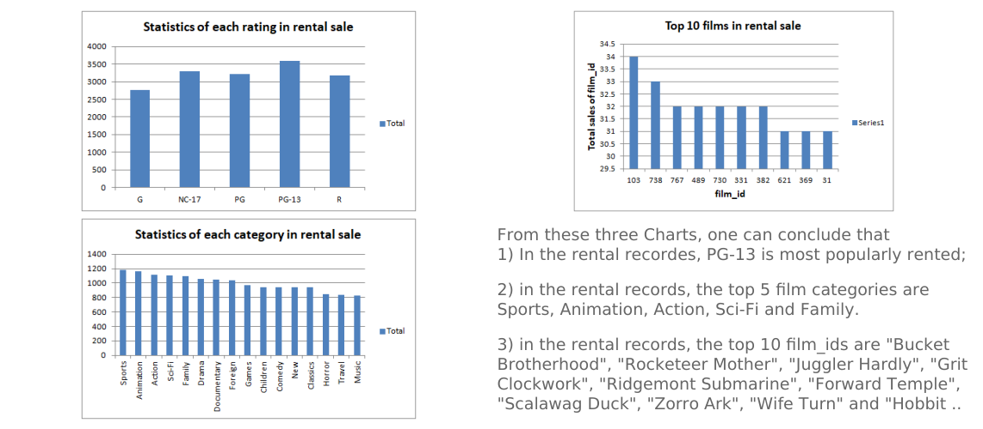
Key visualizations - 1 - Statistics in rental sales

Slide 14
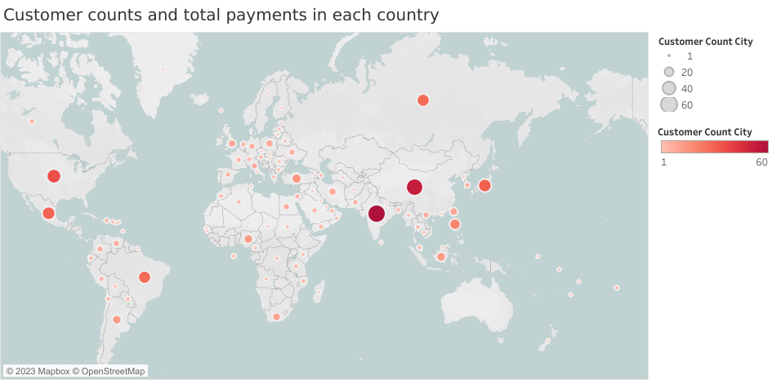
Key visualizations - 2 - Customer distribution all over the world
The top ten countries that have most customers are India, China, United States, Japan,
Mexico, Brazil, Russian Federation, Philippines and Turkey.

Slide 15
Project: Instacart Grocery
Objectives:
To uncover more information about the sales patterns
Data sets
‘Customer_Data_Set’, ‘Data Dictionary’
Tools:
Python, Excel
The project report link:
https://github.com/dongmei-s/Project-Instacart/blob/main/4.10%20Codes%20in%20final%20report.ipynb

Slide 16
Analysis stages
Stages | Contents | Purpose
Verify the quality and integrity of data | Collect data, clean data, verify the completeness, accuracy and validity of data | To ensure the accuracy of the following analysis
Data analysis | Customer consuming patterns over time (day and week); Customer consuming patterns over customer profiles; | To understand the customers better so that give target recommendations at different target time
Modeling | Regression, Clustering | To have a better understanding and make predictions
Conclusion and recommendations | Get conclusion and give recommendations | To answer the key questions the stakeholders care

Slide 17
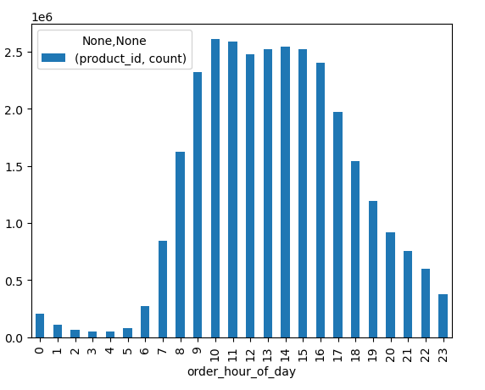
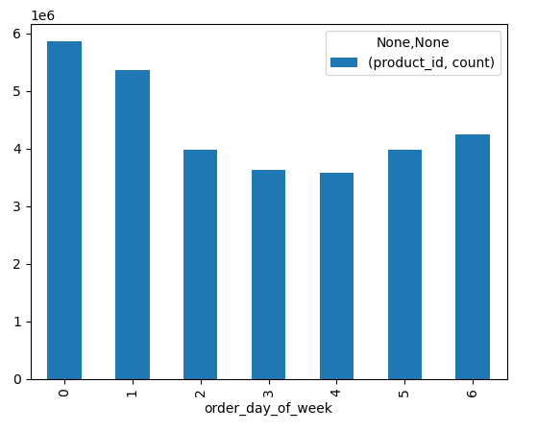
Key visualizations - 1 - Customer consuming patterns over time
Left figure: There are most consuming activities at around from 10 am to 16 pm, and least from 0 to 5 am.
Right figure: There are most consuming activities on the day ‘0’ and ‘1’, and least on ‘3’ and ‘4’.

Slide 18
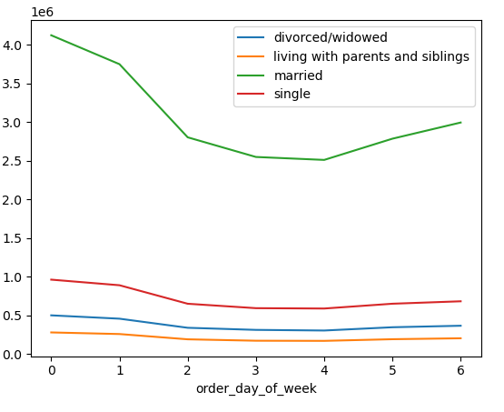
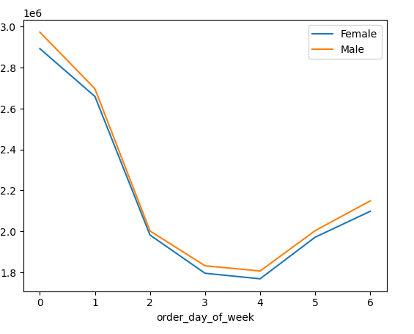
Key visualizations – 2 - Customer patterns vs. Customer profiles
Left figure: For the group 'married', the amount of products ordered by the customers changes over time most obviously, whereas for the group of ‘living with parents and siblings’, it doesn’t change over time so obviously.
Right figure: 1) The consuming patterns over day for female and male customers are consistent;
2) The male customers generally consume more than female customers.

