Slide 1



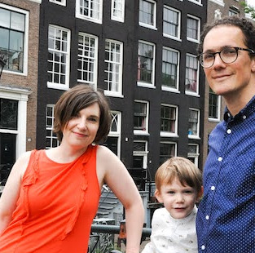
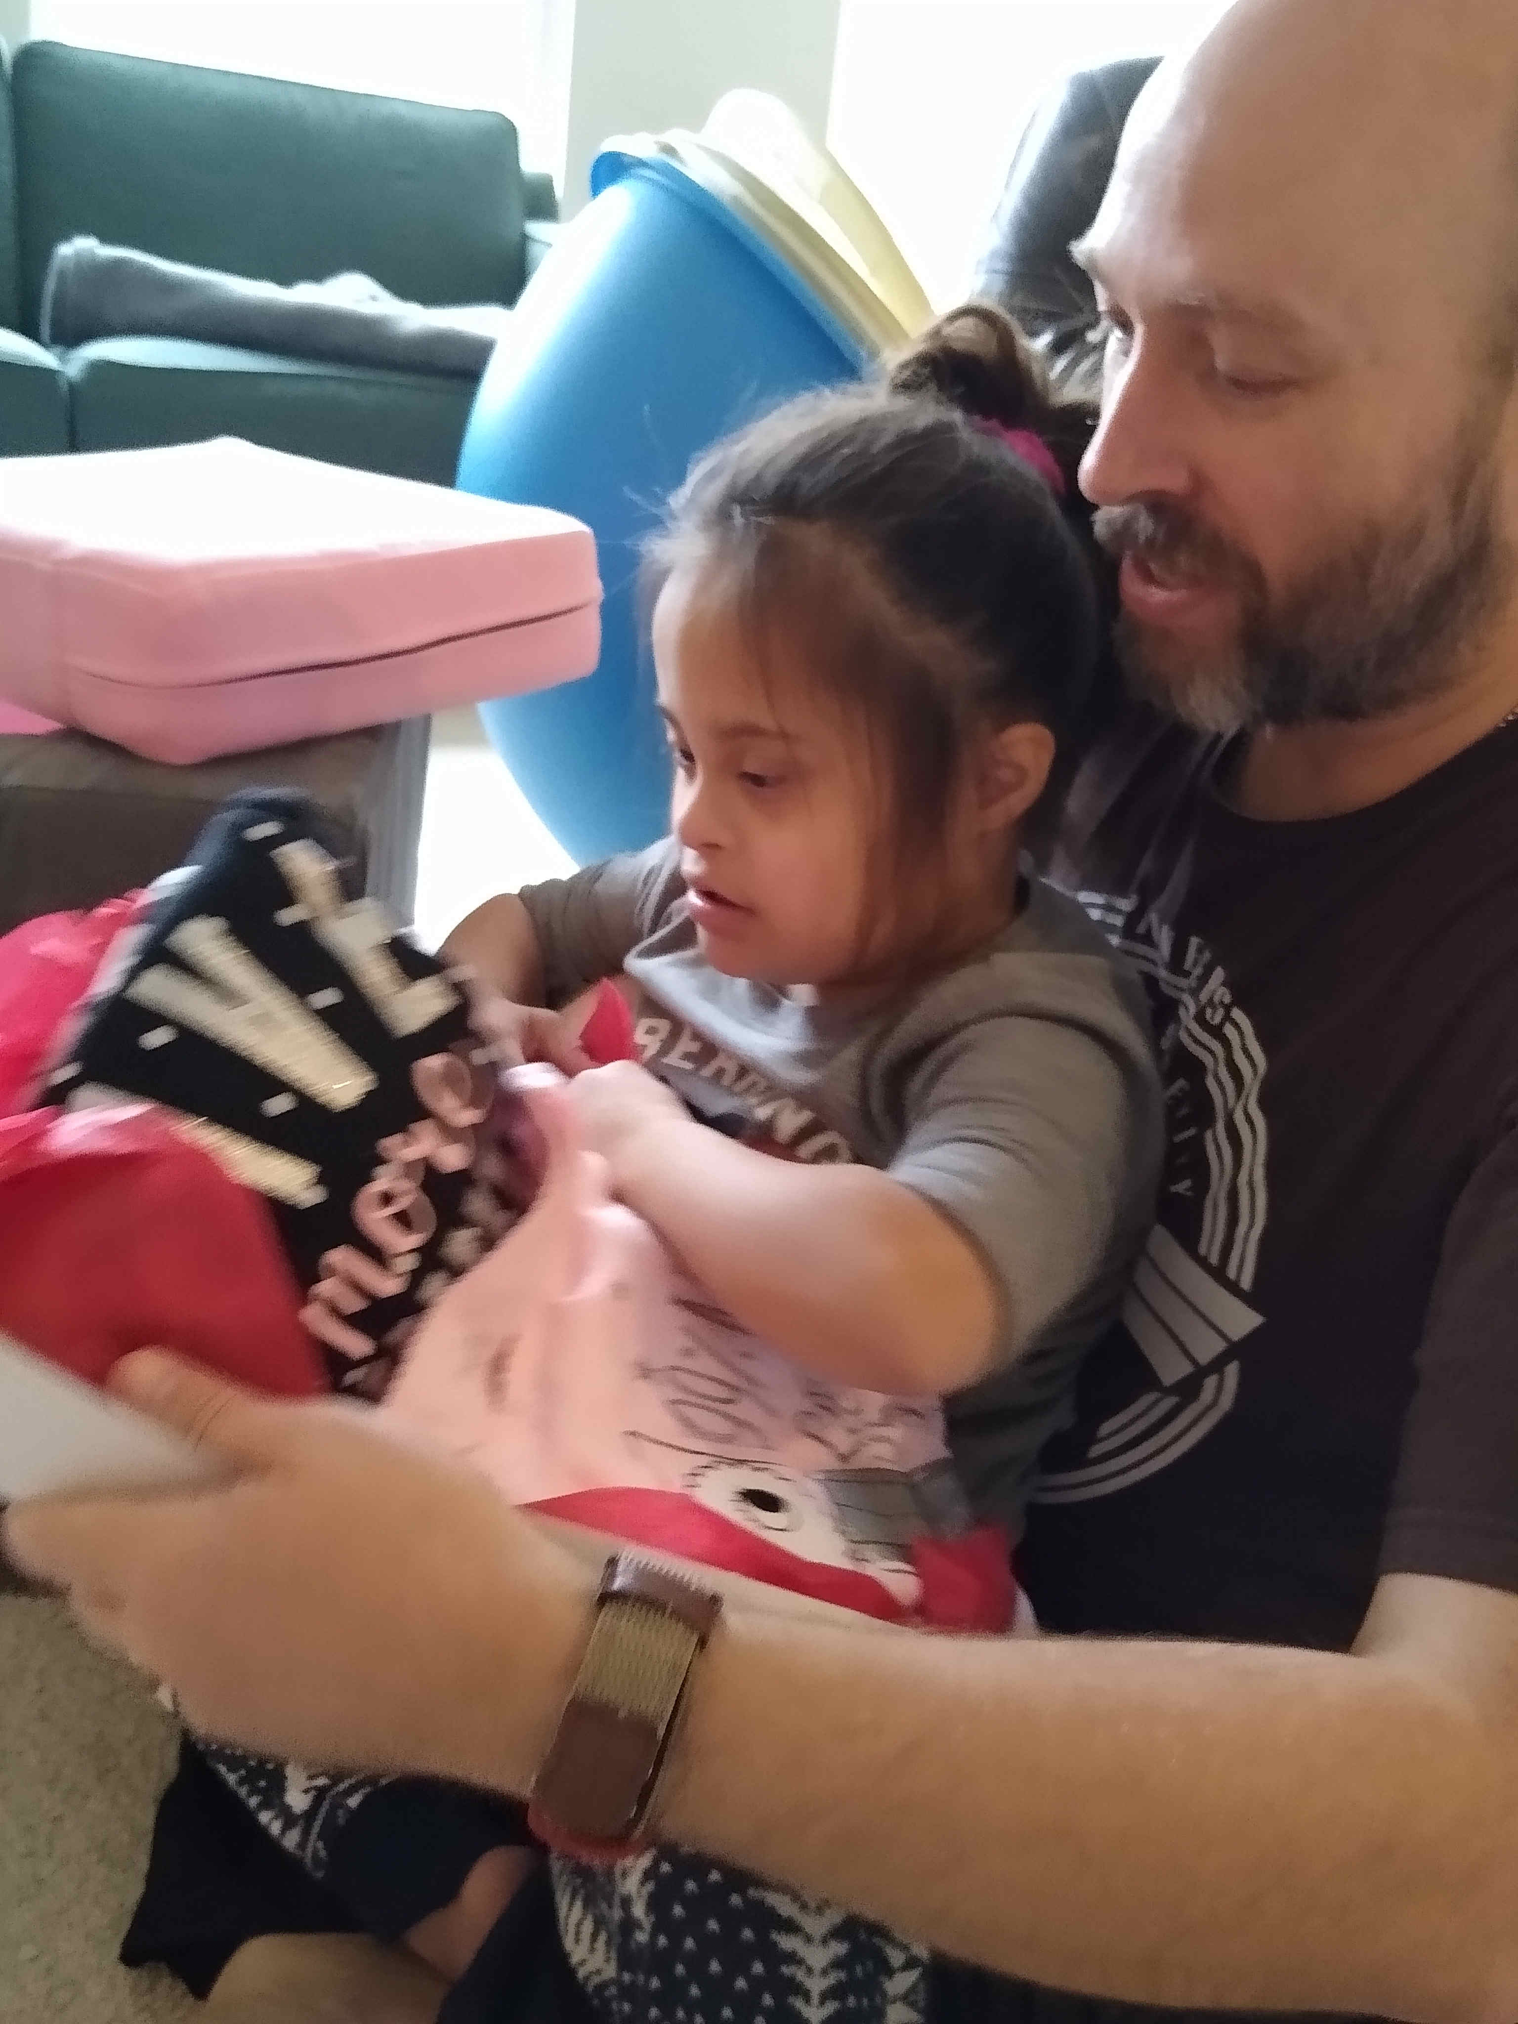
Pulling Poetry out of Big Data:
Machine Learning Models for Blackwell Electronics
Wei Li
Team Lead
Awesome Data Analytics
Lady ADA, Ltd.
Team Awesome
26 April 2021
James Sanders
Data Wrangler
Sam Goodman
Lead Modeler
Jed Todd
Client Services
26 April 2021

Slide 2
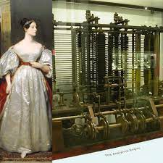
Agenda
Why Lady Ada?
      1815-1852, daughter of Lord Byron
  First programmer, inventor of the algorithm
  “Mathematical science shows what is. It is the language of unseen relations between things. But to use and apply that language, we must be able to fully to appreciate, to feel, to seize the unseen, the unconscious.”
“Poetical Science”
  Goals & Overview
  Better Data for Better Insight
Regional Trends
  Regional Age Breakdowns
Online Customers
  Prediction
Conclusions
  Seaborn Data Visualization
  Bottom-Line
Questions // Discussion
26 April 2021

Slide 3
Goals & Overview
Big Data is a combination of dictionary & scrabble word list
        Lots of insight, hard to digest-- Disjointed and Overpowering
        Enriches your business narrative, once given structure
Machine Learning is the poetry written from those words
        How to bring your voice to life in the hearts of your customers
        Needs to be authentic, structured, and DECLAIMED AT VOLUME
Team Awesome is here to be both pen and muse for you
26 April 2021

Slide 4
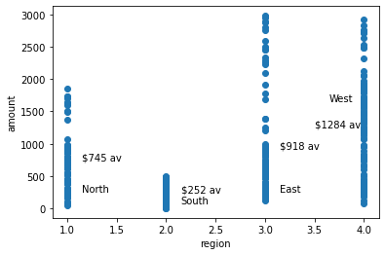
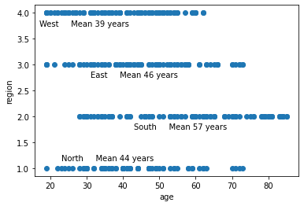
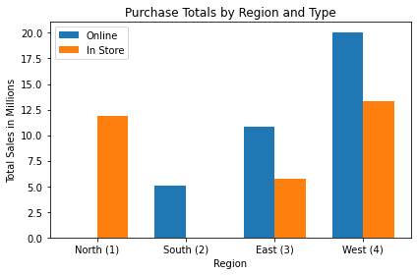
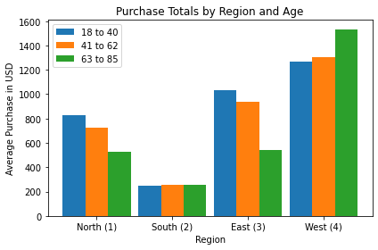
Cleaning up the language
Current data
  Southern region online purchases online
  Northern region exclusively in-store
  No date/period of pull
Better access to data means cleaner results
26 April 2021

Slide 5
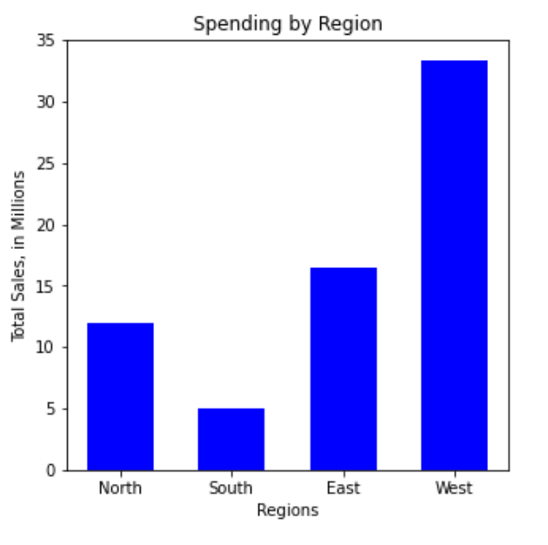
Regional Trends
The Western region outperformed the other 3, combined – both in terms of average purchase and in total sales
The Southern region was the lowest performing
26 April 2021

Slide 6
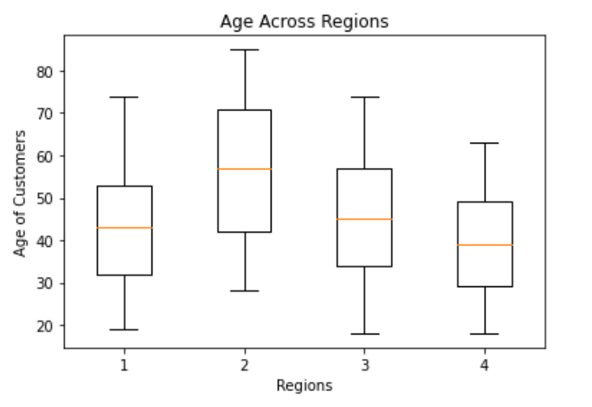
Regional Trends
Region 4 (West) has younger customers, and Region 2 (South) has the oldest.
We can create a model that will predict whether a customer is over 51 years old, based on region and other demographic data. This could be used to target younger, more valuable customers.
26 April 2021

Slide 7
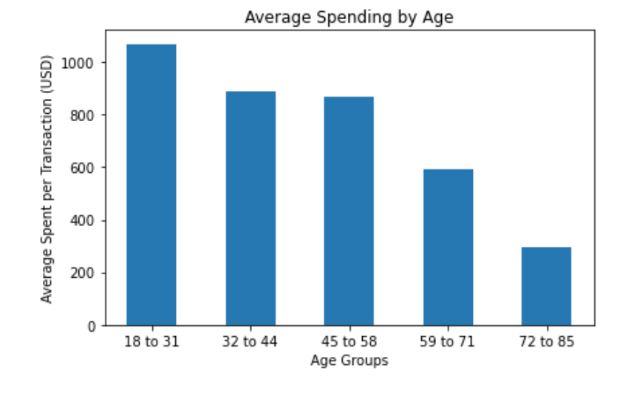
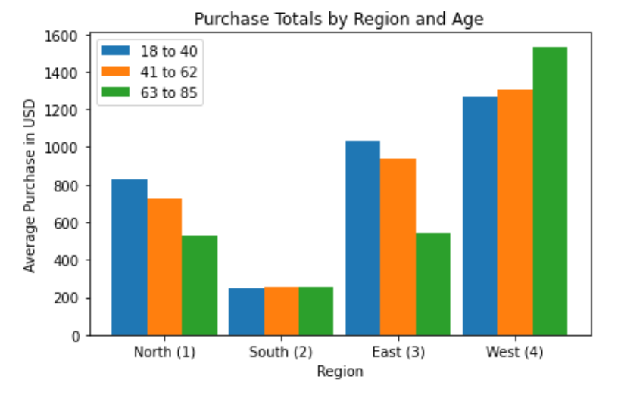
Regional Trends
When looking at the data as a whole, older customers spend less
But when each region is examined individually, this trend only holds for Regions 1 and 3
Region 4 (West) shows the opposite trend, and Region 2 (South) each age group is spending about the same
26 April 2021

Slide 8
Online Customers
Correlation between age and whether the purchase was made online or in store; other predictors of how the purchase was made
Team Awesome // Lady ADA, Ltd.
The analysis of our data set showed that there was a definite relationship between the age of the person and whether the purchase was made in-store or online. We were able to determine this using machine learning to build predictive models.

Slide 9
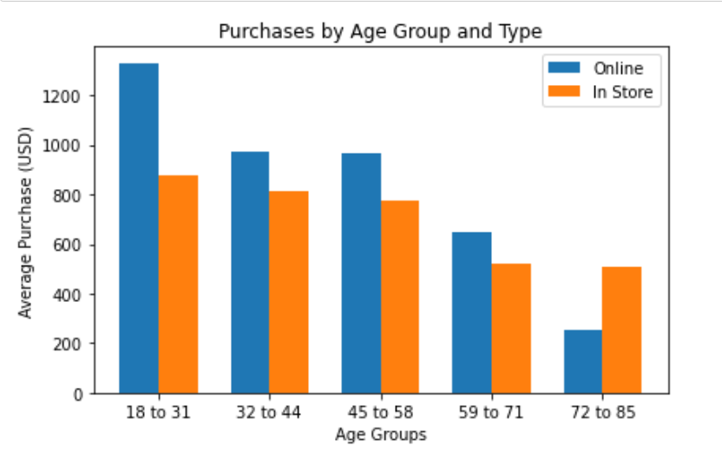
Online Customers
Team Awesome // Lady ADA, Ltd.
This graph shows that age was predictive of if the purchase was made in-store or online. The younger the person is the more likely it is for them to make the purchase online.

Slide 10
Online Customers
Team Awesome // Lady ADA, Ltd.
Age was a strong enough factor that when combined with other demographic and purchase data we were able to build a model that was close to 90% accuracy. However, Age was not the only variable that was a strong indicator of on-line vs in-store. Region was also a strong indicator for how the purchase was made. In fact, using only Age and Region we were able to produce a model that was almost 80% accurate.

Slide 11
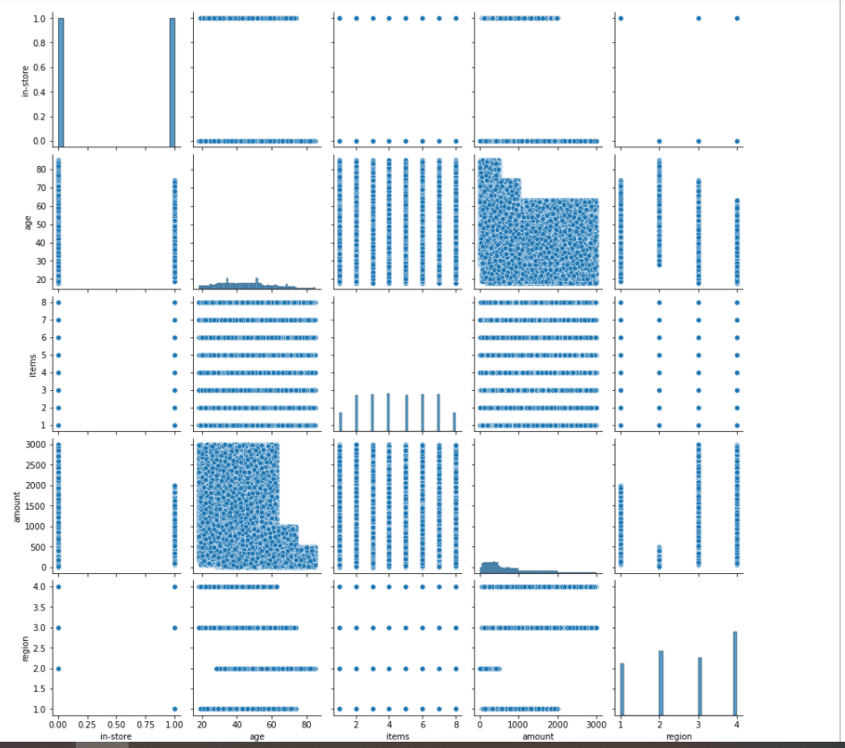
Team Awesome // Lady ADA, Ltd.
What do we see from this Seaborn Pairplot?
Younger people spent more money.
Region 2 has more older people made purchase
Region 2 has the lowest amount, and region 1 has the second lowest.
Region 2 has only online purchase, and region 1 has only in store purchase.
26 April 2021

Slide 12
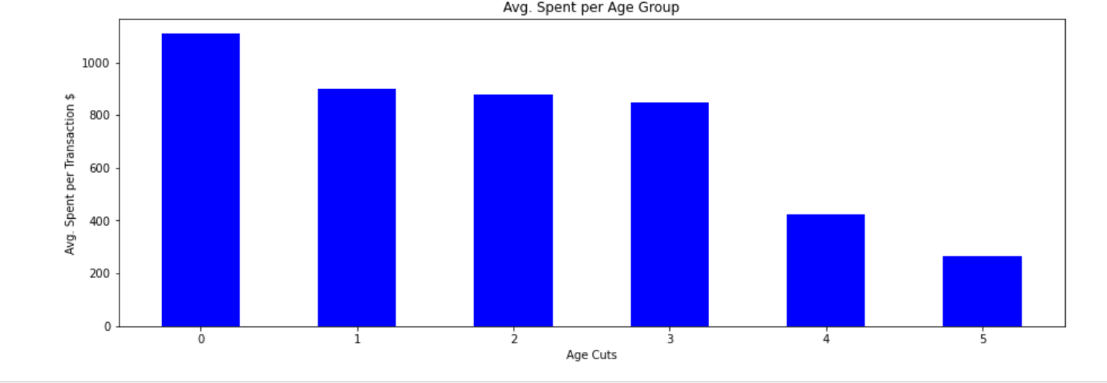
Team Awesome // Lady ADA, Ltd.
Younger age groups spent more $$$
Youngest
Mid-age
Oldest
The VP of Sales, Martin Goodrich, thinks that customers who shop in the store are older than customers who shop online and that older people spend more money on electronics than younger people. He is considering some marketing activities and potentially some design changes to the website to attract older buyers. However, this graphic shows us in fact younger age groups spent more money. In the next slide, I will show you why people more likely shopping online.
26 April 2021

Slide 13
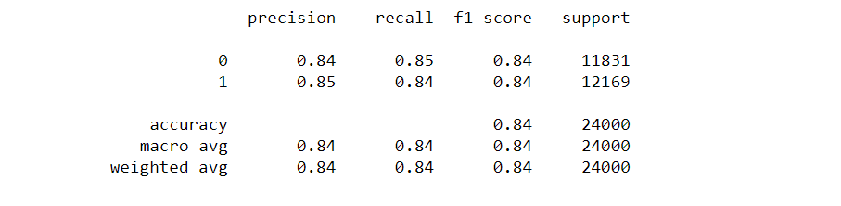
Team Awesome // Lady ADA, Ltd.
Younger age groups more likely shopping online
The age of customer and transaction made online, or in-store relationship is strong.
The Gradient Boosting Classifier was the most accurate at 88.72%
Random Forest Classifier 0.8611875007378803
Decision Tree Classifier 0.8462749893268274
Gradient Boosting Classifier 0.8872374849645737
26 April 2021

Slide 14
Team Awesome // Lady ADA, Ltd.
Some thoughts
Predictive data mining in purchase history deals with learning models to predict customer’s buying habit. Data mining methods are usually applied in purchase history to analyze retrospective data, thus giving department stores the opportunity to exploit large amounts of data routinely collected during their day‐by‐day activity.
Since younger people more likely to shopping online, department stores could predict which brands or lines of products are more likely sold to younger people. And then, department stores can store most of that brands or lines of products in the warehouses instead of local stores. The shipping cost and handling fee from warehouses to end users will be much cheaper than shipped from local stores.
26 April 2021

Slide 15
Questions and Discussion
Is thy face like thy mother's, my fair child!
ADA! sole daughter of my house and heart?
When last I saw thy young blue eyes they smiled,
And then we parted, -- not as now we part,
But with a hope. --
Childe Harold’s Pilgrimage
--Lord Byron, 1815
26 April 2021

