Slide 1
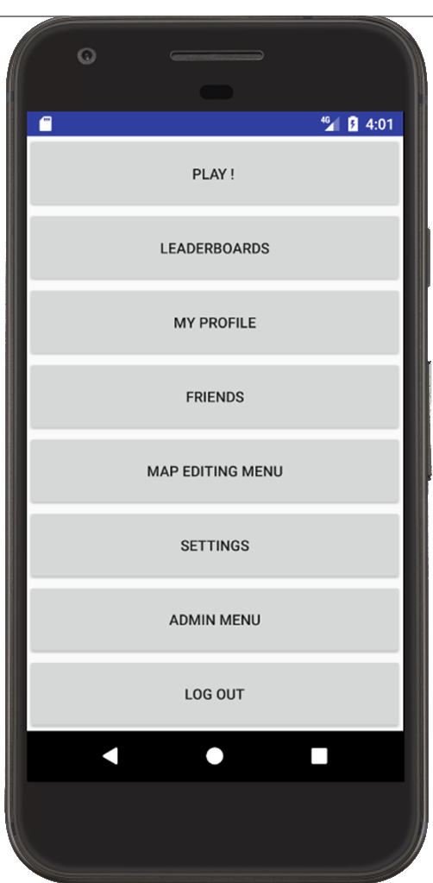
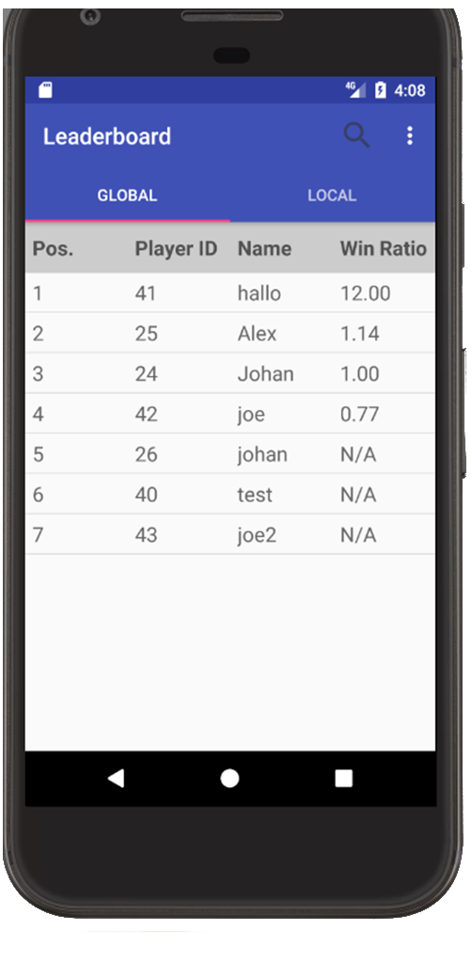
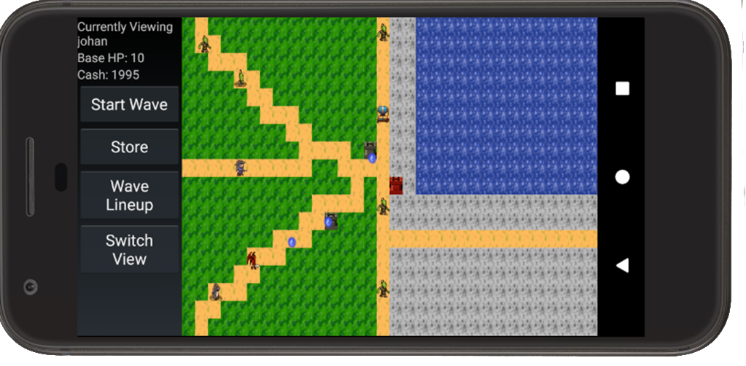
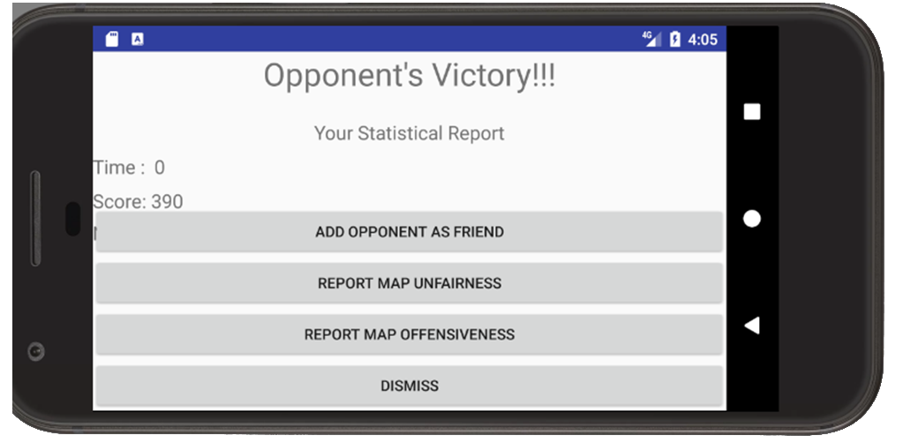
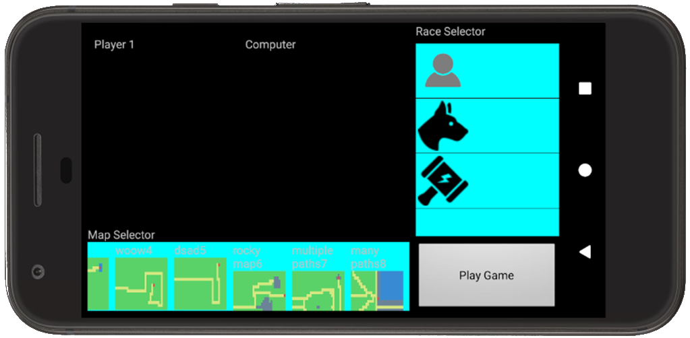
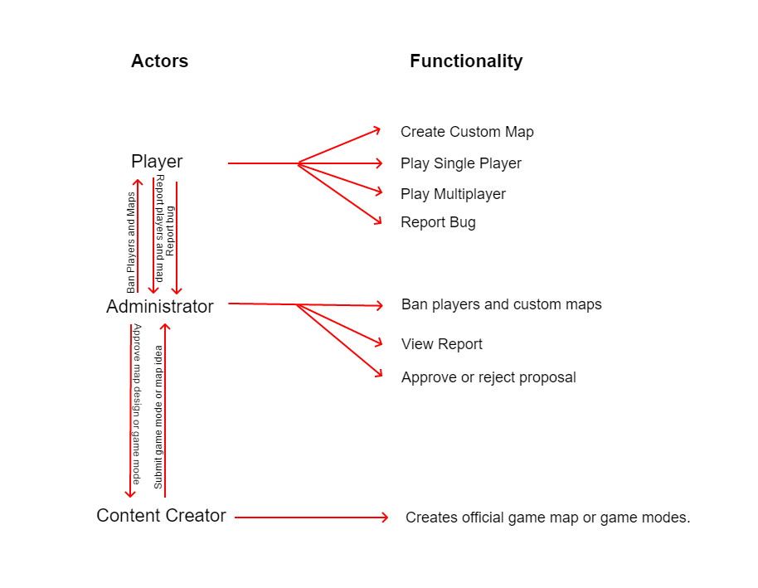
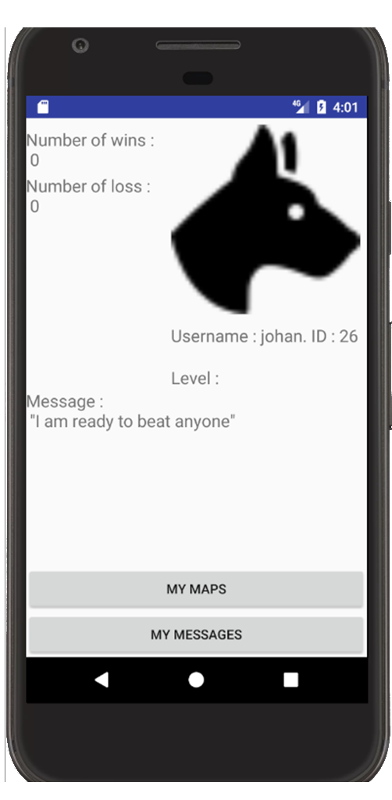
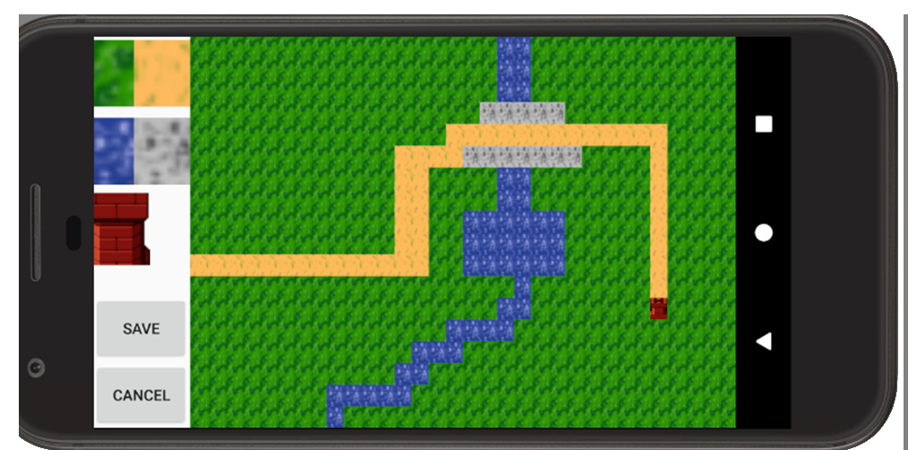
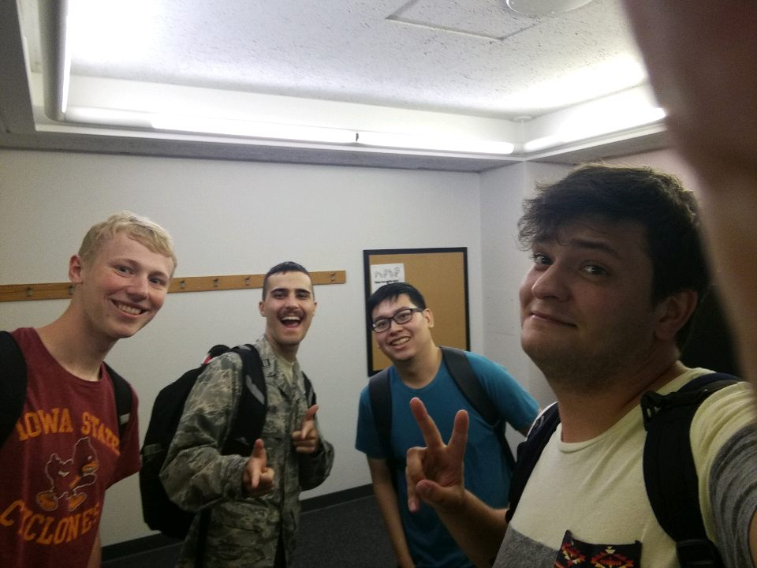
Fantasy Tower Defense
Jeremy Chee
Alex Nicklaus
Joe Ward
Johan Lanzrein
COM S 309 FALL 17
Project Description:
A new spin on the classic tower defense game.
In this application, the players can :
The game includes two main mechanics: attack and defend
Have friends and message them
Create their own map and let other players use them
Play the game vs AI or 1v1
Users:
Admin (take care of bad maps/player)
Players
Map editor
User Interfaces
Main menu : Access all the menus
Login/Register : Login to the app
Game lobby : Choose the game mode and setup the game
- Game : Play the game !
Map editor : Edit your own map and publish them
Friends : add other user and talk with them
My profile : your profile.
Settings : customize your profile
Admin : (ONLY FOR ADMIN) handle the reported maps and players and decide whether or not to ban them.
Team Info:
Team VC_B_4
Jeremy Chee – CPRE (Jr)
Alex Nicklaus – CPRE (Sr)
Joe Ward – COMS (Jr)
Johan Lanzrien– COMS (N.D.)
What went wrong:
We didn’t have time to implement more game modes.
The game part of the map is not 100% stable
What went right:
The app is a full fledge app with possibility to have friends, edit maps etc..
The game is playable.
Lessons Learned:
PHP code for server
Android for applications
Push often to avoid bad merges.
Module Interfaces:
GameObject
Basic interface for objects in game such as Units or Turrets; provides them with an update and getPosition functions
Position(float x, float y)
Gives the floating point x and y postitions for any GameObject
Units (GameLogic game, ArrayList<Position> path, int ID, int health, int speed, DamamgeTyoes unitTypes, int killReward)
Base unit class from which all other Units inheirit their properties and basic functionality
Turret(GameLogic game, int range, int fireRate, DamageTypes type, int power, Position position)
GameStore()
Interacts with the player who purchases Units which will be sent to attack the enemy player
Buyable
Basic interface for any buyable used for GameStore
DamageTypes
Enum specifying different types of damage used by Turrets and Units for damage and resistance
GameLogic(Map map, GameStore store)
Holds the state of the game and updates the state from user input such as the Units in play, Towers in play, currency of each player, and directs Units to calculate damage from Turrets
GamePannel(Context context, AttributeSet attributeSet)
Initializes the game and is responsible for interpreting and translating user inputs
UnitWave(ArrayList<Units> units, int unitDensity)
Contains an ArrayList of Units which is processed converted into a string of integers. These integers are sent over the internet to opposing player the opposing player reads the sting and converts it into an ArrayList
Design Decisions:
Database for everything stored on the server
Client computes the game state (So the game is not totally synchronized on both clients)
All of the assets will be in the client to avoid network latency

