Slide 1
Final Presentation
ELCA for
MPT, AKO and co.
27/06/22
CHUP – PIM Tool

Slide 2
1
2
3
What I’ve learned
What I’ve done
Feedback

Slide 3
What I’ve learned
About the culture
  Share and Learn
  Be positive
  Respect the template

Slide 4
What I’ve learned
About the technologies
  Angular Framework
  .NET Framework
  Entity Framework Core
  Other concepts (Interceptor, Global Exception Handler, Controller-Service-Repository Pattern,...)

Slide 5
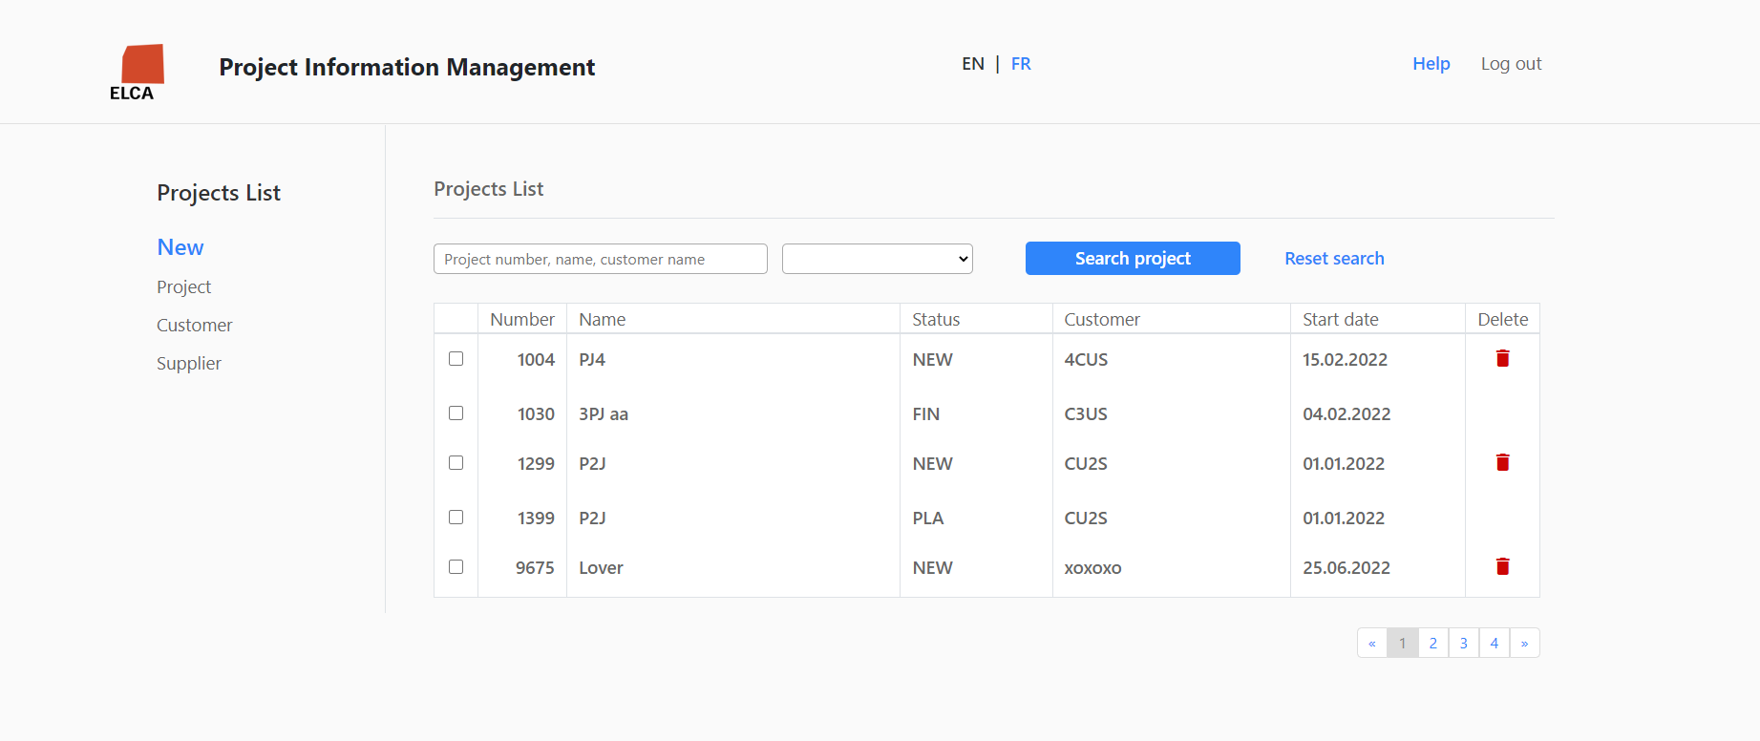
What I’ve done
Introducing Project Information Management (PIM) Tool
Notes:
What I find interesting about PIM Tool:
A tool that is used to manage the specs, the status and many more info of multiple projects
Has a user-friendly interface with some easy-to-use features
Suitable for interns to practice with the technologies
Technical stack: SQL Server, .NET, EF Core, Angular.

Slide 6
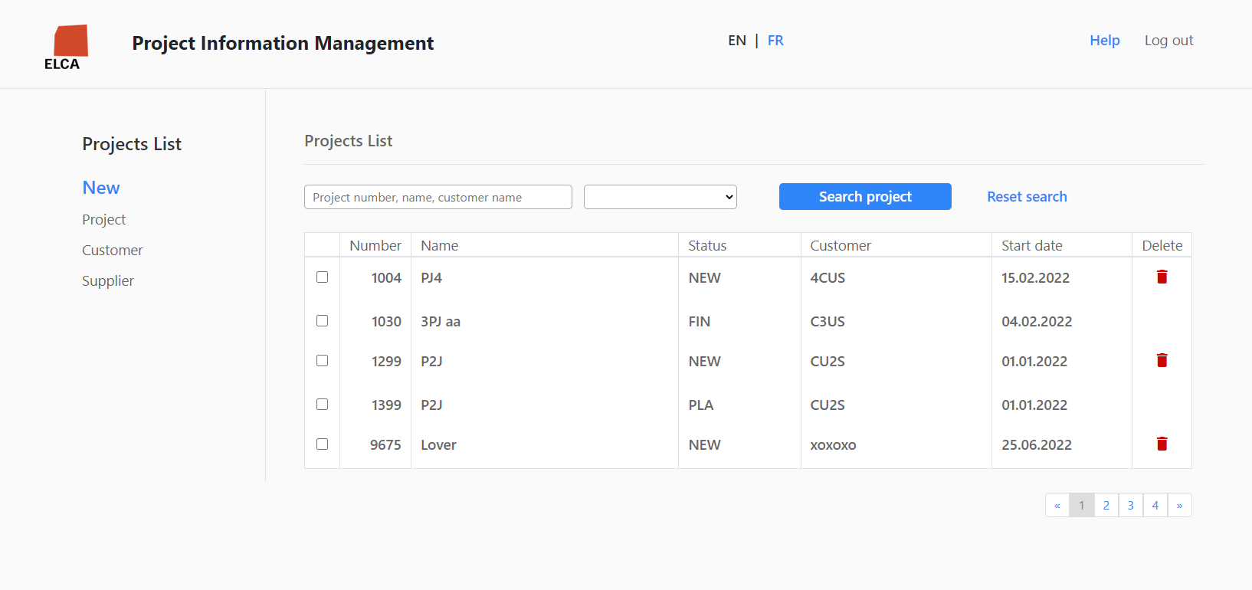
What I’ve done
Project List Screen
  Shows the project list.
  User can delete one or multiple projects.
  User can search for projects.
Notes:
Shows the project list ordered by Project number.
User can delete one or multiple projects with status New.
User can search for projects with certain criterias.

Slide 7
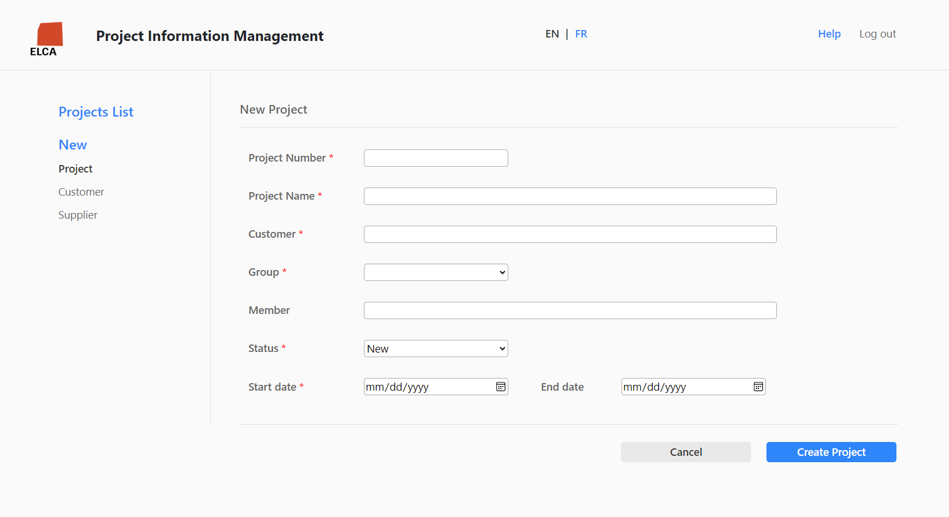
What I’ve done
New Project Screen
  Shows the form of fields.
  User can add projects to system.
  The validations are applied to the front and backend.

Slide 8
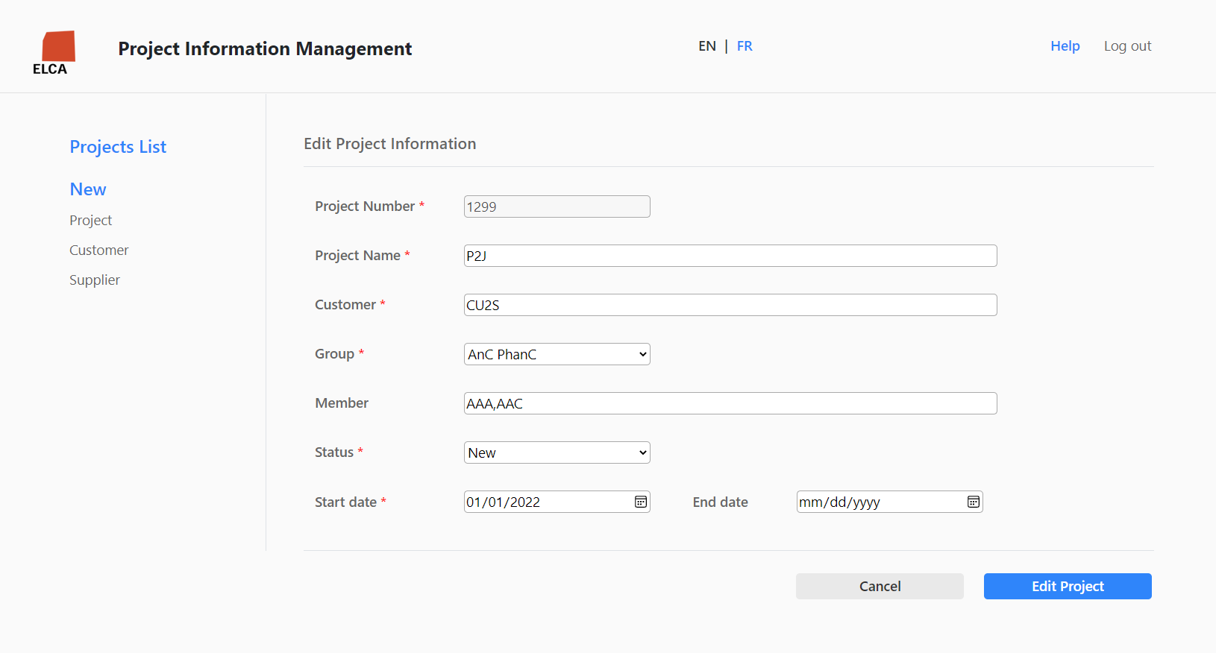
What I’ve done
Edit Project Screen
  Shows the form of the current information.
  User can modify information and press Edit to modify.
Notes:
Shows the form of information with the current information.
User can change or add the information to the project and press Edit to add it.
This screen bases on the component of New project screen.

Slide 9
What I’ve done
Other features:
  Multilingual.
  Criteria and form reserved after navigate to other screens.
  Concurrent update handler.
  Interceptor & Global exception handler.

Slide 10
What I’ve done
Introduce business overview
Technical stack
Detail tasks

Slide 11
Feedback
Self-evaluation
  Having better self-training strategy.
  Knowing and learning new technologies.
  Getting used to the enterprise environment.
Notes:
- Better self-training strategy: I found the efficient ways to manage time and targets, know how to consider the priority of the tasks.
- Knowing and learning new technologies.
- Getting used to the enterprise environment: not going to the company, sit there and wait for the salary. We come to work, and that’s how we develop ourselves.

Slide 12
Feedback
Feedback
  ELCA
    Great working environment.
    Friendly colleagues.
    Flexible working time.
  Onboarding program
    Supportive, caring manager and coaches.
    Rational roadmap.
    Approachable for newcomers.
    Cons: some forms and source codes are a little bit of out-of-date.

Slide 13
phong.chungdong@elca.vn
Chung Dong Phong - CHUP
.NET Intern

