Slide 1
Let’s git!
https://github.com/dongpingsheng/learngit

Slide 2
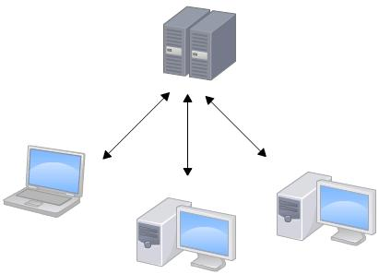
Subversion Architecture

Slide 3
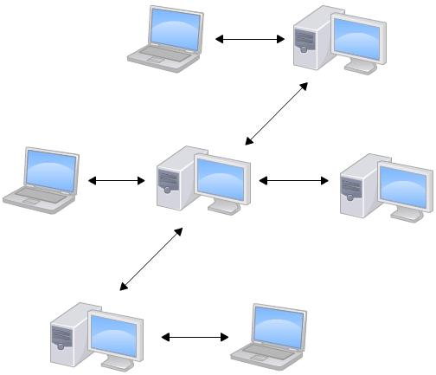
GIT Architecture

Slide 4
Subversion local files system
Files
File’s base version
Svn Server

Slide 5
GIT local files system
User1
FILES
VERSIONS
Branch1 Files
Branch2 Files
User2
FILES
gitHub
VERSIONS
Branch1 Files
Branch2 Files

Slide 6
GIT Branchs
User1
Master FILES
Work base
VERSION Database
Branch1 Files
Branch2 Files

Slide 7
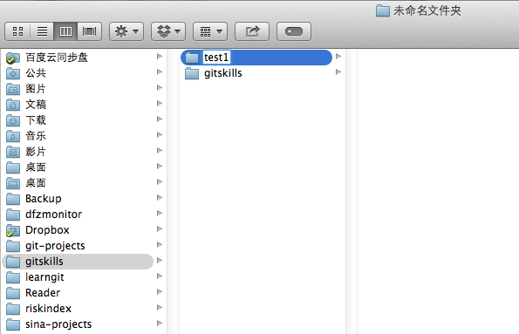
init work path 1

Slide 8
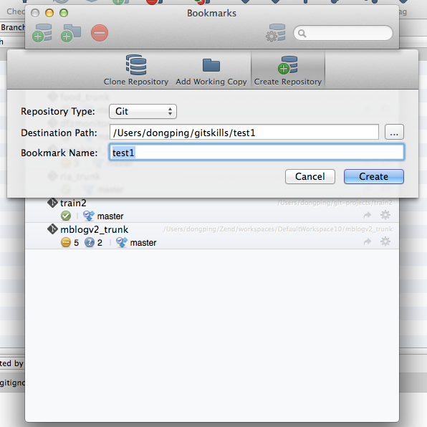
init work path 2

Slide 9
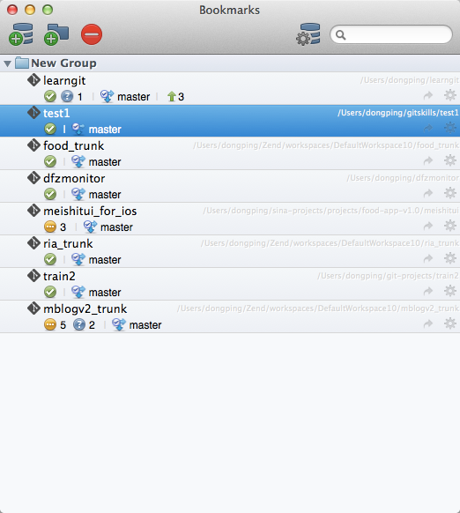
init work path 3

Slide 10
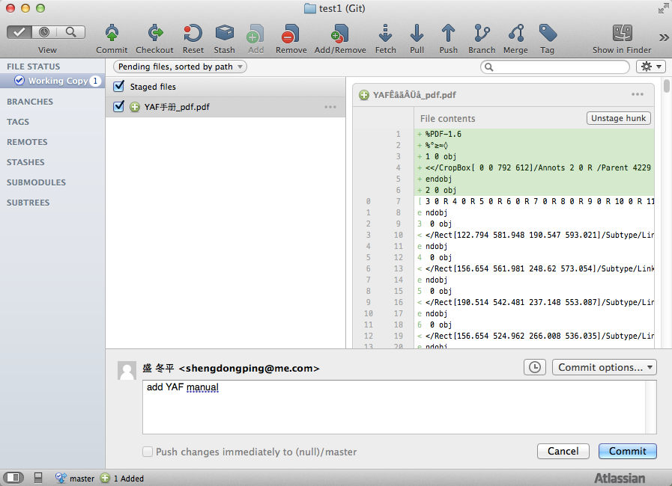
Add files

Slide 11
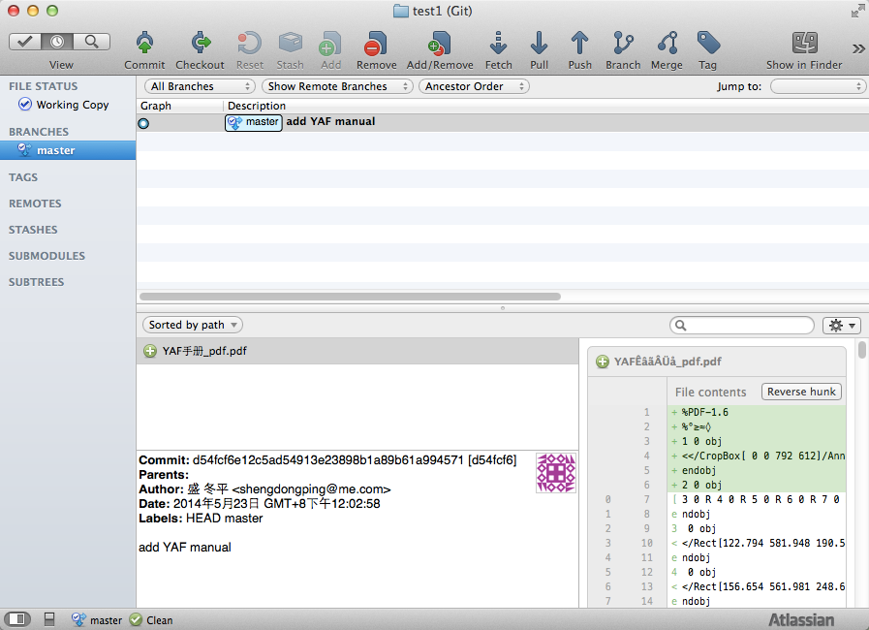
Commit

Slide 12
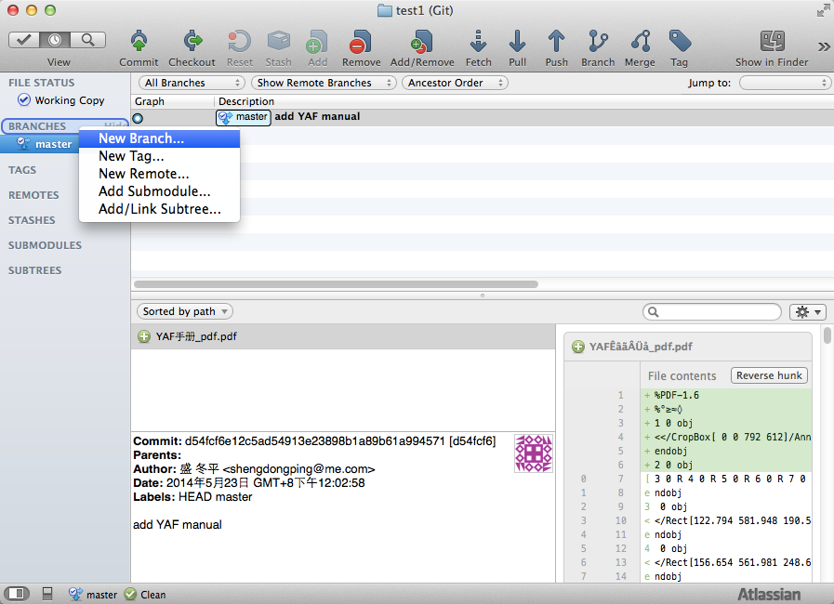
Create Branch 1

Slide 13
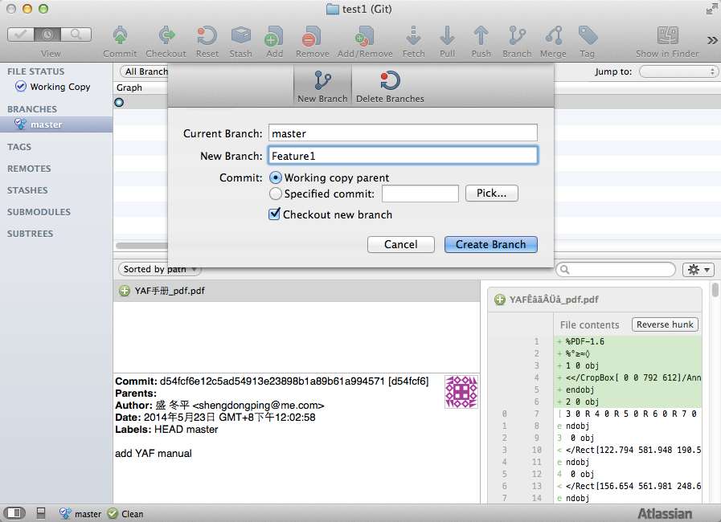
Create Branch 2

Slide 14
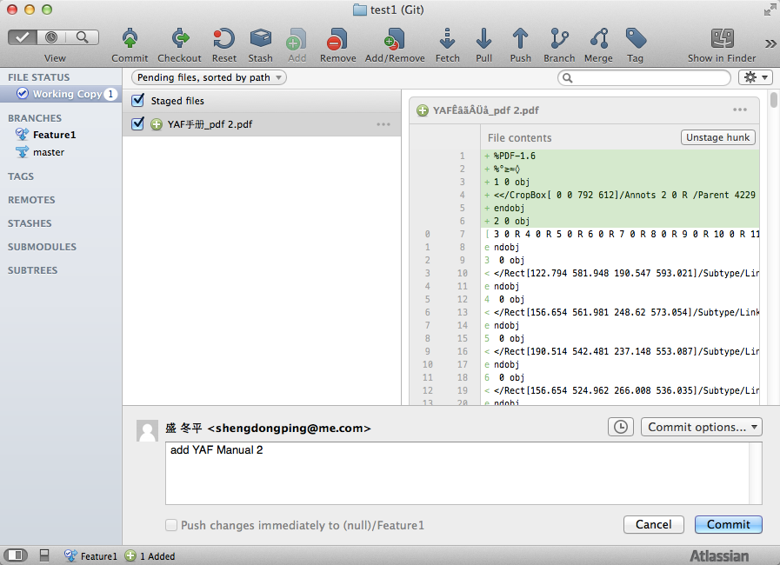
Add file to Branch

Slide 15
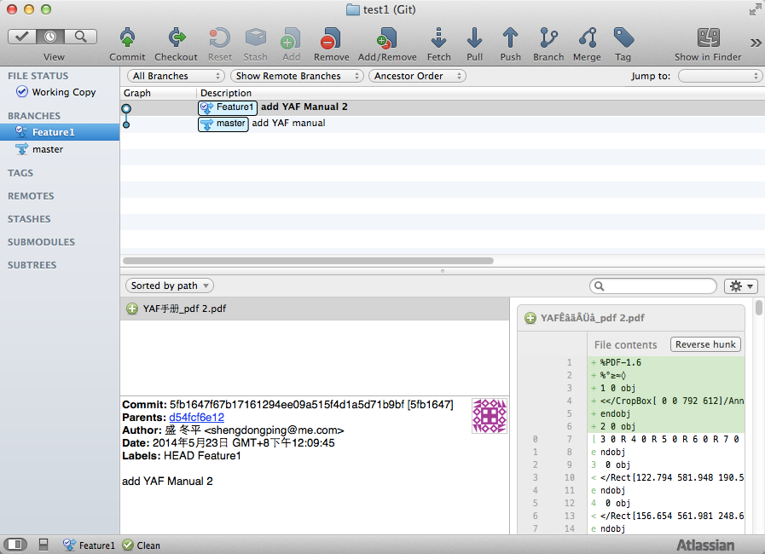
Commit Logs

Slide 16
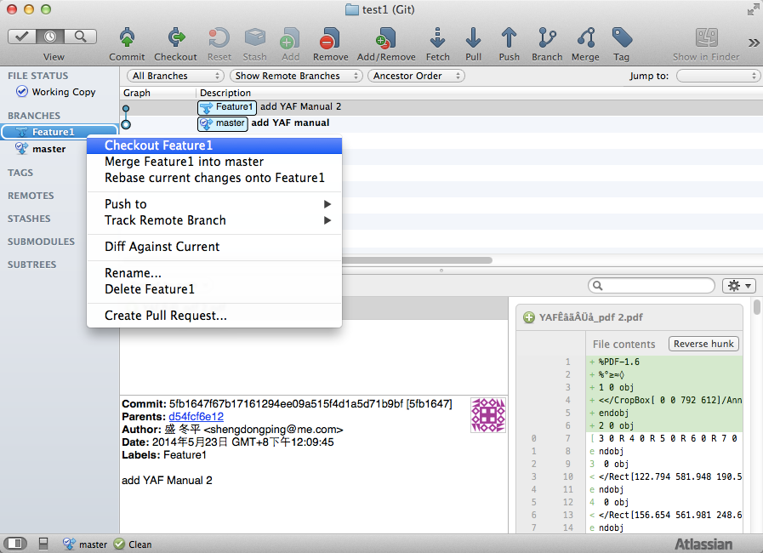
Change Branch
Notes:
Note : git 最大的好处就是一个目录即可以做主干相关的开发也可以做分支相关的开发，不需要象SVN好样，需要把主干checkout到一个目录，分支checkout到另一个目录。

Slide 17
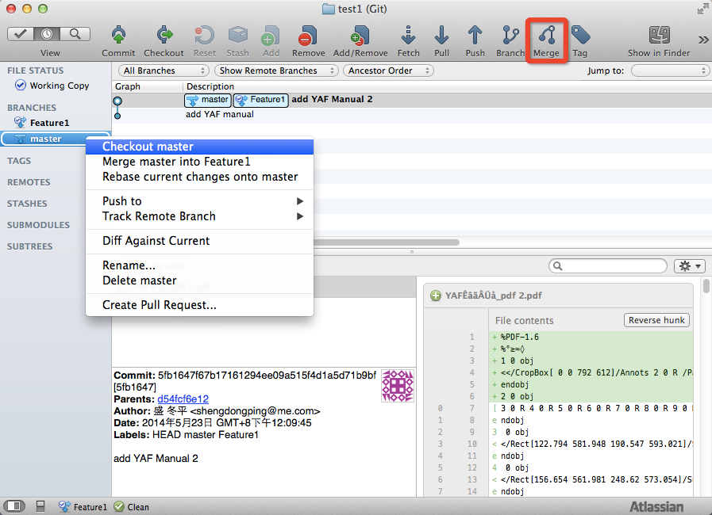
Branch Merge 1

Slide 18
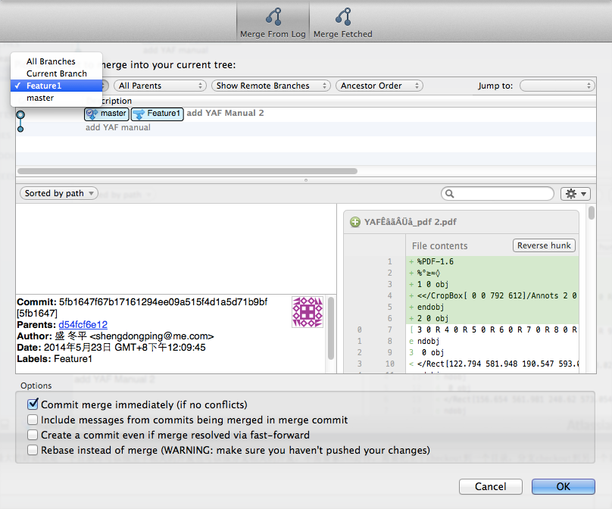
Branch Merge 2

Slide 19
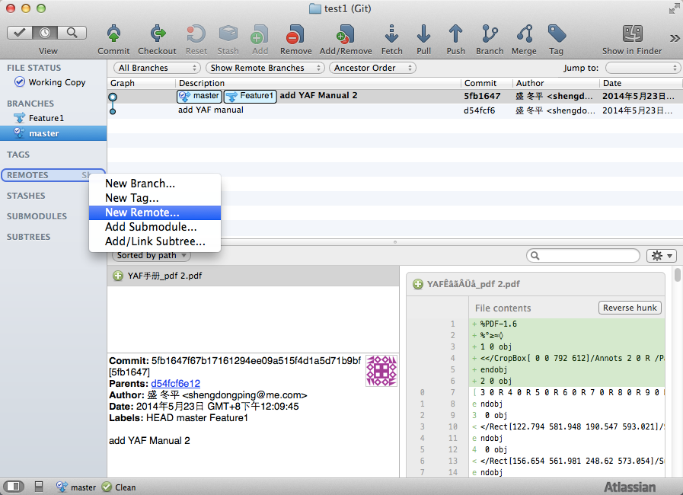
Add Remote 1

Slide 20
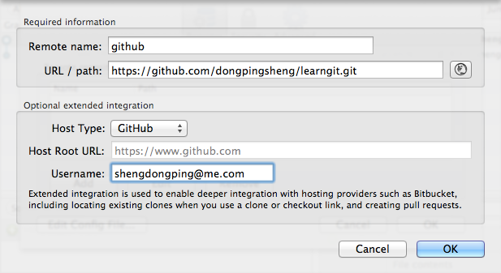
Add Remote 2

Slide 21
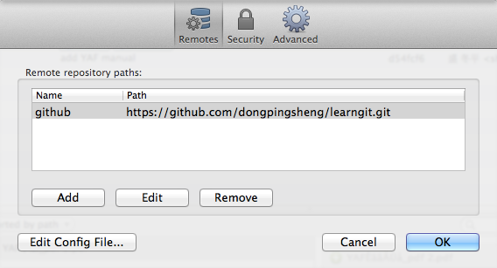
Add Remote 3

Slide 22
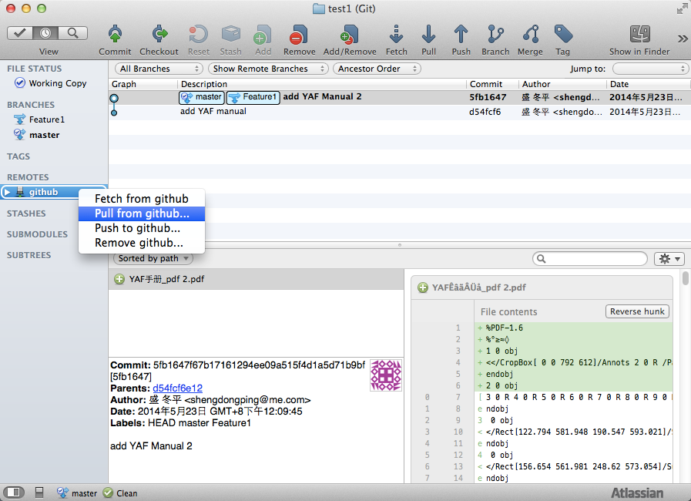
Pull from github 1

Slide 23
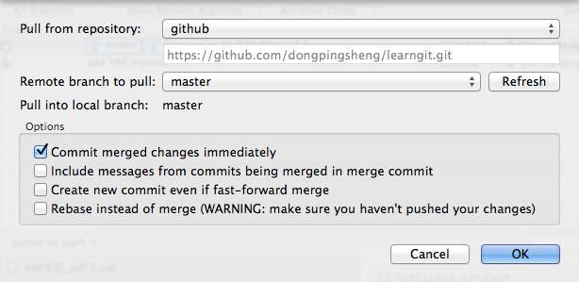
Pull from github 2

Slide 24
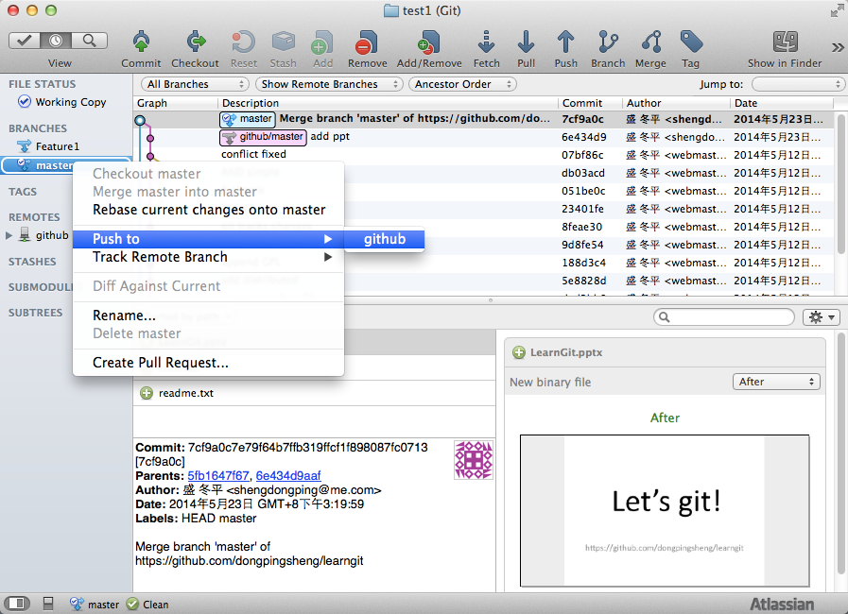
Push to github 1

Slide 25
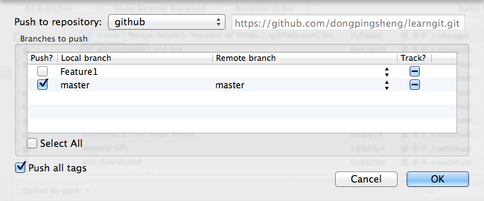
Push to github 2

Slide 26
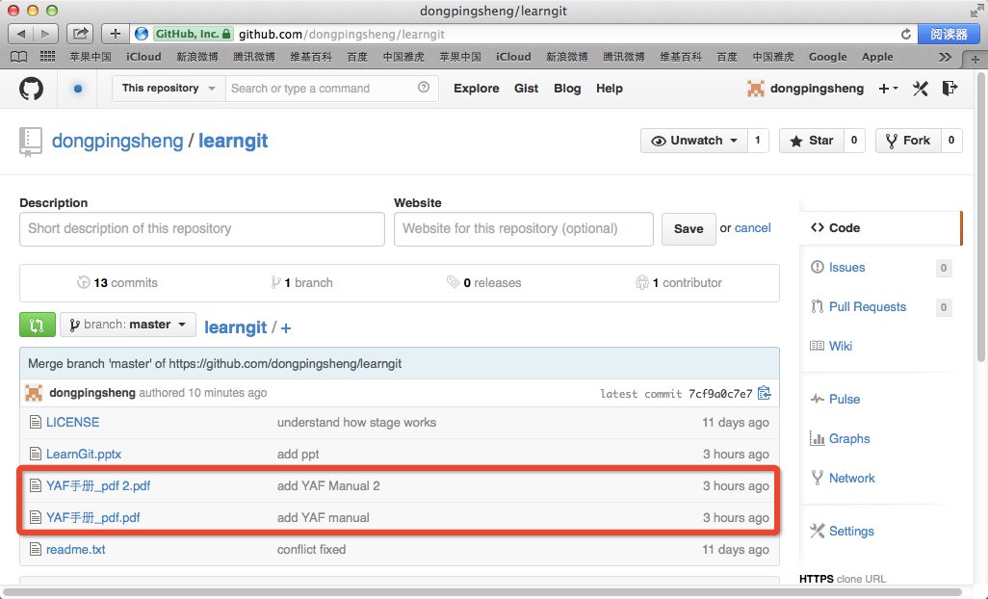
Push to github 3

