Slide 1
Let’s git!
https://github.com/dongpingsheng/learngit

Slide 2
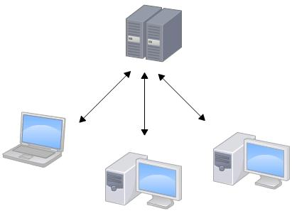
Subversion

Slide 3
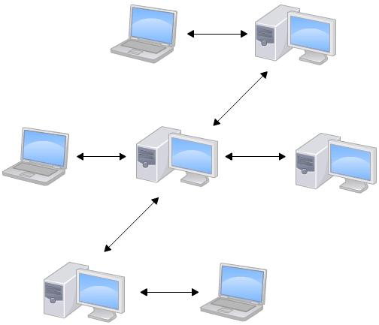
GIT

Slide 4
Subversion
Files
File’s base version
Svn Server

Slide 5
GIT
User1
FILES
VERSIONS
Branch1 Files
Branch2 Files
User2
FILES
gitHub
VERSIONS
Branch1 Files
Branch2 Files

Slide 6
GIT Branchs
User1
Master FILES
Work base
VERSION Database
Branch1 Files
Branch2 Files

Slide 7
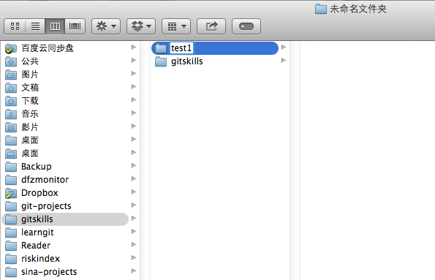
GIT init work path

Slide 8
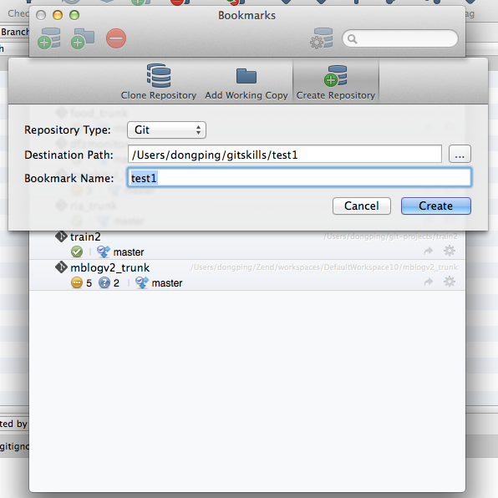
GIT init work path

Slide 9
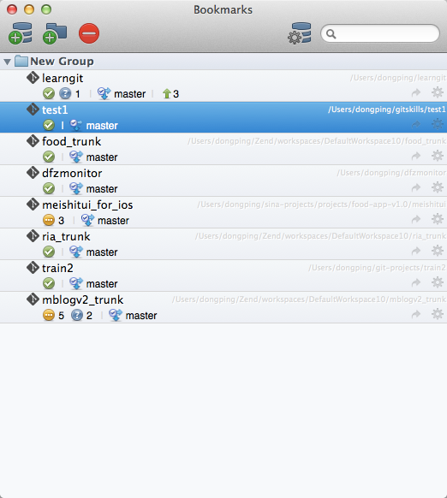
GIT init work path

Slide 10
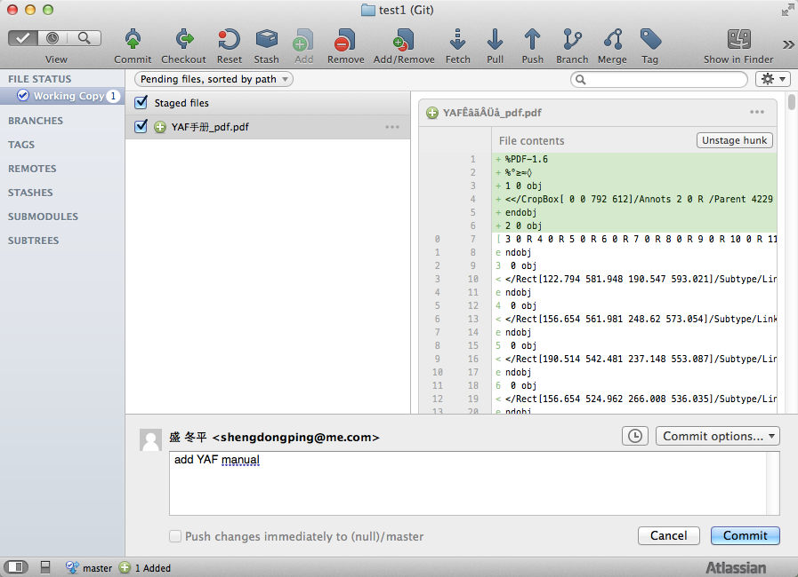
Add files

Slide 11
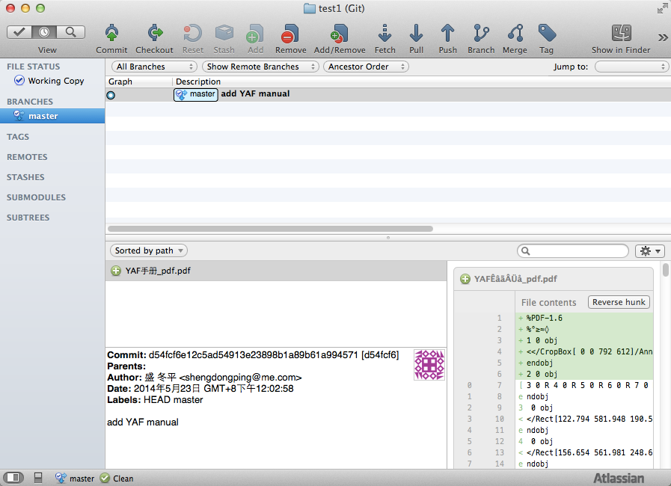
Commit

Slide 12
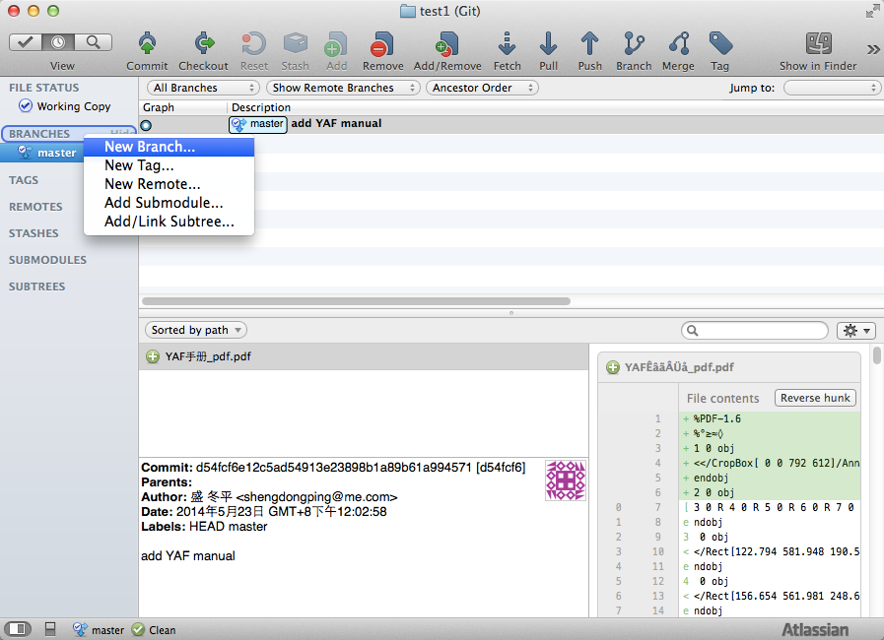
Create Branch

Slide 13
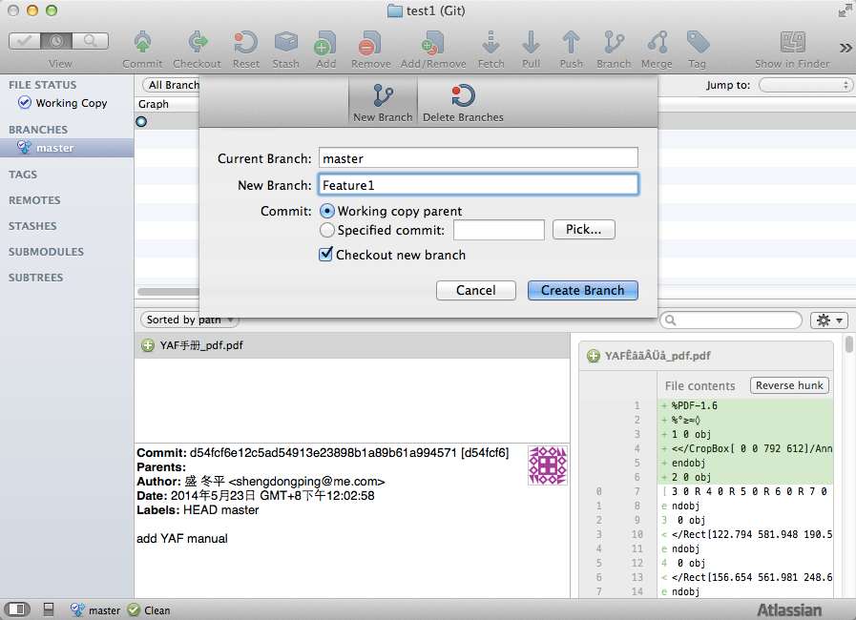
Create Branch

Slide 14
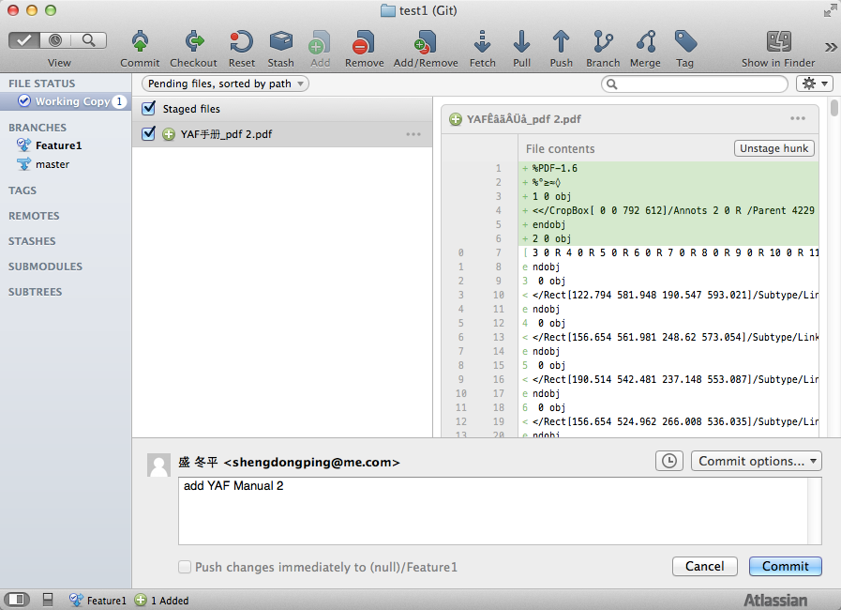
Add file to Branch

Slide 15
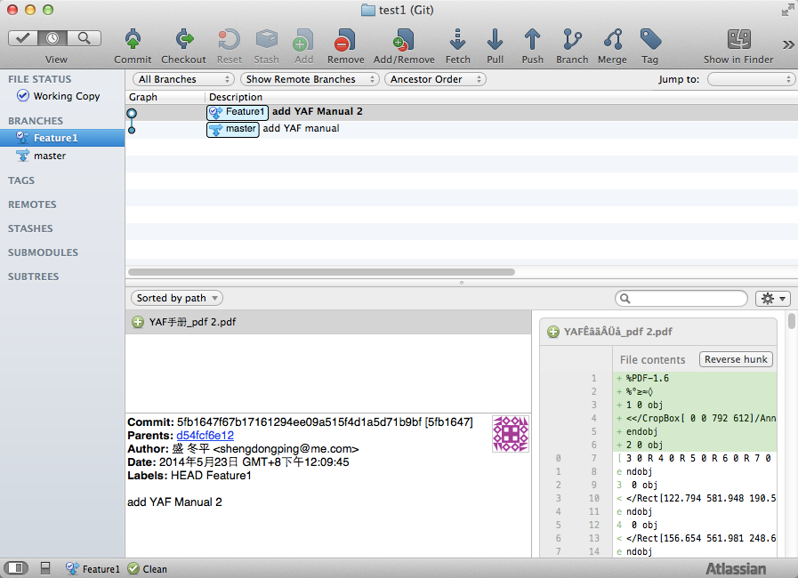
Master & Branch

