Slide 1
NATIONAL MAP AGENT v0.2
From national specification to auditable map execution
FOSS4G Hiroshima 2026 · five-scene Demo RC1
Notes:
The talk opens on the research object: a reviewed, executable, evidence-bearing path from specification to map.
[Sources]
- docs/ARCHITECTURE.md
- data/knowledge/portrayal-graph.json
- src/nma/knowledge.py
- src/nma/portrayal.py
- nmaAgentDemo.html
[/Sources]

Slide 2
A symbol without its source is unauditable
National portrayal rules begin as pages, tables and exceptions—not executable decisions.
SELECTED DECISION
School 9920103 → draw_symbol
Profile tw-nlsc-1000-NLSC112V5.4
Rule rule:portrayal:…:9920103
Page 61
Source NLSC112V5.4 portrayal PDF
Review human-review-required
SHA-256 1f9c4457d7ce…
NMA keeps three things together:
• the selected map action
• the graph path that produced it
• the exact source page and review state
Feature → rule → symbol → observation → PDF page
2
Notes:
Use the school panel to show that the user can inspect page 61, source hash, review status, nodes and edges without leaving the demo.
[Sources]
- data/demo/five-scene-demo.json
- docs/FIVE-SCENE-DEMO.md
- assets/symbols/nlsc112v5.4/manifest.json
[/Sources]

Slide 3
Authority stays visible through execution
Source PDF
Reviewed facts
Property graph
Graph retrieval
Style compiler
Map + evidence
Pages and rules
Human gate
Typed evidence path
Guards and exceptions
Evidence metadata
Inspect or abstain
Trust gates
Extraction candidates are never executable. Unsupported profile or scale abstains before a portrayal rule is used.
The graph—not generated prose—remains the authority for RC1 decisions.
3
Notes:
[Sources]
- docs/ARCHITECTURE.md
- data/knowledge/portrayal-graph.json
- src/nma/knowledge.py
- src/nma/portrayal.py
- nmaAgentDemo.html
[/Sources]

Slide 4
Five scenes reveal five capabilities
School
Hydrant
Police
Fish pond
Post office
Versioned retrieval
+ evidence path
Deterministic symbol
+ official dimensions
Alias resolution
+ name label
Geometry-aware
compound portrayal
Conditional exception
+ abstention
4
Notes:
[Sources]
- data/demo/five-scene-demo.json
- docs/FIVE-SCENE-DEMO.md
- assets/symbols/nlsc112v5.4/manifest.json
[/Sources]

Slide 5
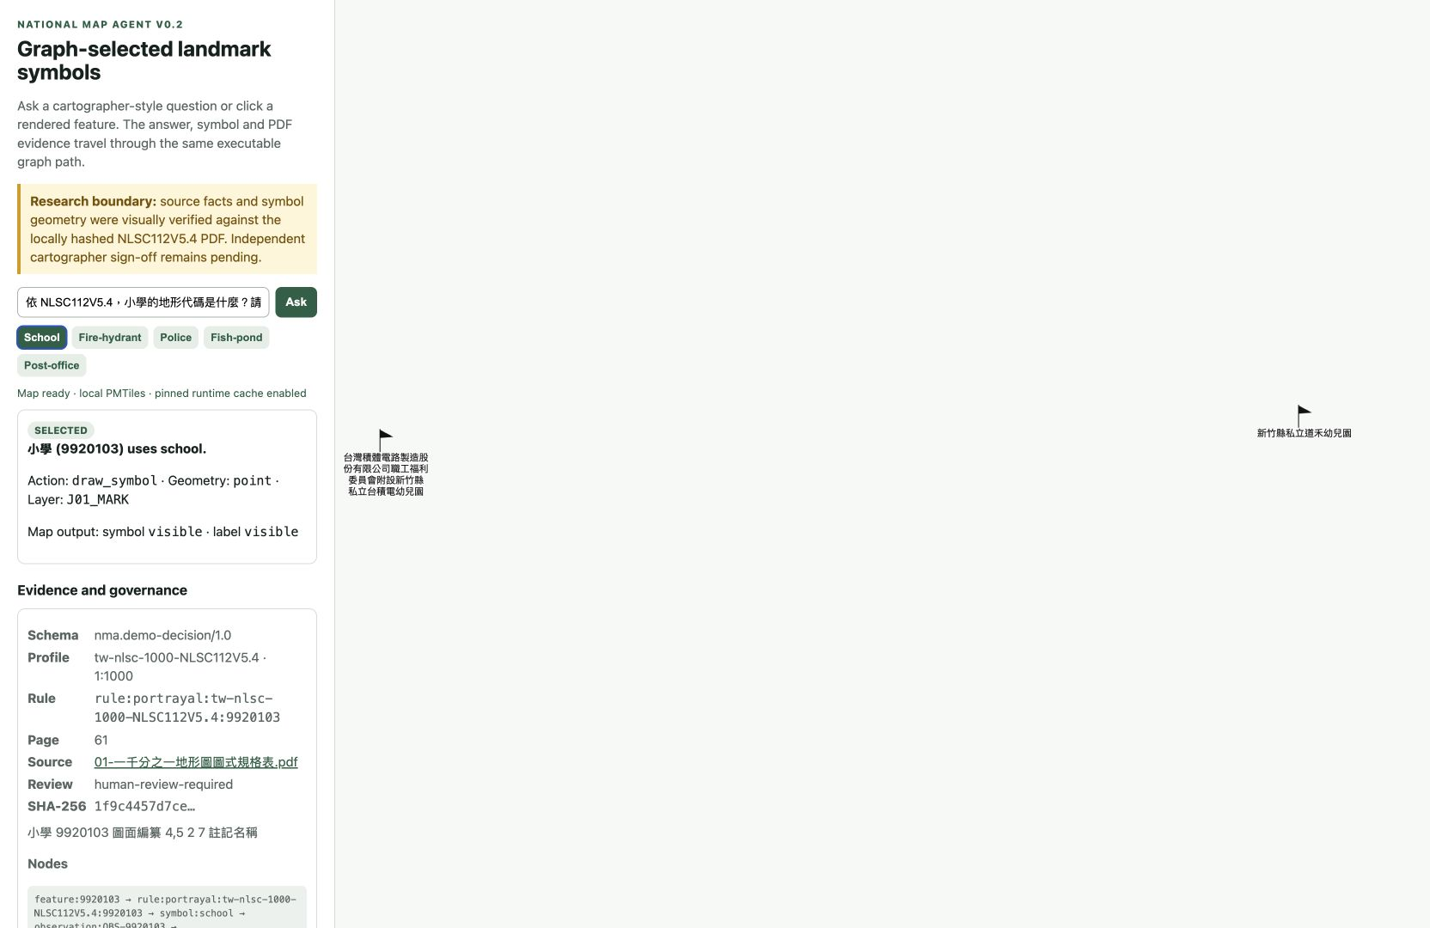
The demo exposes both decision and evidence
Five-minute sequence
1 School — golden path
2 Hydrant — dimensions
3 Police — aliases + label
4 Fish pond — geometry
5 Post office — exception
Fallback: pinned cache → evidence-only → approved recording
5
Notes:
The first scene receives 90 seconds because it establishes the whole evidence-bearing pattern; the next four scenes each isolate a distinct capability.
[Sources]
- data/demo/five-scene-demo.json
- docs/FIVE-SCENE-DEMO.md
- assets/symbols/nlsc112v5.4/manifest.json
[/Sources]
[Sources]
- data/demo/stable-rc1.json
- docs/STABLE-DEMO-RC1.md
- artifacts/rc1/automated-soak.json
- artifacts/rc1/browser-soak.json
[/Sources]

Slide 6
One golden path creates an auditable map layer
Question
or click
Retrieve
subgraph
Enforce
guards
Return
decision
Compile
style
Display or
abstain
Human intent
Code · name · alias
Profile · scale · exception
Action + evidence
Layer + metadata
Map + governance
Every selected result carries profile, rule ID, PDF page, source hash, review status, graph nodes/edges and an execution log.
6
Notes:
[Sources]
- docs/ARCHITECTURE.md
- data/knowledge/portrayal-graph.json
- src/nma/knowledge.py
- src/nma/portrayal.py
- nmaAgentDemo.html
[/Sources]

Slide 7
RC1 is stable enough to present—and bounded enough to trust
Repeated clean resets, cached browser execution and an approved portable fallback all preserve the same five exact decisions.
The figures below are release gates, not claims of publication-grade cartographic authority.
20/20
10/10
0
clean-reset rounds passed
cached browser rounds passed
unresolved blocking defects
7
Notes:
[Sources]
- data/demo/stable-rc1.json
- docs/STABLE-DEMO-RC1.md
- artifacts/rc1/automated-soak.json
- artifacts/rc1/browser-soak.json
[/Sources]

Slide 8
The boundary is part of the contribution—not a footnote
RC1 proves
A bounded, reproducible bridge from reviewed evidence to executable portrayal and map inspection.
RC1 does not claim
Autonomous authoritative map production or correctness beyond the reviewed five-scene profile.
Publication gate
Independent cartographer and expert sign-off; sealed held-out evaluation; named baselines.
Release gate
Confirm PMTiles redistribution terms and deploy the public URL only through an approved path.
8
Notes:
[Sources]
- docs/ARCHITECTURE.md
- data/knowledge/portrayal-graph.json
- src/nma/knowledge.py
- src/nma/portrayal.py
- nmaAgentDemo.html
[/Sources]
[Sources]
- data/demo/stable-rc1.json
- docs/STABLE-DEMO-RC1.md
- artifacts/rc1/automated-soak.json
- artifacts/rc1/browser-soak.json
[/Sources]
[Sources]
- README.md#nma-bench-v01
- docs/BENCHMARK.md
- artifacts/benchmark/results.json
[/Sources]

Slide 9
NEXT
Open the bridge. Keep authority accountable.
Independent review
Held-out benchmark
Public adapters
Notes:
Close by inviting the FOSS4G community to extend the open bridge without hiding uncertainty or authority boundaries.
[Sources]
- docs/FOSS4G-HIROSHIMA-2026.md#community-sprint-invitation
- docs/STABLE-DEMO-RC1.md#risk-disposition
- docs/BENCHMARK.md
[/Sources]

