Slide 1
NATIONAL MAP AGENT v0.2
From national specification to auditable map execution
FOSS4G Hiroshima 2026 · deck v1.0
Notes:
The talk opens on the research object: a reviewed, executable, evidence-bearing path from specification to map.
[Sources]
- docs/ARCHITECTURE.md
- data/knowledge/portrayal-graph.json
- src/nma/knowledge.py
- src/nma/portrayal.py
- nmaAgentDemo.html
[/Sources]

Slide 2
A symbol without its source is unauditable
National portrayal rules begin as pages, tables and exceptions—not executable decisions.
SELECTED DECISION
School 9920103 → draw_symbol
Profile tw-nlsc-1000-NLSC112V5.4
Rule rule:portrayal:…:9920103
Page 61
Source NLSC112V5.4 portrayal PDF
Review human-review-required
SHA-256 1f9c4457d7ce…
NMA keeps three things together:
• the selected map action
• the graph path that produced it
• the exact source page and review state
Feature → rule → symbol → observation → PDF page
2
Notes:
Use the school panel to show that the user can inspect page 61, source hash, review status, nodes and edges without leaving the demo.
[Sources]
- data/demo/five-scene-demo.json
- docs/FIVE-SCENE-DEMO.md
- assets/symbols/nlsc112v5.4/manifest.json
[/Sources]

Slide 3
Authority stays visible through execution
Source PDF
Reviewed facts
Property graph
Graph retrieval
Style compiler
Map + evidence
Pages and rules
Human gate
Typed evidence path
Guards and exceptions
Evidence metadata
Inspect or abstain
Trust gates
Extraction candidates are never executable. Unsupported profile or scale abstains before a portrayal rule is used.
The graph—not generated prose—remains the authority for RC1 decisions.
3
Notes:
[Sources]
- docs/ARCHITECTURE.md
- data/knowledge/portrayal-graph.json
- src/nma/knowledge.py
- src/nma/portrayal.py
- nmaAgentDemo.html
[/Sources]

Slide 4
Five scenes reveal five capabilities
School
Hydrant
Police
Fish pond
Post office
Versioned retrieval
+ evidence path
Deterministic symbol
+ official dimensions
Alias resolution
+ name label
Geometry-aware
compound portrayal
Conditional exception
+ abstention
4
Notes:
[Sources]
- data/demo/five-scene-demo.json
- docs/FIVE-SCENE-DEMO.md
- assets/symbols/nlsc112v5.4/manifest.json
[/Sources]

Slide 5
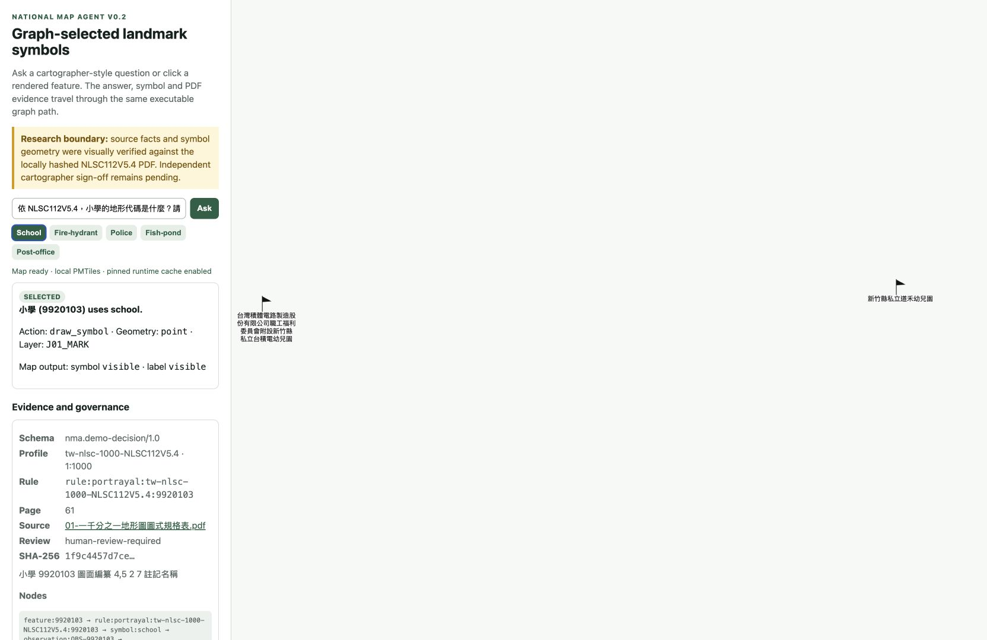
The demo exposes both decision and evidence
Five-minute sequence
1 School — golden path
2 Hydrant — dimensions
3 Police — aliases + label
4 Fish pond — geometry
5 Post office — exception
Fallback: pinned cache → evidence-only → approved recording
5
Notes:
The first scene receives 90 seconds because it establishes the whole evidence-bearing pattern; the next four scenes each isolate a distinct capability.
[Sources]
- data/demo/five-scene-demo.json
- docs/FIVE-SCENE-DEMO.md
- assets/symbols/nlsc112v5.4/manifest.json
[/Sources]
[Sources]
- data/demo/stable-rc1.json
- docs/STABLE-DEMO-RC1.md
- artifacts/rc1/automated-soak.json
- artifacts/rc1/browser-soak.json
[/Sources]

Slide 6
One golden path creates an auditable map layer
Question
or click
Retrieve
subgraph
Enforce
guards
Return
decision
Compile
style
Display or
abstain
Human intent
Code · name · alias
Profile · scale · exception
Action + evidence
Layer + metadata
Map + governance
Every selected result carries profile, rule ID, PDF page, source hash, review status, graph nodes/edges and an execution log.
6
Notes:
[Sources]
- docs/ARCHITECTURE.md
- data/knowledge/portrayal-graph.json
- src/nma/knowledge.py
- src/nma/portrayal.py
- nmaAgentDemo.html
[/Sources]

Slide 7
RC1 is stable enough to present—and bounded enough to trust
Repeated clean resets, cached browser execution and an approved portable fallback all preserve the same five exact decisions.
The figures below are release gates, not claims of publication-grade cartographic authority.
20/20
10/10
0
clean-reset rounds passed
cached browser rounds passed
unresolved blocking defects
7
Notes:
[Sources]
- data/demo/stable-rc1.json
- docs/STABLE-DEMO-RC1.md
- artifacts/rc1/automated-soak.json
- artifacts/rc1/browser-soak.json
[/Sources]

Slide 8
The review package names every data boundary
Authoritative evidence
NLSC112V5.4 pages 11, 50, 60–62 and 69; hash recorded; PDF referenced, not redistributed.
Executable demo data
Contract v1.0; profile NLSC112V5.4; 10 reviewed observations; frozen outputs.
Open assets
Apache-2.0 code; CC0-1.0 synthetic fixtures; source-derived records await independent review.
Release exclusion
PMTiles stays repository-only until redistribution terms are confirmed.
8
Notes:
The public review package separates redistributable code and synthetic fixtures from referenced authority material and the gated PMTiles archive.
[Sources]
- data/README.md
- data/sources/authoritative-sources.json
- data/demo/five-scene-demo.json
- artifacts/release/nma-v0.2-review-package/DATASET.md
- LICENSE
[/Sources]

Slide 9
One command verifies the review package
make review-package checks the curated asset manifest, reruns the frozen five-scene decisions and rejects secrets or machine-specific paths.
It produces a portable ZIP plus a machine-readable verification report.
1
5/5
0
review command
frozen scenes reproduced
secrets or absolute paths
9
Notes:
The review command is a packaging gate, not new demo functionality. It reuses the frozen runner and verifies the curated file list.
[Sources]
- Makefile
- scripts/build_review_package.py
- artifacts/release/nma-v0.2-review-package/README.md
- artifacts/release/nma-v0.2-review-package/MANIFEST.json
[/Sources]

Slide 10
The benchmark becomes publishable in three gates
The current development set tests the architecture. Publication requires a sealed held-out set, expert adjudication and named, versioned baselines.
No current score is presented as a population estimate.
21
NEXT
THEN
development tasks now
sealed held-out evaluation
named baseline comparison
10
Notes:
The current scores are deterministic development evidence. The next two gates prevent the talk from overstating benchmark maturity.
[Sources]
- docs/BENCHMARK.md
- docs/RESEARCH-PROTOCOL.md
- benchmark/portrayal/manifest.json
- artifacts/benchmark/results.json
[/Sources]

Slide 11
Roadmap and paper share one evidence spine
Research question
Can reviewed national portrayal evidence become executable while source authority remains inspectable?
Method and system
Reviewed extraction → typed graph → guarded retrieval → evidence-bearing MapLibre compilation.
Evaluation and limits
Five-scene contract, architecture ablations, soak evidence, expert review and sealed held-out tasks.
Roadmap gates
Cartographer sign-off → held-out benchmark → named baselines → public adapters → approved deployment.
11
Notes:
The roadmap orders scientific gates before distribution gates. The paper skeleton follows the same evidence chain as the demo rather than adding unsupported claims.
[Sources]
- artifacts/release/nma-v0.2-review-package/PAPER-SKELETON.md
- docs/RESEARCH-PROTOCOL.md
- docs/FOSS4G-HIROSHIMA-2026.md
- docs/STABLE-DEMO-RC1.md
[/Sources]

Slide 12
REVIEW
The bridge is open. Review before extending.
Open bounded release
Inspect five paths
Confirm next gate
Notes:
Close on a concrete review action: the bounded Pages artifact is deployed, so the audience can inspect the five evidence paths and decide whether the next release gate is justified. Do not imply that expert cartographic review or unrestricted PMTiles distribution is complete.
[Sources]
- artifacts/release/nma-v0.2-review-package/README.md
- docs/STABLE-DEMO-RC1.md
- docs/FIVE-SCENE-NARRATIVE.md
- docs/PUBLIC-ASSETS-RC1.md
[/Sources]

