Slide 1
Skip Lists
Group 14

Slide 2
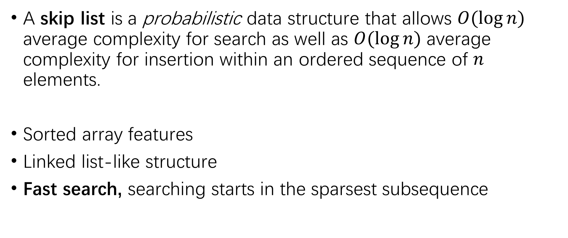
Skip Lists
A skip list is a probabilistic data structure that allows $O(\log{n)}$ average complexity for search as well as $O(\log{n)}$ average complexity for insertion within an ordered sequence of $n$ elements.
Sorted array features
Linked list-like structure
Fast search, searching starts in the sparsest subsequence

Slide 3
Our jobs
Insertion
Deletion
Searching
Find k^{th}

Slide 4
p
p
Len = 2
Len = 2
Len = 1
p
Val
Val
Val
Val
Val
Val
head
1st
2nd
3rd
4th
5th
6th
tail

Slide 5
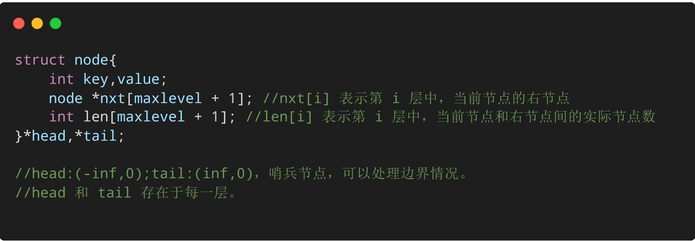
Node structure

Slide 6
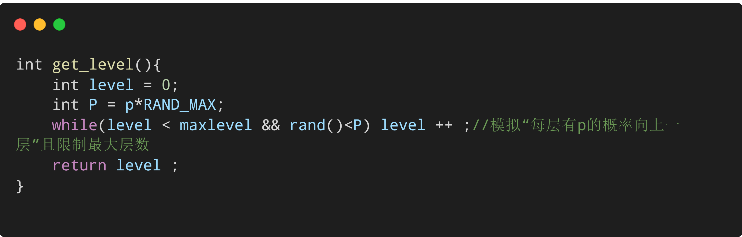
Get level

Slide 7
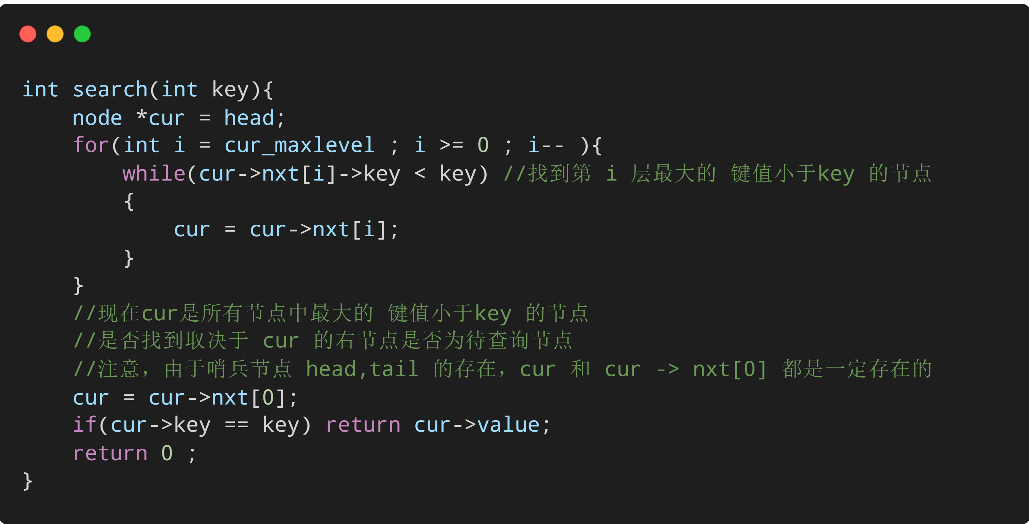
Key operation: Search
Find the node with the largest key value less than key at level i
Kind of like atomic operations, based on which we can do insertion, deletion, searching

Slide 8
Insertion (key = 4.5 as an example)
p
p
Len = 2
Len = 2
Len = 1
p
Val
Val
Val
Val
Val
Val
head
1st
2nd
3rd
4th
5th
6th
tail

Slide 9
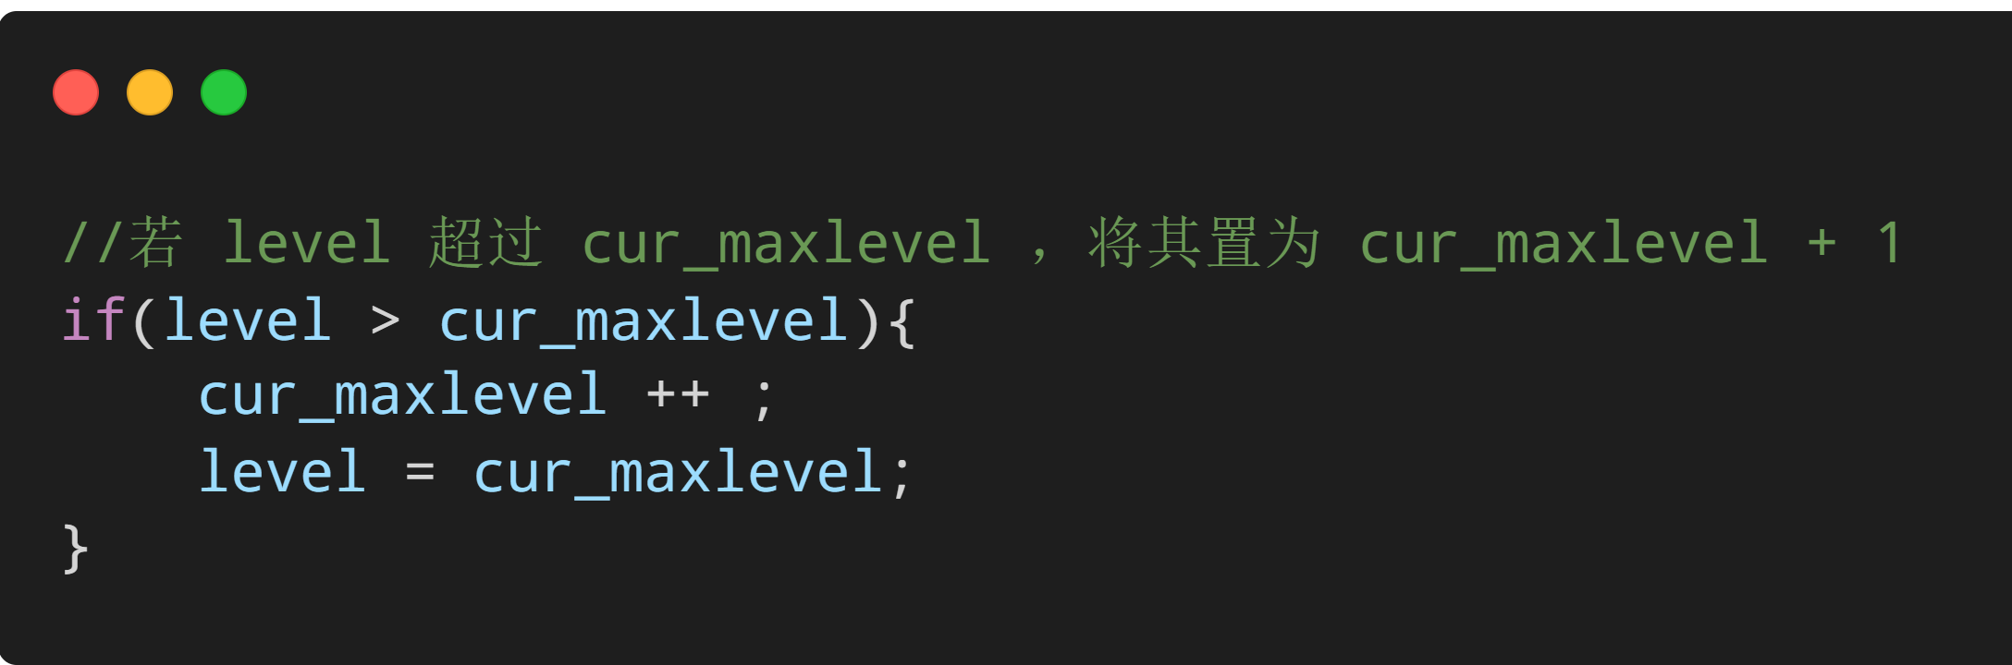
p
p
Len = 1
Len = 2
Len = 2
Len = 1
p
Val
Val
Val
Val
Val
Val
Val
head
1st
2nd
3rd
4th
4.5th
5th
6th
tail

Slide 10
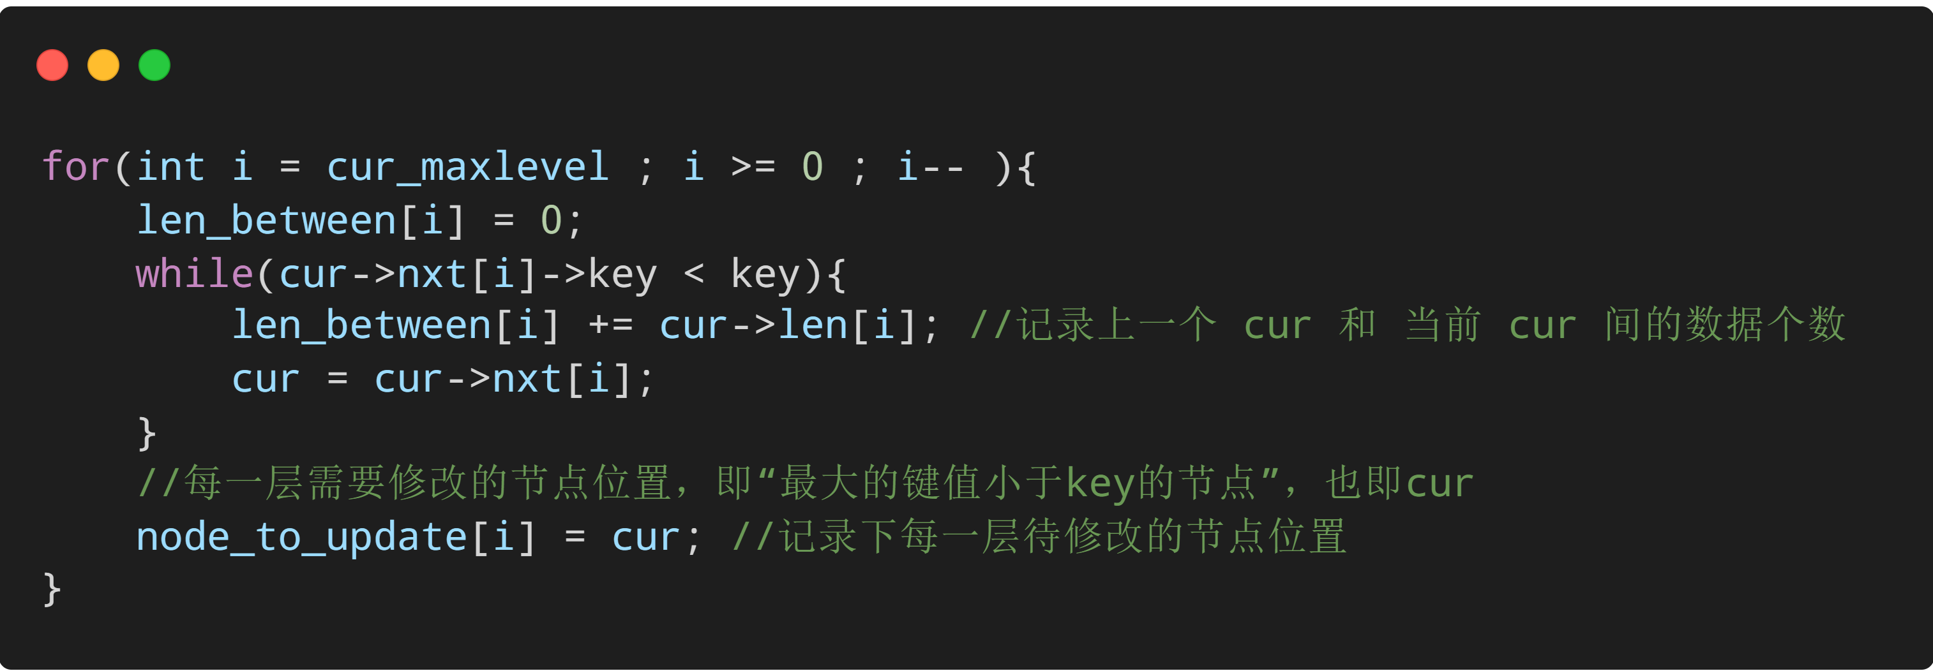
How do we update len ?
We maintain two arrays: node_to_update, len_between

Slide 11
p
p
Len = 1
Len = 2
Len = 2
Len = 1
p
Val
Val
Val
Val
Val
Val
Val
head
1st
2nd
3rd
4th
4.5th
5th
6th
tail

Slide 12
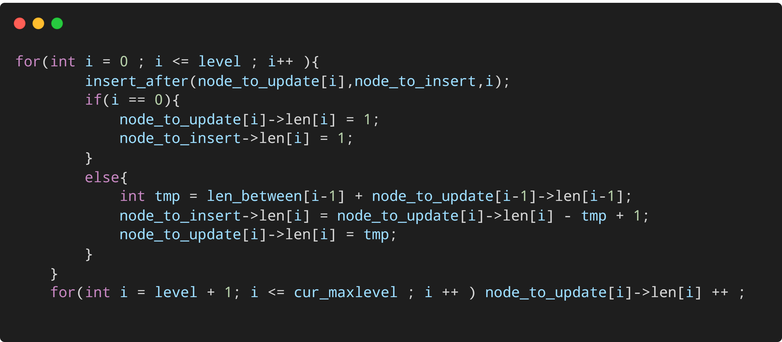
The complete code of insertion

Slide 13
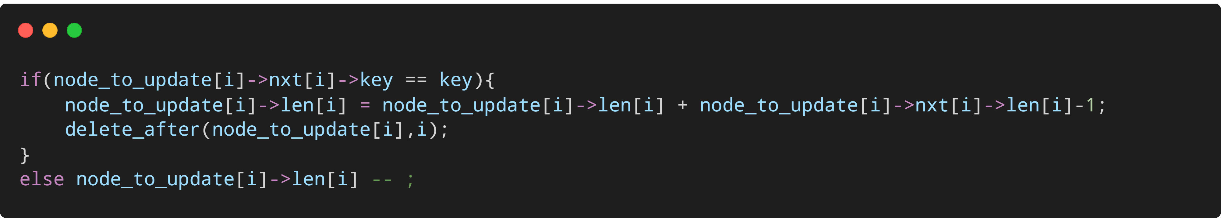
Deletion
Same as insertion
If the top level is empty

Slide 14
Find k^{th} (4th as an example)
p
p
Len = 1
Len = 2
Len = 2
Len = 1
p
Val
Val
Val
Val
Val
Val
Val
head
1st
2nd
3rd
4th
4.5th
5th
6th
tail

Slide 15
Test

Slide 16
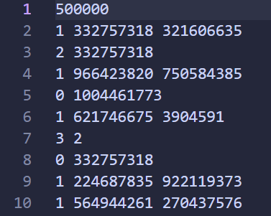
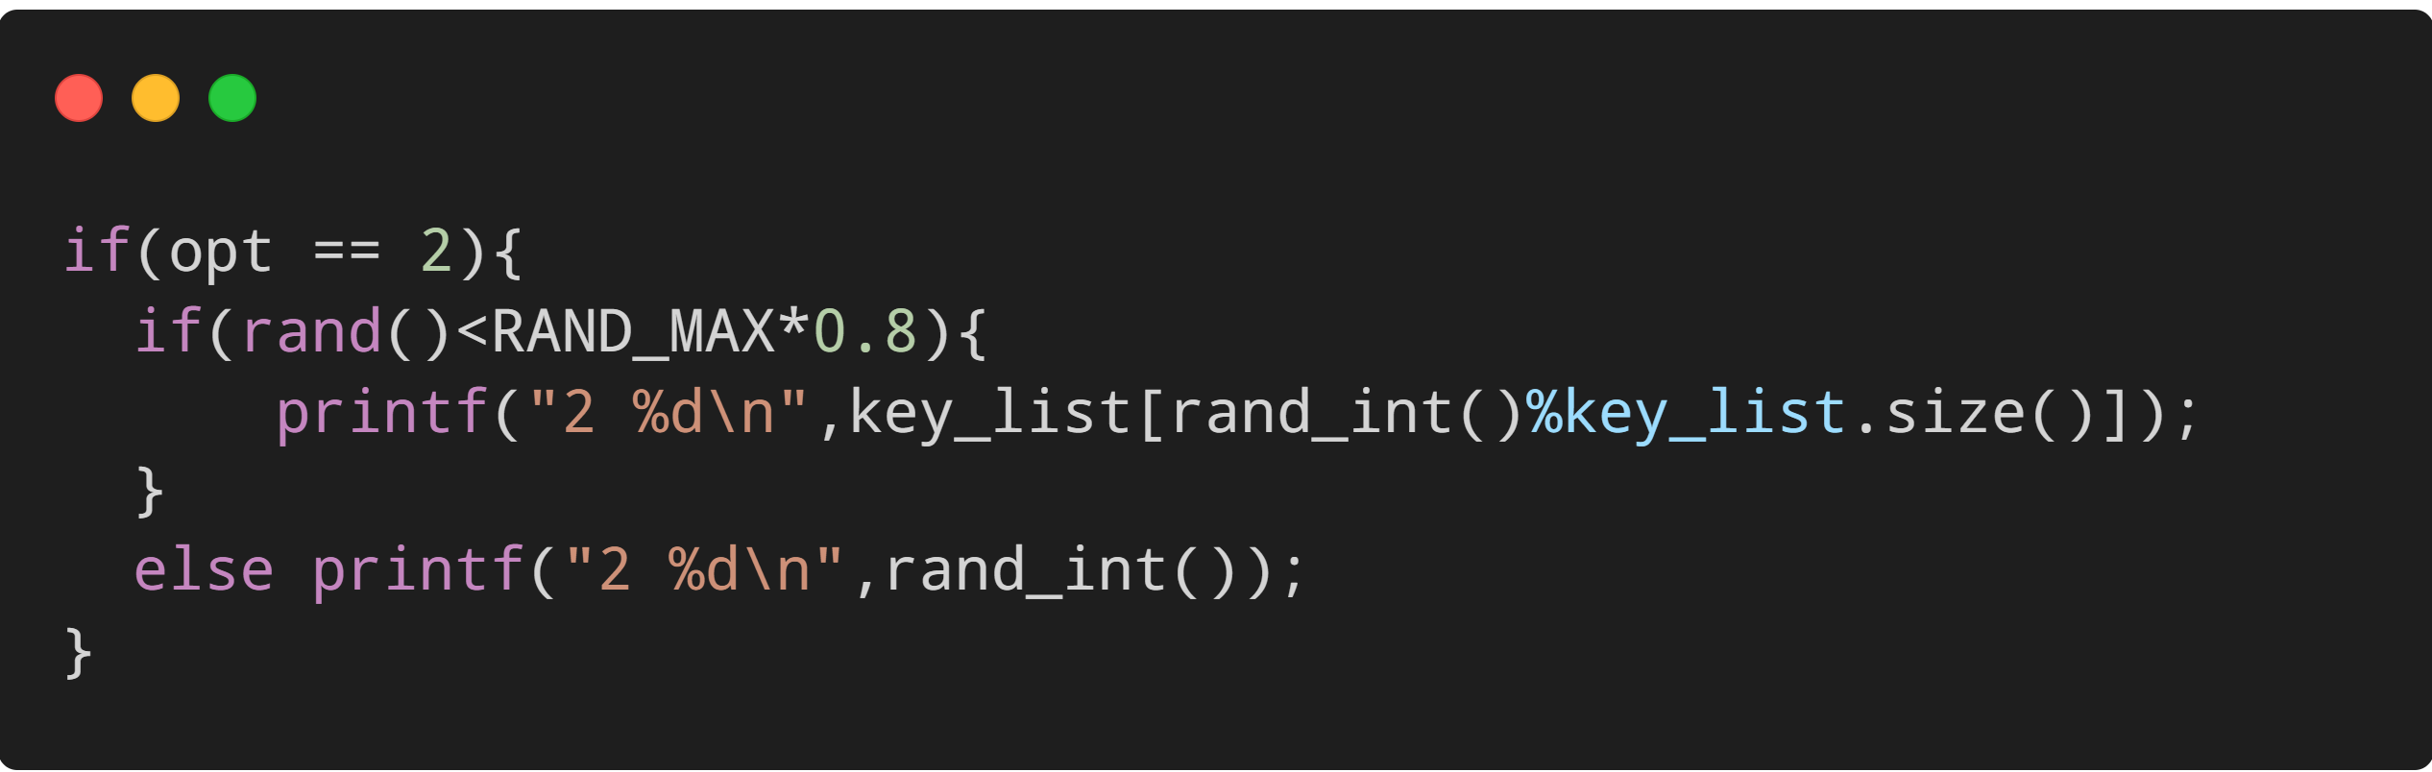

Data generation
$op=0$ Searching
$op=1$ Insertion
$op=2$ Deletion
$op=3$ Find k^{th}
25% Searching + 50% Insertion + 25% Deletion
Deletion: 80% from Skiplist

Slide 17
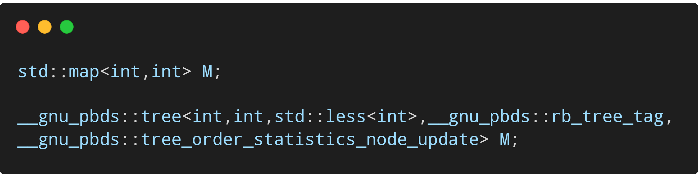
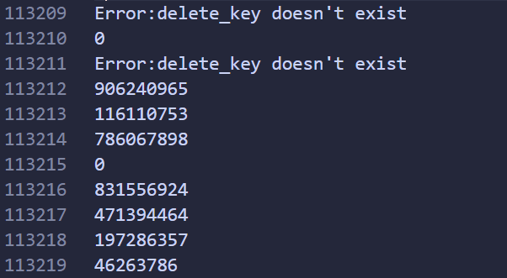
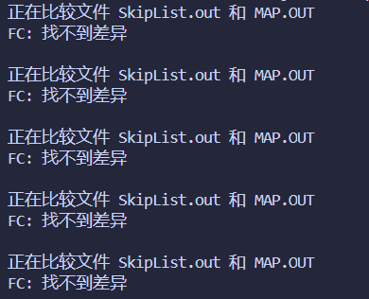
Correctness
SkipList versus map versus Red-black tree
Correct!

Slide 18
Time Complexity

Slide 19
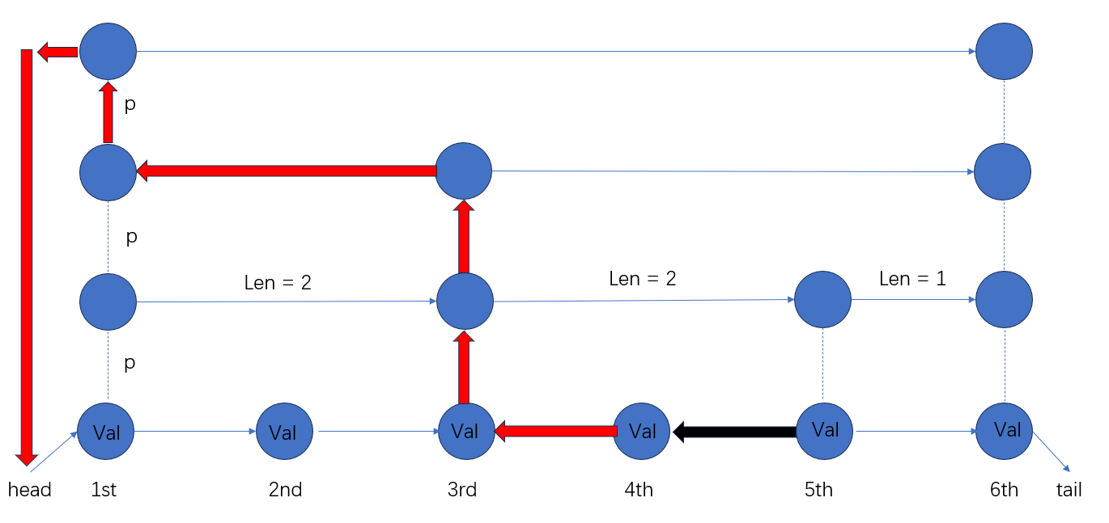

Just prove Searching $∼O(\log{n)}$
Form bottom to top (head of the top level)
$F_{i}=p⋅F_{i−1}+\left(1−p\right)⋅F_{i}+1⇒F_{i}=i/p$

Slide 20
25% Searching + 50% Insertion + 25% Deletion
 | 30000 | 80000 | 100000 | 300000 | 500000 | 1000000
SkipList | 14ms | 67ms | 88ms | 273ms | 542ms | 1304ms
RB Tree | 14ms | 78ms | 84ms | 339ms | 623ms | 1408ms
Map | 73ms | 405ms | 602ms | 8821ms | 42063ms
1/3 Searching + 5/9 Insertion + 1/9 Deletion
 | 30000 | 80000 | 100000 | 300000 | 500000
SkipList | 18ms | 60ms | 61ms | 282ms | 500ms
RB Tree | 21ms | 82ms | 87ms | 332ms | 574ms
Map | 111ms | 914ms | 1536ms | 30116ms | 42063ms
Only Insertion
 | 30000 | 80000 | 100000 | 300000 | 500000
SkipList | 17ms | 82ms | 96ms | 336ms | 602ms
RB Tree | 25ms | 82ms | 129ms | 430ms | 804ms
Map | 16ms | 54ms | 73ms | 229ms | 472ms

Slide 21
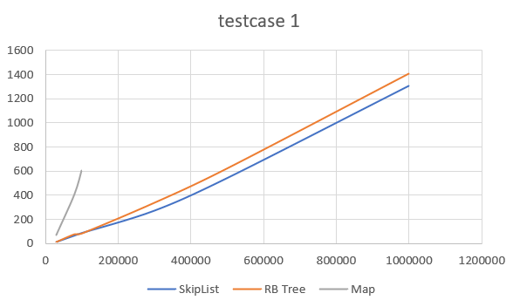
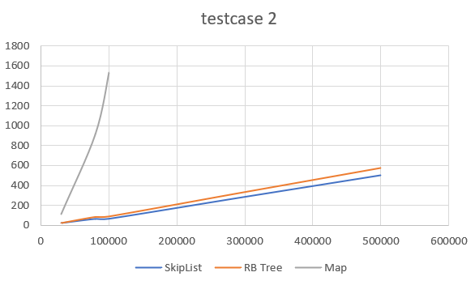
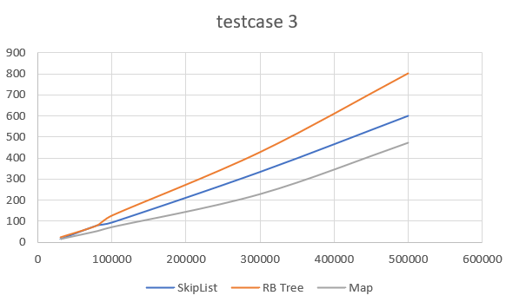

Slide 22
Thanks!

