Slide 1

Machine Learning-based Prognosis on Aircraft Engines’ Remaining-Useful-Life (RUL)
Week 2:
16/12/2022

Slide 2
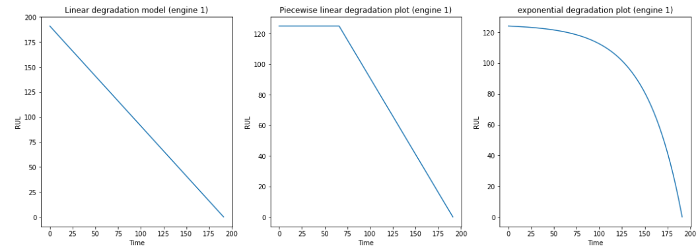
Task 0: Degradation model
Linear degradation
Piece-wise linear degradation
Exponential degradation
Simpler to learn
Closer to reality

Slide 3
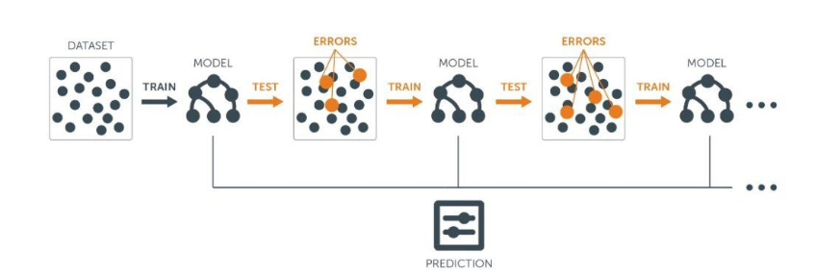
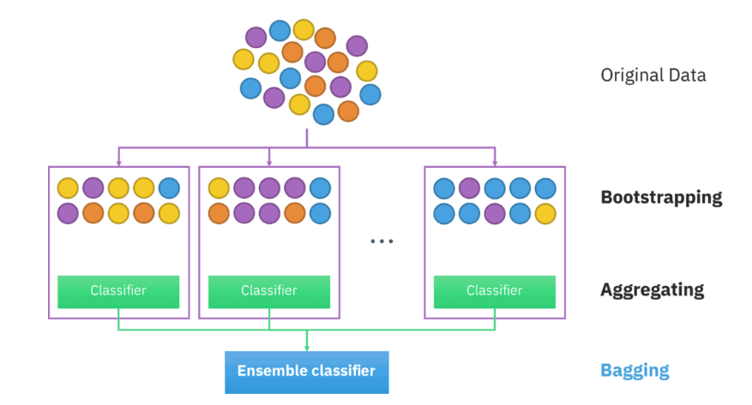
Task 1: Performance of RF
Ensemble Learning
Boosting
Bagging
No-censored data
Single-row
Ensemble prediction
Random Forest Regression
windows

Slide 4
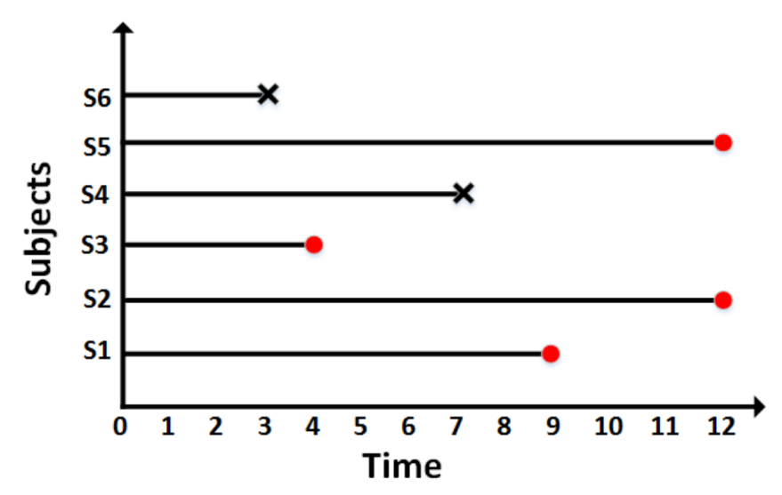
Task 2: RF & GBoost
Ensemble Learning
Boosting
Bagging
No-censored data
Ensemble prediction
Gradient Boosting
Random Forest Regression
censored data
If curious, see Hothorn (2006) Survival Ensembles
(and section 2 of Wang et al. 2017 for basis of survival analysis)
Teasers for the 2nd phase of the project:
Survival Gradient Boosting
Random Survival Forest

Slide 5
Task 2: RF & GBoost
Algorithms | Degradation model | Window length | MSE | S-Score
RF | Piecewise-Linear (early = xxx) | 1 | xxx | xxx
RF | Exponential (shape param = xxx) | 5 | xxx | xxx
GB | Piecewise-Linear (early = xxx) | 1 | xxx | xxx
GB | Exponential (shape param = xxx) | 1 | xxx | xxx
Decide how exhautive the experiements go depending on time availability
Objectives:
Having a grasp of algorithms implementation
High-level idea on the performance of algorithms.

Slide 7
