Slide 1

Machine Learning-based Prognosis on Aircraft Engines’ Remaining-Useful-Life (RUL)
Week 1:
08/12/2022

Slide 2



Task 1: Data Pre-processing
$$y=f\left(x\right)+noise$$
Training set
Test set
x_test
Extracted from
x_train
Extracted from
Implicitly defines
Derived from
y_train
y_test
In practice, it is often the case that data might not be ready to used directly

Slide 3
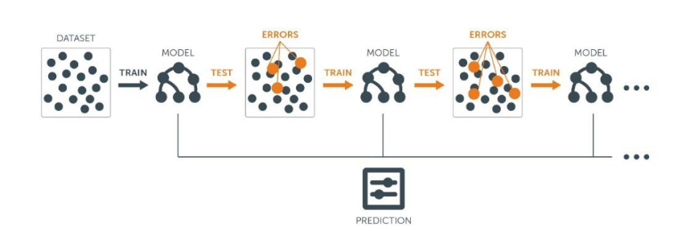
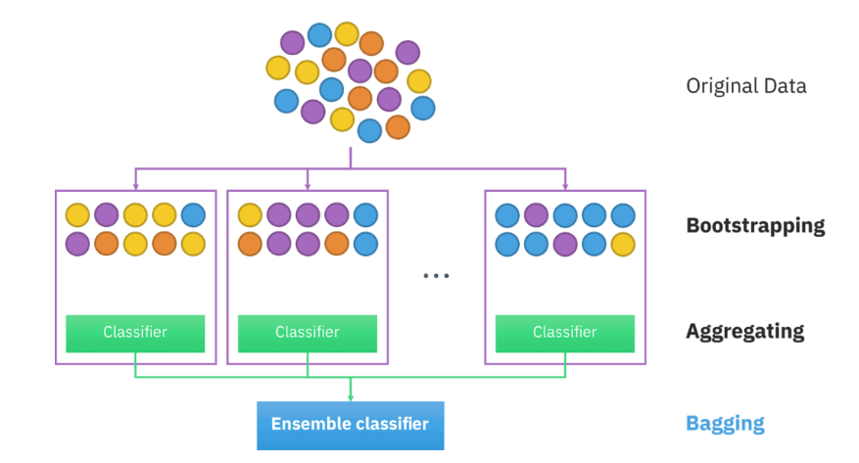
Task 2: Random Forest Regression
Ensemble Learning
Boosting
Bagging
Ensemble prediction
Random Forest Regression

