Slide 1


2021
Tencent Cloud
Product Icon
V1.0
2021/01/17
By dongs365
TENCENT CLOUD DESIGN

Slide 2





























































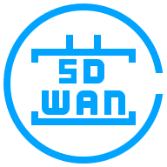
























Slide 3






















Slide 4








































Slide 5
























Slide 6









































Slide 7



























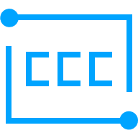
















Slide 8

































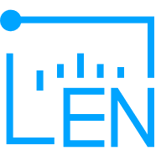
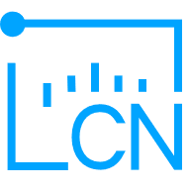













Slide 9































Slide 10

www.cloud.tencent.com

