Slide 1
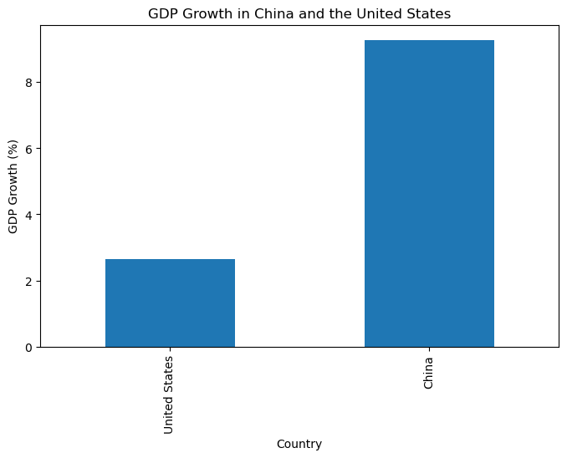
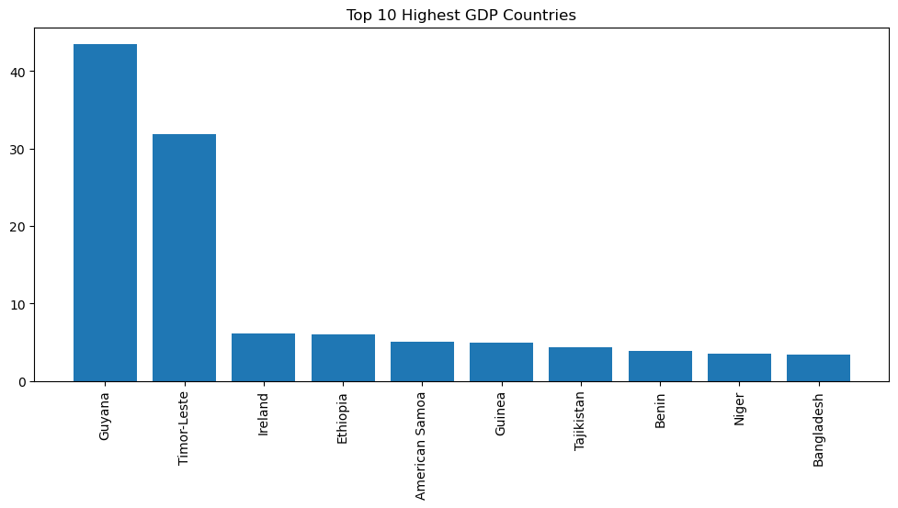
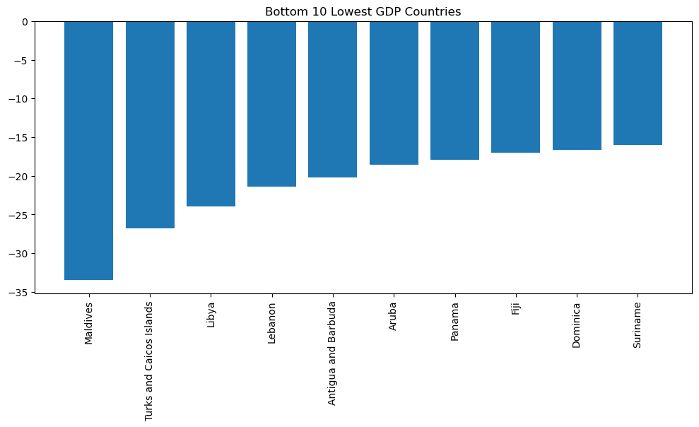
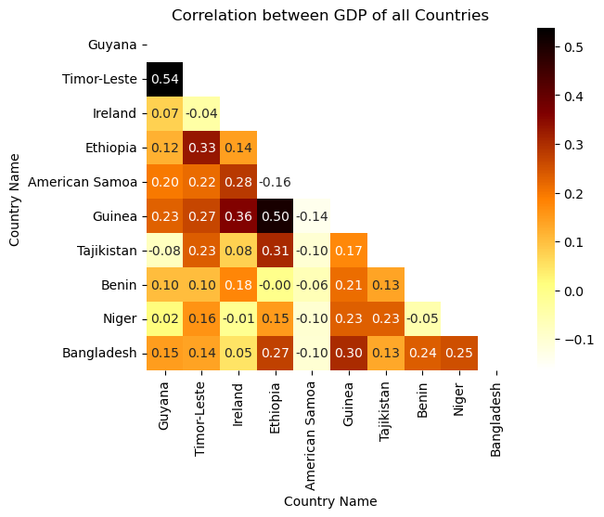
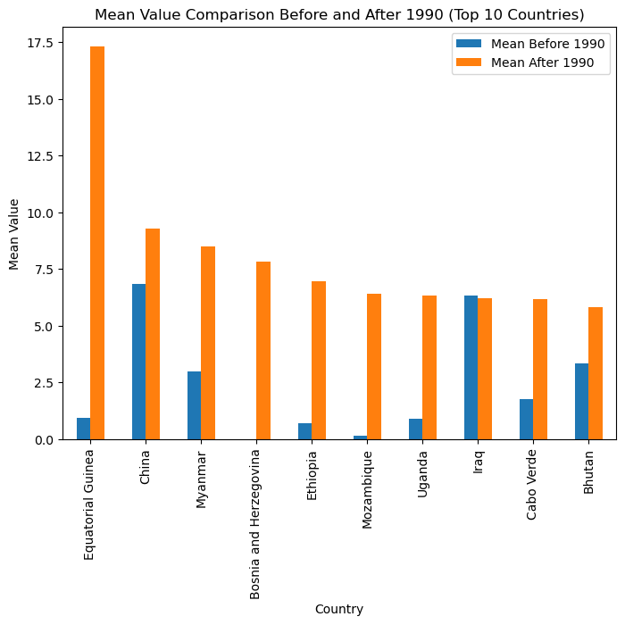
Global GDP Analysis: Trends and Insights
Godstime Nwaneri (22018731)
Abstract
This project analyzes GDP growth across countries using World Bank data. It explores patterns and trends in GDP growth, conducts clustering based on economic indicators, and fits a model to forecast GDP growth for a specific country. The findings provide insights into global economic dynamics and have implications for policymakers and stakeholders.
Introduction
The analysis of Gross Domestic Product (GDP) is crucial for understanding a country's economic performance. This project aims to analyze and interpret GDP growth data from the World Bank dataset to gain insights into economic dynamics across nations. By examining historical trends and patterns in GDP growth, we can identify top-performing countries, assess policy effectiveness, and anticipate future economic trends. The findings will contribute to a comprehensive understanding of global economic trends and provide valuable insights for policymakers and stakeholders.
Analysis
GDP Growth Comparison: We analyzed the GDP growth of the United States and China,
two major economic powerhouses. A bar chart compared the average GDP growth
between China and the United States. Average GDP of China is far higher than USA for last
30 years.
Top and Bottom GDP Countries: We identified the top 10 countries with the highest GDP
in 2020 and showcased them in a bar chart. Guyana was the top GDP country
Correlation of GDP: To explore the interrelationship between the GDP of top 10 countries. Guyana and Timor-Leste was having strong positive correlation means that if the GDP of one country increases the GDP of other also increases.
Mean GDP Before and After 1990: I calculated the mean GDP for two periods:
1961-1990 and 1991-2020. By comparing these means, we determined the change
in economic performance before and after 1990.
Country | Mean Before 1990 | Mean After 1990
Equatorial Guinea | 0.96 | 17.31
China | 6.85 | 9.29
Myanmar | 2.98 | 8.48
Bosnia and Herzegovina | 0.00 | 7.82
Ethiopia | 0.72 | 6.96
Clustering
Fitting
Three clusters were formed based on the GDP growth patterns of countries.
Cluster 0 had a median GDP growth of 3.472112 in 2021.
Cluster 1 had a higher median GDP growth of 5.075085 in 2021.
Cluster 2 had a median GDP growth of 4.449367 in 2021.
Data was normalized
Kmeans was used for clustering data into 3 clusters.
Used the GDP growth data for Guyana to fit a logistic growth model.
Defined the logistic growth function.
Prepared the data by extracting the years and corresponding GDP values.
Performed curve fitting using the logistic growth function and initial parameter estimates.
Generated predictions for the next 20 years using the fitted model.
Calculated confidence intervals for the predictions.
The average GDP in the next 20 years was estimated to be 3.712483.
Plotted the actual GDP data, predicted GDP values, and confidence intervals.
The logistic growth model was used to forecast the GDP of Guyana.
Conclusion
In conclusion, this analysis examined the GDP growth of countries and identified distinct clusters based on economic performance. The clustering analysis revealed different patterns in GDP growth across countries. Furthermore, the model fitting results forecasted Guyana's future GDP with an average value of 3.712483 over the next 20 years. These findings provide valuable insights into global GDP dynamics and inform policymakers and stakeholders in economic planning.
Github URL: ………………………………

