Slide 1
Verilog Lab 1
Prof. Shih-Chieh Chang
Logic Design 2022 spring

Slide 2
Outline
Workstation setting: MobaXterm
Project

Slide 3
Outline
Workstation setting: MobaXterm
Project

Slide 4
MobaXterm Download
Download the free version of MobaXterm
https://mobaxterm.mobatek.net/download-home-edition.html

Slide 5
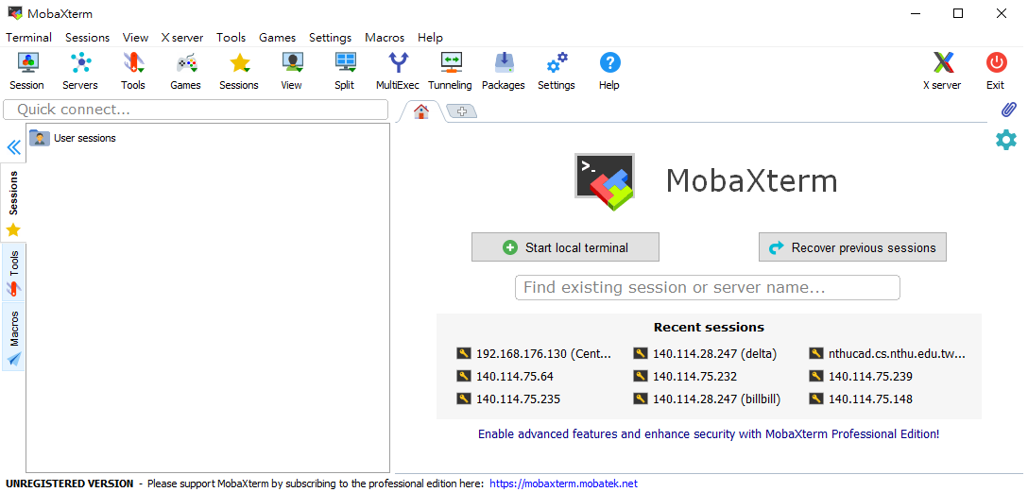
Workstation Setup

Slide 6
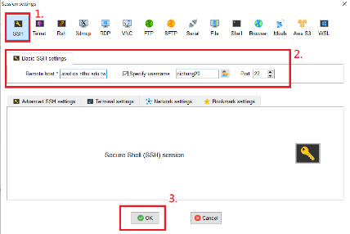
Workstation Setup (Cont.)
Enter the following blank
Remote host: nthucad.cs.nthu.edu.tw
Specify username: (your account)
Port: 22
Click “OK”

Slide 7
Login at the First Time
Key in your initial password from e mail

Slide 8
Change your Password
Type “passwd” to change your password

Slide 9
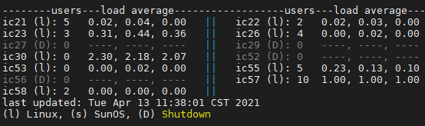
Connecting to Workstation
Find a workstation with less users

Slide 10
Connecting to Workstation (Cont.)
Connect to a work station
ssh -X icXX (XX should be 21~58)

Slide 11
Connecting to Workstation (Cont.)

Slide 12
Create directory
Right click to create new directory “example”
or by command line “mkdir example”

Slide 13
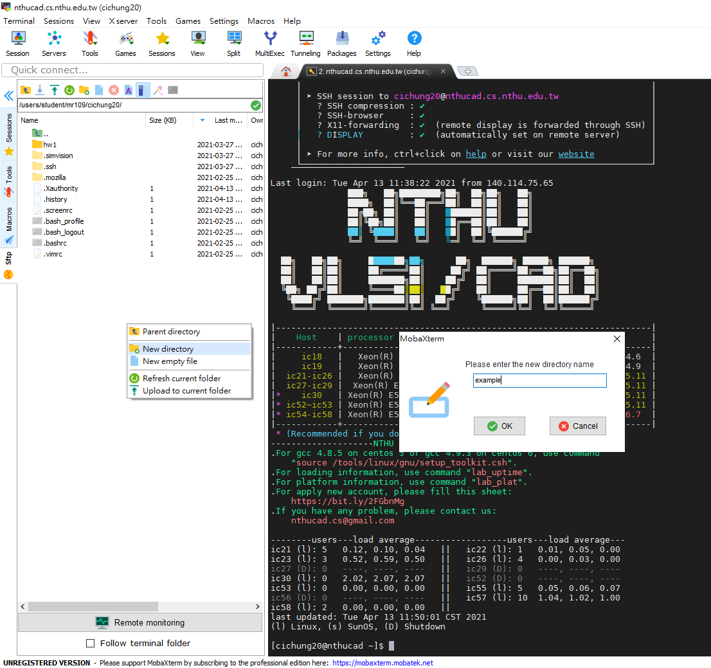
Create directory
1.
2.

Slide 14
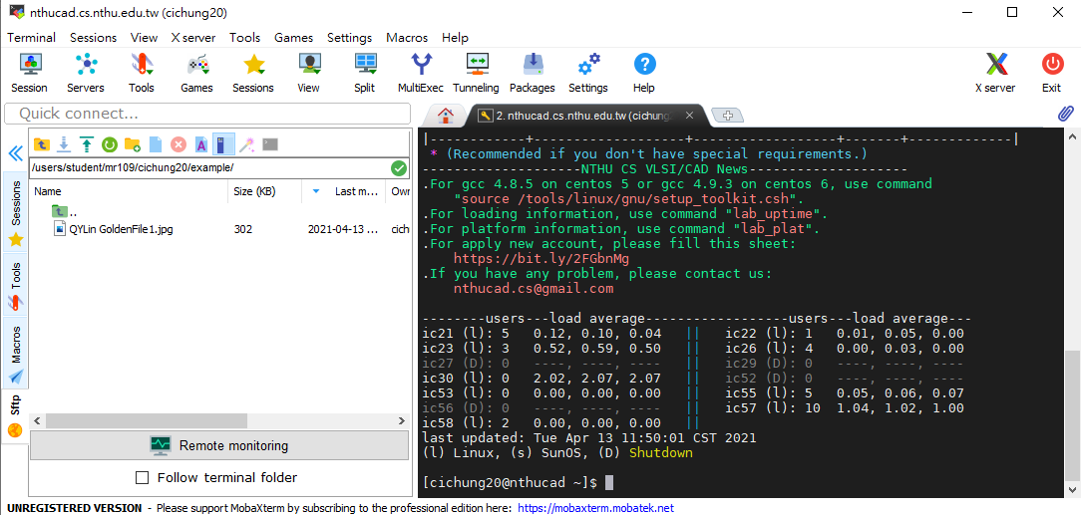
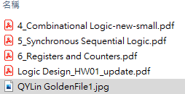
Uploading Files
Upload files
Upload your files by dragging them in to directory

Slide 15
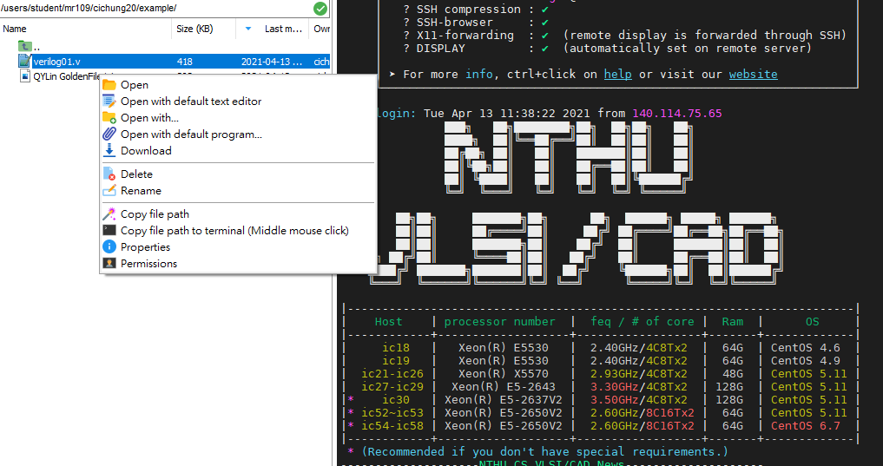
Edit files in workstation
Right click open with mobaXterm’s editor
Vim is available in workstation
You can also edit in Windows then upload it

Slide 16
Run simulation
Use NC verilog as standard simulation platform
You can use any IDE/Editor to program

Slide 17
Run simulation (Cont.)
$ ncverilog all.v file you need
i.e. $ ncverilog Test_Bench.v Simulator.v

Slide 18
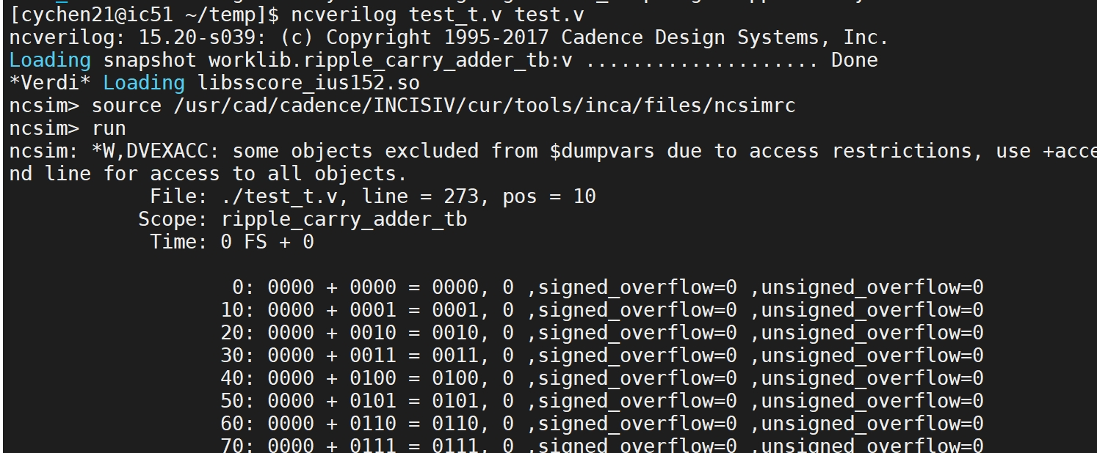
Run simulation (Cont.)

Slide 19
Outline
Workstation setting: MobaXterm
Project

Slide 20
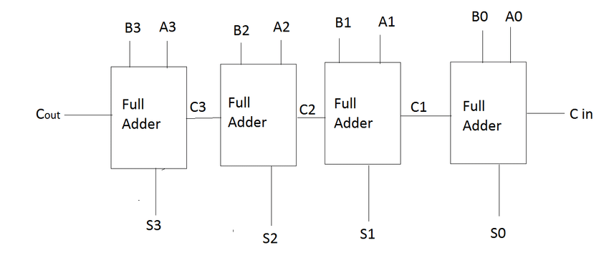
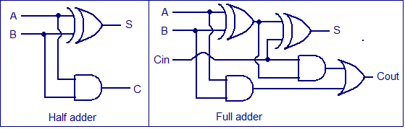
4 bit Ripple Carry Adder

Slide 21

Rules
$A_{3}A_{2}A_{1}A_{0}$, $B_{3}B_{2}B_{1}B_{0}$ are unsigned numbers
Only basic logic gates are ALLOWED (and, or, nand, nor, not ) ,no xor & xnor
Please AVOID using
1. Continuous assignment and conditional operators
2. Behavioral operators (e.g., +, -, &, |, ^, &&, !, ~….., etc.)
3. Behavioral operators are ALLOWED in your TESTBENCH
Edit your own testbench

Slide 22
Please Follow The Format Below
module Ripple_Carry_Adder (in0, in1, out,cout,s_overflow,u_overflow);
input [4-1:0] in0;
input [4-1:0] in1;
output [4-1:0] out;
output cout;
output s_overflow;
output u_overflow;
// here is your design
endmodule

Slide 23
Submission
Lab 1 code submission due date & time: 2022/04/07,11:59pm
Please submit your Verilog codes to eeclass
Lab1_YourStudentID_Codes.v
We will test your codes by our own testbench

