Slide 1
NN reduced model for CFD
Restart from previous work
2024/11/13

Slide 2
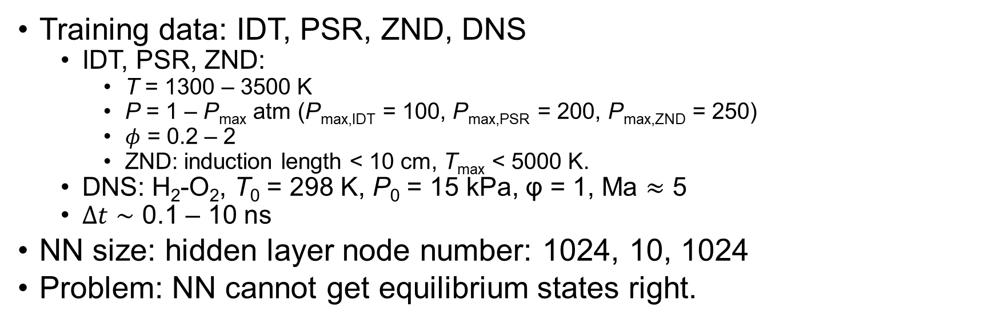

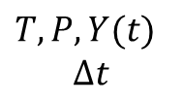
Previous stage, problem
$T,P,Y(t)$
$$Δt$$
Architecture:
NN
$T,P,Y(t+Δt)$
Training data: IDT, PSR, ZND, DNS
IDT, PSR, ZND:
T = 1300 – 3500 K
P = 1 – P_{max} atm (P_{max,IDT} = 100, P_{max,PSR} = 200, P_{max,ZND} = 250)
$φ$ = 0.2 – 2
ZND: induction length < 10 cm, T_{max} < 5000 K.
DNS: H₂-O₂, T₀ = 298 K, P₀ = 15 kPa, φ = 1, Ma $≈$ 5
$Δt∼$ 0.1 – 10 ns
NN size: hidden layer node number: 1024, 10, 1024
Problem: NN cannot get equilibrium states right.

Slide 3
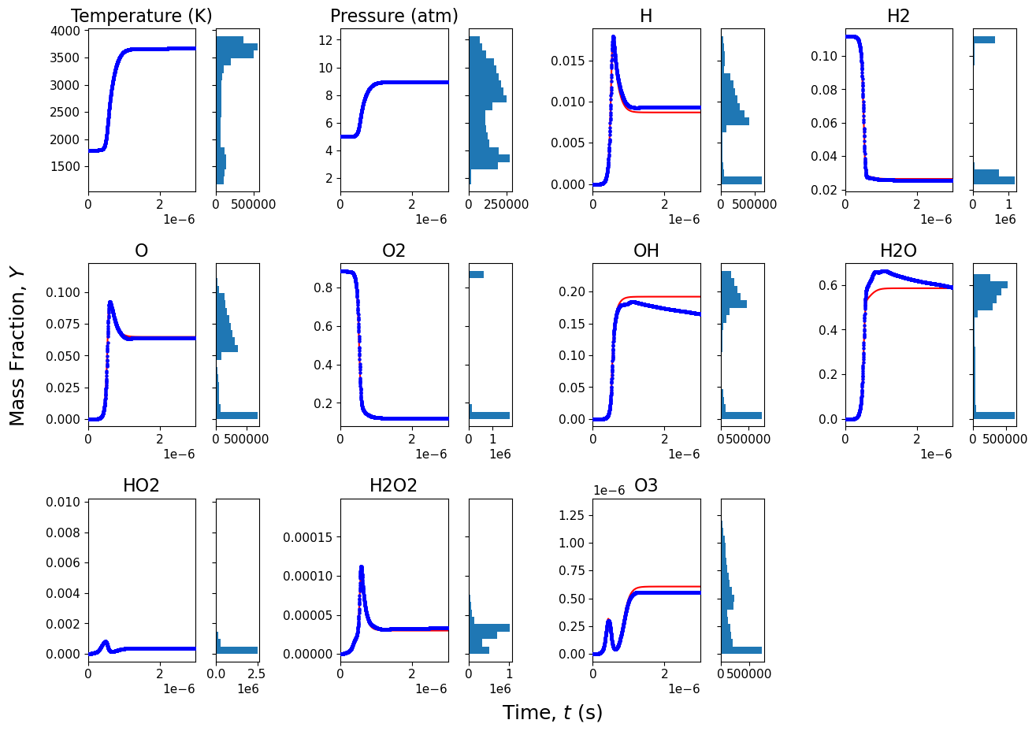
Predict 0-D ignition calculation:
T = 1800 K, P = 5 atm
Inaccurate OH, H₂O
Cannot last long (equilibrium stage is not stable in NN prediction)
Notes:
H,H2,O2,OH,H2O

Slide 4
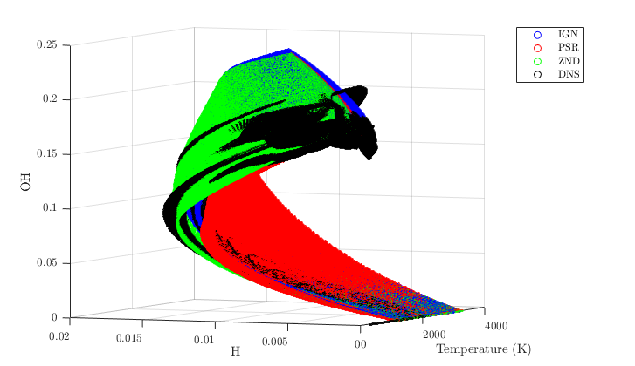
Training condition
Additional training data:
PSR data: capture mixture blend
IDT: zero blend; PSR: full blend.
ZND data: capture extreme conditions
DNS data

Slide 5
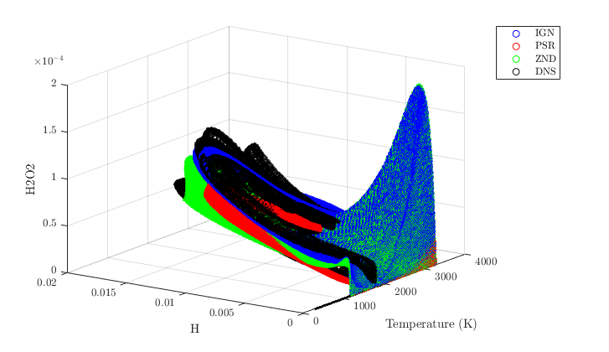
Training condition
Discrepancy between IDT, ZND and DNS data:
For example, high H₂O₂ mole fraction

Slide 6
Next
Equilibrium stage problem
Weight more on equilibrium data
Mass and energy conservation
Use internal energy and density instead of T, P
Test on CFD:
CJ speed
Cell size
Jet speed

