Slide 1
GPU Accelerated Graph Collaborative Filtering
Qianbin Xia
xiaq2@vcu.edu

Slide 2
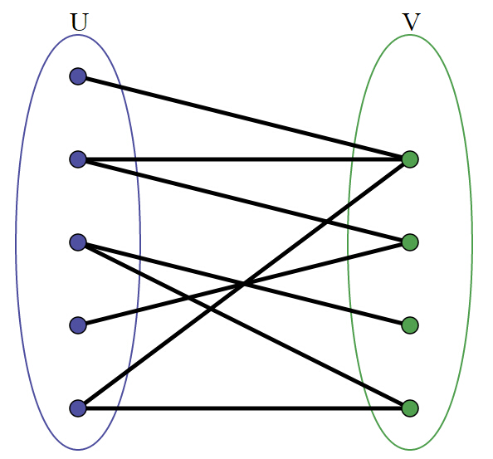
BiPartite Graph
Vertices: disjoint U&V
Edges between U&V
No edges within U|V

Slide 3
Bipartite Graph In real life
Personnel Problem:
You are the boss of a new company. You need to recruit some workers from the LinkedIn. How can pick out candidates from all the members ? How will you assign jobs to each other ?
U:workers
V:skills

Slide 4
Bipartite Graph In real life
Marriage Problem:
There are X men and Y women desire to get married. Participants indicate who among the opposite sex would be acceptable as a potential spouse. If you are one of them, how can you choose several potential spouse from all the opposite sex?
U:participats
V:apperance, salary, hobbies…

Slide 5
How to make a good decision ?
Naive Graph Collaborative Filtering
Full Graph Collaborative Filtering

Slide 6
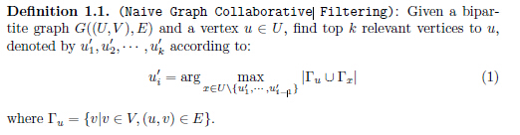
Naive Graph Collaborative Filtering

Slide 7
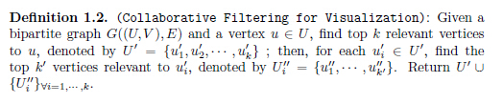
Full Graph Collaborative Filtering

Slide 8
Implementation
Host Side:
Boost library
Thrust graph library (personal developed, open source)
GPU Side:
Thrust graph library (still has some bugs)

Slide 9
Alternative Solution
Focus on the algorithm itself:
typedef struct _Graph_node_A {
int adj[N];
} Graph_node_A;

Slide 10
Flow Chart

Slide 11
Alternative Solution
Input: trace file name
U_start
K: number of most related vertices need to be found

Slide 12
Implementation
GPU side: Each thread takes care of one vertice in U and count how many common it has with the u_start.
1024 vertices in U, then the total number of threads is 1024.

Slide 13
Experiments
Benchmarks:
 | Num of U | Num of V | Num of Edges
divorce | 50 | 9 | 225
IMDB | 428440 | 896308 | 3782463
NotreDame_actors | 392400 | 127823 | 1470404
Sandi_sandi | 314 | 360 | 613

Slide 14
Results
 | divorce | Sand_sandi | connectus | NotreDame | IMDB
CPU | 0.0000 | 0.0000 | 0.0100 | 0.0500 | 0.0800
GPU | 0.0000 | 0.0000 | 0.0000 | 0.0000 | 0.0000

Slide 15
Optimization in future
Leverage the shared memory to boost the performance further more
Implement the full collaborative filtering

Slide 16
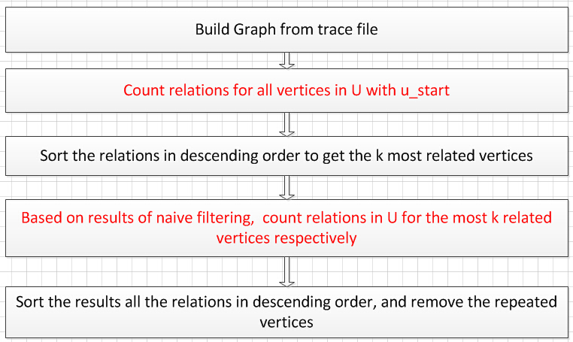
Full Flow Chart

Slide 17
Implementation
Naive Filtering:
Shared memory is leveraged
Number of threads depends on number of vertices in part U.
dimGrid(1, 1)
dimBlock(max_id_A, 1)

Slide 18
Function units
main(): read in the trace file and call the sub-functions.
filterOnDevice, naiveFilterKernel, fullFilterKernel
filteronHost
selSort
compare

Slide 19
Implementation
Full Filtering:
Shared memory is utilized
Number of blocks depends on k
Number of threads per block depends on the number of vertices in part U
dimGrid(1, k)
dimBlock(max_id_A, 1)

Slide 20
Results
Connectus.mtx
Max_id_A: 512
u_start: 3
k | 10 | 20 | 30 | 40 | 50 | 60 | 70 | 80 | 90 | 100
CPU | 6.30 | 12.15 | 18.00 | 23.24 | 29.14 | 35.00 | 40.86 | 46.71 | 52.55 | 58.43
GPU | 1.01 | 0.98 | 0.955 | 1.02 | 1.07 | 1.06 | 1.13 | 1.04 | 1.06 | 1.145

Slide 21
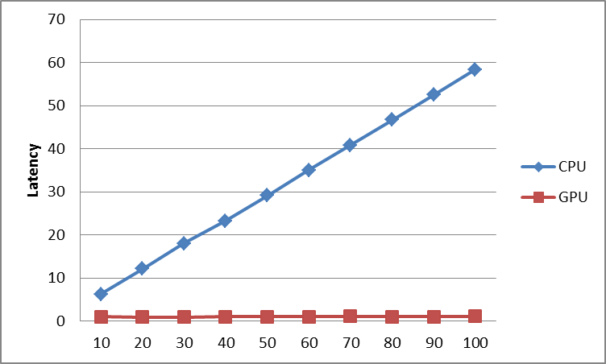
Results

Slide 22
Conclusions
GPU can greatly boost the performance
On GPU side, latencies stay the same with the increasing of k due to the high parallelism.
On host side, latencies is linear with the increasing of k

Slide 23
Possible work in furture
Find a usable CUDA library for graph
Accelerate the sorting algorithm in graph filtering algorithm to improve the performance even more.

