Slide 1
Large-scale Messaging at IMVU
Jon Watte
Technical Director, IMVU Inc
@jwatte
Notes:
Welcome!
I’m Jon…
Very detailed presentation today
Send you home with something you can use

Slide 2

Presentation Overview
Describe the problem
Low-latency game messaging and state distribution
Survey available solutions
Quick mention of also-rans
Dive into implementation
Erlang!
Discuss gotchas
Speculate about the future
Notes:
Talk about the context of the problem.
Talk about possible solutions.
Dive into our chosen solution.
Not all roses!
Maybe some speculation.

Slide 3


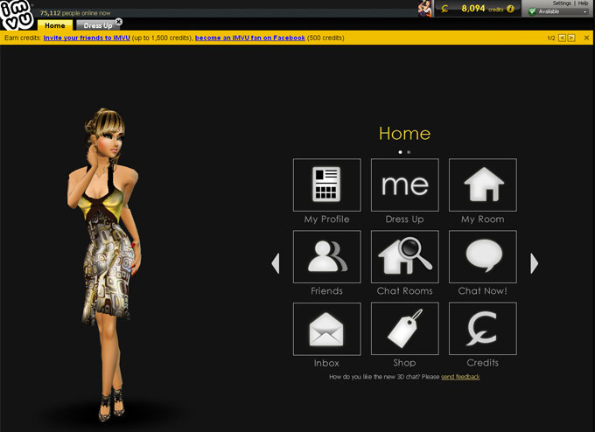
From Chat to Games
Notes:
Starting with 3D chat in 2006.
Web site and installable client.
Keep adding features and tighter integration.
Adding real-time interactions other than chat.

Slide 4
Context
Web Servers
HTTP
Caching
Load Balancers
Databases
Long Poll
Caching
Load Balancers
Game Servers
HTTP
Notes:
We started with a web service.
Client calls web services in PHP.
Over time, break out client services (still in PHP).
Long poll (COMET) for real-time notifications.
Service grows -> inefficient, costly, and out of steam

Slide 5
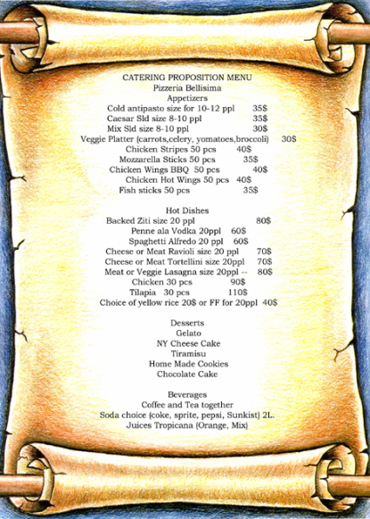
What Do We Want?
Any-to-any messaging with ad-hoc structure
Chat; Events; Input/Control
Lightweight (in-RAM) state maintenance
Scores; Dice; Equipment
Notes:
Any user can join a chat with any other users.
Any users can match up to play online games.
A user can be in many rooms or games at the same time.
No real-time physics – so we can get away with TCP.

Slide 6
New Building Blocks
Queues provide a sane view of distributed state for developers building games
Two kinds of messaging:
Events (edge triggered, “messages”)
State (level triggered, “updates”)
Integrated into a bigger system
Notes:
Named queues provide a rendez-vous point for clients that want to connect
Events are useful for things like chat messages
State is useful for things like scene state of the room, or avatar clothing
All of this lives within a bigger web service with e-commerce
Persistency is handled on the web side

Slide 7
From Long-poll to Real-time
Web Servers
Caching
Load Balancers
Databases
Long Poll
Caching
Load Balancers
Game Servers
Connection Gateways
Message Queues
Today’s Talk
Notes:
Todays talk:
How we built a new system to solve the real-time communication challenge
Within this context.
Remove the long poll protocols
Scale to meet future demands

Slide 8
Functions
Game Server
HTTP
Validation users/requests
Notification
Client
Connect
Listen message/state/user
Send message/state
Create/delete
queue/mount
Join/remove user
Send message/state
Queue
Notes:
What we call “mounts” you’d probably call “channel.”
More on this later!
Users connect and send/receive
Queues use external validation
Servers push information and configuration to queues
Including creating queues

Slide 9

Performance Requirements
Simultaneous user count:
80,000 when we started
150,000 today
1,000,000 design goal
Real-time performance (the main driving requirement)
Lower than 100ms end-to-end through the system
Queue creates and join/leaves (kill a lot of contenders)
>500,000 creates/day when started
>20,000,000 creates/day design goal
Notes:
We started out with a fairly big service
It’s even bigger now
Luckily, we designed it for “better than 10x”
Performance to be real time
Queue operations are frequent

Slide 10

Also-rans: Existing Wheels
AMQP, JMS: Qpid, Rabbit, ZeroMQ, BEA, IBM etc
Poor user and authentication model
Expensive queues
IRC
Spanning Tree; Netsplits; no state
XMPP / Jabber
Protocol doesn’t scale in federation
Gtalk, AIM, MSN Msgr, Yahoo Msgr
If only we could buy one of these!
Notes:
Requirements. Alphabet soup of available systems.
Enterprise trade-offs we don’t have.
Or don’t scale to our size. Or both.
Example: Some queues require restarts to add authenticated users!
The best fits aren’t available for purchase. (AIM, Facebook Chat, Gtalk, etc)

Slide 11
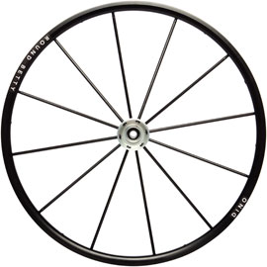
Our Wheel is Rounder!
Inspired by the 1,000,000-user mochiweb app
http://www.metabrew.com/article/a-million-user-comet-application-with-mochiweb-part-1
A purpose-built general system
Written in Erlang
Notes:
Found an article by Richard James about writing a 1,000,000 user chat server application.
That’s a lot of users on a single machine!
Solution was fairly simple.
If Erlang: big performance, little code, we should probably use it!
Implement our own general messaging system based on our game-based requirements

Slide 12

Section: Implementation
Journey of a message
Anatomy of a queue
Scaling across machines
Erlang
Notes:
Now, we dive into deeper technology.

Slide 13
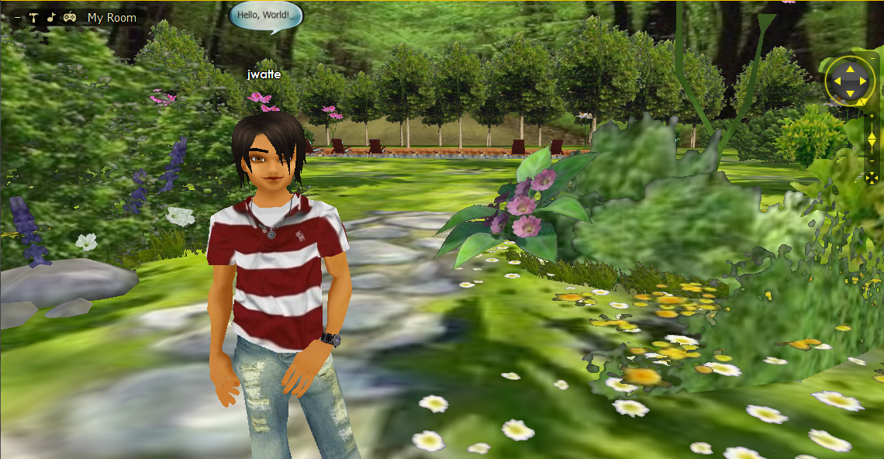
The Journey of a Message
Notes:
To illustrate the system we built.
Start with a simple chat message.
I’m in a room, saying something.
Where does that go?

Slide 14
The Journey of a Message
Gateway
Queue Node
Message in Queue: /room/123
Mount: chat
Data: Hello, World!
Gateway for User
Queue Node
Queue Process
Find node for /room/123
Find queue /room/123
List of subscribers
Gateway
Validation
Gateway
Gateway for User
Forward message
Notes:
A queue for events within a given scene
All participants subscribe to this queue.
A channel for chat messages within this queue.
Send the chat message: addressed to this channel within this queue.
Send through a gateway server we connect to.
Forwards this message to the queue server, dispatches to queue
Queue does validation, unicasts to each user in the list of subscribed users
Gateways format and send the message to each user.

Slide 15
Anatomy of a Queue
Queue Name: /room/123
Mount
Type: message
Name: chat
User A: I win.
User B: OMG Pwnies!
User A: Take that!
…
Mount
Type: state
Name: scores
User A: 3220
User B: 1200
Subscriber List
User A @ Gateway C
User B @ Gateway B
Notes:
A queue is a unit of subscription, keeping a list of subscribers
Map to zone/user/room/game instance
Within a queue, rules are “mounted” to a name, creating channels
A mount is a unit of data validation and ordering
Enforce specific rule set
May map to specific object instance within the scene
Mounts can be messaging or state-based
Edge triggered vs. Level triggered
For example, chat messages == edge, highscore == state
The role of the queue: one copy of each event, up-to-date on the state.

Slide 16
A Single Machine Isn’t Enough
1,000,000 users, 1 machine?
25 GB/s memory bus
40 GB memory (40 kB/user)
Touched twice per message
one message per is 3,400 ms
Notes:
1,000,000 user chat application doesn’t scale
Consider the memory bus that this traffic has to run over.
Each user 40 kilobytes each. Touched twice per message.
We can touch 25 GB per second, over 80 kB/user
About 35,000 users for 10 messages per user per second

Slide 17
Scale Across Machines
Gateway
Queues
Gateway
Queues
Internet
Gateway
Queues
Consistent Hashing
Gateway
Queues
Notes:
throw more hardware at the problem. == more CPU memory busses!
each user may subscribe to many queues
built a crossbar between users and queues == crossbar between gateway and queuenode
Find queue server, use a consistent hashing mechanism
Distributes load evenly
Allows us to move units of load between queue servers

Slide 18
Consistent Hashing
The Gateway maps queue name -> node
This is done using a fixed hash function
A prefix of the output bits of the hash function is used as a look-up into a table, with a minimum of 8 buckets per node
Load differential is 8:9 or better (down to 15:16)
Updating the map of buckets -> nodes is managed centrally
Hash(“/room/123”) = 0xaf5…
Node A
Node B
Node C
Node D
Node E
Node F
Notes:
The consistent hashing works like this …
Table of buckets small: less cache pressure on the CPU, more variable load
worst load differential is about 10%, size of table is less than a kilobyte.
If you want to scale to lots of nodes, you’d probably trade for more level load and don’t worry about L1 cache, as this table is a pretty small factor overall.

Slide 19
Consistent Hash Table Update
Minimizes amount of traffic moved
If nodes have more than 8 buckets, steal 1/N of all buckets from those with the most and assign to new target
If not, split each bucket, then steal 1/N of all buckets and assign to new target
Notes:
We can update this table at runtime, point buckets at different servers.
At some point, 8*N buckets for N servers
Split each bucket in two – add one bit to index mask
Now, steal buckets

Slide 20

Erlang
Developed in ‘80s by Ericsson for phone switches
Reliability, scalability, and communications
Prolog-based functional syntax (no braces!)
25% the code of equivalent C++
Parallel Communicating Processes
Erlang processes much cheaper than C++ threads
(Almost) No Mutable Data
No data race conditions
Each process separately garbage collected
Notes:
Next topic: Erlang
Erlang is the evil genius of distributed systems.
…
Let’s take a quick look at some Erlang code.

Slide 21
Example Erlang Process
counter(stop) -> stopped;
counter(Value) -> NextValue = receive {get, Pid} -> Pid ! {value, self(), Value}, Value; {add, Delta} -> Value + Delta; stop -> stop; _ -> Value end, counter(NextValue). % tail recursion
% spawn process
MyCounter = spawn(my_module, counter, [0]).
% increment counter
MyCounter ! {add, 1}.
% get value MyCounter ! {get, self()};
receive
{value, MyCounter, Value} -> Value
end.
% stop process MyCounter ! stop.
Notes:
Implemented in Erlang
Erlang: processes instead of objects.
Processes are lightweight – lighter than threads (VM implementation)
Messages, not calls. Messaging copies state. No mutating state!
Counter implementation on left; user on right
…

Slide 22
Section: Details
Load Management
Marshalling
RPC / Call-outs
Hot Adds and Fail-over
The Boss!
Monitoring
Notes:
distributed system: lot of moving parts
Here are some of them!

Slide 23
Load Management
Internet
Gateway
Queues
Gateway
Queues
HAProxy
HAProxy
Gateway
Queues
Consistent Hashing
Gateway
Queues
Notes:
Load Balancer in front of gateways
We use HAProxy; there are others (F5, Barracuda, etc)
Gateways grow with user count and average number of messages per user per second
Queue nodes grow with queue count and average number of messages per queue per second
Each gateway talks to each queue node, so one TCP connection per queue node per gateway

Slide 24
Marshalling
message MsgG2cResult {
required uint32 op_id = 1;
required uint32 status = 2;
optional string error_message = 3;
}
Notes:
Marshalling is how data structures turn into packets
There are many IDLs and serialization libraries
We chose Google Protocol Buffers
Generates code for your language
Existing runtimes for Python, C++ and Java
New runtimes for Erlang and PHP

Slide 25
RPC
Web Server
PHP
HTTP + JSON
admin
Gateway
Message Queue
Erlang
Notes:
Web and game servers talk to the queues
RPC using JSON from PHP generated by protobuf
Incoming HTTP requests use a shared secret and are firewalled off, so are implicitly trusted by the queues
Once past the incoming gateway, there is no difference in structure between messages

Slide 26
Call-outs
Web Server
PHP
HTTP + JSON
Gateway
Message Queue
Erlang
Mount
Credentials
Rules
Notes:
Rules enforcement lives outside the queue (e g login credentials, game rules)
The gateway or queue can defer processing of a message, making a HTTP RPC call to application servers, which in turn talk to DB
Rule enforcement can also be a native Erlang module (for performance)
Because of call-out, Ordering is on a per-mount basis
(Subscription is on a per-queue basis)

Slide 27
Management
The Boss
Gateway
Queues
Gateway
Queues
Gateway
Queues
Consistent Hashing
Gateway
Queues
Notes:
Management happens through a singleton role called “the boss.”
Just like in real life:
The Boss gathers metrics from workers
The Boss tells them what to do.
The workers keep doing what they were last told, even if the boss is gone.

Slide 28
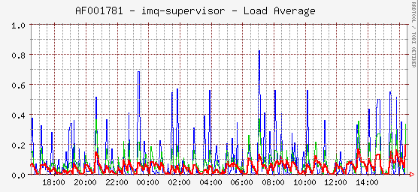
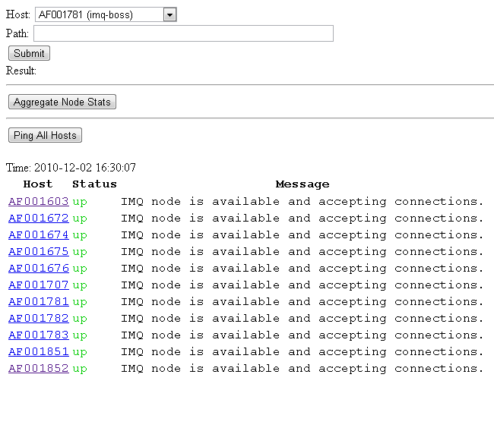
Monitoring
Example counters:
Number of connected users
Number of queues
Messages routed per second
Round trip time for routed messages
Distributed clock work-around!
Disconnects and other error events
Notes:
The Boss aggregates per-host counters
Counters are graphed, and may page ops
When measuring end-to-end-time: machine clock skew

Slide 29
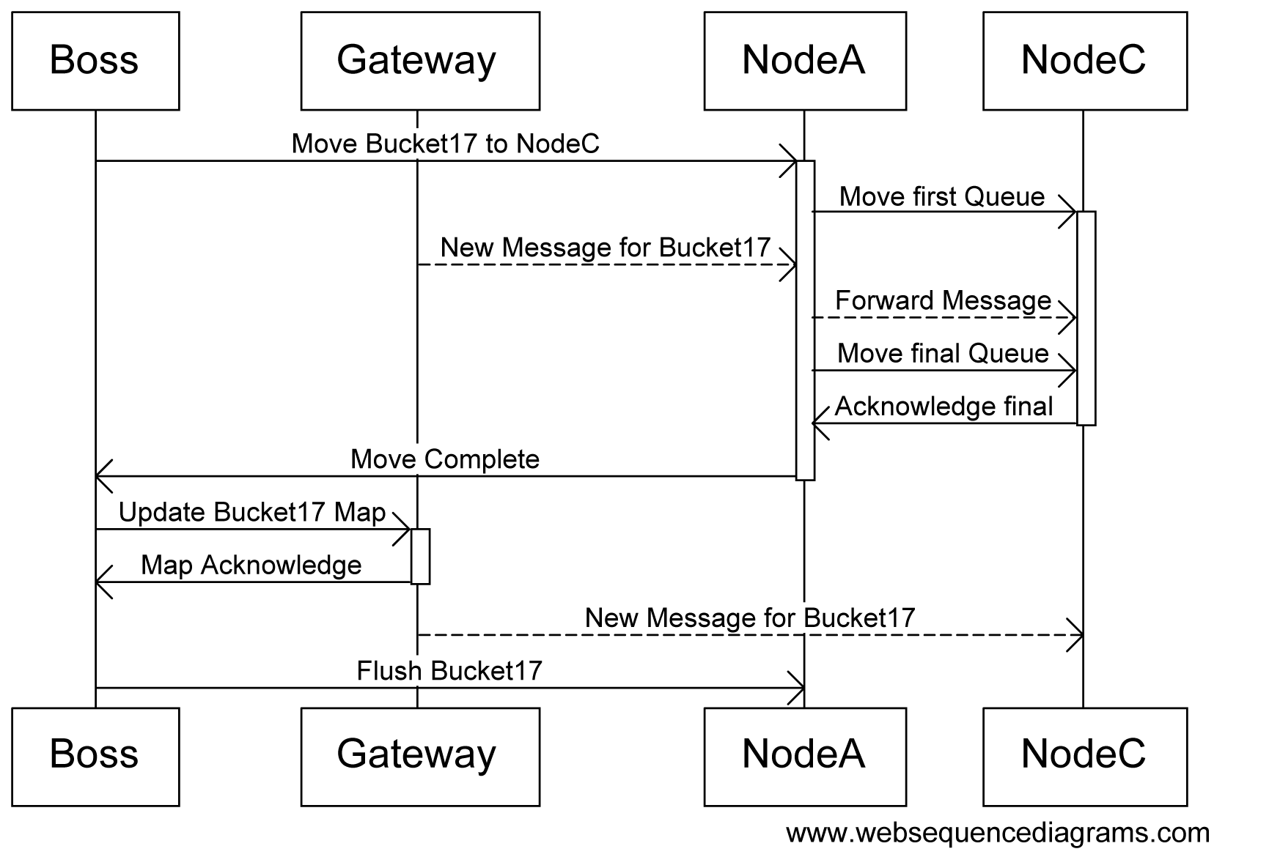
Hot Add Node
Notes:
Add capacity to meet demand?
Adding new gateways is trivial
Adding new nodes: moving queue name space through hash buckets
A globally coordinated sequence while still serving
Managed by the Boss (a singleton node)

Slide 30

Section: Problem Cases
User goes silent
Second user connection
Node crashes
Gateway crashes
Reliable messages
Firewalls
Build and test
Notes:
So far, it all sounds great!
What could possibly go wrong?
Well, let me count the ways…

Slide 31

User Goes Silent
Some TCP connections will stop (bad WiFi, firewalls, etc)
We use a ping message
Both ends separately detect ping failure
This means one end detects it before the other
Notes:
Bad WiFi or firewalls
(or cell phone modem, or …)
Both ends time out and disconnect separately

Slide 32
Second User Connection
Currently connected user makes a new connection
To another gateway because of load balancing
A user-specific queue arbitrates
Queues are serialized there is always a winner
Notes:
Second connection for same user
On different gateway
Coordinated through a “management queue” per user
Because queues are serialized, latest wins

Slide 33
Node Crashes
State is ephemeral it’s lost when machine is lost
A user “management queue” contains all subscription state
If the home queue node dies, the user is logged out
If a queue the user is subscribed to dies, the user is auto-unsubscribed (client has to deal)
Notes:
State is ephemeral: loss of node is bad
Users with management queues on the node get logged off
Activities with queues on the node are informed, have to deal
Luckily, very rare (pretty much never) occurrence

Slide 34
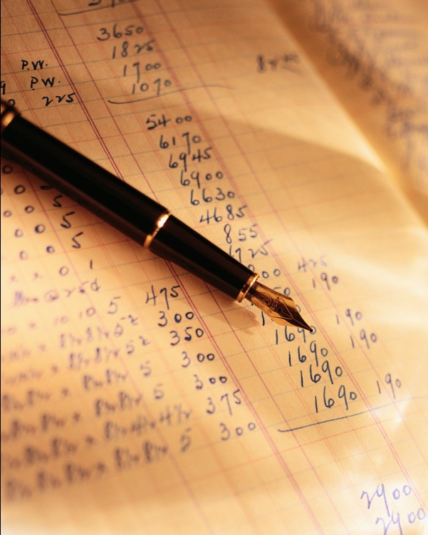
Gateway Crashes
When a gateway crashes client will reconnect
History allow us to avoid re-sending for quick reconnects
The application above the queue API doesn’t notice
Erlang message send does not report error
Monitor nodes to remove stale listeners
Notes:
Gateway crashing -> client re-try
Quick re-try optimization
Apps may not notice (except for timing hiccup)
One gnarl: Erlang message send is fire-and-forget

Slide 35

Reliable Messages
“If the user isn’t logged in, deliver the next log-in.”
Hidden at application server API level, stored in database
Return “not logged in”
Signal to store message in database
Hook logged-in call-out
Re-check the logged in state after storing to database (avoids a race)
Notes:
Feature request: reliable messages
System is NOT RELIABLE
Put state where it belongs: in database

Slide 36

Firewalls
HTTP long-poll has one main strength:
It works if your browser works
Message Queue uses a different protocol
We still use ports 80 (“HTTP”) and 443 (“HTTPS”)
This makes us horrible people
We try a configured proxy with CONNECT
We reach >99% of existing customers
Future improvement: HTTP Upgrade/101
Notes:
Firewalls: the bane of connected games
Lost less than 1% switching away from HTTP
We do use ports 80 and 443 still

Slide 37
Build and Test
Continuous Integration and Continuous Deployment
Had to build our own systems
Erlang In-place Code Upgrades
Too heavy, designed for “6 month” upgrade cycles
Use fail-over instead (similar to Apache graceful)
Load testing at scale
“Dark launch” to existing users
Notes:
Agile development support for Erlang lags
Load testing anything at scale is hard: dark launch

Slide 38
Section: Future
Replication
Similar to fail-over
Limits of Scalability (?)
M x N (Gateways x Queues) stops at some point
Open Source
We would like to open-source what we can
Protobuf for PHP and Erlang?
IMQ core? (not surrounding application server)
Notes:
What does the future look like?
Just getting started.

Slide 39
Q&A
Survey
If you found this helpful, please circle “Excellent”
If this sucked, don’t circle “Excellent”
Questions?
@jwatte
jwatte@imvu.com
IMVU is a great place to work, and we’re hiring!
Notes:
Thanks!
Please contact me.
Questions?

