Slide 1
Nodejs web开发简介
--董玉伟

Slide 2
大纲
nodejs 简介(安装 ,运行时v8选项,ECMA 标准兼容性 ,npm包管理器简介 )
  安装
  node 运行时v8引擎配置选项
  nodejs中可以使用的ecma标准语言新特性(JSON, Proxy元编程...)
  npm 包管理器介绍
  node-dev (监控文件内容变化,自动重启---live reload)
  Nodejs编程特殊关注点
    process.next_ticket
    Stream
    Buffer
    异步错误处理
nodejs web 开发框架 express 简介 (restful api, query, params,文件上传下载 )
  express框架对restful api开发的支持
  express框架中路由映射,参数解析,sesson-cookie管理,文件上传下载
js 异步编程与Promise(Deferred)模式
ria-packager 开发中遇到的部分问题及解决方案
  按需加载模板数据: require('a/b/c/_test/main.json');
  less 中背景图片 url 处理 ( 相对路径调整 , 加md5 版本号 )
  mustache 模板渲染(加载子模板,清除缓存)
  进程管理(简介ria-packager中涉及到的与进程管理相关内容)
  在线打包静态资源 , 实时输出 log 日志到浏览器(Transfer-Encoding:chunked)

Slide 3
About nodejs
http://nodejs.org/
https://github.com/joyent/node/wiki
Node.js is a platform built on Chrome's JavaScript runtime for easily building fast, scalable network applications. Node.js uses an event-driven, non-blocking I/O model that makes it lightweight and efficient, perfect for data-intensive real-time applications that run across distributed devices.

Slide 4
How to install node
Windows mac用户直接下载2进制安装包即可.
最新的node也有linux (64位)二进制包(预编译好的)
Read the document!
https://github.com/joyent/node/wiki/Installation

Slide 5
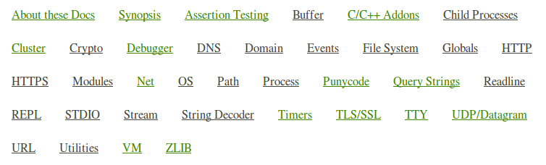
Module api
module

Slide 6
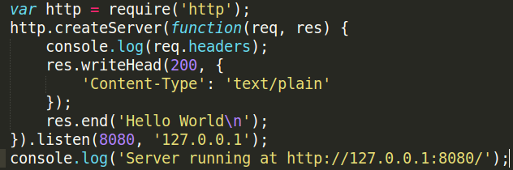
Http server
A tiny http server

Slide 7
Buffer 模块
http://nodejs.org/api/buffer.html
Pure JavaScript is Unicode friendly but not nice to binary data. When dealing with TCP streams or the file system, it's necessary to handle octet streams.
Raw data is stored in instances of the Buffer class. A Buffer is similar to an array of integers but corresponds to a raw memory allocation outside the V8 heap. A Buffer cannot be resized.
除了binary data,涉及到大量字符串操作也应该尽量使用buffer.
比如文件上传解析, 邮件解析等.

Slide 8
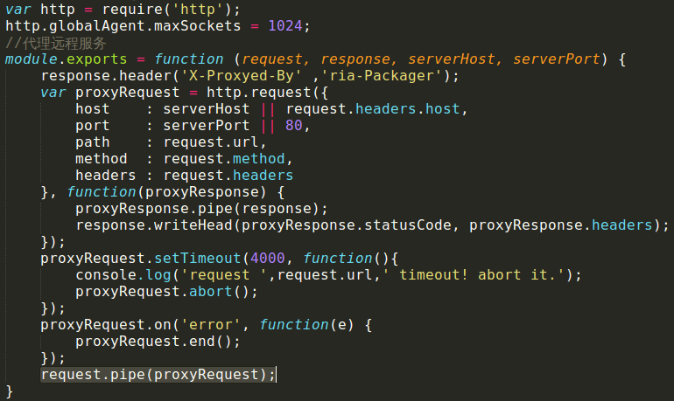
stream
http://nodejs.org/api/stream.html
reader.pipe(writer);
stream pipe:一边读,一边写,比读完再写要快.

Slide 9
异常处理与domain模块
http://nodejs.org/api/domain.html
全局捕获: process.on('uncaughtException')
try … catch 无法捕获异步 事件(如使用process.nextTick执行的代码)中的错误!
Domain模块应运而生.

Slide 10
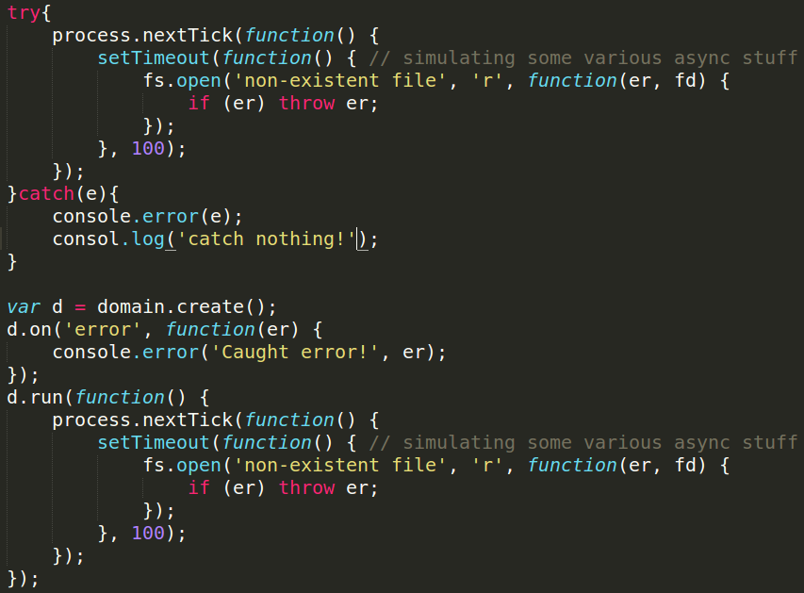
使用domain模块处理异常

Slide 11
nodejs中异步执行代码
process.nextTick(fn) 由node主事件循环来调度,保证无阻塞,是真正异步的.
setTimeout(fn, 0) 实际上是阻塞式的!
window.requestAnimationFrame 高级浏览器为动画提供的接口,可用来实现比setTimeout更流畅的动画效果. 由浏览器主事件循环来调度.

Slide 12
ECMA 5(6) Mozilla Features Implemented in V8
没有浏览器端开发要考虑那么多兼容性问题
https://github.com/joyent/node/wiki/ECMA-5-Mozilla-Features-Implemented-in-V8
http://dailyjs.com/2012/10/15/preparing-for-esnext/

Slide 13
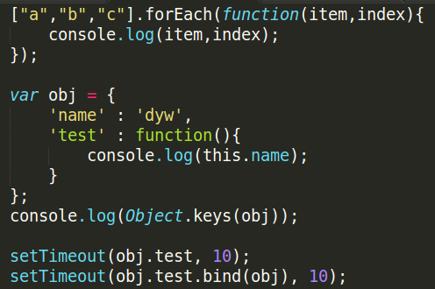
ecma5
[].forEach
Object.keys
Function.bind

Slide 14
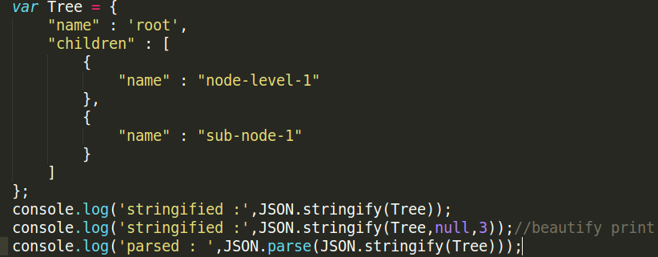
JSON
JSON.stringify
JSON.parse

Slide 15
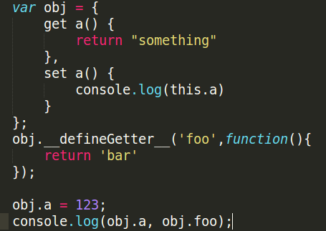
__defineGetter__

Slide 16
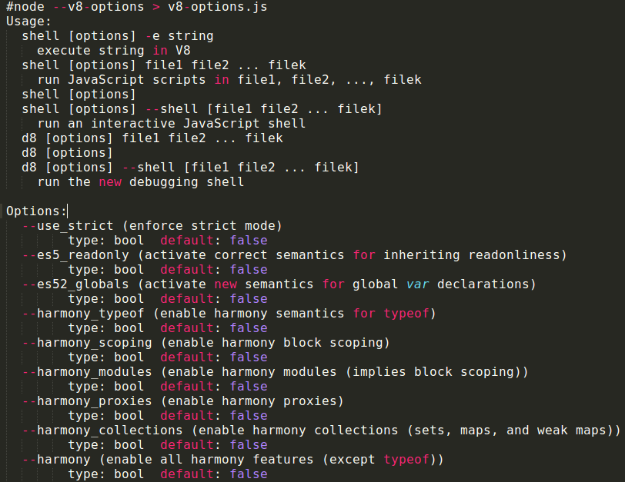
node --v8-options

Slide 17
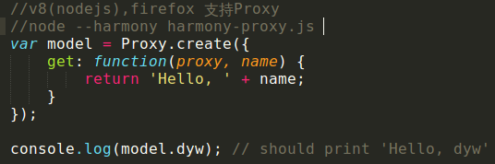
node --harmony_proxies(动态元编程)
node –harmony or node –harmony_proxies
http://soft.vub.ac.be/~tvcutsem/invokedynamic/proxies_tutorial

Slide 18
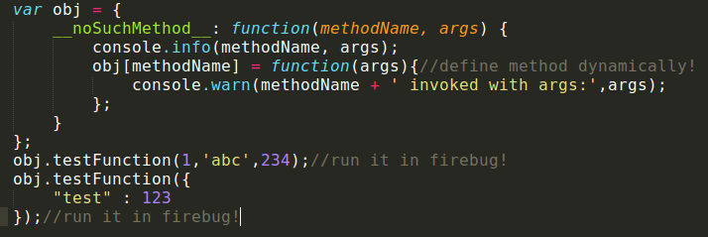
Spider monkey __noSuchMethod__
__noSuchMethod__
仅Firefox 浏览器支持

Slide 19
node-dev
node test.js
node-dev test.js //监控js内容变化,即时重启node

Slide 20
npm
npm publish(npm adduser)
npm install express -g
npm update express -g
package.json

Slide 21
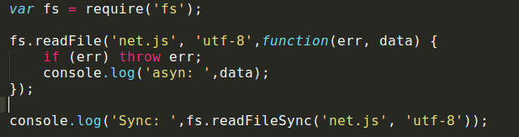
异步 vs 同步
fs.readFileSync('net.js', 'utf-8');
fs.readFile('net.js', 'utf-8',function(err, data) {});
nodejs编程推荐都用异步方式,以保证无阻塞.

Slide 22
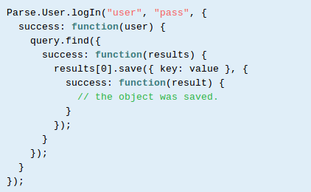
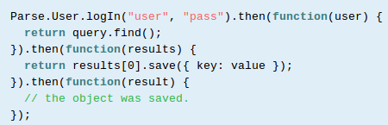
异步回调的嵌套陷阱
promises

Slide 23
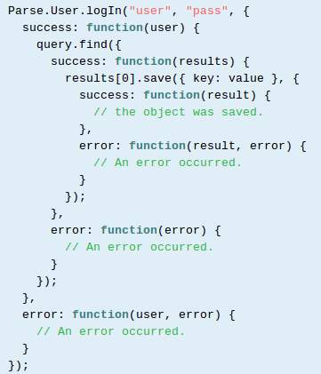
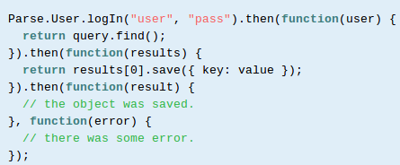
使用promise解决回调嵌套
promise

Slide 24
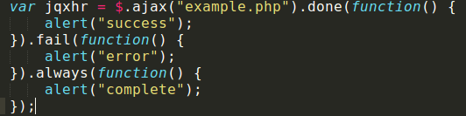
jQuery Promise
http://api.jquery.com/jQuery.ajax/
The jqXHR objects returned by $.ajax() as of jQuery 1.5 implement the Promise interface, giving them all the properties, methods, and behavior of a Promise (see Deferred object for more information).

Slide 25
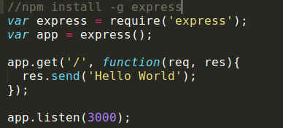
Express web framework
Sinatra inspired web development framework for node.js -- insanely fast, flexible, and simple
Built on Connect Middleware
http://expressjs.com
npm install -g express
Read the doc!!

Slide 26
What Express Does
Parses arguments and headers
Routing
Views
Partials
Layouts
Configuration
Sessions

Slide 27
Request Object
req.param
req.query
req.body
Req.files
req.flash ---- show error msg
req.session , req.cookies express.cookieParser;
req.headers
Notes:
Req.Param is an abstraction layer for picking up information about a request – it automatically searches:
Query strings
Posted form values
Route values
And will let you pick from what’s available

Slide 28
Response Object
res.redirect
res.write ---Transfer-Encoding:chunked
res.end
res.download res.sendfile res.attachment
res.send
res.status
res.json res.jsonp
res.format res.render

Slide 29
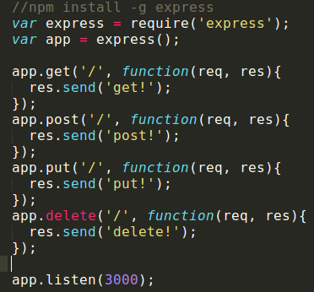
express--CRUD
CRUD <---> HTTP Get,Post,Put,Delete
restful

Slide 30
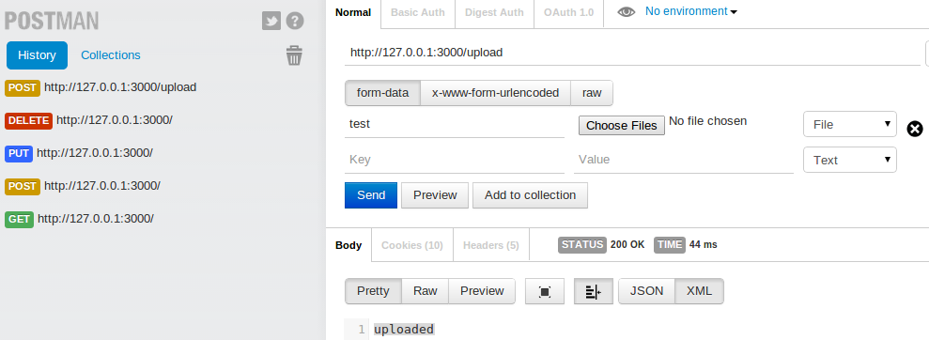
Get-Post-Put-Delete

Slide 31
express.methodOverride
<input type="hidden" name="_method" value="delete"/> 附加参数_method.
app.use(express.bodyParser());
app.use(express.methodOverride());
jQuery.ajax() 通过type参数支持http PUT及DELETE方法(部分浏览器XMLHttpRequest对象支持put,delete方法)

Slide 32
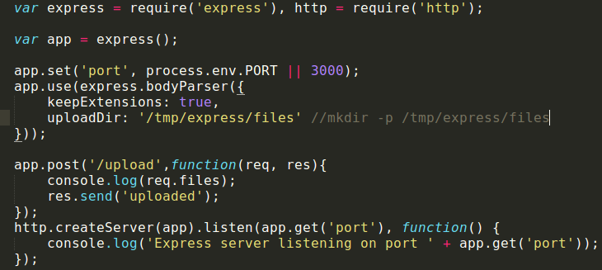
express—file upload
app.use(express.bodyParser)
https://github.com/felixge/node-formidable

Slide 33
ria-packager开发中遇到的部分问题及解决方案
require('a/b/c/_test/main.json');
less中背景图片url处理(相对路径调整,加md5版本号)
Mustache模板渲染
进程管理
在线打包,实时输出log日志到浏览器

Slide 34
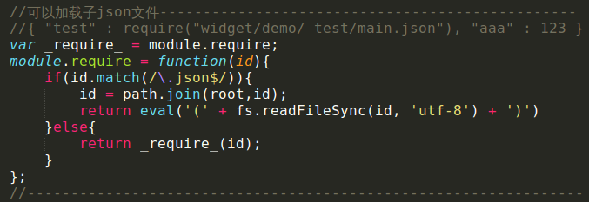
按需加载模板数据
require('a/b/c/_test/main.json');
使用eval解析json
重载require.

Slide 35
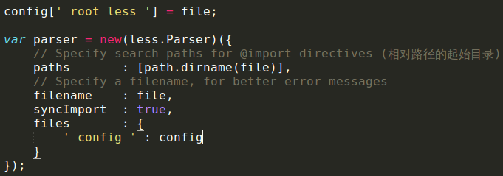
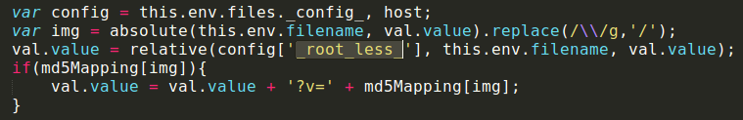
less中背景图片url处理
path.relative
打包时先copy所有图片,并计算其md5 hash.

Slide 36
mustache模板渲染
清除模板缓存 mustache.clearCache();
加载子模板:

Slide 37
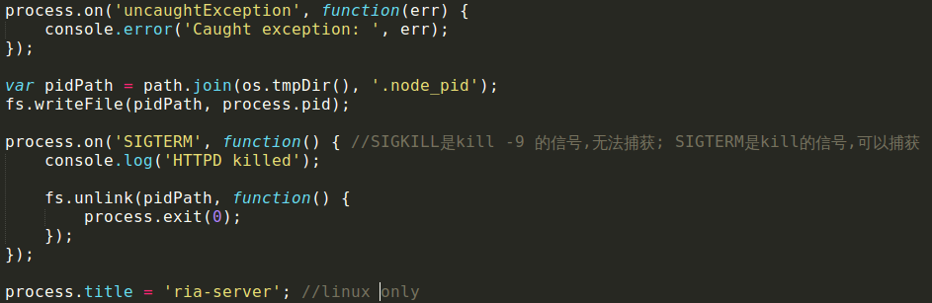
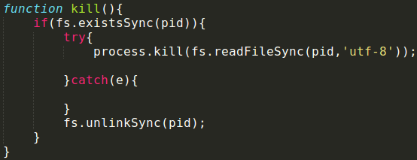
进程管理
process.pid

Slide 38
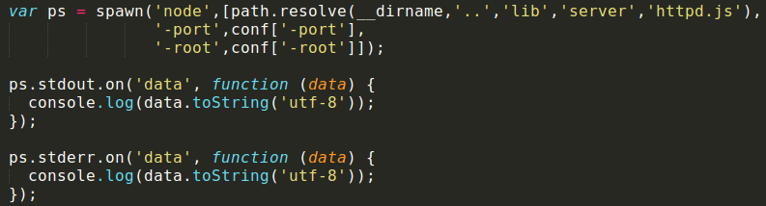
spawn进程
Spawn or fork(clone) or exe

Slide 39
信号处理
SIGTERM , SIGKILL,... 软重启.
process.exit(0||1); 0成功,1出错.

Slide 40
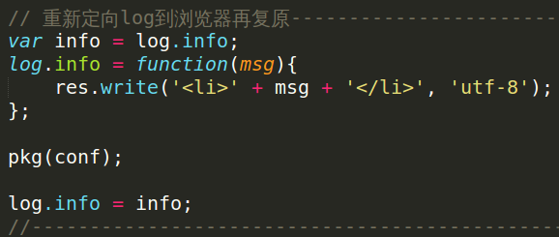
在线打包工程
实时输出log日志到浏览器
http://192.168.66.211:8888/mobile/deploy

Slide 41
The end
Q & A?

