Slide 1
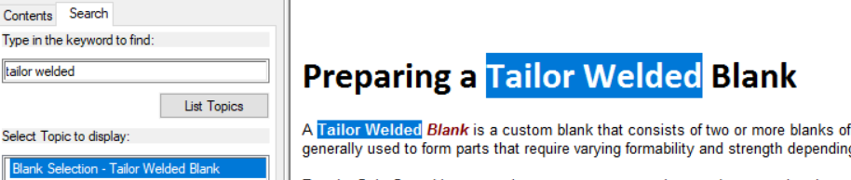
How to define tailor welded blank
A: Preparing a tailor welded blank in help

Slide 2
2. How to create double attached geometry?
A: Mirror double attached/Advanced Double Attached in help

Slide 3
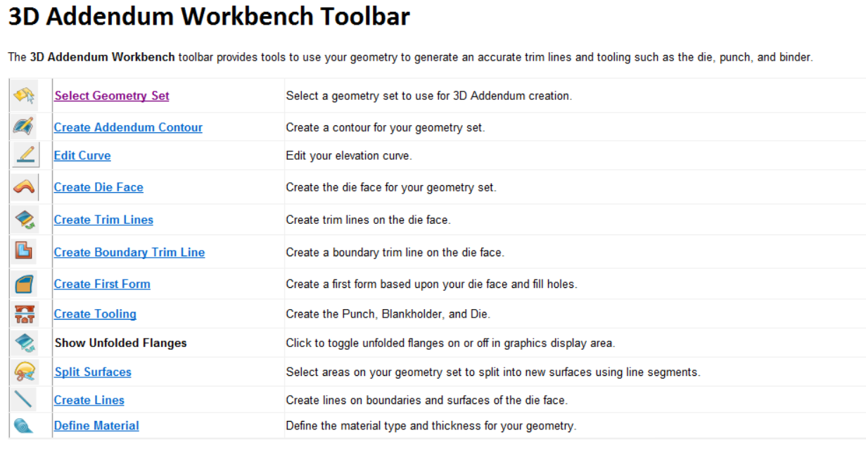
3. How to create 3D addendum?
A: answer needs to be extracted from the following in help file

Slide 4

4. How to edit part features?
A: Define or edit part features in help file

Slide 5

5. What could cause solving problem in incrmental?
A: Trouble shooting from help file

Slide 6
6. Formingsuite system requirement?
A:https://simcompanion.hexagon.com/customers/s/article/FormingSuite-2023-System-Requirements
FormingSuite® (Except FASTIncremental®):64-bit Microsoft Windows 10
Multi-core, 64-bit processor (ex. Intel i5, i7, i9 or Xeon)
Dedicated graphics processor (integrated graphics such as Intel HD graphics will yield poor performance)
4GB of RAM - 8GB or more is highly recommended
10GB Free Hard Disk space
Microsoft Office 2016 and above for report generation
For FASTIncremental® configurations:64-bit Microsoft Windows 10 (recommended)
High-end, Multi-core, 64-bit processor (ex. Intel i7, i9 or Xeon) - 4 to 8 cores are highly recommended
Dedicated graphics processor (integrated graphics such as Intel HD graphics will yield poor performance)
16GB of RAM - 32GB+ is highly recommended
100GB Free Hard Disk space
Microsoft Office 2016 and above for report generation

Slide 7
7. Cannot run FormingSuite using remote access/terminal server
A:https://simcompanion.hexagon.com/customers/s/article/Cannot-run-FormingSuite-using-remote-access
Description
The ability to run FormingSuite using a remote login system such as remote desktop is determined based on the licensing model in use. Nodelocked licenses will not run via remote access. In this scenario, the license is designed to be accessed only from the actual client workstation. Remote login is considered to be accessing the software from another system, which is similar to accessing a floating license. Launching FormingSuite from a remote login session will result in an error message similar to "FlexNet licensing error -103: Terminal Server remote client not allowed" Floating (aka server, shareable, network) licenses do permit remote access since this licensing model supports usage of the software from multiple client systems and is only limited by the number of users.

Slide 8
8. Error when generating Excel reports from FormingSuite
A:https://simcompanion.hexagon.com/customers/s/article/Error-when-generating-Excel-reports-from-FormingSuite
Summary
This article explains how to resolve the error message "Programmatic access to Office VBA project is denied" or "Error 1004 - Programmatic access to the Visual Basic Project is not trusted" when creating reports from FormingSuite
Description
If, when generating an Excel report from FormingSuite you get an error that says "Programmatic access to Office VBA project is denied" or "Error 1004 - Programmatic access to the Visual Basic Project is not trusted", open the Trust Center in Excel and go to the Macro Settings section. Make sure the "Trust access to the VBA project object model" check box is checked. Close Excel and try making the report again. To access this setting: Open Excel
From the File menu/Office button, select Options
Select the Trust Center category
Click the Trust Center Settings button in the lower right
Select the Macro Settings category
Check the box marked “Trust access to the VBA project object model”
In order to run reports in FormingSuite version 2017.0 or newer, you also require Microsoft's XML library. This should be installed by default on most systems, but you can install it manually by downloading it from Microsoft's web site.

Slide 9
9. How to configure FormingSuite to use MSC licensing
A:https://simcompanion.hexagon.com/customers/s/article/How-to-configure-FormingSuite-2021-to-use-MSC-One-licensing
Summary
FormingSuite does work with MSC licensing, however additional manual configuration steps are required. With a default installation, FormingSuite will only look for a conventional FTI license. This article outlines the required steps.
Description
FormingSuite provides support for two separate licensing systems: the FTI-specific nodelocked and floating licenses, and the MSC token based licensing system. These two systems are unable to operate concurrently, so the client machine must be configured to use one or the other. The license configuration settings are stored in the HKEY_CURRENT_USER section of the registry so any changes to the settings must be made while logged in as the end-user and not logged is as an IT administrator. By default, FormingSuite is will enable access to all available modules (such as FASTBLANK, BLANKNEST, etc) using the FTI licensing system. In this scenario, the software will automatically check out the highest combination of FTI module licenses available without duplicating functionality. When the licensing settings are left to this default configuration, MSC licenses will not be checked. To change the settings to use MSC licensing, do the following:Log into Windows using the end user's account
Starting FormingSuite - it will fail the license check and open the License Configuration dialog
Select the Server Hostname option and set it to the portnumber@servername for the MSC license server hosting the licenses. The default port number is 27500. For example 27500@msclicenseserver
Click the License Manager button in the upper right of the dialog
The License Manager (and Windows User Account Control) will request permission to make changes. This may require an administrative password. It may take a few seconds to launch.
Click the LICENSE CONFIGURATION button to select the required product licensing configuration
Uncheck all options and then select only the MSC One configuration(s) you want to use.
Accept and close the License Manager
Restart FormingSuite. It should now work.
If you are still unable to access your MSC One licenses after making the above changes, check the following:In the client installation folder (typically C:\FTI\FormingSuite), ensure that the Licensing folder (as well as the FTI\ Temp and dat folders) have full control permissions for all users. This is required to allow the initial license path/server information to be set.
Ensure that your MSC One license contains the required FEATURE lines. The FTI configurations all begin with FTI_. If the FTI FEATURES are missing, you may require a new license - contact your account representative at MSC.
Ensure that the license server is running properly by checking the server log files. If the log file does not exist or is empty, make sure that the log file folder has sufficient permissions for the license service. You may have to restart the license service after changing the permissions.
Ensure that there are sufficient available tokens to run the application on the client system
If either the MSC_LICENSE_FILE or FTI_LICENSE_FILE system environment variables exist, check their settings. If they are set to a different location, they could conflict with the software setting.
If you are unable to access the license from a remote location or using a slower network connection (such as internet or VPN), create a system environment variable called FLEXLM_TIMEOUT and set it to 3000000 (three million). This will force the software to wait longer for a reply from the license server
If these suggestions do not solve the problem, please contact your MSC Support representative.

Slide 10
10. License installation and set up Guide

