Slide 1
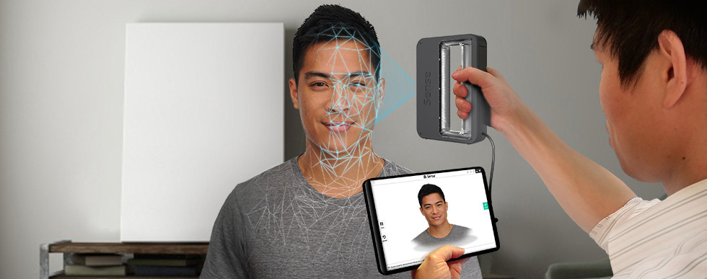
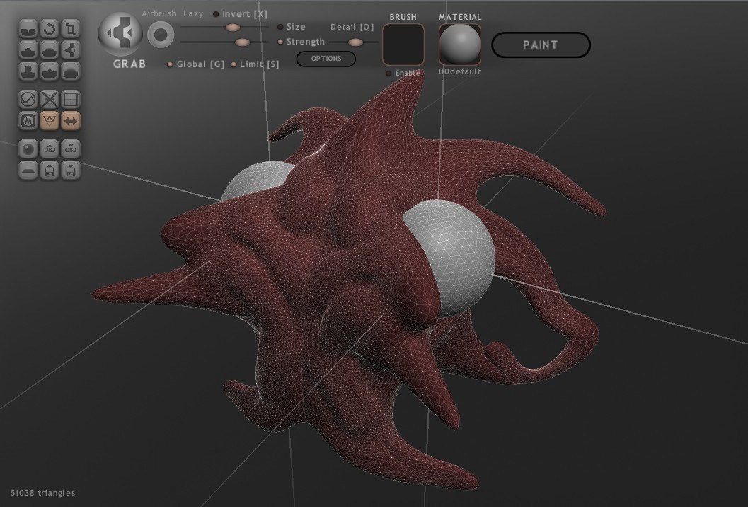

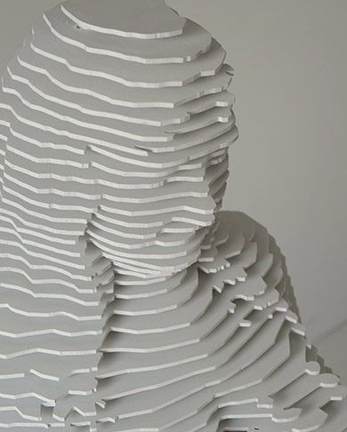
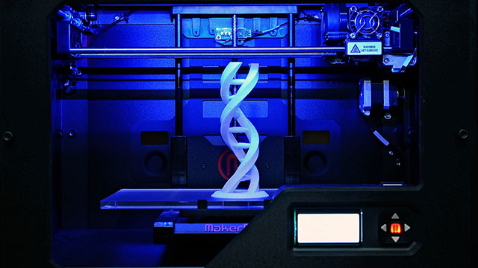
PROCESS OVERVIEW
3D Scanning
3D Reconstruction
Mesh Repair
Mesh Editing
Mesh Validation
Modeling
Sculpturing
3DPrinting Pre-processing
3D Printing
Mesh Slicing
G-Code Generation

