Slide 1
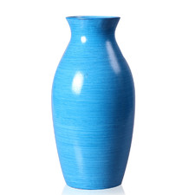
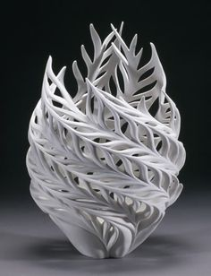
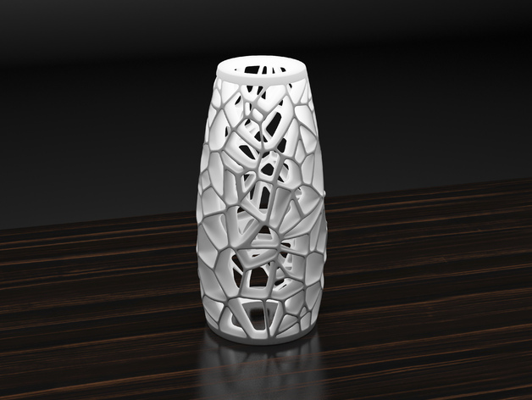
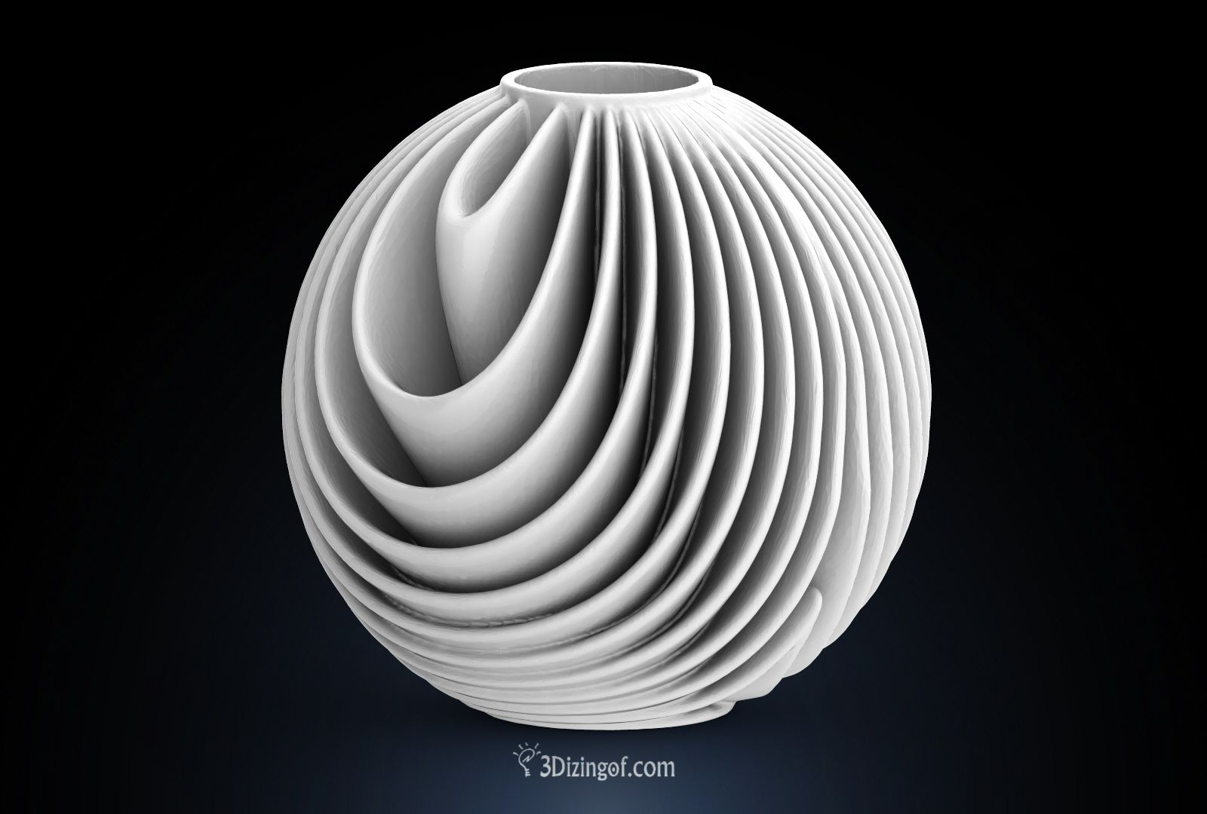
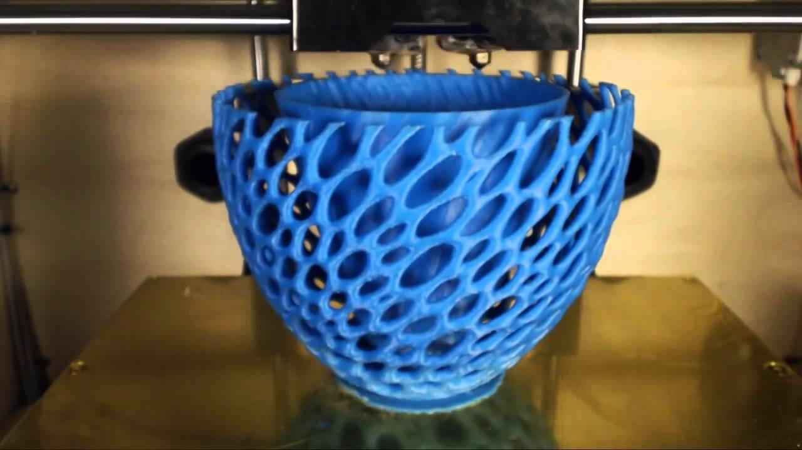
CASE STUDY - CREATIVE FURNITURE
Scanned Object
Design Transformation
Creative Furniture
Furniture Store (e.g., IKEA)
Local Print / Deliever / Install

Slide 2
CASE STUDY - CREATIVE FURNITURE
Scanned Object
Anyone can scan something.
Design Transformation
Our software platform provides user with the ability to be more “Creative” to design something unique on their own.
Creative Furniture
Furniture Store (e.g., IKEA)
All furniture designs can be shopped and custom sized.
Local Print / Deliever / Install
We can develop our own patented 3D furniture printer and sell it.
We can collaborate with local 3D studio to manufacture, deliver and install.

