Slide 1
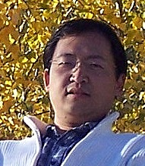
DONG'S PROFILE
ASSESSMENT
Passionate in 3D Development
WORK EXPERIENCE
Research Lead / Senior Software Developer
3D Industry Verterian (10+ Years)
CAD (Siemens PLM NX, SolidWorks, CATIA,...)
CAE (Fluent, Comsol, Forming Suite,...)
Skills in Geometry, Graphics and Computing
Geometry Processing
Computational Geometry
Computer Graphics
Computer Vision
Artificial Intelligence
EDUCATION
Ph.D. , Mechanical Engineering, University of Calgary
M.Sc, Automotive Engineering, Tongji University
B.Sc, Automotive Engineering, Tongji University

