Slide 1
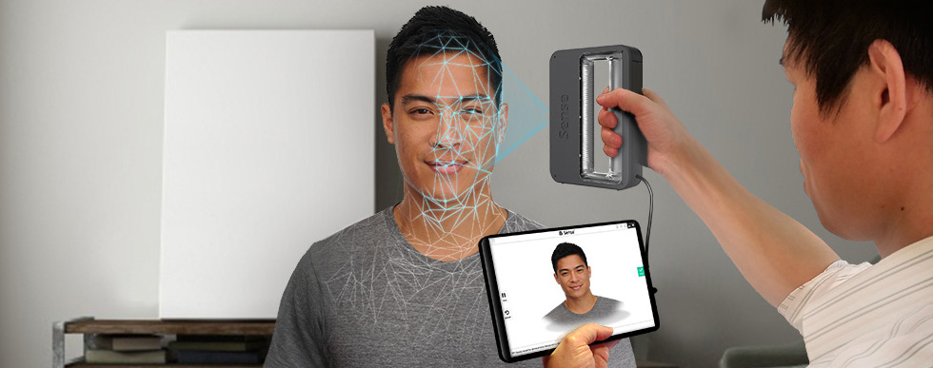
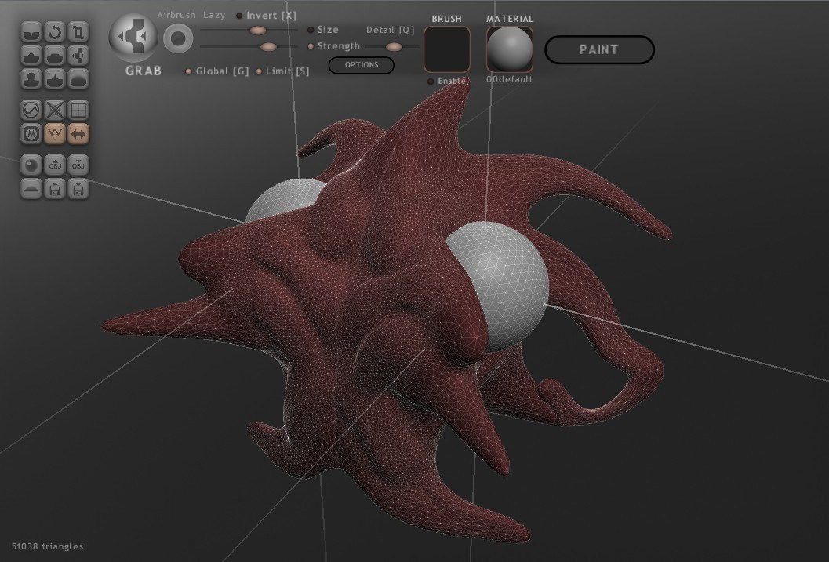

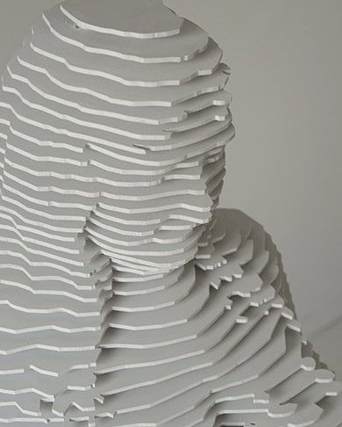

PROCESS OVERVIEW
3D Scanning
3D Reconstruction
Mesh Repair
Mesh Editing
Mesh Validation
Modeling
Sculpturing
3DPrinting Pre-processing
3D Printing
Mesh Slicing
G-Code Generation

Slide 2

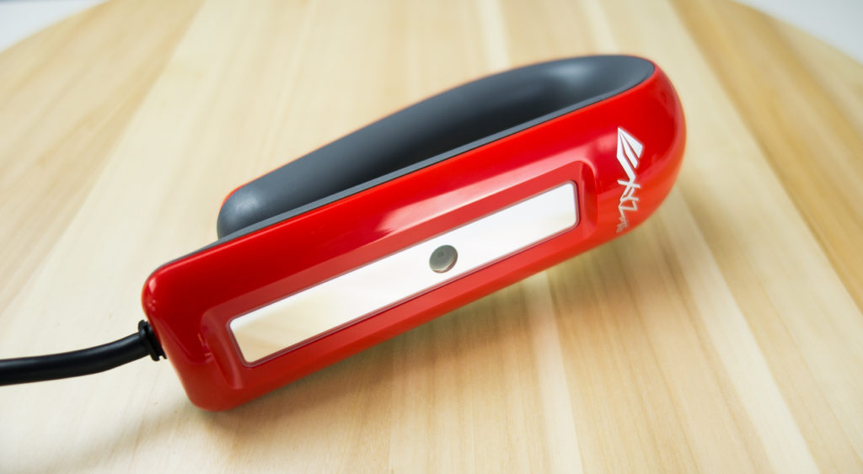
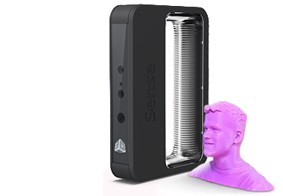

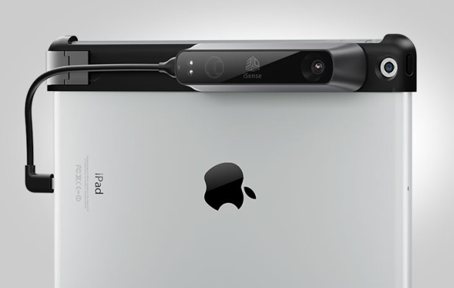
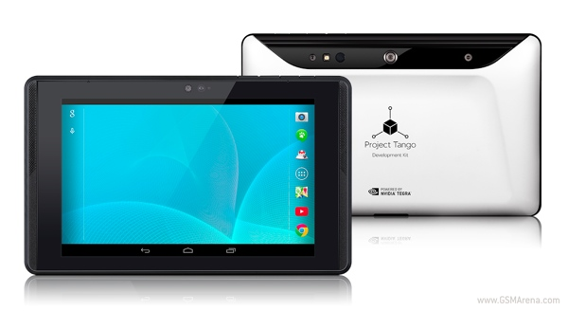
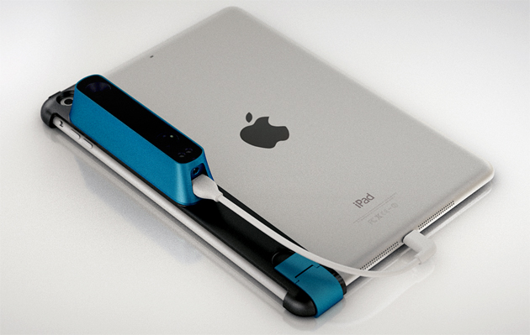
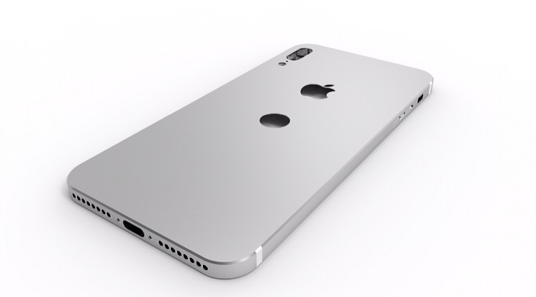
3D SCANNING BECOMES EASY
XBOX ONE
XYZ 3D Scanner
XYZ 3D Scanner
Sense
Bevel Scanner
Bevel Scanner
iSense
Project Tango
Project Tango
Strucutre Sensor
iPhone
iPhone

Slide 3
3D PRINTING BECOMES EASY

