Slide 1
WHY WE NEED 3D SCANNING AND 3D PRINTING
3D Measurement
Interior Design
Interior Decoration
Customized Products
Old Parts Reproduction
One of a Kind Ornaments
One of a Kind Toys and Games
One of a Kind Medical Devices
Art Pieces
Food Production
Apparel and Fashion
Educational Models
Rapid Prototyping
…

Slide 2
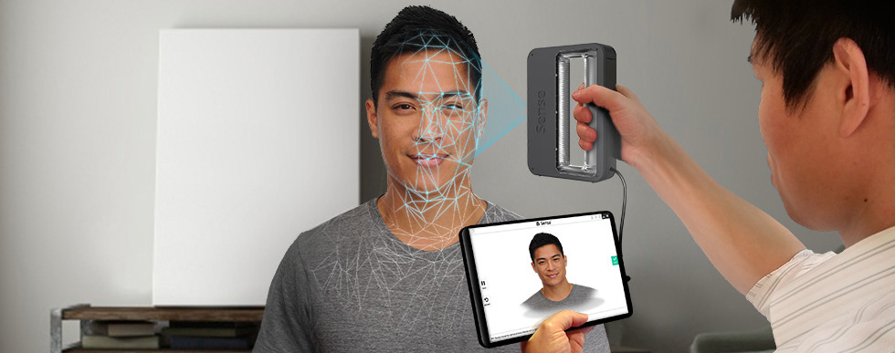
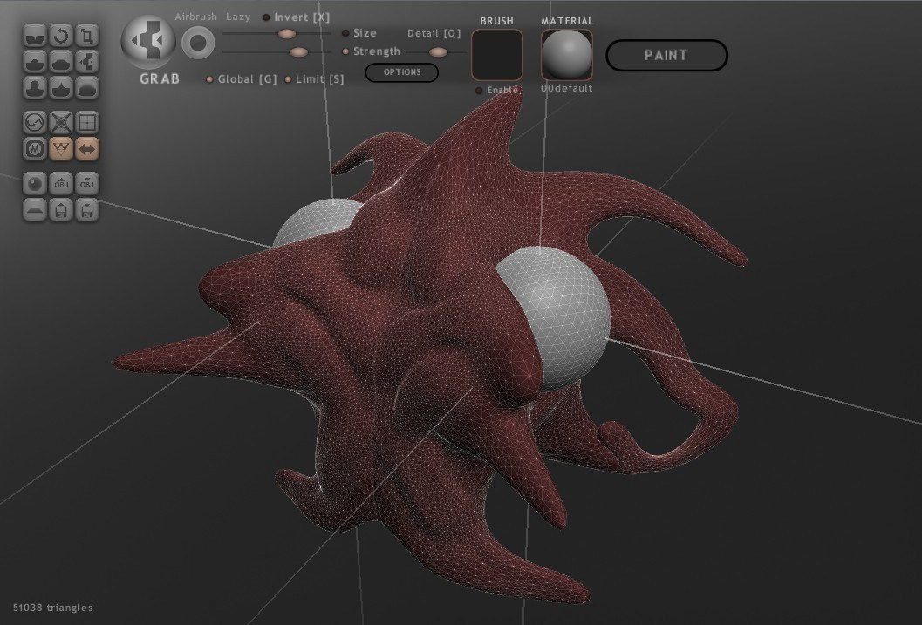

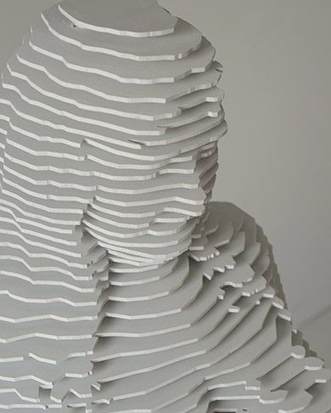
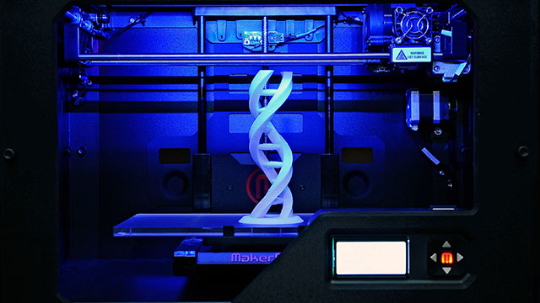
FROM 3D SCANNING TO 3D PRINTING
3D Scanning
3D Reconstruction
Mesh Repair
Mesh Editing
Mesh Validation
Modeling
Sculpturing
3DPrinting Pre-processing
3D Printing
Mesh Slicing
G-Code Generation

Slide 3
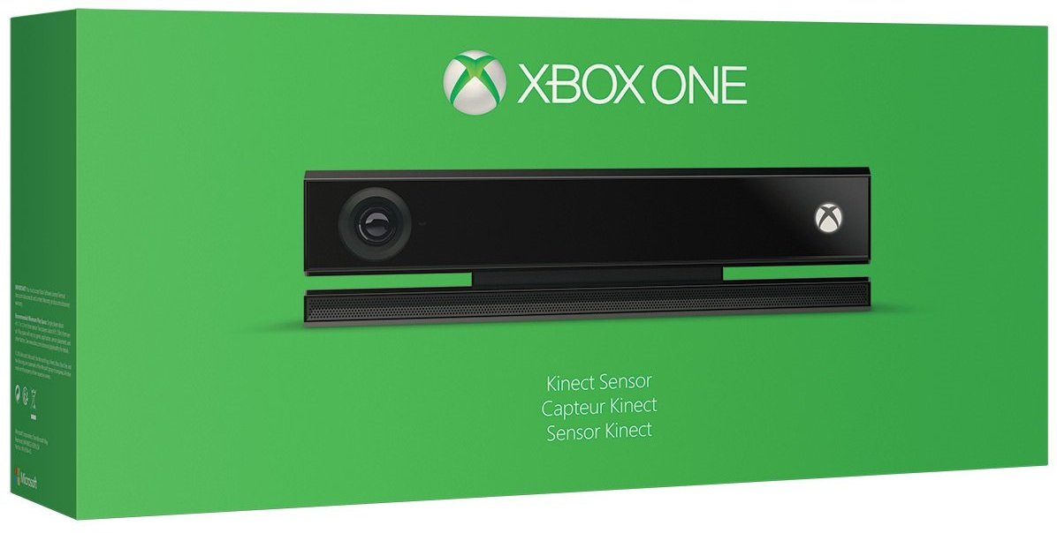
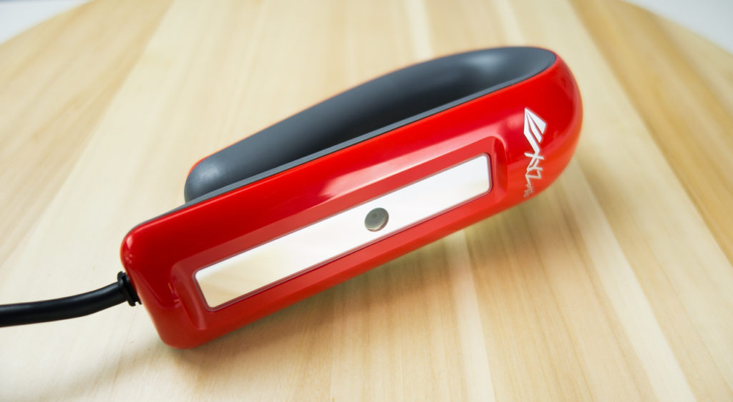
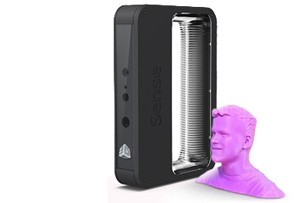
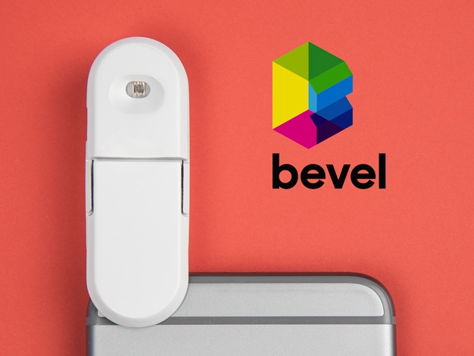
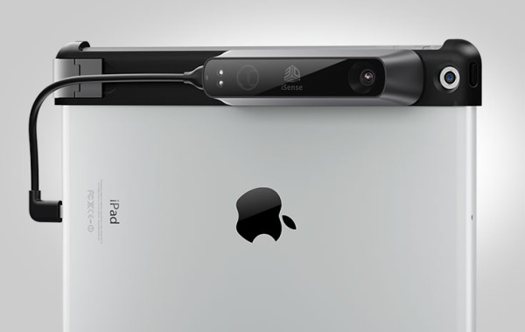
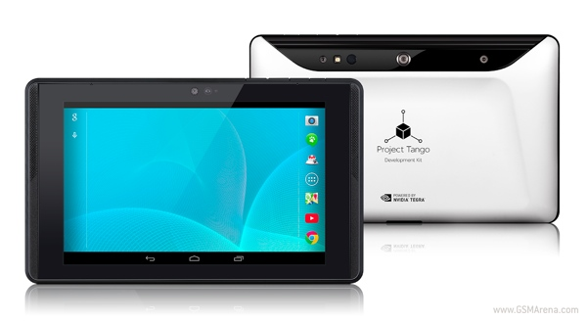
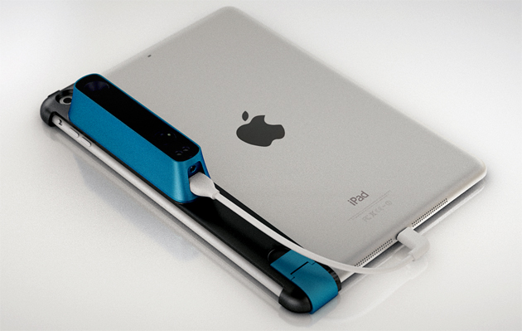
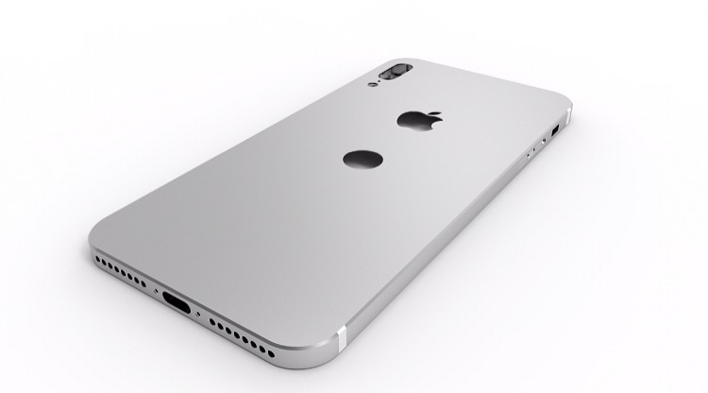
3D SCANNING BECOMES EASY
XBOX ONE
XYZ 3D Scanner
XYZ 3D Scanner
Sense
Bevel Scanner
Bevel Scanner
iSense
Project Tango
Project Tango
Strucutre Sensor
iPhone
iPhone

Slide 4
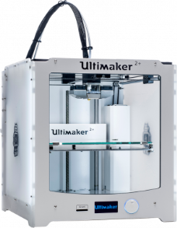
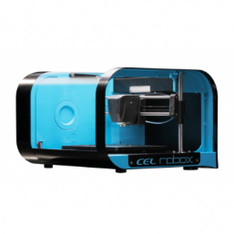
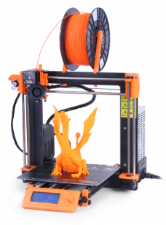
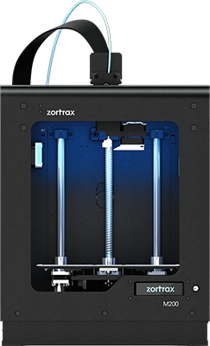
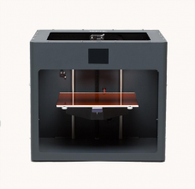
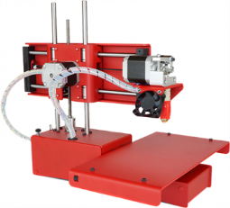
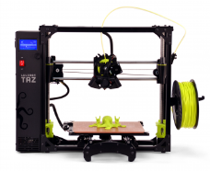
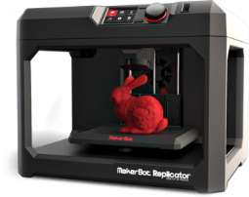
3D PRINTING BECOMES EASY
Ultimaker Ultimaker 2+
CEL Robox
Original Prusa i3 MK2
Zortrax M200
CraftBot PLUS
Printrbot Simple Metal
LulzBot TAZ 6
Replicator 5th Gen

Slide 5
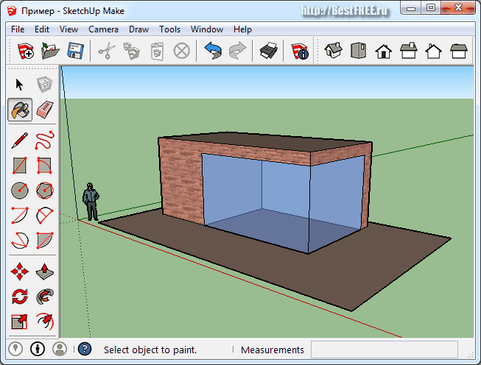
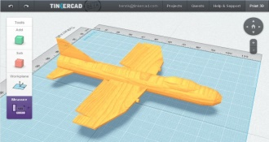
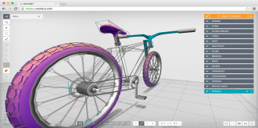
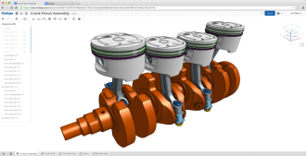
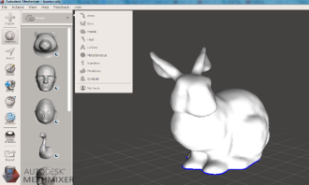
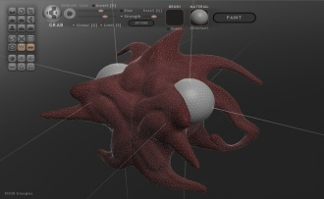
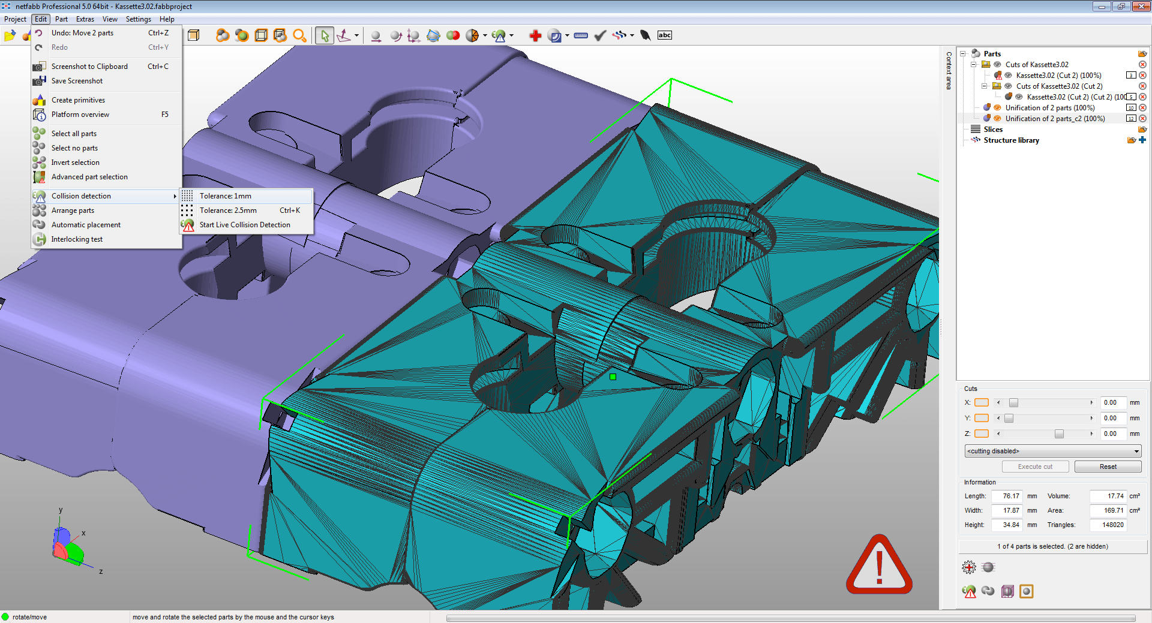
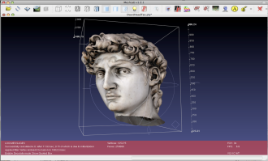
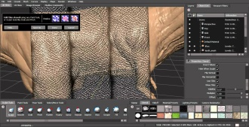
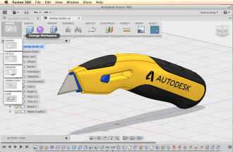
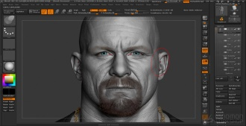
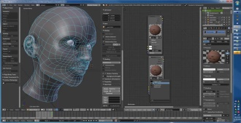
MODELING IS PAINFULL
Technology
MESH
SUBDIVISION
NURBS
VOID
Usability

Slide 6
WHAT WE DO

