Slide 1
Wiki概论

Slide 2
Impress the judges
State your accomplishments! Tell people what you have achieved from the start.
Be clear about what you are doing and how you plan to do this.
You have a global audience! Consider the different backgrounds that your users come from.
Make sure information is easy to find; nothing should be more than 3 clicks away.
Avoid using very small fonts and low contrast colors; information should be easy to read.

Slide 3
outline
Home
Team Team Collaborations
Project Description Design Experiments Demonstrate
Proof of concept Results Notebook
Parts Parts Basic Part Composite Part Part Collection
Safety
Attributions
Human practices Human Practices HP Silver HP Gold
Integrated Practices Engagement
Awards Entrepreneurship Hardware Software
Measurement Model

Slide 4
1.Homepage
document your project
introduce your team members
document your progress
share your iGEM experience

Slide 5
2.Team
Team Collaborations

Slide 6
Team introduce your team members, instructors, and advisors
合照+个人照+描述
Include pictures of your teammates, don’t forget instructors and advisors!
You can add a small biography or a few words from each team member, to tell us what you like, and what motivated you to participate in iGEM.
Take team pictures! Show us your school, your lab and little bit of your city.
Remember that image galleries can help you showcase many pictures while saving space

Slide 7
Collaborations team collaboration silver medal criterion
在各个层面帮助其他队伍
Improve the function of another team's BioBrick Part or Device
Characterize another team's part
Debug a construct
Model or simulating another team's system
Test another team's software
Help build and test another team's hardware project
Mentor a high-school team
complete this page and detail the nature of your collaboration with another iGEM team

Slide 8
3. Project
Description Design Experiments Proof of concept Demonstrate Results Notebook

Slide 9
Description improve a previous part or project gold medal criterion
Summaries, consist, accurate and unambiguous
A clear and concise description of your project.
A detailed explanation of why your team chose to work on this particular project.
References and sources to document your research.
Use illustrations and other visual resources to explain your project.

Slide 10
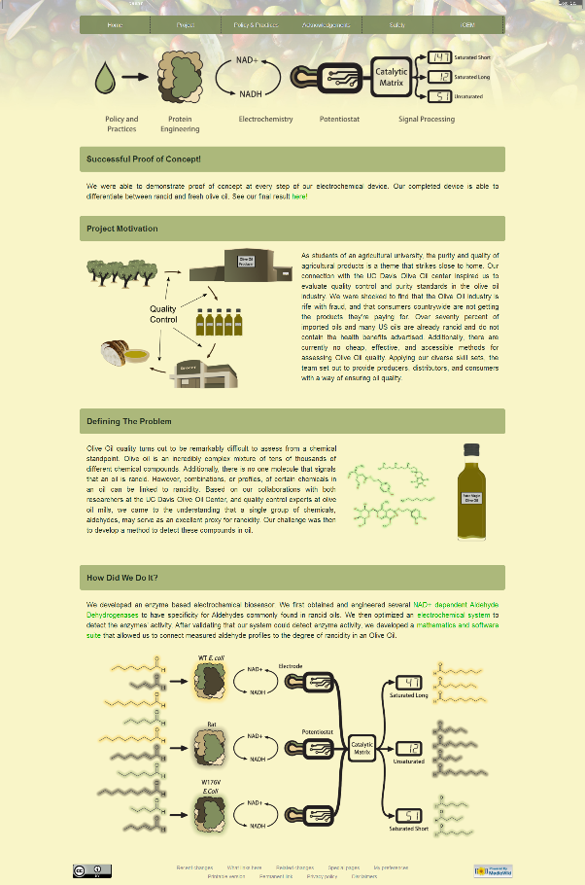

Slide 11
Design design special prize
If your team is going for a gold medal by building a functional prototype, you should tell us what you did on this page.
This is a prize for the team that has developed a synthetic biology product to solve a real world problem in the most elegant way. The students will have considered how well the product addresses the problem versus other potential solutions, how the product integrates or disrupts other products and processes, and how its lifecycle can more broadly impact our lives and environments in positive and negative ways.

Slide 12
Experiments
Protocols
research
Experiments
Documentation of the development of your project

Slide 13
Proof of concept gold medal criterion for proof of concept
take the first steps to make their project real
assemble a device from BioBricks and show it works.
build some equipment if you're competing for the hardware award.
create a working model of your software for the software award

Slide 14
Demonstrate
a quick reference page for the judges to see what you achieved during your summer
Clearly and objectively describe the results of your work.
Future plans for the project
Considerations for replicating the experiments
A list of linked bullet points of the successful results during your project
A list of linked bullet points of the unsuccessful results during your project

Slide 15
Results
Same as above

Slide 16
Notebook
Document the dates you worked on your project
Chronological notes of what your team is doing.
Brief descriptions of daily important events.
Pictures of your progress.
Mention who participated in what task

Slide 17
4.Parts
Parts Basic Part Composite Part Part Collection

Slide 18
Parts
Registry
Part Name
Part type
Creator
Sequence
Short Description (60 characters on what the DNA does)
Long Description (Longer description of what the DNA does)
Design considerations
Webpage
showcase the parts you have made
put up much more information as you gather it over the summer
images, plots, characterization data

Slide 19
Basic Part basic part special prize
list all the basic parts your team has made during your project.
add all characterization information for your parts on the Registry.
not put characterization information on this page.

Slide 20
Composite Part composite part special prize
list all the composite parts your team has made during your project.
add all characterization information for your parts on the Registry.
not put characterization information on this page.

Slide 21
Part Collection Part Collection special prize
explain how all your parts form a collection
a theme that ties all your parts together
more than 10 parts in this collection
list all the parts in the collection your team made during your project.
add all characterization information for your parts on the Registry.
not put characterization information on this page

Slide 22
5.Safety
safety forms的延伸，任何事都行
write about how you are addressing any safety issues in your project
go beyond the questions on the safety forms,
write about whatever safety topics are most interesting in your project.
(You do not need to copy your safety forms onto this wiki page.)

Slide 23
Safe Project Design
Does your project include any safety features? Have you made certain decisions about the design to reduce risks? Write about them here! For example:
Choosing a non-pathogenic chassis
Choosing parts that will not harm humans / animals / plants
Substituting safer materials for dangerous materials in a proof-of-concept experiment
Including an "induced lethality" or "kill-switch" device
Safe Lab Work
What safety procedures do you use every day in the lab? Did you perform any unusual experiments, or face any unusual safety issues? Write about them here!
Safe Shipment
Did you face any safety problems in sending your DNA parts to the Registry? How did you solve those problems?

Slide 24
6.Attributions Attributions bronze criterion
引用别人的贡献（就像参考文献一样）
General Support
Project support and advice
Fundraising help and advice
Lab support
Difficult technique support
Project advisor support
Wiki support
Presentation coaching
Human Practices support
Thanks and acknowledgements for all other people involved in helping make a successful iGEM team

Slide 25
Distinguish work done by the students from work done by others, including the host labs, advisors, instructors, and individuals not on the team roster.
You can have a project based on a previous team, or based on someone else's idea, as long as you state this fact very clearly and give credit for the original project.

Slide 26
7.Human practices
Human Practices HP Silver HP Gold
Integrated Practices Engagement

Slide 27
Human Practices
write about the Human Practices topics you considered in your project
document any special activities you did
(such as visiting experts, talking to lawmakers, or doing public engagement)
Some Human Practices topic areas
Philosophy
Public Engagement / Dialogue
Education
Product Design
Scale-Up and Deployment Issues
Environmental Impact
Ethics
Safety
Security
Public Policy
Law and Regulation
Risk Assessment

Slide 28
HP Silver human practices silver medal criterion

Slide 29
HP Gold human practices gold medal criterion

Slide 30
Integrated Practices Best Integrated Human Practices award

Slide 31
Engagement Best Education and Public Engagement award

Slide 32
8.Awards
Entrepreneurship Hardware Software
Measurement Model

Slide 33
Entrepreneurship Best Supporting Entrepreneurship award
The Best Supporting Entrepreneurship award recognizes exceptional effort to build a business case and commercialize an iGEM project. This award is open to all teams to show that entrepreneurship is something all teams can aspire to do with their project. This award can go to an new project, or to a previous project that a team aimed to commercialize. Have you filed a provisional patent on your project/device/process? Have you raised money to build and ship products? Have you pitched your idea to investors and received money? Complete the entrepreneurship section on the 2016 Judging form and tell us what you did. As always in iGEM, the aim is to impress the judges!

Slide 34
Hardware Best Hardware award
work on many other types of problems in synbio.
Robotic assembly
Microfluidics
low cost equipment and measurement

Slide 35
Software Best Software Tool award
iGEM projects often create or adapt computational tools to move the project forward. Because they are born out of a direct practical need, these software tools (or new computational methods) can be surprisingly useful for other teams. Without necessarily being big or complex, they can make the crucial difference to a project's success. This award tries to find and honor such "nuggets" of computational work.

Slide 36
Measurement Best Measurement award
There are a lot of exciting Parts in the Registry, but many Parts have still not been characterized. Synthetic Biology needs great measurement approaches for characterizing new parts, and efficient new methods for characterizing many parts at once. If you've done something exciting in the area of Measurement, describe it here!

Slide 37
Model Best Model award
Mathematical models and computer simulations provide a great way to describe the function and operation of BioBrick Parts and Devices. Synthetic Biology is an engineering discipline, and part of engineering is simulation and modeling to determine the behavior of your design before you build it. Designing and simulating can be iterated many times in a computer before moving to the lab. This award is for teams who build a model of their system and use it to inform system design or simulate expected behavior in conjunction with experiments in the wetlab.

