Slide 2
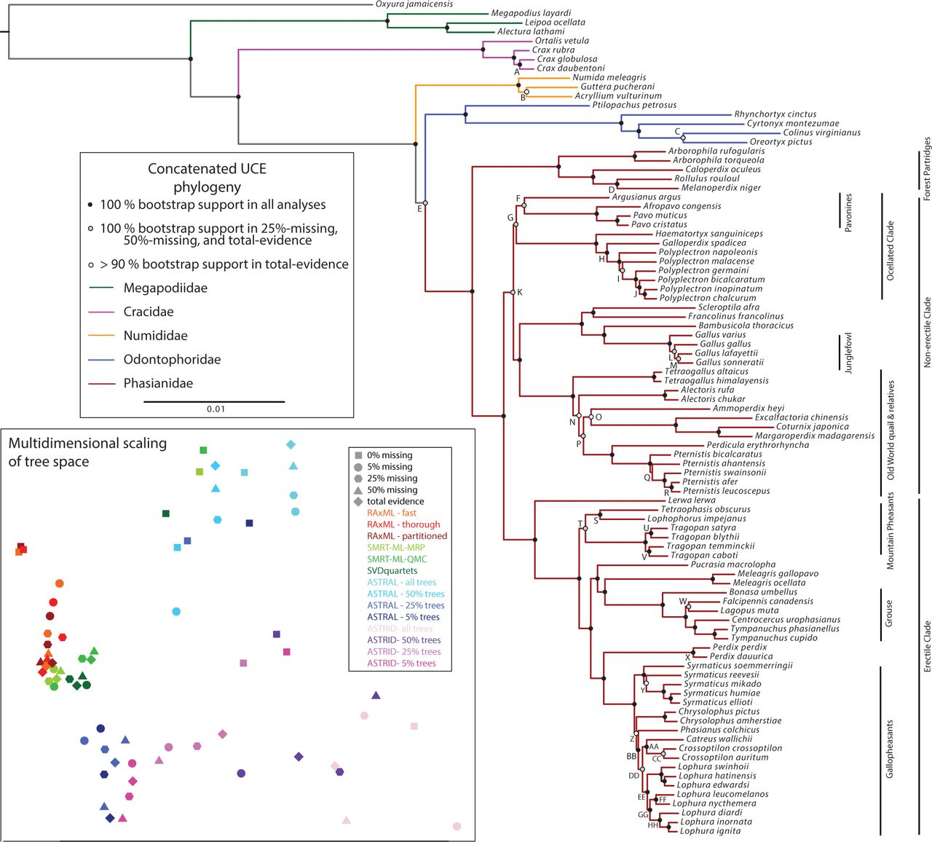
1 SRA
1 SRA
1 ready + 1 SRA
1 SRA
1 ready
1 ready
Lyrurus tetrix 1 ready
1 ready
1 SRA
1 SRA

