Slide 2
实验结果

Slide 3
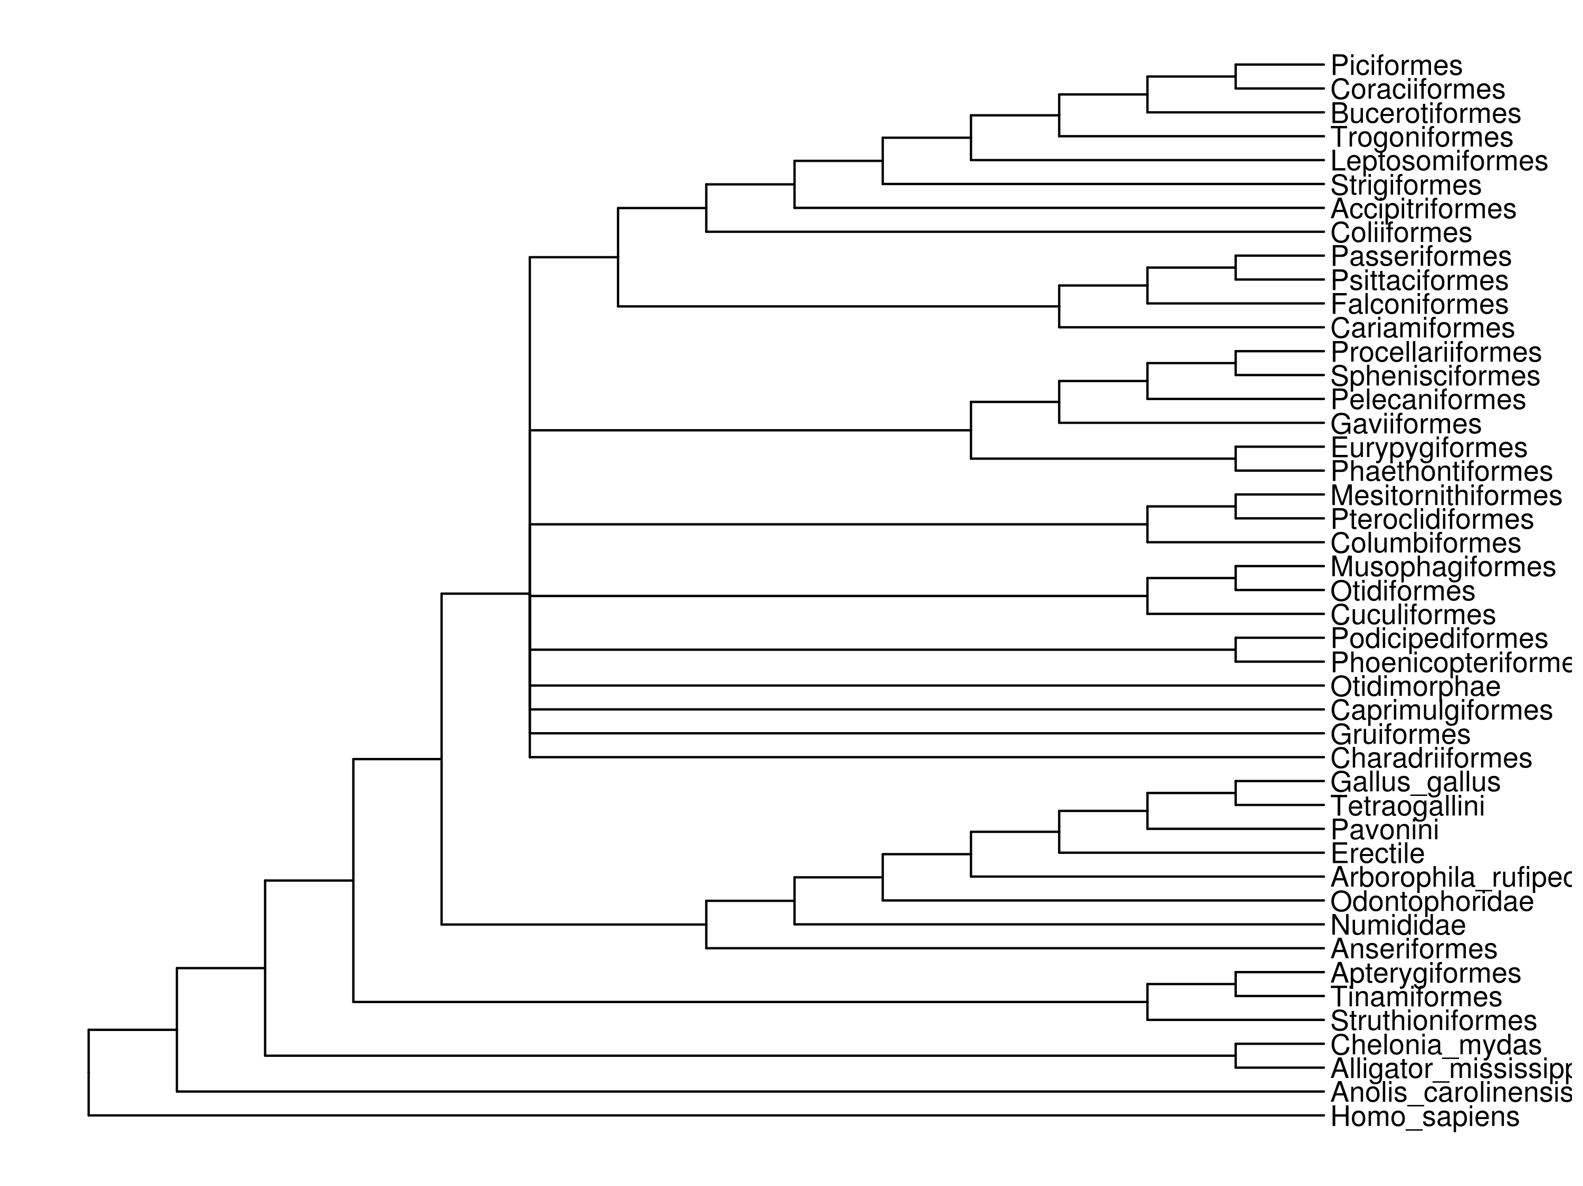
R
I
鸟类各目的检索表（鸡形目一直到家鸡）
F
Q
V
S
H
L
V
H
R
T
N
P
K
Y
F
N
G
M
M
S
L
H
D
N
E
R
K
E
P
S
L
L
S
M
D
I
E
K
N
K
P
H
D
N
M
I
I
N
D
W
R
Y
Galliformes
K
D
F
S
C
E
I
R
I
Y
Q
C
G
K
K
Y
R
N
I
V
K
S
R
V

Slide 4
highlight

Slide 5
1. 115 物种( 其中，44 基因组注释 + 24 转录组组装）
2. 8892直同源基因，蛋白质总长为×××
3. 新的衍征挖掘算法
4. R包：标准化和流程化 workflow

Slide 6
R包：使检索表的建立从博士生一两年的项目简化为仅需数天的常规流程
1. 批量并行注释基因组（包装 AUGUSTUS）
2. 自动生成核心直同源基因集（基于 OrthoDB）
3. 不同来源的数据转化为 HaMStR 输入文件
4. 分析 NCBI 组学数据分布的 pipeline
。。。。。。

Slide 7
新的衍征挖掘算法 （see word for details）

Slide 8
To better mine amino acid apomorphy suitable for molecular description, I developed a novel C++ program.
It will analyze each column of a gene matrix according a given phylogenetic tree and print information of selected node.

Slide 9
criterion for printing a node
1.We consider the node contains apomorphy.
2.The node is suitable for classification.

Slide 10
2. suitable for classification: no overlap between two clades
A
J
J
J
K
K
K
K
N
K
B
B
C
E
V
E
E
J
D
D
D
D
H
E
No overlap
J occurs both in upper and lower

Slide 11
1. potential apomorphy site
(1) We can deduce the transition of state
(2) The missing data ratio is low.

Slide 12
(1) state: three classes
① a definite state (such as “K”)
② two possible state (such as “D|E”)
③ mess

Slide 13
When the state of the two clades are both of class ①, the state of the node would be of class ① or class ② (e.g. “K” + “K” = “K”, “E” + “D” = “E|D”)
When the state of the one clades are of class ① and the other class ②, the state of the node would be of class ② or class ③ (e.g. “K” + “K|J” = “K”, “K” + “D|E” = “mess”)
For all other situation, the state of the node would be interpreted as mess.

Slide 14
A
A|D
mess
D
mess
H
E
E
E
E
mess
E
H
E
D|E
E
E|H
H
D
D
D|H
D
H

Slide 15
(2) missing score
tip node : 1.
internal node: like energy flow of food web.
“ecological efficiency”： 1 / (number of clades)

Slide 16
1
0.5
(1+0)/2=0.5
0.75
(1+0.5)/2=0.75
1
0.58333
(0.75+0+1)/3=0.58333
1
0.42448
1
(0.58333+0.265625)/2=0.42448
0.265625
0.53125
0.5
(1+0)/2=0.5
0.0625
0.25
1
(0.5+0)/2=0.25
0.125
(0.25+0)/2=0.125
(0.125+0)/2=0.0625
(0.0625+1)/2=0.53125
(0.53125+0)/2=0.265625

Slide 17
1. potential apomorphy site
(1) state isn’t “mess”
(2) missing score <= 1/3

Slide 18
The end

Slide 19
A
J
K
K
N
B
C
V
E
D
D
H

