Slide 1

Critical Path Method
Example selection:田沛熙
PowERPOINT:周正宜 范炳健 张文博
REPORT：董自经

Slide 2
THREE PARTS
1.Example Introduction
2.Table of events
3.CPM
4.Gantt chart

Slide 3

English Language Culture Festival
PART 1 :EXAMPLE INTRODUCTION
Welcome to our upcoming English Cultural Festival!
Aim:
Celebrate the diversity and richness of the English language
Provide a platform to showcase the cultural characteristics of different countries
Inspire participants to be passionate about learning English
Promote understanding and respect for different cultures.

Slide 4
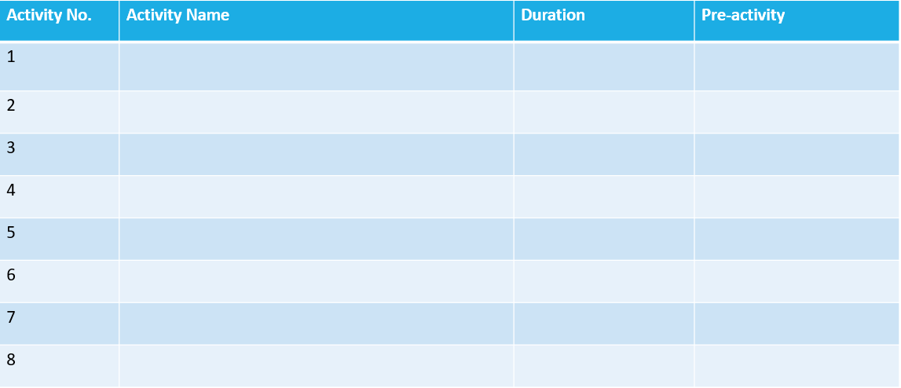
PART 2 :TABLE OF EVENTS
Determine the theme
1
0
Organize meetings
1
1
Determine the activities list
2
2
Recruit volunteers
3
0
Arrange space and equipment
4
3
Publicize events
1
3
2
6
Prepare materials and equipment
Hold the festival
1
4.5.7

Slide 5

Formulation
EF=ES+D
LS=LF-D
ES=max(pre_activities.EF)
(先决活动的最早结束中的最大值)
LF=min(sub_activities.LS)
(后续活动的最晚开始中的最小值)

Slide 6

PART 3:CPM
Activity name
ES | D | EF
ST |  | ST
LS | D | LF
EF=ES+D
LS=LF-D
ES=max(pre_activities.EF)
LF=min(sub_activities.LS)
Determine the theme
Organize meetings
Determine activities list
Arrange space and equipment
0
1
1
1
1
2
2
2
4
4
4
8
0
1
0
0
2
0
0
3
0
0
5
0
0
1
1
1
1
2
2
2
4
4
4
8
Hold the festival
Prepare materials
4
1
5
5
2
7
8
1
9
1
6
1
1
7
1
0
8
0
5
1
6
6
2
8
8
1
9
Publicize events
0
2
2
6
4
6
Recruit volunteers
6
2
8

Slide 7

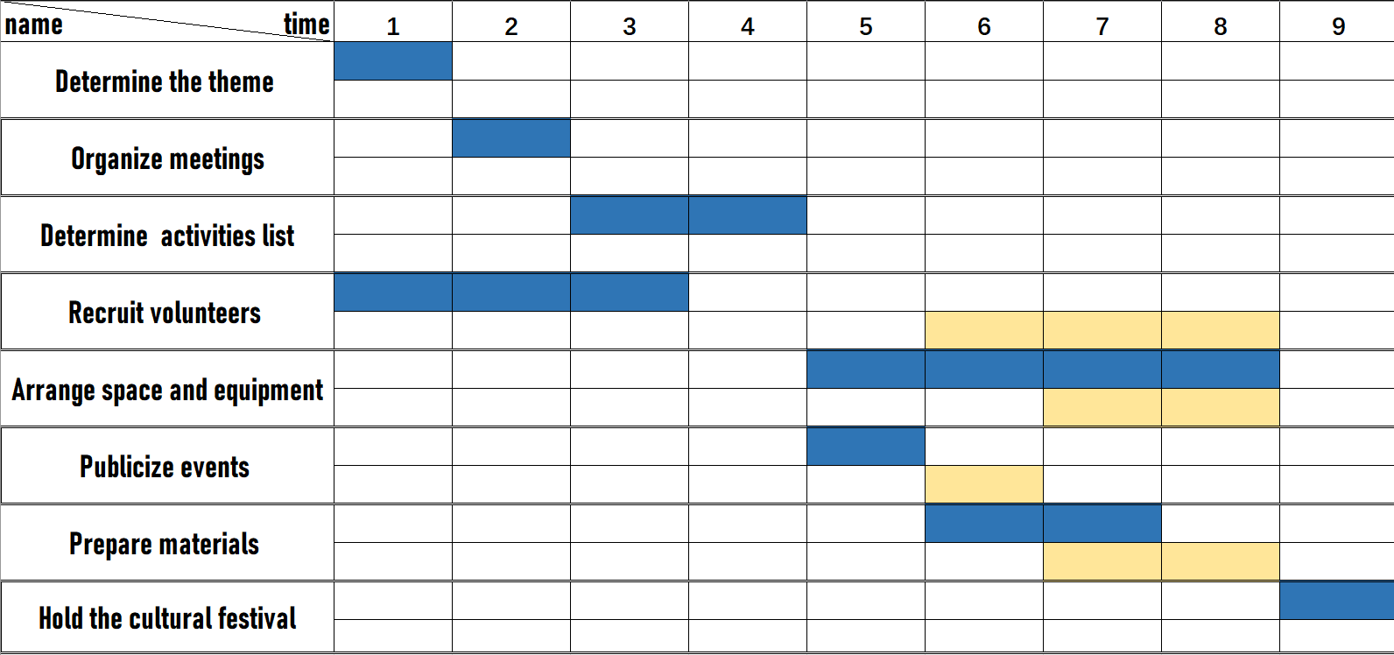
PART 4：Gantt Chart
Gantt Chart

Slide 8
Thanks for listening
Group 1

