Slide 1

Organigram
GROUP 1
2024.3.10

Slide 2
About Organigram
Definition
Function
Example

Slide 3

Definition
An Organigram is a diagram that maps out the structure of an organization.

Slide 4

Function
providing a clear picture of the hierarchy
illustrating the chains of command and the flow of communication within the company

Slide 5

What’s more?
streamlining operations.
facilitating decision-making processes.
fostering a more organized workplace environment.

Slide 6

One example
Sam supermarket

Slide 7
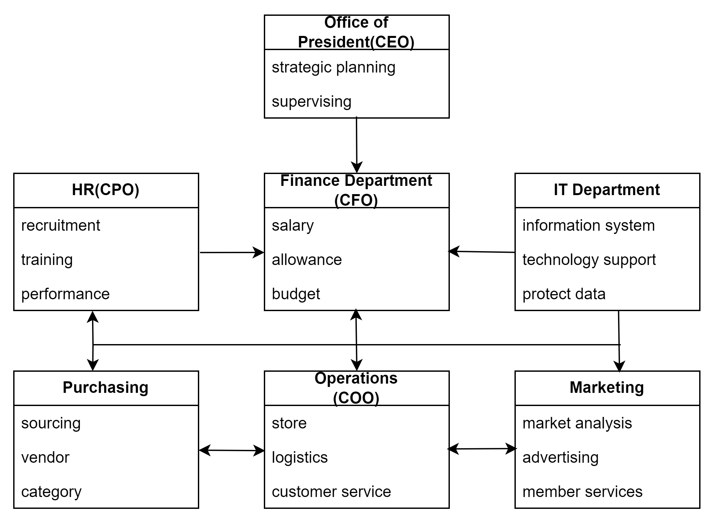
The whole organigram
of Sam’s Club

Slide 8
CEO
CFO
COO
strategic planning
supervising
salary &allowance
budget
store&logistics
customer
service

Slide 9
CPO
Marketing
Purchasing
recruitment
performance assess
sourcing
category
Market analysis
advertising

Slide 10
IT Department
information system
protect data
technology support
troubleshooting
My strengths
a robust understanding of it systems
continuous learning
get along well with others

Slide 11

That’s all thanks for listening
Group 1

